Slide 1
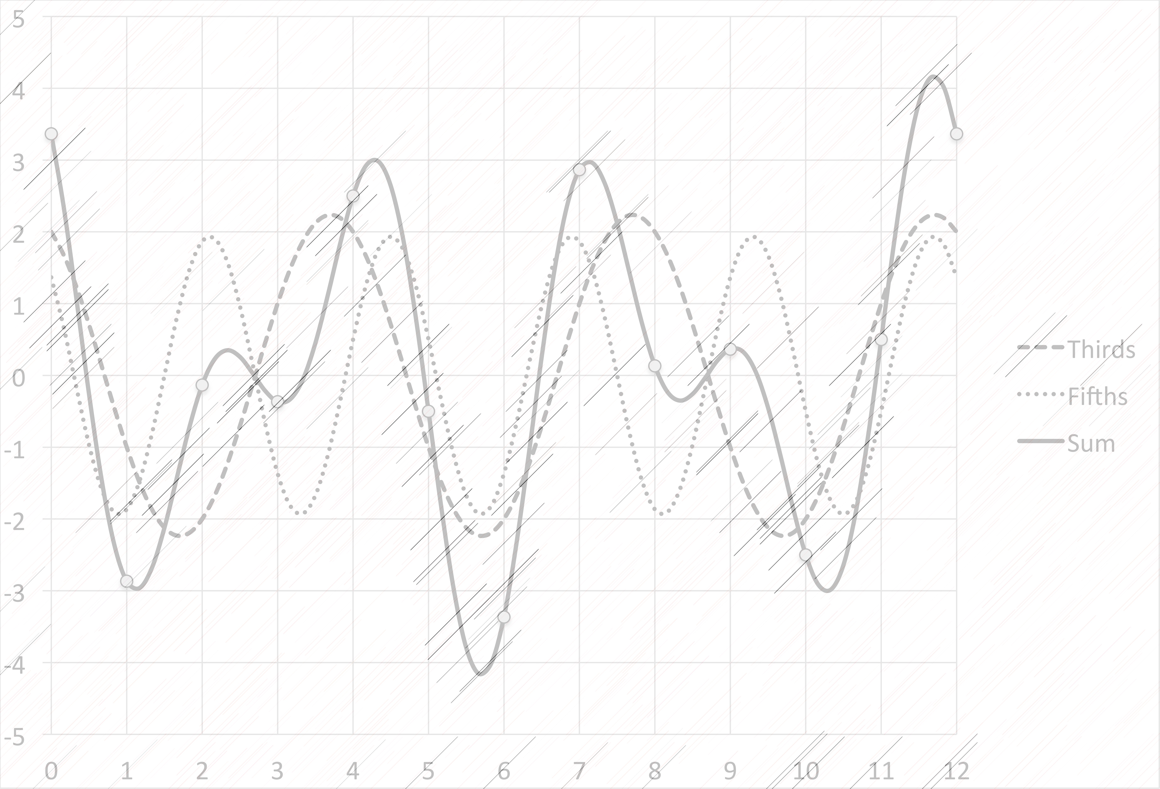
Restoring the Structural Status of Keys through DFT Phase Space
Jason Yust, Boston University
Presentation to the
International Congress on Music and Mathematics
Nov. 26–29, 2014
A copy of this talk is available at
people.bu.edu/jyust/

Slide 2
Outline
I. Schenker, Brahms, and Keys: The Problem
1. Schenker’s analysis of Brahms’s F major Cello Sonata
2. Structure as long-range voice leading
3. An alternative: DFT phase space
II. DFT and Triadic Orbits
1. DFT components as sinusoidal approximations
2. Triadic orbits
III. Beethoven’s Heiliger Dankgesang
1. Scalar context and triadic orbits
2. The D–C motive
3. Strength and weakness

Slide 3
I. Schenker, Brahms, and Keys
Schenker’s analysis of Brahms’s F major Cello Sonata
Structure as long-range voice leading
An alternative: DFT Phase Space

Slide 4
Schenker, Brahms, and Keys
A Music-Analytic Problem with a Mathematical Solution
The Schenkerian Syllogism
False!
Hidden Premise: Voice leading is always a relationship between individual harmonies.
Premise: Long-range structure is contrapuntal (based on voice-leading).
Conclusion: Long-range structure is reductive—i.e., it consists of relationships between non-adjacent harmonies.
Problematic

Slide 5
Schenker, Brahms, and Keys
A Music-Analytic Problem with a Mathematical Solution
So what’s wrong with reductive analysis?!?
Schenker: Der Freie Satz Fig. 110d(2)

Slide 6
Schenker, Brahms, and Keys
Brahms, F major Cello Sonata, Op. 99,
Subordinate Theme

Slide 7
Schenker, Brahms, and Keys

Slide 8
Schenker, Brahms, and Keys
Persistence of C major context is obscured
Structure is based on large-scale voice leadings,
which must occur between distinct musical objects (chords).
This leads to a reductive approach.
Cadential points must take precedence
as structural events

Slide 9
Schenker, Brahms, and Keys
Alternative:
A spatial concept of tonality . . .
DFT phase space
Amiot, Emmanuel. (2013). “The Torii of Phases,” Mathematics and Computation
in Music, MCM 2013 (ed. Yust, Wild, & Burgoyne) 1–18.
Yust, “Schubert’s Harmonic Language and Fourier Phase Space.” Journal of Music
Theory (forthcoming). Available at http:/people.bu.edu/jyust/SchubertDFT.pdf

Slide 10
Schenker, Brahms, and Keys
Phase of
5th Fourier
Coefficient
Phase of 3rd Fourier Coefficient

Slide 11
Schenker, Brahms, and Keys
Properties of DFT Phase Space
• Objects are pcsets, multisets, or statistical pc distributions
• Toroidal geometry
• Vertical axis indicates circle-of-fifths position
• Horizontal axis captures triadic voice-leading properties
• Many kinds of harmonic objects exist in the space: single pcs, harmonies, scales, etc.

Slide 12
Schenker, Brahms, and Keys
Properties of DFT Phase Space
•Space is continuous—paths connect points via a potential infinite series of intermediate states (pc distributions)
• Spatial conceptualization of DFT is inspired by Mazzola’s concept of gesture.
• Nearness in the space (its topology) is based on common pc content.

Slide 13
Schenker, Brahms, and Keys
Important key-defining
progressions occur within
regions
Other progressions average
to the appropriate tonal center
B⁷
E⁷
G⁷
Positions of chords
Dashed lines outline tonal regions
(see Yust [forthcoming])

Slide 14
Schenker, Brahms, and Keys
Properties of DFT Phase Space
A path can represent a motion from A to B, but it can also represent “B in the context of A.”
Combination of pcsets is highly tractable: the position of A + B is easily predictable from the path A → B.
Averaging over more objects (pcs, triads) restricts the range of activity.

Slide 15
Schenker, Brahms, and Keys
B⁷
E⁷
E min.
A min.
A min.
C maj.
C maj./
Progression of chords
Progression of keys

Slide 16
2. DFT and Triadic Orbits
DFT components as sinusoidal approximations
Triadic orbits

Slide 17
Discrete Fourier Transform on Pcsets
Lewin, David (1959). “Re: Intervallic Relations bet-ween Two Collections of Notes,” JMT 3/2.
——— (2001). “Special Cases of the Interval Function between Pitch Class Sets X and Y.” JMT 45/1.
Quinn, Ian (2006–2007). “General Equal-Tempered Harmony,” Perspectives of New Music 44/2–45/1.
Amiot, Emmanuel (2013). “The Torii of Phases.” Proceedings of the International Conference for Mathematics and Computation in Music, Montreal, 2013 (Springer).
Notes:
This work is based on the idea of treating a pcset as a signal and taking its Fourier transform to isolate significant intervallic properties. The idea was first proposed by Lewin and further developed by Ian Quinn as a measure of set class similarity. Both Lewin and Quinn focus on magnitudes of the resulting Fourier components, which contain the transposition- and inversion-independent interval information. The current paper and Amiot’s are interested instead in the phases of the components, which contain the residue of transposition-dependent information. The phases therefore can show relationships between instances of the same set class, not just between different set classes.

Slide 18
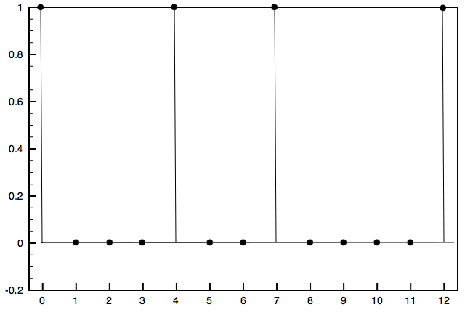
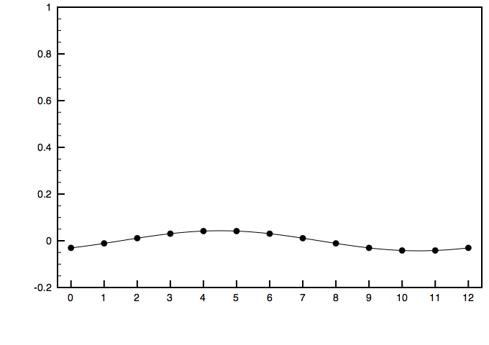
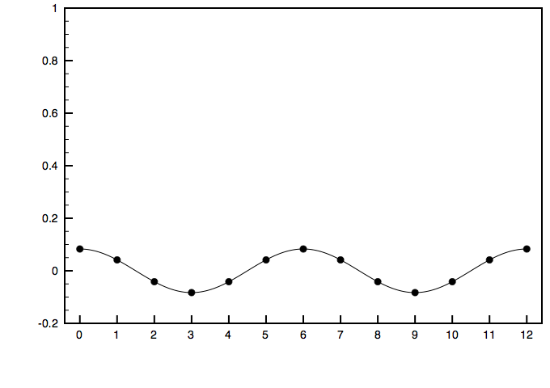
DFT components
C major triad
=
Component 1:
magnitude = 0.043
+
Component 2:
magnitude = 0.083
+
. . .
Notes:
The Fourier transform described in Lewin (1959) and Quinn (2006–7) treats a pcset as a signal by interpreting each pc as a spike in pc space as shown in the first graph. The Fourier transform decomposes this into 12 sinusoidal components, the first two of which are shown below.
Components 1 and 2 have very small magnitudes for consonant triads. The nth component can be interpreted as an equal division of the octave into n parts. The phase of the component is how it is transposed to best match the give pcset. Component 0 indicates the cardinality of the pcset, and Components 7–11 duplicate the information given by components 1–5.

Slide 19
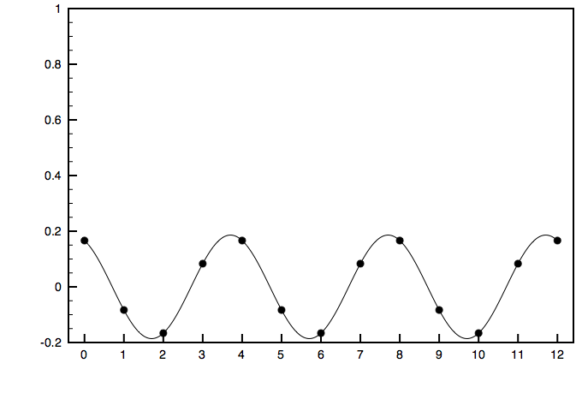
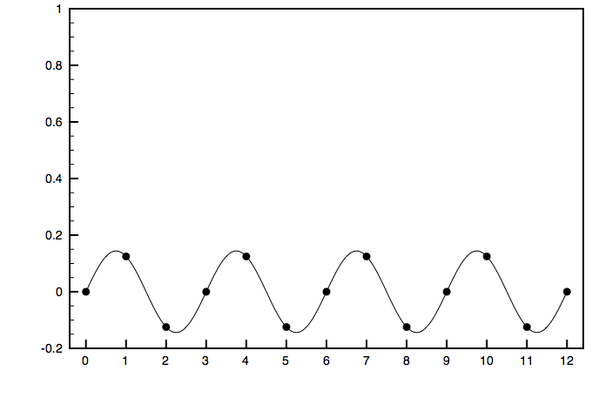
DFT components
C major triad
=
Component 3:
magnitude = 0.186
+
Component 4:
magnitude = 0.144
+
. . .
Notes:
Component 3 is the largest magnitude component for major and minor triads. (Note that component 4 is also of substantial magnitude.)

Slide 20
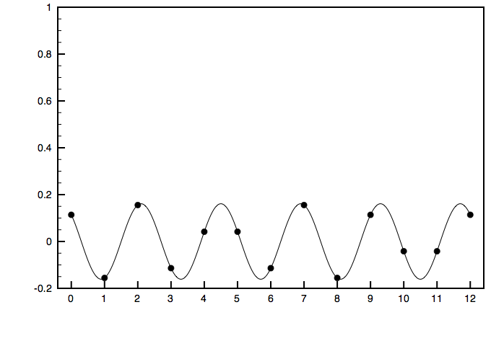
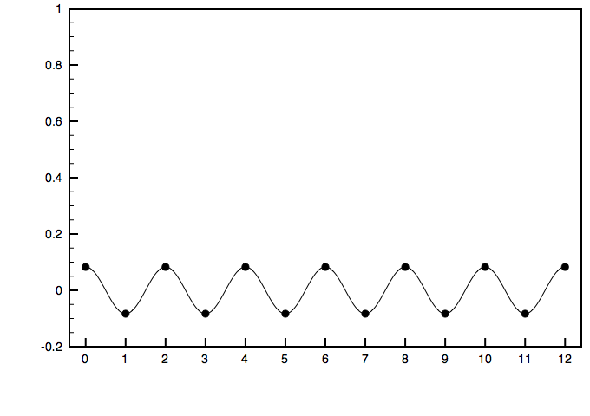
DFT components
C major triad
=
Component 5:
magnitude = 0.161
+
Component 6:
magnitude = 0.083
+
. . .
Notes:
Component 5 is the second largest for consonant triads.

Slide 21
Triadic Orbits
C
C#
D
D#
E
F
F#
G
G#
A
A#
B
(C)
The peaks of the
sinusoid are shown
by the dashed lines.
The troughs of the
sinusoid are the
boundary points

Slide 22
Triadic Orbits
C
C#
D
D#
E
F
F#
G
G#
A
A#
B
(C)
The triadic orbits go
from trough to trough,
and group pcs that
may be considered
displacements of
those in the triad

Slide 23
Triadic Orbits
Any pc-distribution can define a set of triadic orbits, including scales.
C diatonic:
C
C#
D
D#
E
F
F#
G
G#
A
A#
B
(C)
Regions of stability
Periphery: Unstable upper and lower neighbors
Pitch classes at the
center of a region
are more stable
Pitch classes at the
periphery of regions
are unstable
displacements

Slide 24
3. Heiliger Dankgesang
Scalar contexts and triadic orbits
The D–C motive
Strength and weakness

Slide 25
Heiliger Dankgesang: Scalar Contexts
First
intonation
and chorale
C–A hexachord
C diatonic
Ambiguous
position
Upper neighbor to C
Peripheral
Upper
Neighbor
Central position

Slide 26
Heiliger Dankgesang: Scalar Contexts
Evolution of scalar contexts over the first
intonation and chorale
C diatonic
A–C hex.
{F, G, A, C}

Slide 27
Heiliger Dankgesang: Scalar Contexts
Chorale phrase 4:
Ending high in the orbit gives the
effect of suspension

Slide 28
Heiliger Dankgesang: Scalar Contexts
D is central
C diatonic
A is central
D diatonic

Slide 29
Heiliger Dankgesang: Scalar Contexts
D diatonic
Central
On boundary of two orbits
D melodic minor
Upper periphery
of orbit
C diatonic
C–A hexachord
Status of F major triad
and pitch-class A in
different contexts
F major triad
Scalar contexts
Status of pitch-class
D in the different contexts

Slide 30
Heiliger Dankgesang: Motivic D–C
Final form of the intonation:
D–C

Slide 31
Heiliger Dankgesang: Motivic D–C
C diatonic
C–A hexachord
D as upper neighbor to C

Slide 32
Heiliger Dankgesang: Motivic D–C
D as lower neighbor to C,
upward striving
C–A hexachord
C diatonic
C maj. tonality

Slide 33
Heiliger Dankgesang: Motivic D–C
End of Neue Kraft section
D C

Slide 34
Weakness and Strength
In an F major context, the step C–D
is a weak neighbor motion
In a C major context, it is a strong
completion of passing motion
Within orbit
Between orbits

Slide 35
Weakness and Strength
As passing note
in C major context
As upper neighbor
in F major context

Slide 36
Heiliger Dankgesang: Coda
Chorale tune
End of chorale
phrase
A – B – C
D – C
Strong in C maj.
Weak in F maj.
D – C (PAC!)
E – D – C
Chorale tune
D – C !

Slide 37
Conclusions
• DFT phase space effectively reflects tonal process at multiple levels of structure.
• It does so through processes of combination rather than reduction.
• Relating levels through combination better reflects the traditional notion of keys.
• Motions in DFT phase space can be construed as a kind of voice leading through the idea of triadic orbits.
• Triadic orbits also have hermeneutic value in showing the gravitational forces that color tones and distinguishing strong and weak melodic motions.

Slide 38
Restoring the Structural Status of Keys through DFT Phase Space
Jason Yust, Boston University
Presentation to the
International Congress on Music and Mathematics
Nov. 26–29, 2014
A copy of this talk is available at
people.bu.edu/jyust/

Slide 39
Appendices:
A1: Derivation of tonal regions

Slide 40
Derivation of Tonal Regions
Boundaries between major and minor follow the circle of fifths through
diatonic scales and dominant sevenths / individual pcs.

Slide 41
Derivation of Tonal Regions
A characteristic hexachord is at the center of the major regions.
Boundaries between fifth-related major regions are parallel to an axis
that approximately passes through this hexachord.

Slide 42
Derivation of Tonal Regions
Minor region boundaries are parallel to an axis that approximately
passes through the harmonic minor scale

Slide 43
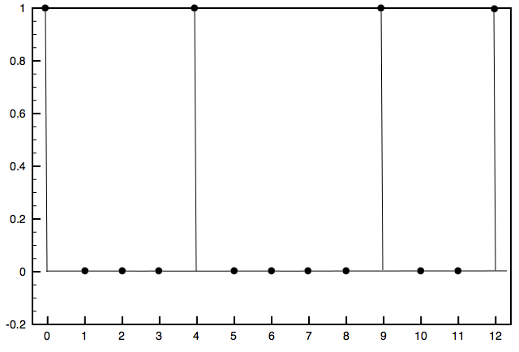
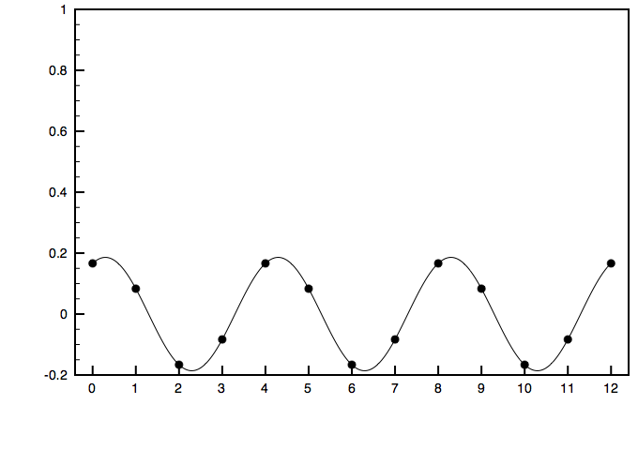
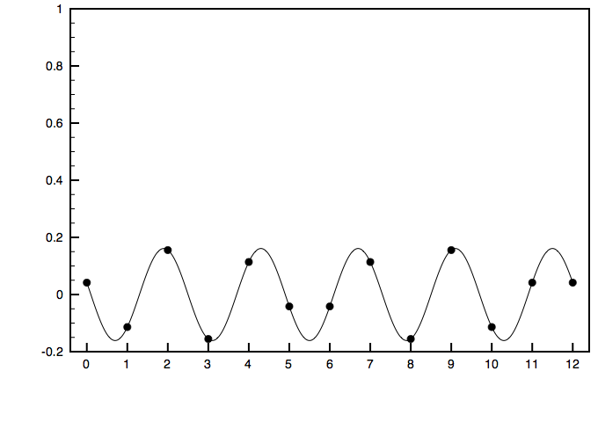
Discrete Fourier Transform: Periodicity
C major triad
A minor triad
Component 3:
phase= –0.464
Component 3:
phase= 0.464
Component 5:
phase = 1.309
Component 5:
phase = 0.785
Notes:
We will consider just the largest components, numbers 3 and 5. Every transposition or inversion of a major or minor triad has a different phase on one or both of these components. Component 4 will be revisited in appendices A1 and A2.
This slide shows how a change from C major to A minor affects the phase of these two components.

Slide 44
Discrete Fourier Transform: Balances
3-component balance
5-component balance
See Quinn “General Equal-Tempered Harmony,” Perspectives of New Music 44/2–45/1 (2006–2007).
Notes:
Quinn’s Fourier balances are a convenient way to conceptualize the meaning of the phase components. The 3rd component shows which augmented triad the chord is closest to. The 5th component gives a position around the circle of fifths. Note that tritones cancel out on both of these balances (meaning that adding a note a tritone away from another note has the same effect as removing that note). On the other hand, major seconds have the same canceling effect on the 3rd component, but are actually a reinforcement on the 5th component.

Slide 45
Discrete Fourier Transform: Balances
3-component balance
5-component balance
C major triad
Notes:
Example: A minor is close to C major. (Small change in phases).

Slide 46
Discrete Fourier Transform: Balances
3-component balance
5-component balance
A minor triad
Notes:
Example: A minor is close to C major. (Small change in phases).

Slide 47
Discrete Fourier Transform: The Tonnetz
Phase of the 5-component
Phase of the 3-component
Notes:
We interpret the phases of components 3 and 5 as axes in a continuous space on chords. Each dimension is cyclical, so that the graph is actually a flattened torus.
This slide begins by plotting major and minor triads in this space, and then adds other consonant intervals and singletons. The resulting layout reflects the Tonnetz, which can be shown by drawing triangular regions around each consonant triad with a singleton at each vertex and a consonant interval in the center of each side. (One could also draw the dual Tonnetz, by connecting each triad to its nearest three neighbors. The consonant intervals would again be in the center of each edge, but the single pcs would be at the center of hexagonal regions.)
Note that many set classes share positions in the space. As indicated in the caption, diminished triads coincide with the position of their thirds (as singletons), dominant and half-diminished sevenths coincide with their constituent fifths, and diatonic scales coincide with their ^1–^3 major third. In many cases, the cancelation of tritones explains these coincidences. Not shown are harmonic minor scales, which coincide with their tonic minor triads, and melodic minor scales, which coincide with their ^5 as singleton (or ^1 of the acoustic scale).
All of these sets would be disambiguated if other components, such as the 4th component, were included.

Slide 48
Discrete Fourier Transform: The Tonnetz
R-L Progression

Slide 49
Discrete Fourier Transform: The Tonnetz
P-L Progression

Slide 50
Discrete Fourier Transform: The Tonnetz
R-P Progression

Slide 51
Restoring the Structural Status of Keys through DFT Phase Space
Jason Yust, Boston University
Presentation to the
International Congress on Music and Mathematics
Nov. 26–29, 2014
A copy of this talk is available at
people.bu.edu/jyust/

Slide 52
Bibliography
Amiot, Emmanuel. (2013). “The Torii of Phases.” Proceedings of the International Conference for Mathematics and Computation in Music, Montreal, 2013, ed. J. Yust, J. Wild, and J.A. Burgoyne (Heidelberg: Springer).
Callender, Clifton, Ian Quinn, and Dmitri Tymoczko. (2008). “Generalized Voice-Leading Spaces.” Science 320: 346–8.
Childs, Adrian (1998). “Moving beyond Neo-Riemannian Triads: Exploring a Transformational Model for Seventh Chords.” JMT 42(2): 181–193.
Clark, Suzanna (2011). “On the Imagination of Tone in Schubert Liedesend (D473), Trost (D523), and Gretchens Bitte (D564). ” In The Oxford Handbook of Neo-Riemannian Music Theories ed. Gollin and Rehding (New York: Oxford Univ. Press), 249–321.
——— (2011). Analyzing Schubert (New York: Cambridge Univ. Press).
Cohn, Richard (1999). “As Wonderful as Star Clusters: Instruments for Gazing at Tonality in Schubert.” 19th Century Music 22(3): 213–232.
——— (2011). Audacious Euphony: Chromaticism and the Triad’s Second Nature (New York: Oxford Univ. Press).
Cone, Edward (1982). “Schubert’s Promissory Note: An Exercise in Musical Hermeneutics.” 19th-Century Music 5(3): 233–241.
——— (1984). “Schubert’s Unfinished Business.” 19th-Century Music 7(3): 222–232.

Slide 53
Bibliography
Damschroder, David. 2010. “Schenker, Schubert, and the Subtonic Chord.” Gamut 3/1, 127–166.
———. 2010. Harmony in Schubert (Cambridge, Eng.: Cambridge Univ. Press).
Fisk, Charles. 2001. Returning Cycles: Contexts for the Interpretation of Schubert’s Impromptus and Last Sonatas (Berkeley, Calif.: UC Press).
Gollin, Edward (1998). “Some Aspects of Three-Dimensional ‘Tonnetze.’” JMT 42(2): 195–206.
Kopp, David. 2002. Chromatic Transformations in Nineteenth-Century Music (Cambridge, Eng.: Cambridge Univ. Press).
Krumhansl, Carol (1990). Cognitive Foundations of Musical Pitch (New York: Oxford Univ. Press).
Krumhansl, Carol, and Edward Kessler (1982). “Tracing the Dynamic Changes in Perceived Tonal Organization in a Spatial Representation of Musical Keys.” Psychological Review 89/4, 334–368.
Lewin, David. 1959. “Re: Intervallic Relations between Two Collections of Notes.” Journal of Music Theory 3: 298–301.
Quinn, Ian. 2006. “General Equal-Tempered Harmony” (in two parts). Perspectives of New Music 44(2)–45(1): 114–159 and 4–63.
Pesic, Peter. 1999. “Schubert’s Dream.” 19th-Century Music 23, no. 2: 136–144.

Slide 54
Bibliography
Rothstein, William (1991). “On Implied Tones.” Music Analysis 10(3): 289-328.
Sobaskie, James William. 2003. “Tonal Implication and the Gestural Dialectic in Schubert’s A minor Quartet.” Schubert the Progressive, ed. B. Newbould. (Aldershot: Ashgate), 53–80.
Temperley, David (2007). Music and Probability (Cambridge, Mass.: MIT Press).
Temperley, David and Elizabeth Marvin (2008). “Pitch-Class Distribution and the Identification of Key,” Music Perception 25/3, 193–212.
Tymoczko, Dmitri (2012). “The Generalized Tonnetz.” JMT 56(1): 1–52.
——— (2013). “Geometry and the Quest for Theoretical Generality.” JMM 7(2).
Webster, James. 1978/79. “Schubert’s Sonata Form and Brahms’s First Maturity,” 19th-Century Music 2: 18–35.
Wollenberg, Susan. 2011. Schubert’s Fingerprints: Studies in the Instrumental Works (Surrey, Eng.: Ashgate).
Yust, Jason (forthcoming). “Distorted Continuity: Chromatic Harmony, Uniform Sequences, and Quantized Voice Leadings.” MTS 36.
——— (forthcoming). “A Space for Inflections: Following up on JMM’s Special Issue on Mathematical Theories of Voice Leading” JMM 7(3).
——— (2013). “Tonal Prisms: Iterated Quantization in Chromatic Tonality and Ravel’s ‘Ondine.’” JMM 7(2), 145–165.

Slide 55
Appendices:
A1: Functional categories in c4/c5 space (slides 51–52)
A2: A Tonnetz on dominant and half-diminished sevenths (slides 53–58)
A3: Phase space and voice leading (slides 59–68)
A4: Key profiles and phase space (slides 69–71)

Slide 56
A1: Functional categories in c5/c4 space
Phase of the 5-component
Phase of the 4-component
Notes:
We can also plot chords using the fourth Fourier component instead of the third.

Slide 57
A1: Functional categories in c5/c4 space
Phase of the 5-component
Phase of the 4-component
Notes:
The phase of the fourth Fourier component segregates chords according to harmonic function in a given tonal context. In this example, F major is chosen as tonic, and regions are drawn with dashed lines. In the middle, around the tonic, are other tonic functioning and tonic substitute chords, as well as applied chords to predominants. To the right of the tonic chords, and wrapping around to the far left, are predominant chords, and to the left of the tonic chords are dominant functioning chords. (Note the inclusion of vii#5 and bVII in the dominant-functioning region, validating a claim made by Damschroder (2010,Gamut) for these as substitute dominants in his work on Schubert.)

Slide 58
A2: Tonnetz of seventh chords in c4/c5 space
a^{∅7}–C⁷
≡L*
common P5th
a^{∅7}–D⁷
ii^{∅7}–V⁷ type
≡F*
a^{∅7}–F⁷
vii^{∅7}–V⁷ type
≡R*
Notes:
The c4/c5 plot distinguishes dominant and half-diminished seventh chords, which are on top of one another in the c3/c5 plots (where dominant and half-diminished sevenths are in the same position as their constituent perfect fifth). This means we can use the c4/c5 plot to draw a seventh-chord Tonnetz analogous to the triadic Tonnetz. This way of generalizing the Tonnetz to four-note chords follows a different logic than other proposals (e.g., those of Childs, Gollin, and Tymoczko). The three adjacencies of this Tonnetz are minimal voice-leadings, but not the only minimal voice leadings (there are many—the ones here are distinguished by c5 proximity, meaning they occur in the same or closely related keys). The three axial directions lead to sequences by minor third (vertical), major second (/), and perfect fifth (\).

Slide 59
A2: Tonnetz of seventh chords in c4/c5 space
All Wechsel progressions
involving two semitones
voice leading work
Notes:
Relative voice-leading parsimony is very common for dominant and half-diminished sevenths, so it is not in itself a sufficient criterion for something like a Tonnetz. (The minimal voice-leading distance is two semitones, but there are more Wechsels with two semitone voice leadings than there are with larger ones.) Nonetheless, the seven two-semitone Wechsels are also the smallest distances in c4/c5 space.

Slide 60
A2: Tonnetz of seventh chords in c4/c5 space
Example: Tristan Prelude,
opening progression
Notes:
Here are examples of some well-known Wagner progressions involving dominant and half-diminished sevenths (discussed by Lewin (1996) and Douthett and Steinbach (1998)) . The progressions tend to involve one larger motion (augmented-sixth like, creating a large circle-of-fifths distance) and one simpler one.

Slide 61
A2: Tonnetz of seventh chords in c4/c5 space
Example: Beginning of the
Immolation scene from
Götterdammerung
Notes:
The Immolation progression is a reflection of the Tristan progression on the Tonnetz, even though they are not, e.g., inversionally related.

Slide 62
A2: Tonnetz of seventh chords in c4/c5 space
Example: “Amfortas’s
Agony” Leitmotif from
Parsifal
Notes:
The Amfortas progression also looks similar, a rotation on the Tonnetz.

Slide 63
A2: Tonnetz of seventh chords in c4/c5 space
A∅ 7
F maj.
Subsets of Bb diatonic
or common tones (Aº)
Subsets
C min.
F dom.7
Notes:
Position of triads in the space. They fall on the border between the dominant and half-diminished sevenths that share three common tones (“R*”-related), closest to the seventh chord that contains them (the triad given by removing the seventh of a dominant chord or the root of a half-diminished one).

Slide 64
A3: Phase space vs. voice leading
Fourier Phase Space (c3/c5)
Diatonic Triad Space (derived via quantization in voice-leading geometries)
R
L
P
R
P
← enharmonic cycle →
L
← diatonic cycle →
← diatonic cycle →
← enharmonic cycle →
Notes:
A similar Tonnetz-like geometry can also be derived from voice-leading considerations. The figure on the right is from an unpublished article, but the principle upon which it’s based (voice-leading quantization) can be found in articles forthcoming in the Journal of Mathematics and Music and Music Theory Spectrum. Both are continuous geometries, each is a torus with an enharmonic cycle and a perpendicular “diatonic” cycle, and the layout is essentially the same if we focus on triads only. The underlying principles are different however, which changes the interpretation of the space between the triads. In the voice-leading geometry, the space traversed, e.g., in an R progression includes all the chords that occur as one pitch slides continuously to the other (hence the gray augmented-triad regions). In the Fourier phase space, this traversal consists of continuous changes in the quantities of the pcs present. For example, an R progression from F maj -> D min can be traversed by continuously fading out C while fading in the D (or doing these two things one after the other). This explains why the midpoint of every progression is the position of set consisting just of the common tones for that progression. For instance, halfway between F maj. and D min. is the major third F-A.
An important advantage of the Fourier approach is that it is not restricted to one cardinality at a time. In voice leading spaces, it is not possible represent the relationship between, e.g., a triad and a seventh chord without specifying a doubling for the triad.
Each of these systems has its virtues, but it is important to recognize that one is not more or less abstract than the other. Both systems, when applied to music, envision a harmonic progression as a kind of imaginary continuo (to use Rothstein’s term). Voice leading geometry sees the imaginary continuo as consisting of a fixed number of pitch classes and continuous motion as a kind of glissando in one or more of these voices. Fourier phase space instead views the imaginary continuo as a kind of sound board with twelve sliders, one for each pitch class. Continuous motion in the space involves gradually “fading in” some pcs while fading out others. Both abstractions involve mapping real music onto a highly circumscribed controlled universe, which is supposed to represent the essence of the harmonic progression.

Slide 65
A3: Phase space vs. voice leading
The pitch-class
quantities model
Voice leading model
Notes:
Here’s a picture. The Fourier analysis is based on a model where the pitch classes are fixed but their presence or absence can be adjusted along a continuum. The voice leading model treats the number of voices as fixed, and their pitch classes as continuously variable. (However, note also that the discrete Fourier transform is usually considered a sampling of a continuum, so it is robust with respect to variable intonation, etc., and other sampling rates are possible in principle).

Slide 66
A3: Phase space vs. voice leading
The phase spaces can be interpreted as
kinds of voice-leading spaces!
Unlike voice-leading geometries from Callender, Quinn, & Tymoczko 2008 they are robust with respect to omissions and doublings. This is possible because an additional assumption is made: chords are assumed to be nearly even.
Component 3 shows voice-leading direction between the nearest even 3-note chords.
Component 5 shows voice-leading directions between implied diatonic scales.

Slide 67
A3: Phase space vs. voice leading
A dyad is close to
the triads it might
represent (omission)

Slide 68
A3: Phase space vs. voice leading
Larger chords are close to
their constituent triads
(added notes)
F min7
E dom7

Slide 69
A3: Phase space vs. voice leading
Larger sets are close to
their constituent triads
(added notes)
E diat.

Slide 70
A3: Phase space vs. voice leading
Example: Sequence
from “Gruppe aus
dem Tartarus” (D. 583)
Voice-leading model:
Notes:
Notice the “splits” and “joins.” A pure three-voice model would be inaccurate: if the suspension is included, it is impossible to introduce the new upper note by stepwise motion.

Slide 71
A3: Phase space vs. voice leading
Example:
Example: Sequence
from “Gruppe aus
dem Tartarus” (D. 583)

Slide 72
A3: Phase space vs. voice leading
A similar, nearby,
sequence on triads

Slide 73
A3: Phase space vs. voice leading
A nearby sequence on
triads and seventh
chords.

Slide 74
A4: Key profiles and phase space
MDS of Key Profiles from
Krumhansl and Kessler 1982
Harmonic Phase Space
Notes:
One familiar application of the quantity-of-pc way of thinking is the kind of statistical distribution used in key profiles (e.g. Krumhansl-Kessler 1982, Krumhansl 1990, Temperley 2007). On the left is Krumhansl and Kessler’s multi-dimensional scaling solution for key relatedness based on the correlations of the experimentally derived major and minor key profiles. In these key profiles, “quantities of pc” are average goodness-of-fit ratings for the given pc in the given context. They also have been interpreted as statistical likelihood of a note appearing in a given tonal context, or as the distribution of pcs in an actual musical passage or experimental stimulus (Temperley 2007, Temperley and Marvin 2008).

Slide 75
A4: Key profiles and phase space
MDS of Key Profiles from
Krumhansl and Kessler 1982
Harmonic Phase Space
Notes:
Krumhansl and Kessler’s key-correlation space is essentially the same as the c4/c5 harmonic phase space, up to an arbitrary 90-degree rotation and reflection, and a normalization of the parameters.

Slide 76
A4: Key profiles and phase space
MDS of Key Profiles from
Krumhansl and Kessler 1982
Harmonic Phase Space

