Slide 1
Pre-program: introduction to Excel, STATA & DATA ANALYSIS
EMBA Data Analysis
Professor Timothy Simcoe
Boston University School of Management

Slide 2
Introduction: Management as Measurement
In the 1830’s, France imported about 40 million leeches each year for medicinal purposes.*
In 1836, Pierre Louis ran one of the first randomized controlled experiments: treats pneumonia patients with either (a) early aggressive blood-letting, or (b) less aggressive measures.
“I was surprised to see that more than half our ideas failed to move the metrics they were designed to move. Humbling.”
- Ronny Kohani, Amazon’s director of personalization
“If you cannot measure it, you cannot improve it.”
- Lord Kelvin
* Source: “Bad Medicine” David Wootton

Slide 3
Pre-program Objectives
Introduce key concepts and terminology
- Observation, Unit of analysis, Variable types
Introduce software: Excel and Stata
- Cleaning and loading data
- Creating variables
- Summary statistics
- Excel <=> Stata
Get to know each other!

Slide 4
When you ask for data, how does it arrive?
What is the file format?
- Excel (.xls), Access (.mdb), ASCII Text (.txt), Stata (.dta), etc…
How is the data “structured”?
- Tables, spreadsheet, relational DB, flat file, unstructured…
- How many files and/or tables?
Has the information been “cleaned”?
- Documentation available
- Checks for missing data and/or logical consistency

Slide 5
Spreadsheets vs. Databases
Spreadsheets
- Easy to enter and manipulate data by hand
- Lots of flexibility and low setup costs
- User is responsible for tracking relationships
- No automated consistency / quality checks
Databases
- Up-front cost to design tables and define links
- Specialized knowledge, e.g. Structured Query Language (SQL)
- Greater long-run efficiency in storage & retrieval
- Greater consistency: machine enforces design rules
Spreadsheets have low fixed costs, but high variable costs,
compared to relational databases

Slide 6
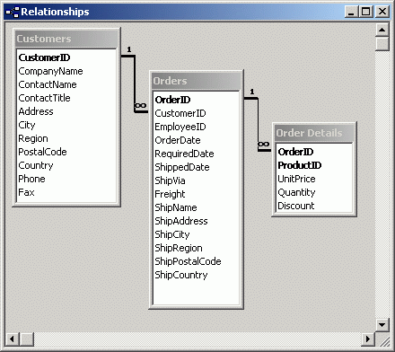
Relational Databases (in one slide)
Shopping Cart Application
- Multiple Tables: Customer, Order & Item
- Each table has “records” (rows) and “fields” or “variables” (columns)
- Each records has a unique “key” or identifier (ID) variable
- Relational Links: ID variables that appear in multiple tables
- Link types: 1-to-1, many-to-1 or Many-to-many

Slide 7
The “Big Data” Value Chain
Skills | Tools
Collect & Reduce Data | Hadoop / SQL
Mine & Analyze Data | Stata / R / Excel
Visualize & Present Results | Adobe CS / Stata / Office
These activities are complements, not substitutes
EMBA DA will emphasize Analysis & Presentation

Slide 8
Statistical analysis almost always begins with “rectangular” data
Rectangular data is analogous to a single table or worksheet
- Each row is called an observation
- We will use letter “N” to denote total # of observations
- Each column contains a single variable
- We will use letter “X” to denote a (generic) variable
- More on variable types in a few minutes
Creating a rectangular dataset can be a huge amount of work
- Matching, merging, appending, cleaning, etc.
- But not in this class!
Group Exercise: Re-format AnnualSales.xls as rectangular data

Slide 9
What is the unit of analysis in AnnualSales.xls?
Each row is an observation
- In AnnualSales.xls we have store-year observations
The unit of analysis is the “object” that you are studying
- For AnnualSales.xls, it could be region, city, store or store-year
- It depends on the question being asked!
Common types of data sets
- Cross-section: A collection of things (observation == unit of analysis)
- Panel Data: Repeated observations (e.g. stores by year)
- Multi-level: Multiple panels (e.g. stores in cities in regions)

Slide 10
Variable Types
Computers recognize two variable types
- Numeric and String variables
- So, 5.7 is not the same as “5.7”
- Don’t assume the computer “understands” numbers!
Statisticians recognize (roughly) three variable types
- Metric or continuous, e.g. height, weight, or sales
- Ordered categorical, e.g. Likert (1-5) scale or low-medium-high
- Unordered Categorical, e.g. gender, location
What are the types (computer and statistical) of each variable in AnnualSales.xls?
Examples of metric, ordered and unordered categorical data in your workplace?

Slide 11
Break and Pre-Assessment

Slide 12
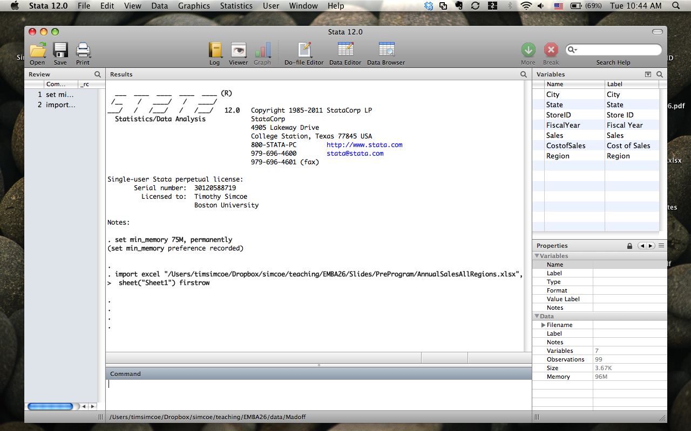
Stata’s Windows
Results Window: Where Stata
displays output after you tell it
to do something
Review window: A list of your last few commands
click on them for a “do over”
Variables window:
Useful info about
the variables in
current data set
Command window: Where you type in commands
(unless you prefer to use the drop down menus)

Slide 13
Getting an Excel File into Stata
Make the data rectangular in Excel
Make sure numbers are formatted as “numbers”
Open Stata*
Select “File > Import > Excel Spreadsheet” from dropdown menus
Find the file you wish to load into Stata
Choose the correct Excel Worksheet if application
Check “Import First Row as Variable Names” if applicable
Make sure you have correct # of rows / observations
Click “OK”
To save in Stata format, select “File > Save as…” drop down
Practice by importing the “StoreManagers” tab from our AnnualSales.xls
Spreadsheet and saving it as a Stata file

Slide 14
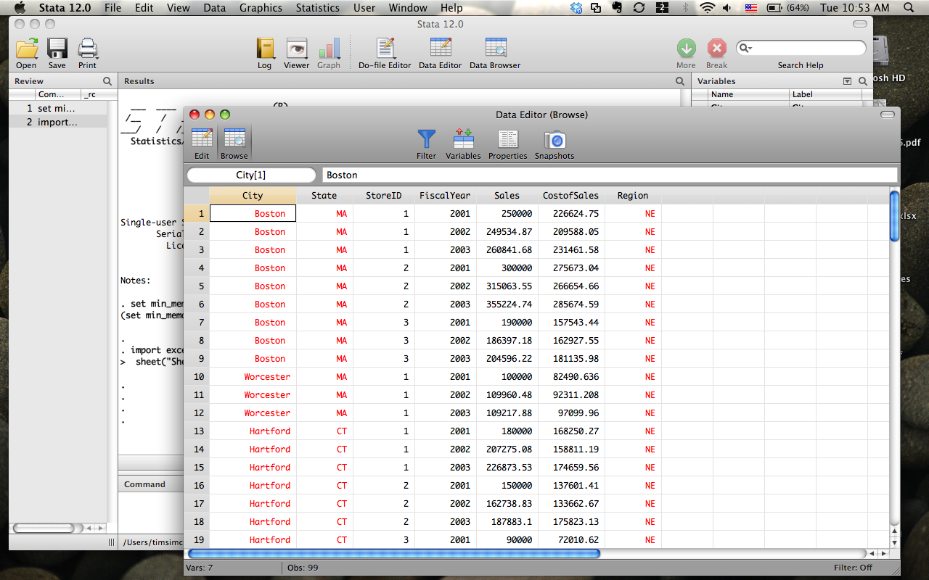
Stata also has a “spreadsheet” window
Data Editor allows editing (not recommended)
Data Browser only permits viewing data
Click here to view data in “spread- sheet” format
Note that string variables are displayed in RED, & numeric
variables are displayed in BLACK

Slide 15
Creating new variables
Problem: Calculate Gross Income and Gross Margin by store-year
Using Formulas in Excel
- Create a new column for Gross Income
- Enter the formula (Gross Income = Sales – Cost of Sales)
- Useful Trick: Absolute references ($) and cut & paste
Using Stata’s “generate” command
- Type “generate GrossIncome = Sales – CostofSales” in command window
- Useful trick: Click next to variable name to paste in command window
- No spaces allowed in variable names
- Can change variable names, e.g. “rename CostofSales COGS”

Slide 16
Summarizing a variable
What is the average Gross Margin for all store-years in our data?
Using Functions in Excel
- Create a new column containing GrossMargin = GrossIncome / Sales
- Use the function “= average([data range])” to compute an average
- Other functions: count([data]), stdev([data]), min([data]), max([data])
Using Stata’s “summarize” command
- Type “summarize [variable name]” in command window
- For more information use “summarize [variable name], detail”

Slide 17
Making tables (for categorical data)
Problem: What is the average Gross Margin for each region by year?
Using Pivot Tables in Excel
- Not required material, but you might find it useful
- Select “Data > Pivot Table…” from drop down menus
- Use the Wizard Tool to build your table
Using Stata’s “table” command
- Type “table Region FiscalYear, contents(mean GrossMargin)”
- OR use Stata’s drop-down menus
- “Statistics > Summaries, tables and tests > Tables > Table of summary statistics”

Slide 18
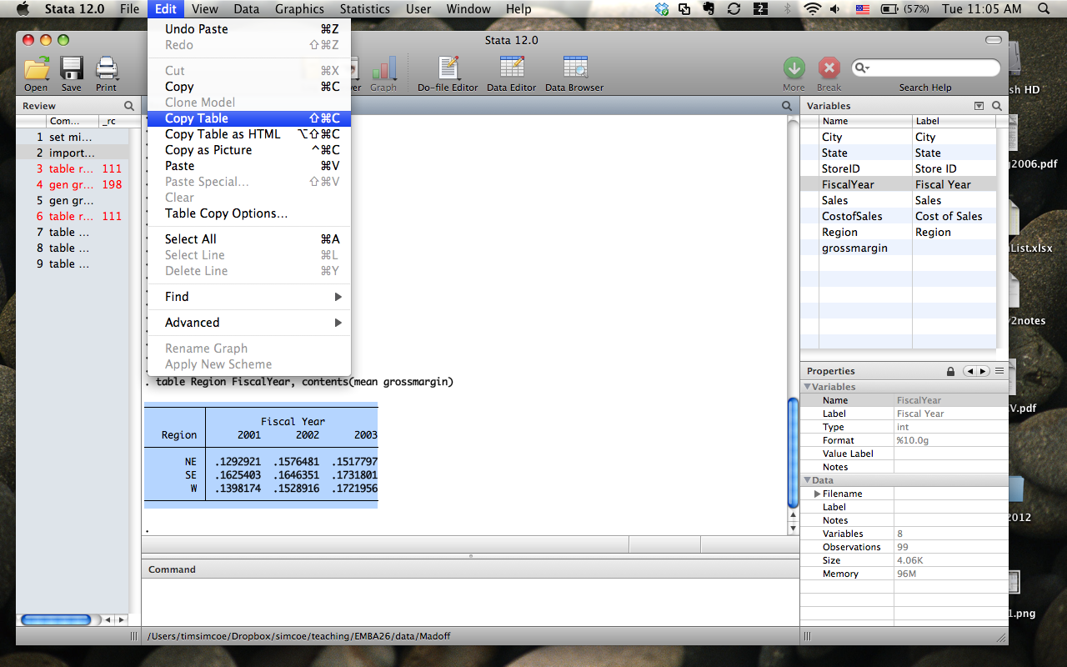
Copying Stata output into Excel
Select a Table in the Results Window
Go to “Edit > Copy Table”
Paste into Excel

Slide 19
Merging datasets
Forget about doing this in Excel
In Stata
Make sure two files correctly formatted (.dta)
Place files in same directory (for simplicity)
Make sure merge variable names are identical
Move to correct directory (“File > Change Working Directory…”)
Type the following command
merge m:1 City State StoreID Region using managers
Merge Type
- m:1 = many-to-1
Could be 1:m or m:m
Merge Variable Names
Name of data
set to merge

Slide 20
Stata vs. Excel: Frequently Asked Questions
Will this course teach me to use Excel?
No. I assume you are have some basic Excel skills (e.g. arithmetic formulas, copy & paste) and will introduce advanced material in class as needed.
Why do we use STATA?
Instead of Excel
Excel lacks tools for serious statistical analysis
Stata is much easier to use for any data analysis that goes beyond the basics
STATA will familiarize you with quantitative analysts’ “tools of the trade”
Instead of SPSS or SAS
My goal: “democratize” evidence-based decision-making; STATA is the perfect tool for this
PC-based (not designed for mainframe)
Extremely powerful (equal to SPSS or SAS)
Intuitive menu-driven interface
You can TAKE IT WITH YOU wherever you work and use it independent of firm IT infrastructure

Slide 21
Additional Stata Resources
The Instructor
- I am available to answer Stata questions any time
- I prefer to take these questions by email
Help Manuals
- Type “help” or “help [command name]” in Stata to see the manuals
Internet
- Google “Stata Help” for a wealth of information
SMG Tools
- I’ve posted a Tutorial, Cheat Sheet and Tips to a “Stata Help” folder
Reference Books
- “A Gentle Introduction to Stata”

Slide 22
Data Analysis: where are we going?
Problem: Should this chain expand in the Southeast?
Reformulate the question: How confident are we that higher margins in the Southeast are not random?
Build a “model” to test that question
Gross Margins = Year Effects + Region Effects + Store-level “noise”
Use the model to conduct a statistical test
“regress grossmargin i.fiscalyear i.regionCode”
Use results to make informed business decisions
Iterative process: each step informs the prior step
Statistical software speeds up steps #2 and #3 dramatically

Slide 23
A Quick Experiment
Naïve measurement can (and does) lead us astray
Sampling on the outcome
“Airport book” consulting
“Survivor bias” in hedge/mutual fund returns
Correlation versus causation
Study: nightlights produce myopia
You might like this 30” monitor because you purchased a display cable
We will develop tools and frameworks for thinking about causality when we observe relationships in the data

Slide 24
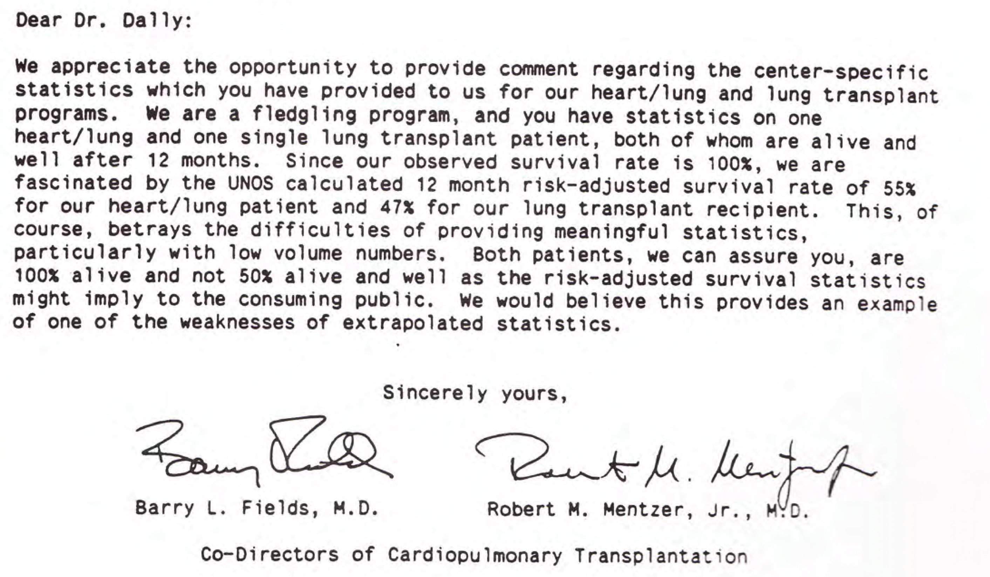
Another Tale of Caution
We will develop tools and frameworks for thinking about inference (statements about precision of measured relationships)

Slide 25
BIG PICTURE: Information Technology has given firms the opportunity know much more…
About customers
Credit card transactions
Loyalty programs
Payment history
Behaviors & attitudes
About operations
SCM systems / RFID
Mfg. process control
About Employees
Retention
Performance
Knowledge mgmt
Comp & incentives
About Suppliers
Bidding/pricing history
On-time performance
How can firms use this information trail to create better products & services, make better decisions, and compete more effectively?

Slide 26
Problem: It’s hard to make data-driven decisions
DIFFICULTIES WITH EVIDENCE-BASED MANAGEMENT
Many organizations are not used to thinking this way
Managers don’t prioritize data acquisition
Powerful constituencies feel threatened
Few incentives to gather / act-on data
Data are costly to gather
New IT systems are expensive
Existing databases ill-suited and difficult to combine
Requires specialized skills
Deep analysis can require sophisticated modeling
Managers are bad at analytics, statisticians can’t manage…
In this course you learn to overcome these problems

Slide 27
Step 1: To become a sophisticated proponent & consumer of quantitative analyses
To develop a solid conceptual grasp of statistical methods
e.g. random sampling, hypothesis testing, multiple regression
To understand and articulate the power of controlled randomized experiments
correlation vs. causation, description vs. prediction
To understand when analytical methods are appropriate and when they fail

Slide 28
Step 2: To apply workhorse analytical methods on real-world data sets
To become familiar with the critical skills of a quantitative analyst
building, testing and refining an empirical model
managing large(ish) data sets
communicating key assumptions and results
To develop an appreciation for the broad scope of simple statistical methods
applications to operations, marketing and finance

Slide 29
Step 3: To identify and address organizational barriers to evidence-based management
To learn to identify opportunities for data analysis and/or systematic experimentation
To effectively promote the evidence-based approach within a complex organization
To become sensitive to ethical and security issues that arise in working with large databases
What you will have learned in these three steps enables you to implement “evidence-based management” in practice

Slide 30
Short Bio
Experience
Five years in consulting, 6 months at CEA
PhD from Berkeley (Business & Public Policy)
Previously taught at U of Toronto (5 years)
Research interests
Standardization (Technology & Quality)
Innovation, particularly in ICT industries
Intellectual property
Applied Econometrics
Personal
Married with 3 kids: Kate (10), Anne (8) & Teddy (3)
Enjoy skiing, golf, running and Red Sox

Slide 31
Questions?

