Slide 1

Dimensions of Atonality:
Commentary on Hippel and Huron 2020
Jason Yust, .
Ohio State University
Music Cognition Seminar
11/15/2020

Slide 2
Fourier Transform on Pitch-Class Sets and Distributions
Using discrete Fourier transform, we can
• Identify harmonic qualities, through spectra
• Relate harmonies of similar quality through phase spaces
Krumhansl’s tonal space is a phase space.

Slide 3


Fourier Transform on Pitch-Class Vectors: A brief history
Lewin, David (1959). “Re: Intervallic Relations between Two Collections of Notes,” JMT 3/2.
——— (2001). “Special Cases of the Interval Function between Pitch Class Sets X and Y.” JMT 45/1.
Quinn, Ian (2006–2007). “General Equal-Tempered Harmony,” Perspectives of New Music 44/2–45/1.
Callender, Cliff (2007). “Continuous Harmonic Spaces,” JMT 51/2
Amiot, Emmanuel (2007). “David Lewin and Maximally Even Sets.” Journal of Mathematics and Music 1/3.
——— (2016). Music Through Fourier Space: Discrete Fourier Transform in Music Theory. (Springer)
Yust, Jason (2015). “Schubert’s Harmonic Language and Fourier Phase Spaces.” JMT 59/1.
——— (2016). “Special Collections: Renewing Forte’s Set Theory.” JMT 60/2.

Slide 4
Pitch-Class Vectors
Key profiles are pitch-class vectors
Example:
Krumhansl-Kessler C major:
Krumhansl-Kessler C minor:
C C# D Eb E F F# G Ab A Bb B
(6.4, 2.2, 3.5, 2.3, 4.4, 4.1, 2.5, 5.2, 2.4, 3.7, 2.3, 2.9)
(6.3, 2.7, 3.5, 5.4, 2.6, 3.5, 2.5, 4.8, 4.0, 2.7, 3.3, 3.2)
Pitch-class sets and multi-sets are also pitch-class vectors
Example:
C major triad:
C major scale + tonic triad:
C C# D Eb E F F# G Ab A Bb B
( 1, 0, 0, 0, 1, 0, 0, 1, 0, 0, 0, 0)
( 2, 0, 1, 0, 2, 1, 0, 2, 0, 1, 0, 1)
Other names: “Characteristic function,” “pitch-class distribution”

Slide 5
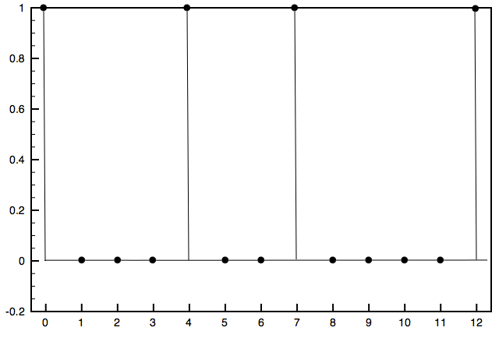
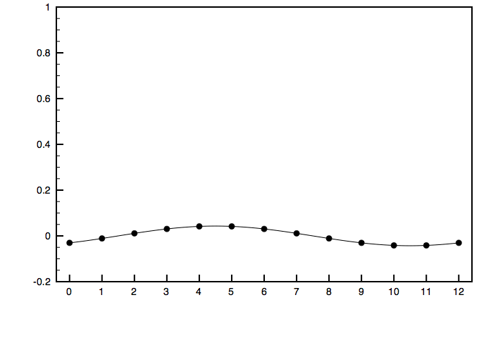
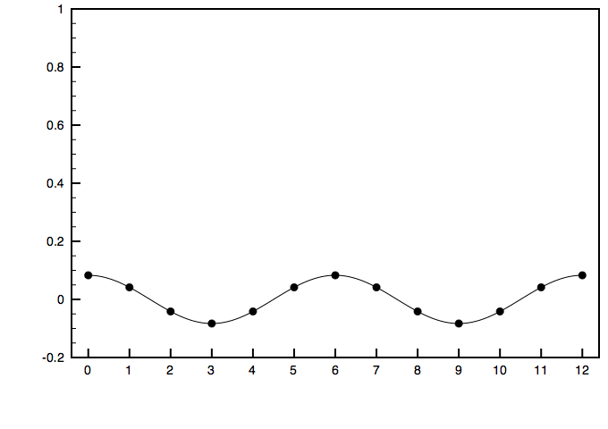
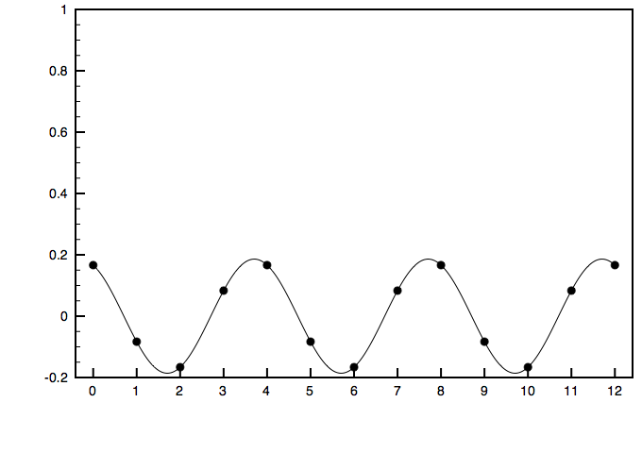
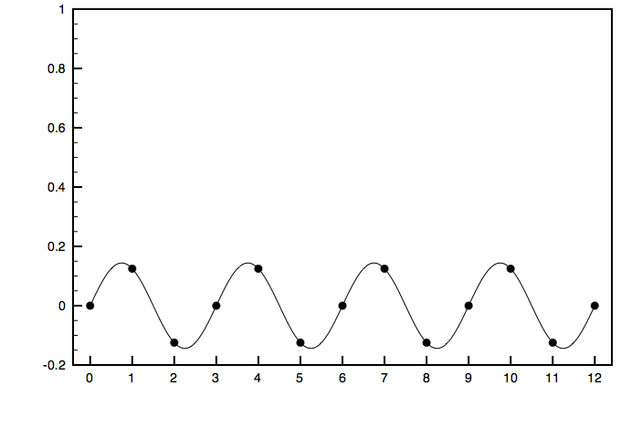
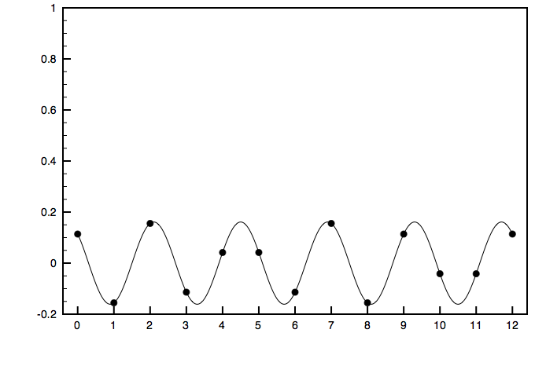
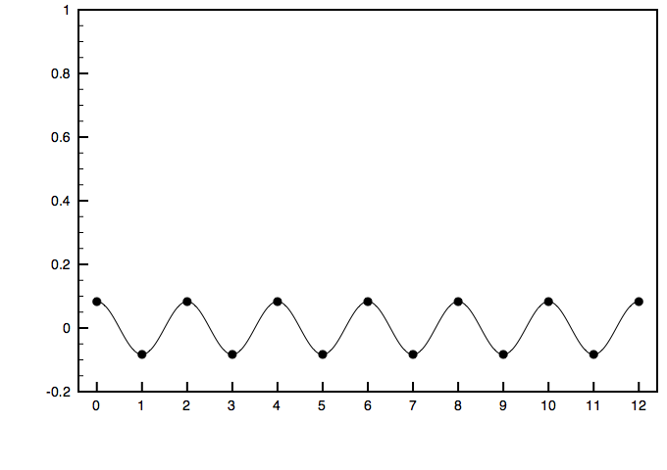
Fourier Transform of a Pitch-Class Vector
C major triad = f₀ +
f₁
+
f₂
+
f₃
+
f₄
+
f₅
+
f₆
+ . . .
The DFT is a lossless transformation from a pitch-class vector to a sum of periodic functions dividing the octave into 1–6 parts.

Slide 6
Fourier Qualities
f₁
f₂
F₁ represents a concentration of pitch-class weight on the full pc circle.
F₂ represents a concentration of pitch-class weight on a half-octave (tritone) cycle.

Slide 7
Fourier Qualities
f₃
f₄
f₃ gives the weighting on the nearest augmented triad or hexatonic scale.
f₄ gives the weighting on the nearest diminished seventh or octatonic scale.

Slide 8
Fourier Qualities
f₅
f₆
f₅ give the balance on the circle of fifths
f₆ gives the weighting on one of the two whole-tone collections.

Slide 9
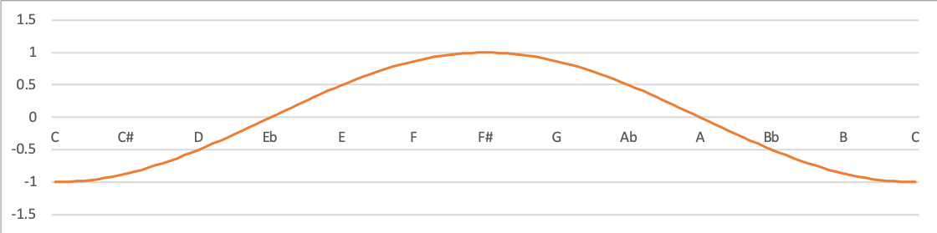
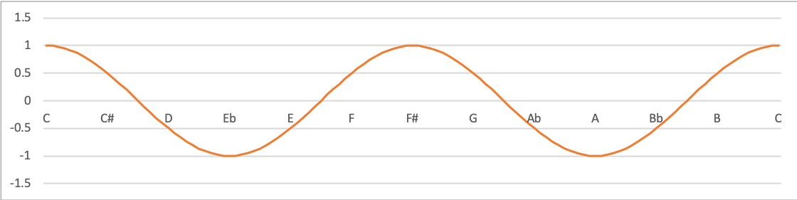
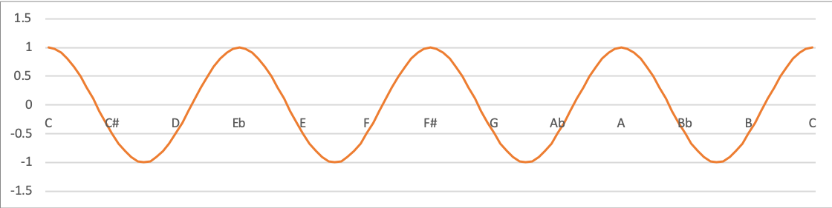
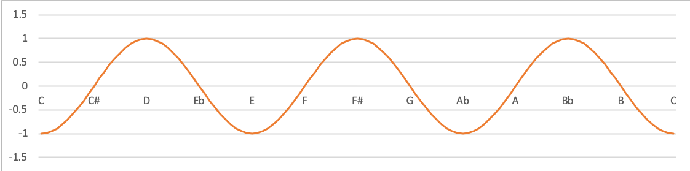
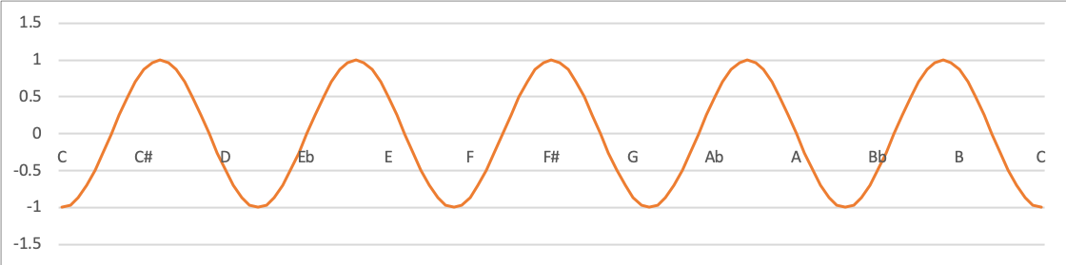
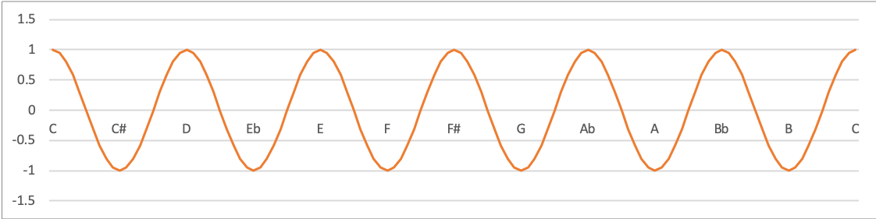
The Six Harmonic Qualities
Use of f₁ and f₂ requires dissonant harmony and abandonment of traditional voice-leading principles
f₁
f₂
f₃ represents the triadic/ functional element of tonality.
f₃
f₄ represents octatonicism, a potential extension of tonality.
f₄
f₅ represents the diatonic element of tonality.
f₅
f₆ represents the balance between whole tone scales.
f₆

Slide 10
Fourier Transform as Vector Sums
Fourier component f_{k} can be derived as a vector sum with each pitch class as a unit vector, where the unit circle is the 8ve/k.
The length of the resulting vector is the magnitude of the component, and the angle is its phase.
Example: C maj. triad, k = 3
f₃

Slide 11
Fourier Transform as Vector Sums
Fourier component f_{k} can be derived as a vector sum with each pitch class as a unit vector, where the unit circle is the 8ve/k.
The length of the resulting vector is the magnitude of the component, and the angle is its phase.
Example: C maj. triad, k = 5
f₅
F₃

Slide 12
Single component spaces (complex plane)
Example: F₅ space
Eb major scale
Distance from the center is the magnitude of f₅
C minor triad
C major scale
C major triad
Single pitch-class C
Angle is the phase of f₅

Slide 13
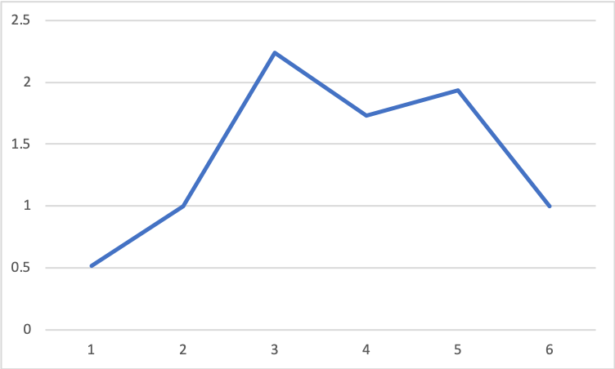
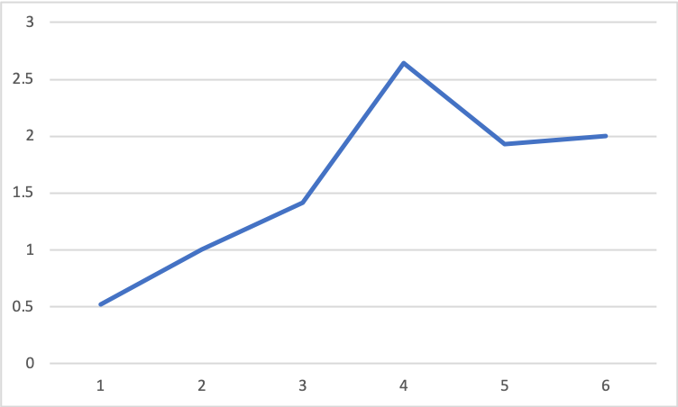
Fourier Spectra
The spectrum of a pitch-class vector shows the magnitudes of all its Fourier coefficients (ignoring phases)
The spectrum is invariant with respect to transposition and inversion (i.e. it is a set class property)
Examples:
Major/minor triad
Dominant 7th

Slide 14
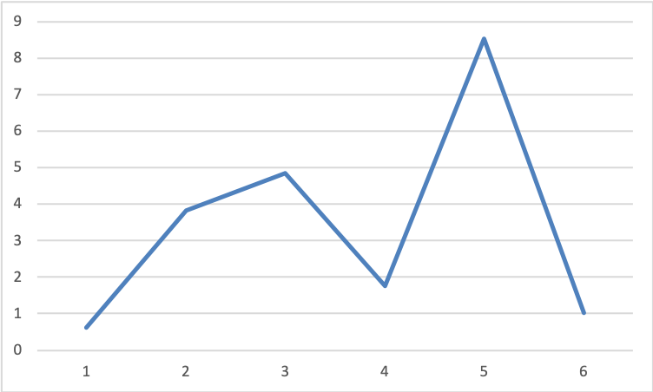
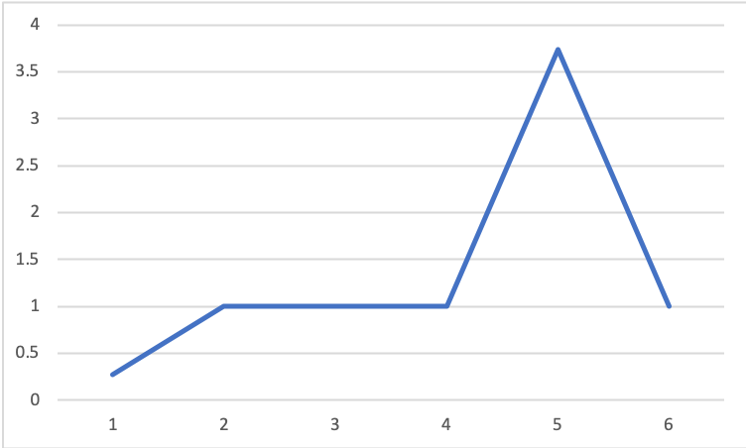
Fourier Spectra
The spectrum of a pitch-class vector shows the magnitudes of all its Fourier coefficients (ignoring phases)
The spectrum is invariant with respect to transposition and inversion (i.e. it is a set class property)
Examples:
Krumhansl-Kessler major key
Diatonic scale

Slide 15
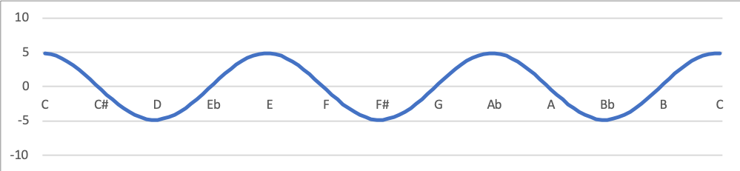
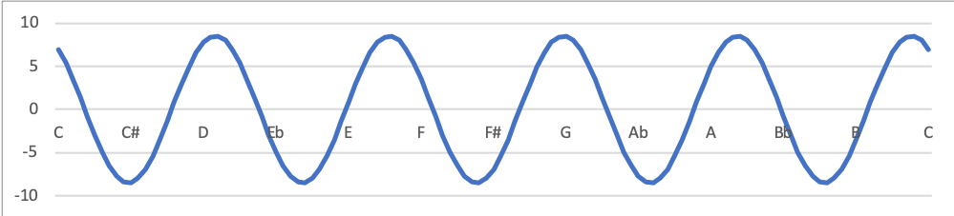
From Spectra to Phase Spaces
Krumhansl-Kessler major key
Pitch-class distribution
Spectrum
f₃
Largest coefficients:
f₅
The sum of these gives a good approximation:
f₃+f₅

Slide 16
From Spectra to Phase Spaces
Transpositions of the key correspond to phase shifts of the components
←Phase of f₃→
←Phase of f₅→

Slide 17
From Spectra to Phase Spaces
←Phase of f₃→
←Phase of f₅→
Krumhansl and Kessler Tonal Space

Slide 18
Application to 12-tone rows
Dimensions of atonality

Slide 19
Correlation and Convolution
Convolution theorem:
DFT(cross-correlation(A, B)) = DFT(A) × DFT(B)
In mathematical notation (c_{k} is the cross-correlation and ^ indicates the DFT):
i.e., the magnitudes are a componentwise product
and the phases are a componentwise difference

Slide 20
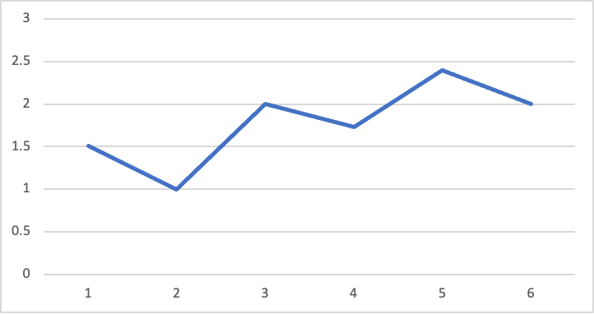
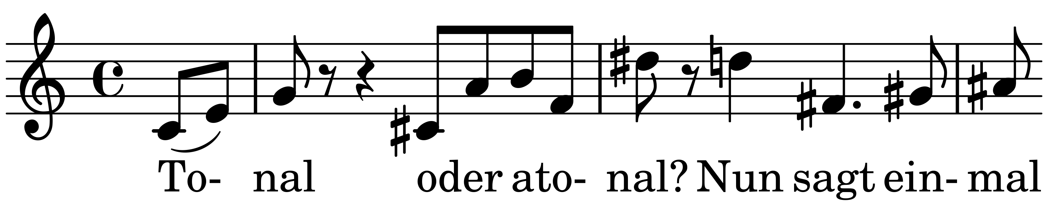
Example
Spectrum of hexachord
Schoenberg, Op. 28/1
{G, A, B, C, C#, E}
(110010010101)
a
b
c
(1, 1, 0, 0, 0, 1, 0, 1, 0, 1, 0, 1 )
×
(6.4,2.2, 3.5, 2.3, 4.4, 4.1, 2.5, 5.2, 2.4, 3.7, 2.3, 2.9)
=
6.4+2.2 + 0 + 0 + 0 + 4.1 + 0 + 5.2 +0 + 3.7 + 0 +2.9 = 24.7
C Db D Eb E F F# G Ab A Bb B
(24.7, 18.8, 21.6, 17.5, 24.0, 20.8, 18.7, 24.5, 18.3, 24.0, 17.1, 20.8)

Slide 21
Example
Spectrum of hexachord
Schoenberg, Op. 28/1
{G, A, B, C, C#, E}
(110010010101)
a
b
c
(1, 1, 0, 0, 0, 1, 0, 1, 0, 1, 0, 1 )
×
(2.2, 3.5, 2.3, 4.4, 4.1, 2.5, 5.2, 2.4, 3.7, 2.3, 2.9, 6.4)
=
2.2+3.5 + 0 + 0 + 0 + 2.5 +0 +2.4 + 0 +2.3 +0 + 6.4 = 18.8
C Db D Eb E F F# G Ab A Bb B
(24.7, 18.8, 21.6, 17.5, 24.0, 20.8, 18.7, 24.5, 18.3, 24.0, 17.1, 20.8)

Slide 22
Example
Spectrum of hexachord
Schoenberg, Op. 28/1
{G, A, B, C, C#, E}
(110010010101)
a
b
c
(1, 1, 0, 0, 0, 1, 0, 1, 0, 1, 0, 1 )
×
(3.5, 2.3, 4.4, 4.1, 2.5, 5.2, 2.4, 3.7, 2.3, 2.9, 6.4, 2.2)
=
3.5+2.3 + 0 + 0 + 0 +5.2 + 0 +3.7 + 0 + 2.9 +0 +2.2 = 21.6
C Db D Eb E F F# G Ab A Bb B
(24.7, 18.8, 21.6, 17.5, 24.0, 20.8, 18.7, 24.5, 18.3, 24.0, 17.1, 20.8)

Slide 23
Simplification 1: Multiply Spectra
Krumhansl-Kessler major key
Spectrum of hexachord
{G, A, B, C, C#, E}
×
(110010010101)
High values in the cross-correlation will occur when spectra are similar

Slide 24
Simplification 1: Multiply Spectra (Covariance)
Hippel and Huron procedure
Top 20 most tonal
Spectrum Covariance
Top 20 most tonal
1 | Berg | Lulu Principal 3
2 | Schoenberg | Op.27 no.4
3 | Berg | Lulu Principal 4
4 | Berg | Lulu Principal 1
5 | Berg | Lyric Suite 1
6 | Berg | Lulu Schoen
7 | Berg | “Der Wein”
8 | Schoenberg | Phantasia
9 | Berg | Lulu Lulu
10 | Schoenberg | Op.50a
11 | Berg | Lulu Alwa
12 | Berg | Violin Concerto
13 | Berg | Lulu Countess
14 | Schoenberg | Op.28-1
15 | Schoenberg | Op.29
16 | Berg | Chamber Conc. 1-3
17 | Berg | Lulu Acrobat
18 | Schoenberg | Op.35 no.2
19 | Schoenberg | Op.42
20 | Berg | Lulu Principal 2
1 | Berg | Lulu Principal 4
2 | Schoenberg | Op.27 no.4
3 | Berg | Lulu Principal 3
4 | Berg | Lulu Principal 1
5 | Berg | Lyric Suite 1
6 | Berg | Lulu Lulu
7 | Berg | Lulu Schoen
8 | Berg | Lulu Countess
9 | Schoenberg | Op.50a
10 | Berg | Lulu Acrobat
11 | Berg | Lulu Alwa
12 | Berg | “Der Wein”
13 | Berg | Violin Concerto
14 | Schoenberg | Phantasia
15 | Schoenberg | Op. 45
16 | Schoenberg | Op.29
17 | Schoenberg | Op.42
18 | Schoenberg | Op.23
19 | Berg | Lulu Principal 2
20 | Berg | Lulu Chorale
Spearman rank r = .95

Slide 25
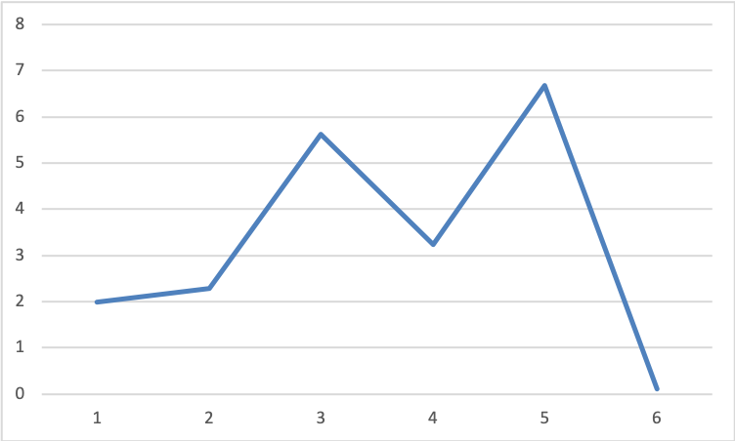
Simplification 2: Maximum 2f₃+3f₅
Covariance with the KK profiles is determined primarily by |f₅| and |f₃|
Krumhansl-Kessler major key
Krumhansl-Kessler minor key
A further simplified measure of tonalness is therefore given by 3|f₅| + 2|f₃|

Slide 26
Simplification 2: Maximum 2f₃+3f₅
Hippel and Huron
Top 20 most tonal
Spectrum Covariance
Top 20 most tonal
2f₃ + 3f₅
Top 20
1 | Berg | Lulu Principal 3
2 | Schoenberg | Op.27 no.4
3 | Berg | Lulu Principal 4
4 | Berg | Lulu Principal 1
5 | Berg | Lyric Suite 1
6 | Berg | Lulu Schoen
7 | Berg | “Der Wein”
8 | Schoenberg | Phantasia
9 | Berg | Lulu Lulu
10 | Schoenberg | Op.50a
11 | Berg | Lulu Alwa
12 | Berg | Violin Concerto
13 | Berg | Lulu Countess
14 | Schoenberg | Op.28-1
15 | Schoenberg | Op.29
16 | Berg | Chamber Conc. 1-3
17 | Berg | Lulu Acrobat
18 | Schoenberg | Op. 35 no.2
19 | Schoenberg | Op. 42
20 | Berg | Lulu Principal 2
1 | Berg | Lulu Principal 4
2 | Schoenberg | Op.27 no.4
3 | Berg | Lulu Principal 3
4 | Berg | Lulu Principal 1
5 | Berg | Lyric Suite 1
6 | Berg | Lulu Lulu
7 | Berg | Lulu Schoen
8 | Berg | Lulu Countess
9 | Schoenberg | Op.50a
10 | Berg | Lulu Acrobat
11 | Berg | Lulu Alwa
12 | Berg | “Der Wein”
13 | Berg | Violin Concerto
14 | Schoenberg | Phantasia
15 | Schoenberg | Op. 45
16 | Schoenberg | Op. 29
17 | Schoenberg | Op. 42
18 | Schoenberg | Op. 23
19 | Berg | Lulu Principal 2
20 | Berg | Lulu Chorale
1 | Schoenberg | Op.27 no.4
2 | Berg | Lulu Principal 3
3 | Berg | Lulu Principal 4
4 | Berg | Lulu Principal 1
5 | Berg | Lyric Suite 1
6 | Schoenberg | Op. 29
7 | Berg | Lulu Lulu
8 | Berg | Lulu Scoen
9 | Berg | Violin Concerto
10 | Webern | Op. 24
11 | Berg | “Der Wein”
12 | Berg | Lulu Countess
13 | Schoenberg | Phantasia
14 | Schoenberg | Op. 50a
15 | Schoenberg | Op. 50c
16 | Schoenberg | Op. 37
17 | Schoenberg | Op. 28 no. 1
18 | Berg | Lulu Alwa
19 | Berg | Lulu Chorale
20 | Schoenberg | Op. 42
Spearman rank r = .95
Spearman rank r = .91

Slide 27
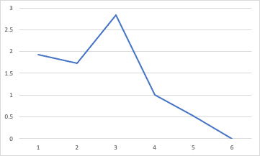
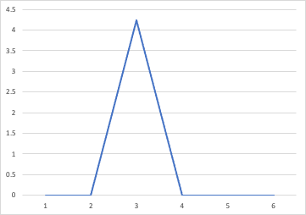
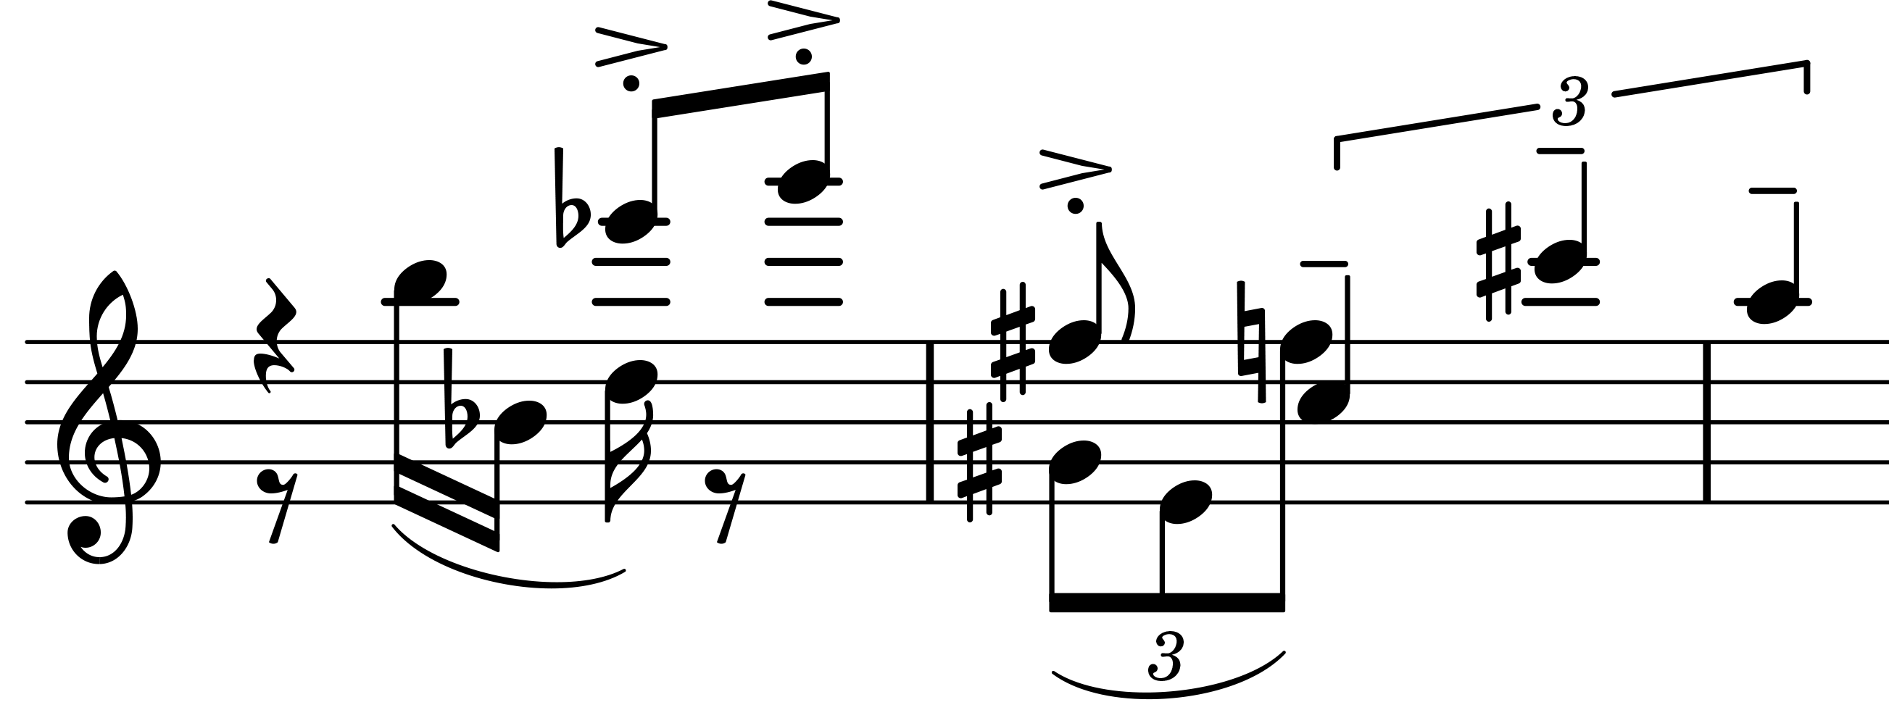
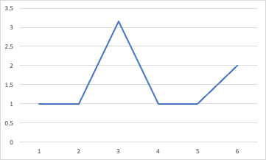
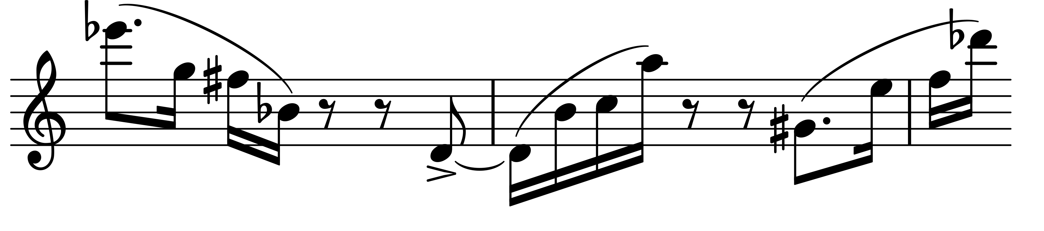
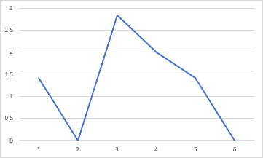
Hexatonic Rows
Initial tetrachord:
Hexachord:
Webern Op. 24
Concerto for Nine Instruments
Final tetrachord:
Hexachord:
Schoenberg Op. 29 Suite
Both tetrachords:

Slide 28
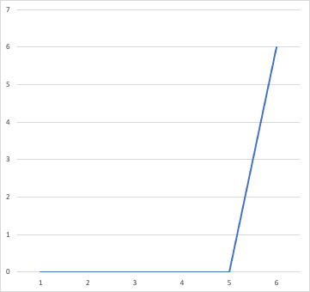
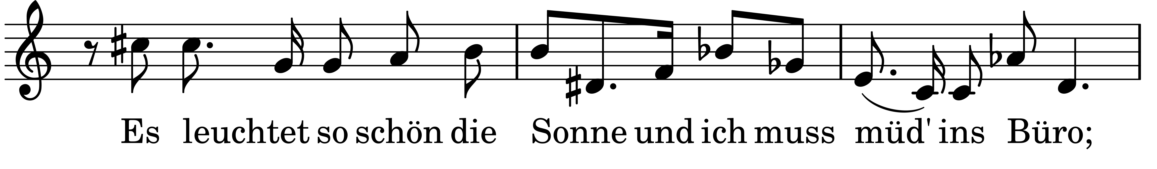
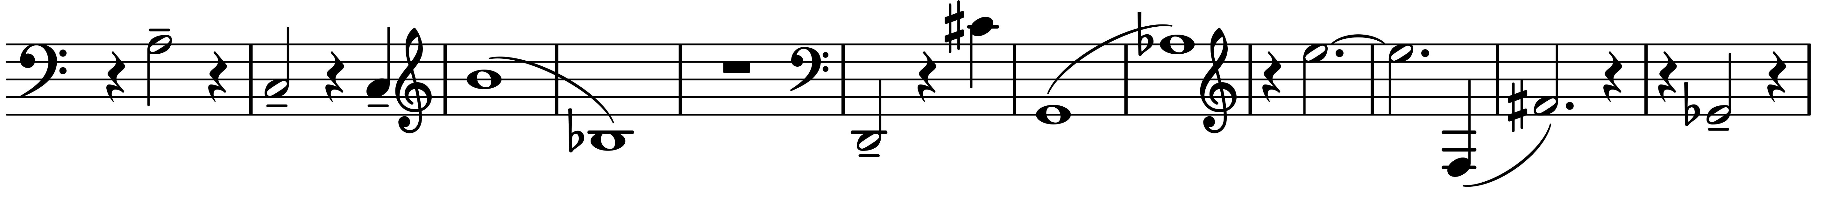
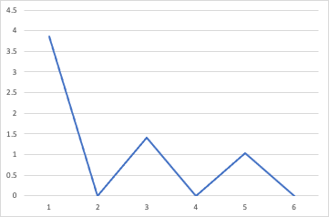
Highly atonal rows
Hexachord spectrum (Whole tone):
Schoenberg Op. 48 no. 3
Webern Op. 21 Symphony
Hexachord spectrum (Chromatic):

Slide 29
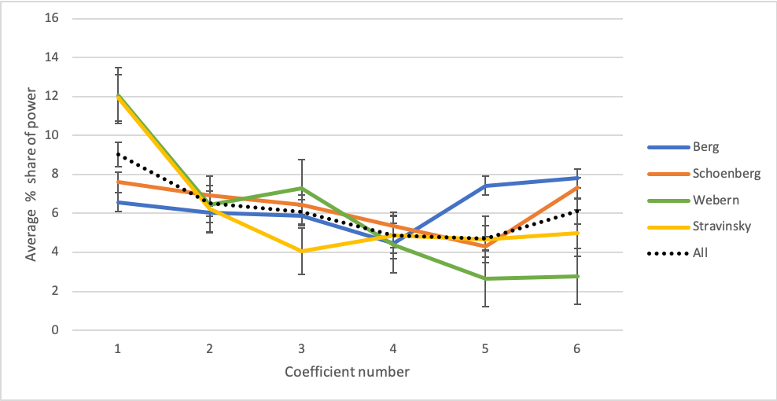
Average spectrum by composer
• Berg’s rows are more tonal because they are more diatonic
• There are two strategies to construct more atonal rows:
—High f₁ (chromatic concentration), typical of Webern and Stravinsky
—High f₆ (whole tone quality), typical of Schoenberg

Slide 30
Phase Spaces
One-dimensional phase spaces are Quinn’s Fourier balances,
superimposed n-cycles created by multiplying the pc-circle by n.
Ph₁
Ph₂
Ph₃
Ph₄
Ph₅
Ph₆
N.B. counter-clockwise orientation

Slide 31
Krumhansl’s Tonal Space
Krumhansl’s space is based on correlations between key profiles.
Key profiles may be derived from
• Listener rankings of stability of tones in a given context,
• Frequency of occurrence of tones in the given key,
• etc.
Krumhansl and Kessler’s key profiles based on listener ratings
C major
C minor

Slide 32
Krumhansl’s Tonal Space
T₅ →
T₅ →
← T₄ ————
← T₄ ————
Toroidal map of key profiles from
Krumhansl and Kessler 1982

Slide 33
Krumhansl’s Tonal Space
T₅ →
T₅ →
Horizontally aligned elements have similar tonic triads
← T₄ ————
← T₄ ————
Vertically aligned elements have similar basic scales
Toroidal map of key profiles from
Krumhansl and Kessler 1982

Slide 34

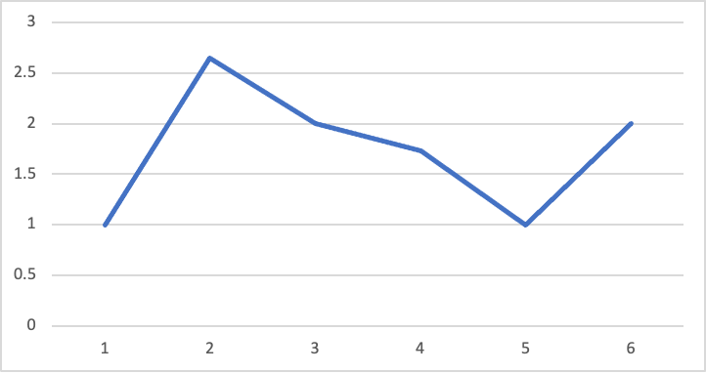

Examples
Spectrum of hexachord
Schoenberg, Op. 28/1
Spectrum of hexachord
Berg, “Akrobat” row

