Slide 1

Rhythmic Qualities,
Meter, and Reich’s Cyclic Canons
Presentation to SMT 2019, Columbus, Ohio
Jason Yust, .

Slide 2
Goals
• Introduce a concept of rhythmic qualities analogous to Quinn’s (2006) harmonic qualities.
• Relate rhythmic qualities to meter.
• Describe Reich’s cyclic rhythms using rhythmic spectra.
• Demonstrate mathematical properties of the DFT and their significance to understanding cyclic rhythms.

Slide 3
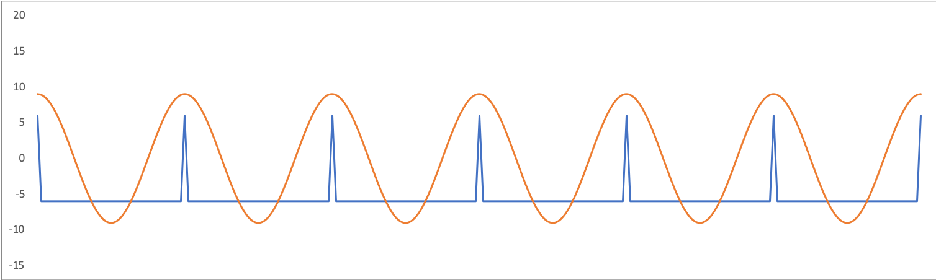
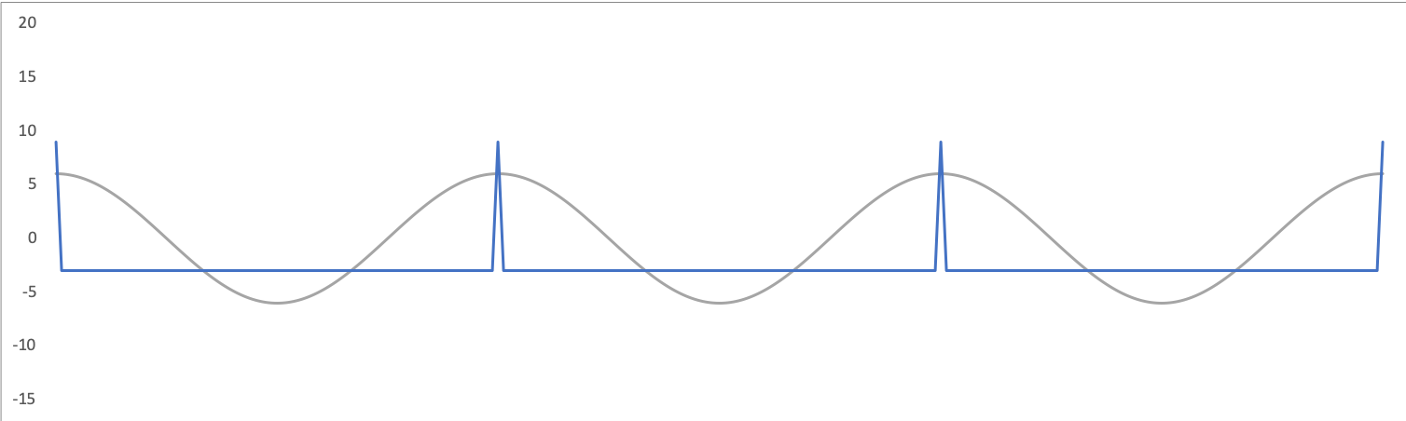
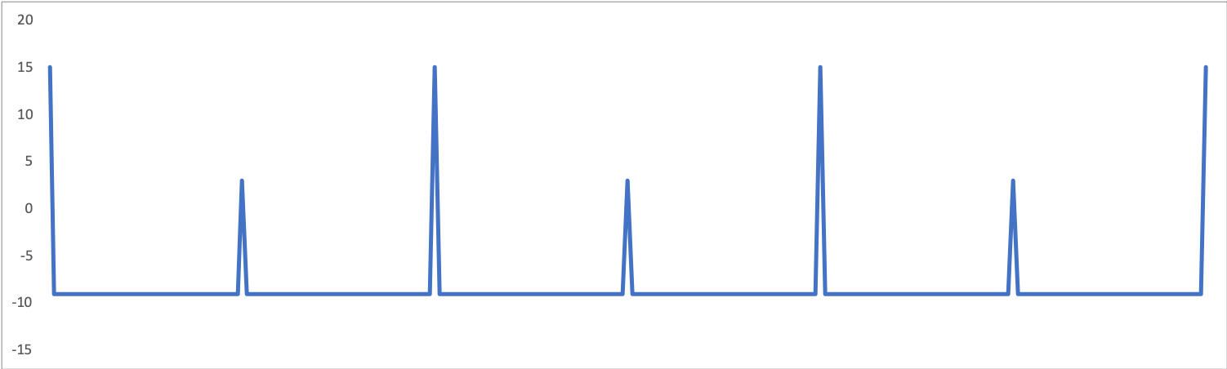
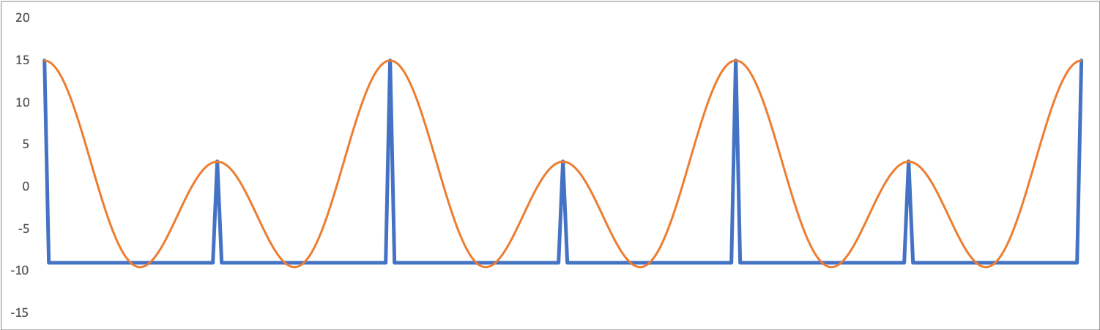
Simple metrical rhythms as periodic functions
q q q q q q
:||
+
h h h
:||
=
+
=

Slide 4
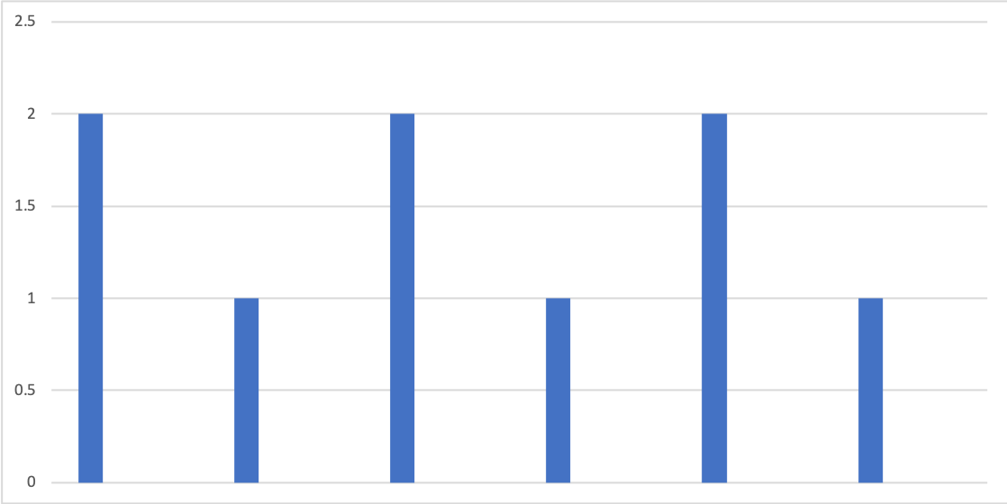
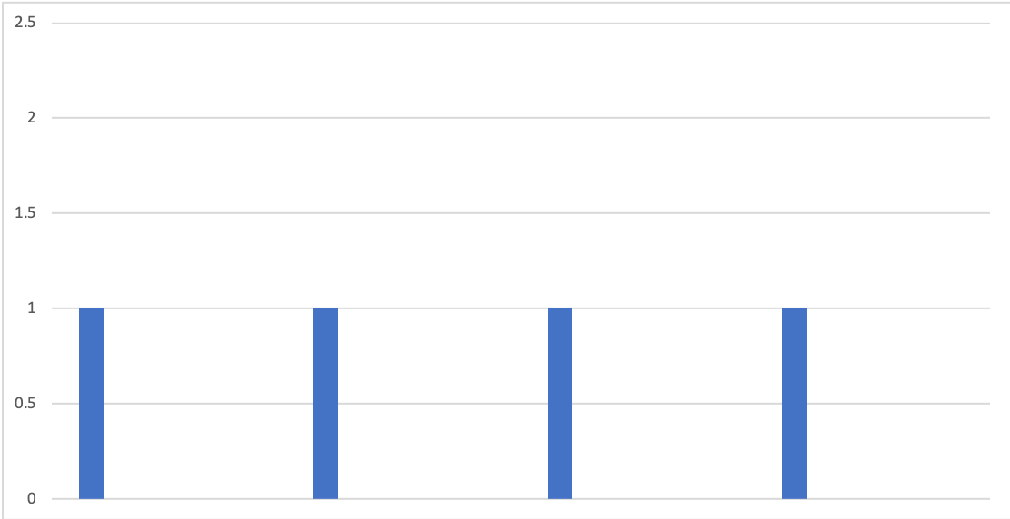
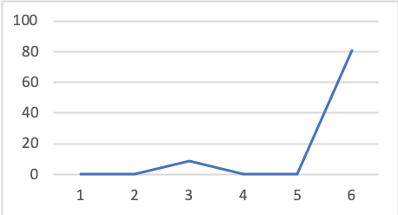
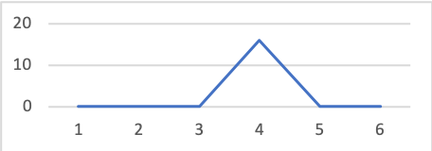
Meter type corresponds to spectrum
q q q q q q
q. q. q. q.
h
q
q.

Slide 5
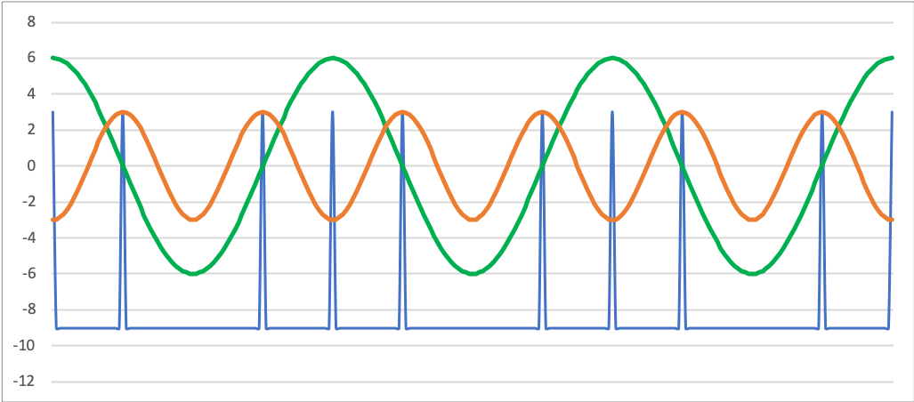
Displacement corresponds to phase
h h h
+
‰ q e) e q e) e q e
=
e q e e q e e q e
Phase Shift
>

Slide 6
Rhythmic Qualities
Cycle of 12
eeeeeeeeeeee
:||
2 Subcycles
iiiiiq iiiiiq
:||
3 Subcycles
iiiq iiiq iiiq
:||
4 Subcycles
iiq iiq iiq iiq
:||
5 Subcycles?
iiq iq iiq iq iq
:||
6 Subcycles
iq iq iq iq iq iq
:||
Notes:
f5 is funky

Slide 7
Rhythmic Qualities
e e e e e e e e e e e e
Full cycle divided into 5 equal subcycles:
All 12 eighth-note timepoints fall in different positions within the subcycle.
//
//
//
//
//
//

Slide 8

Rhythmic Qualities

Slide 9
Rhythmic Qualities
The discrete Fourier transform (DFT) converts any cyclic rhythm on a grid of n time points to a set of n rhythmic qualities by
Wrapping the complete cycle into k subcycles (for all k s.t. 0 < k < n).
The results for complementary f_{k} and f_{n – k} are equivalent, so we consider only f₁ to f_{u/2} .
(2) Summing the rhythm in the vector space (f_{k}) for each of these subcycles.
Each f_{k} is represented by a magnitude and a phase, representing the size of quality k and its orientation in the cycle.

Slide 10
DFT on pitch-class sets
David Lewin (1959), “Re: Intervallic Relations between Two Collections of Notes.” Journal of Music Theory 3/2.
Ian Quinn (2006), “General Equal-Tempered Harmony.” Perspectives of New Music 44/2–45/1
Emmanuel Amiot (2007), “David Lewin and Maximally Even Sets.” Journal of Mathematics and Music 1/3
Jason Yust (2015), “Applications of DFT to the Theory of Twentieth-Century Harmony.” Mathematics and Computation in Music, Fifth International Conference (MCM 2015), ed. T. Collins, D. Meredith, A. Volk (Springer)
——— (2016), “Special Collections: Renewing Set Theory.” Journal of Music Theory 60/2

Slide 11
DFT on pitch-class sets and rhythms
Emmanuel Amiot (2009), “New Perspectives on Rhythmic Canons and the Spectral Conjecture” JMM 3/2.
——— (2011), “Structures, Algorithms, and Algebraic Tools for Rhythmic Canons.” PNM 49/2
Emmanuel Amiot and William Sethares (2011), “An Algebra for Periodic Rhythms and Scales” JMM 5/3.
Emmanuel Amiot (2016), Music through Fourier Space (Springer).
Andrew Milne, David Bulger, Steffen Herff, and William Sethares (2015), “Perfect Balance: A Novel Organizational Principle for Musical Scales and Meters.” MCM 2015.
Andrew Milne, David Bulger, and Steffen Herff (2017), “Exploring the Space of Perfectly Balanced Rhythms and Scales.” JMM 11/2.
Matthew Chiu (2018), “Form as Meter: Metric forms through Fourier Space,” Master’s Thesis, Boston University.

Slide 12
On the Beat-Class–Pitch-Class Analogy
Milton Babbitt (1962), “Twelve-Tone Rhythmic Structure and the Electronic Medium.” PNM 1/1.
Jeff Pressing (1983), “Cognitive Isomorphisms in Pitch and Rhythm in World Musics: West Africa, the Balkans, and Western Tonality.” Studies in Music 17.
Richard Cohn (1992), “Transpositional Combination of Beat-Class Sets in Steve Reich’s Phase-Shifting Music.” PNM 30/2.
——— (2016), “A Platonic Model for Funky Rhythms.” Music Theory Online 22/2.
Jay Rahn (1996), “Turning the Analysis Around: Africa-Derived Rhythms and Europe-Derived Music Theory.” Black Music Research Journal 16/1.
John Roeder (2003), “Beat-Class Modulation in Steve Reich’s Music.” Music Theory Spectrum 25/2.

Slide 13

Example: Reich’s signature rhythm (Clapping Music)
Used in . . .
Clapping Music (1972), Music for Pieces of Wood (1973), Music for 18 Musicians (1974–6), Desert Music (1984), Sextet (1985), Three Movements (1986), Electric Counterpoint (1987), . . .
0, 1, 2, 4, 5, 7, 9, 10
Clapping Music
Music for Pieces of Wood
Sextet I

Slide 14
Example: Reich’s signature rhythm
0, 1, 2, 4, 5, 7, 9, 10
Notes:
Vuust: metastability

Slide 15
Example: Reich’s signature rhythm
Vector addition for f₁
0, 1, 2, 4, 5, 7, 9, 10

Slide 16
Example: Reich’s signature rhythm
Vector addition for f₂
0, 1, 2, 4, 5, 7, 9, 10

Slide 17
Example: Reich’s signature rhythm
Vector sums for f₃ and f₄
0, 1, 2, 4, 5, 7, 9, 10

Slide 18
Example: Reich’s signature rhythm
Vector sum for f₅
0, 1, 2, 4, 5, 7, 9, 10

Slide 19
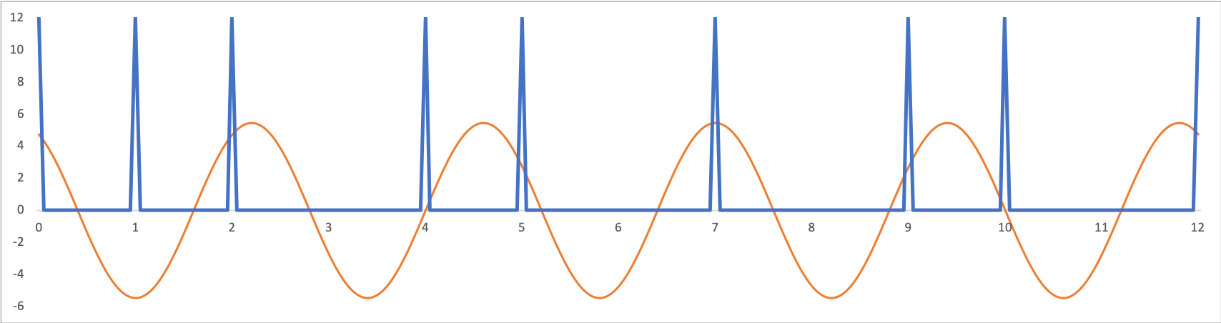
Example: Reich’s signature rhythm
0, 1, 2, 4, 5, 7, 9, 10
Phase
Rhythm
Magnitude
f₅

Slide 20
Example: Reich’s signature rhythm
The spectrum of a rhythm shows the sizes of each component
as squared magnitudes
Spectrum of the Clapping Music rhythm:
Notes:
Peter Vuust: metastability, Tiffany Nicely: Many Meters

Slide 21
Meter and Rhythmic Qualities
Heard in 3/2 (division of the measure in 3) or 12/8 (division of the measure in 4) the Clapping Music rhythm has a feel that is metrical but syncopated.
Notes:
Phase: Fernando Benadon’s Afro-Cuban percussionists

Slide 22
Meter and Rhythmic Qualities
The largest rhythmic quality, f₅, is roughly in phase with the downbeat, but is not metrical in any regular meter.
f₅

Slide 23
The signature rhythm
0, 1, 2, 4, 5, 7, 9, 10
Diatonic set
Perfectly even
3/12
Perfectly even 4/12

Slide 24
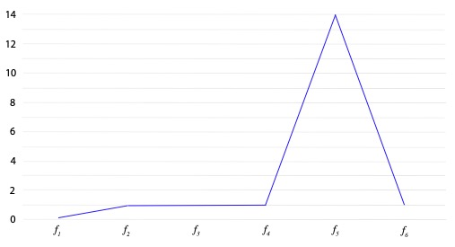
Maximizing f₅
“Circle
of 5ths”
Spectrum
Squared mag.
“Diatonic rhythm” from Sextet mvt. 5

Slide 25
Mathematical properties of the DFT
Invertibility:
{Weighted collections of onsets} {Qualities}
One-to-one
Conservation of power:
Sum of squared onset weights = Sum of squared qualities
Magnitudes are invariant over rotation and retrograde
(transposition and inversion)
The maximally even rhythm of cardinality n maximizes f_{n}

Slide 26
Mathematical properties of the DFT
Conservation of power:
Maximizing f₅ entails minimizing all other qualities
Squared mag.
“Diatonic rhythm” from Sextet mvt. 5
Notes:
West African music and appropriation

Slide 27
Mathematical properties of the DFT
Convolution theorem:
Transpositional combination (convolution) of sets corresponds to
multiplication of their spectra.
Convolution in the rhythmic domain = canon
e ‰ e ‰ e e ‰ e ‰ e ‰ e :|||
x
e ‰ ‰ ‰ ‰ ‰ ‰ ‰ e ‰ ‰ ‰ :|||
=

Slide 28
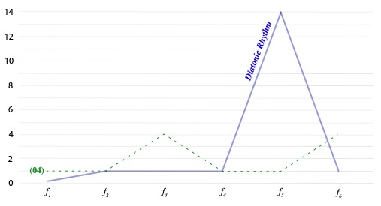
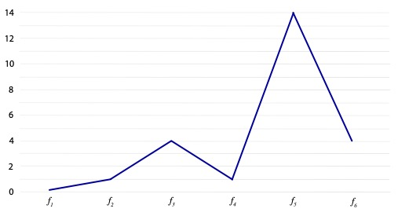
Convolution
e ‰ e ‰ e e ‰ e ‰ e ‰ e :|||
x
e ‰ ‰ ‰ ‰ ‰ ‰ ‰ e ‰ ‰ ‰ :|||
(0,2,4,5,7,9,11) x (0,8)
= (0,0,1,2,3,4,5,5,7,7,8,9,10,11)

Slide 29
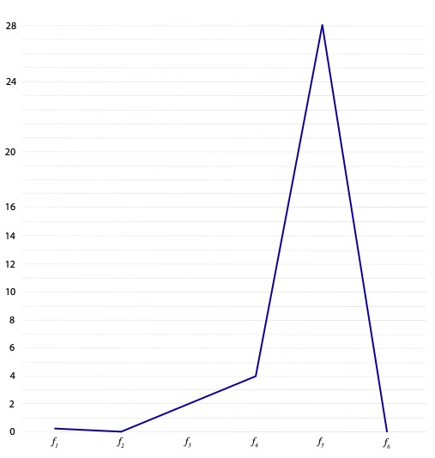
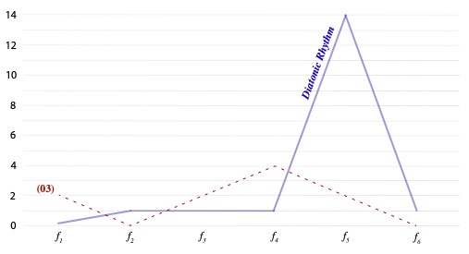
Convolution
e ‰ e ‰ e e ‰ e ‰ e ‰ e :|||
x
e ‰ ‰ e ‰ ‰ ‰ ‰ ‰ ‰ ‰ ‰ :|||
(0,2,4,5,7,9,11) x (0,3)
= (0,0,2,2,3,4,5,5,7,7,8,9,10,11)

Slide 30
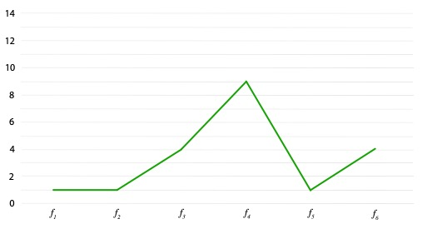
Changing meter in the finale of the Sextet
Piano part, Sextet, mvt. 5
Squared mag.

Slide 31
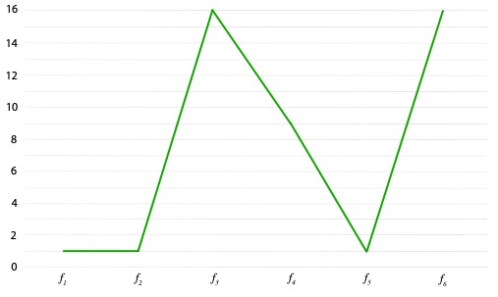
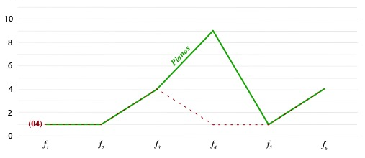
Changing meter in the finale of the Sextet
(0,3,4,6,8,9) x (0,8)
= (0,0,2,3,4,4,5,6,8,8,9,11)

Slide 32
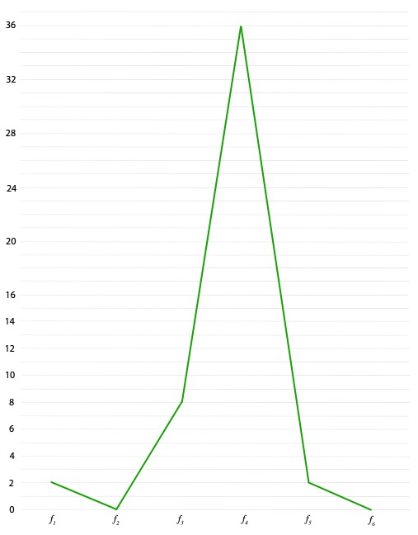
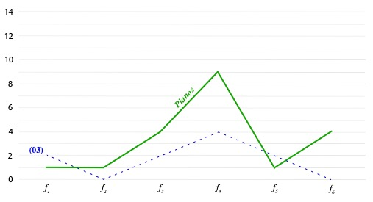
Changing meter in the finale of the Sextet
(0,3,4,6,8,9) x (0,3)
= (0,0,3,3,4,6,6,8,9,9,11)

Slide 33
Canons on the signature rhythm
Sextet mvt. 1:
(0,1,2,4,5,7,9,10) x (0,2)

Slide 34
Canons on the signature rhythm
Sextet mvt. 1:
(0,1,2,4,5,7,9,10) x (0,2,5)

Slide 35
Canons on the signature rhythm
Electric Counterpoint mvt. 3:
(0,2,5,9)
(0,3,5,9)
0
0
2
3
9
9
Spectra:
5
5

Slide 36
Sextet Mvt. 4
A modification of the signature rhythm to fit in an irregular 22-onset universe
The relationship between these rhythms can be seen by scaling their spectra to reflect the common shape

Slide 37
Sextet Mvt. 4
One of Reich’s canons on this rhythm

Slide 38
Electric Counterpoint, Mvt. 2

Slide 39
Rhythmic Qualities,
Meter, and Reich’s Cyclic Canons
Presentation to SMT 2019, Columbus, Ohio
Jason Yust, .

Slide 40
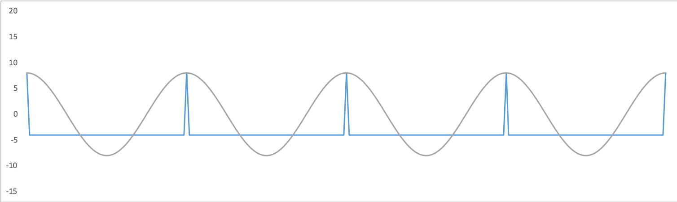
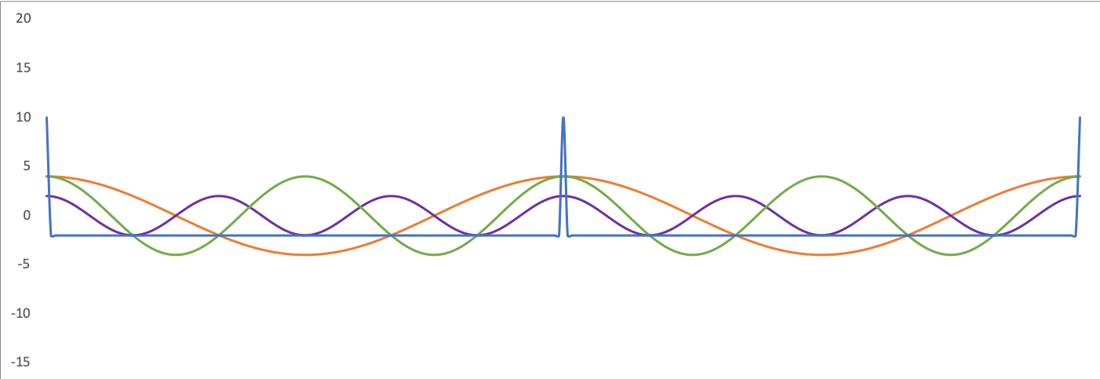
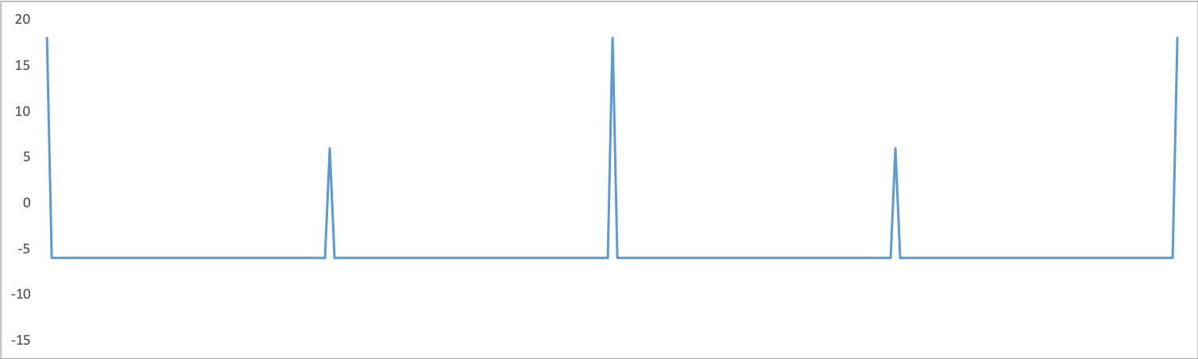
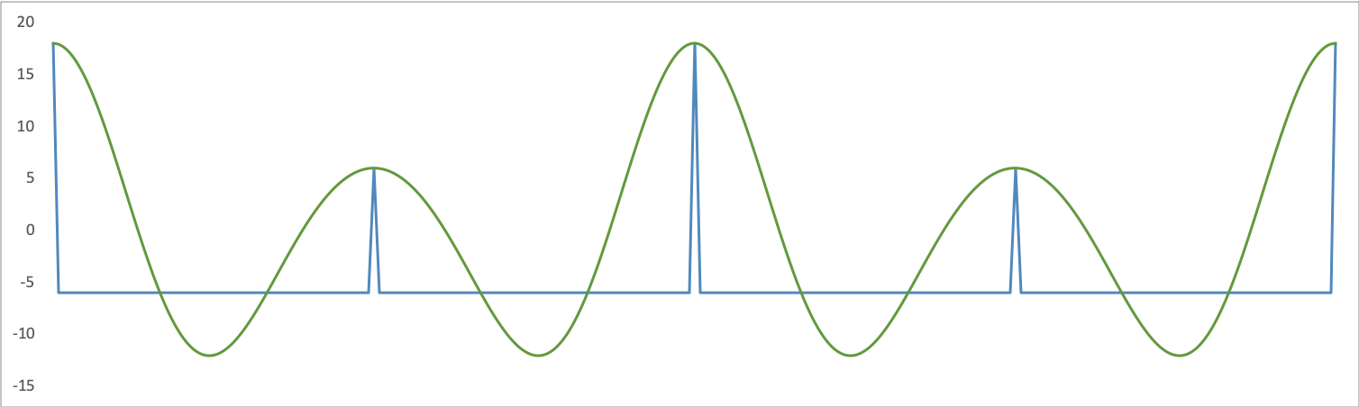
Simple metrical rhythms as periodic functions
q. q. q. q.
:||
+
h. h.
:||
=
+
=

