Slide 1

Response to John Gingerich’s “Beethoven’s Op. 95, Ignaz Schuppanzigh, and the Path to the Late Style”
Boston University Center for Beethoven Research
Symposium on Op. 95
April 17, 2021
Jason Yust .
http:/people.bu.edu/jyust
jason.yust@gmail.com

Slide 2
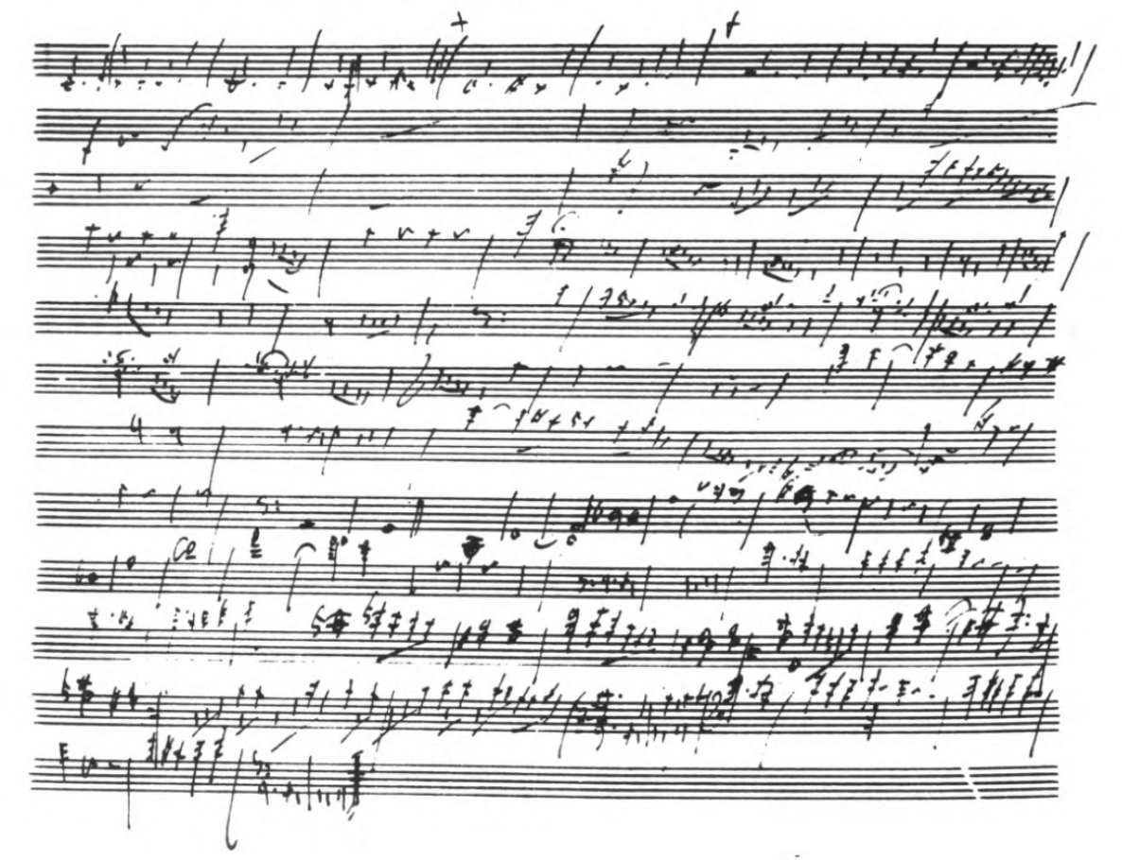
String Quintet, Op. 29
Beethoven’s
first sketch of Op. 29, showing non-standard choice of subordinate key
from Churgin, “Beethoven’s Sketches for his String Quintet, Op. 29,” in Studies in Musical Sources and Style (AR-editions), 1990.

Slide 3
Op. 95, mvt. 4: End of final refrain

Slide 4
Op. 95, mvt. 4: End of final refrain

Slide 5
Op. 95, mvt. 4: Exposition

Slide 6
Op. 95, mvt. 4: Exposition

