Slide 1
Harmonic qualities as key to
Scriabin’s late harmonic practice
Jason Yust and Thomas Noll

Slide 2
Outline
• Harmonic qualities and the DFT: Hexatonic, Octatonic, Diatonic, and Whole-tone
• The Mystic chord, tonality, and the DFT
• Octatonicism and Diatonicism, Local and Global
• Examples:
—Op. 11 nos. 3 and 4
—Op. 35 no. 2
—Op. 59 no. 2
—Op. 74 nos. 1–5

Slide 3
DFT and Harmonic Qualities

Slide 4


DFT on pc-vectors and harmonic quality: References
Lewin, David (1959). “Re: Intervallic Relations between Two Collections of Notes,” JMT 3/2.
——— (2001). “Special Cases of the Interval Function between Pitch Class Sets X and Y.” JMT 45/1.
Quinn, Ian (2006–2007). “General Equal-Tempered Harmony,” Perspectives of New Music 44/2–45/1.
Callender, Cliff (2007). “Continuous Harmonic Spaces,” JMT 51/2
Amiot, Emmanuel (2007). “David Lewin and Maximally Even Sets.” Journal of Mathematics and Music 1/3.
——— (2016). Music Through Fourier Space: Discrete Fourier Transform in Music Theory. (Springer)
Yust, Jason (2015). “Schubert’s Harmonic Language and Fourier Phase Spaces.” JMT 59/1.
——— (2016). “Special Collections: Renewing Forte’s Set Theory.” JMT 60/2.

Slide 5
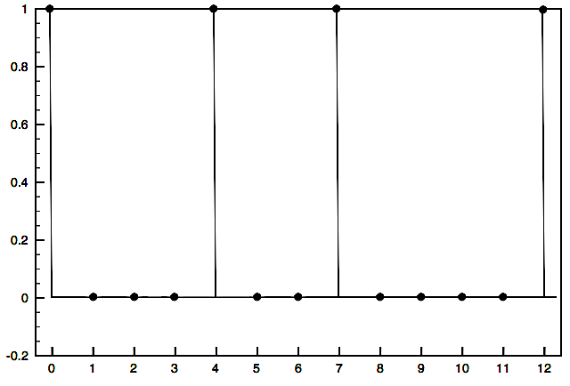
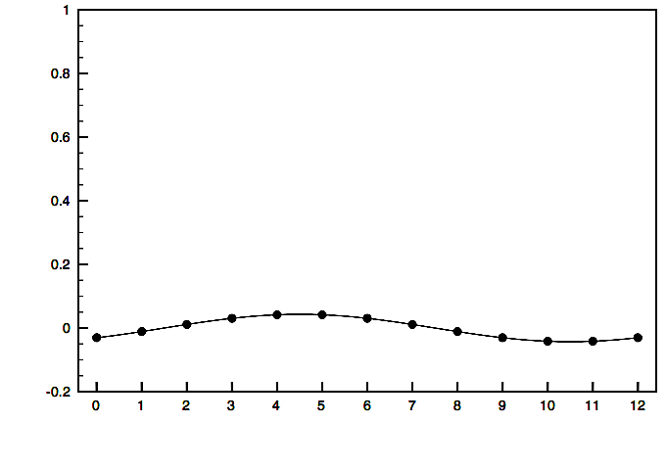
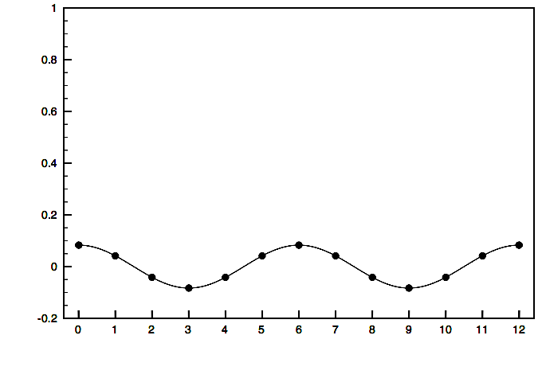
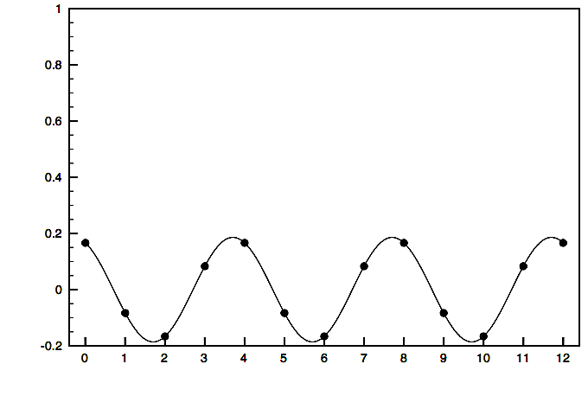
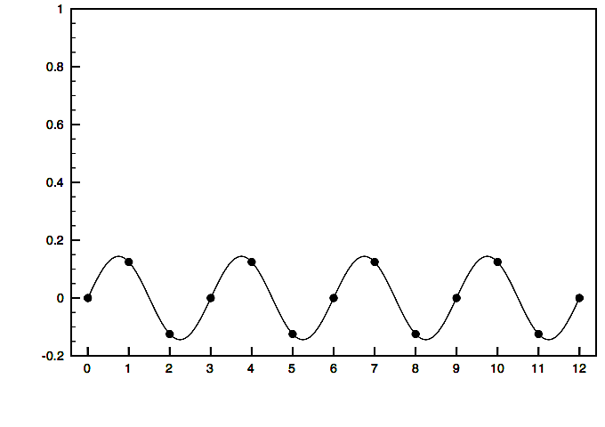
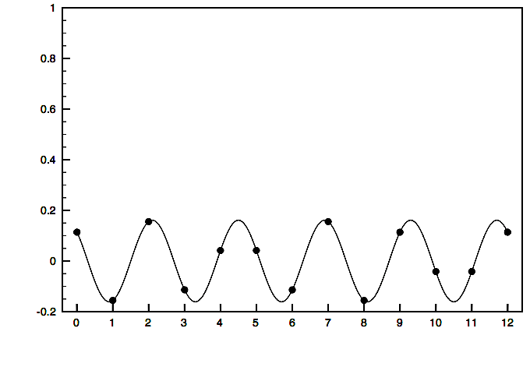
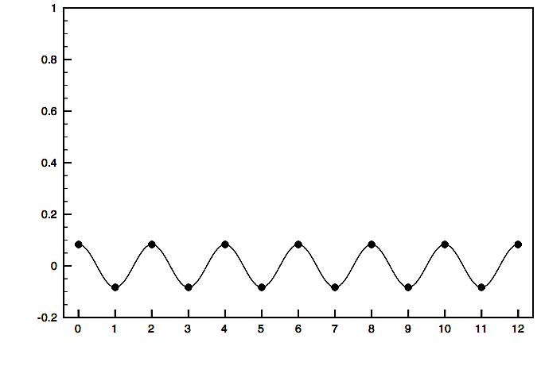
C major triad = F₀ +
F₁
+
+
F₂
F₃
+
F₄
+
F₅
+
F₆
+ . . .
The DFT is a lossless transformation from a pitch-class vector to a sum of periodic functions dividing the octave into 1–6 parts.

Slide 6
Harmonic qualities
F₁ represents a concentration of pitch-class weight on the full pc circle.
F₂ represents a concentration of pitch-class weight on a half-octave (tritone) cycle.
F₃ gives the weighting on the nearest augmented triad or hexatonic scale.

Slide 7
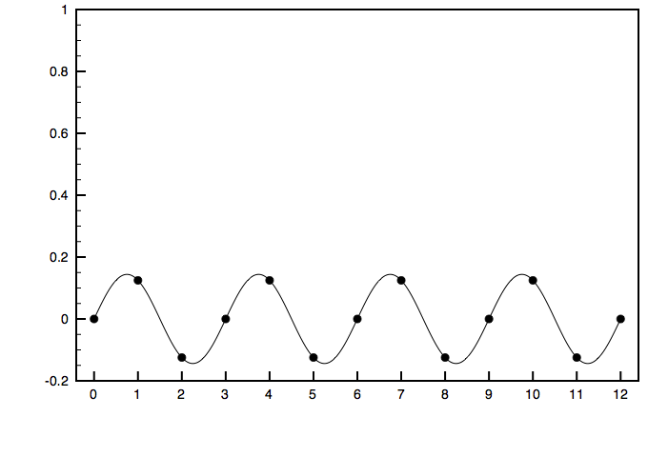
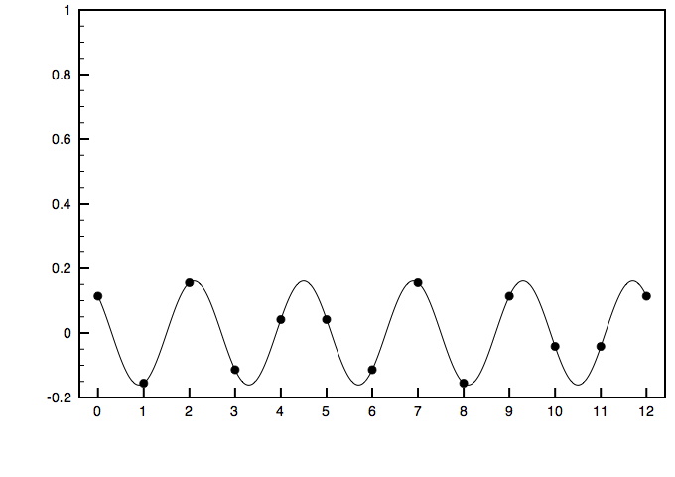
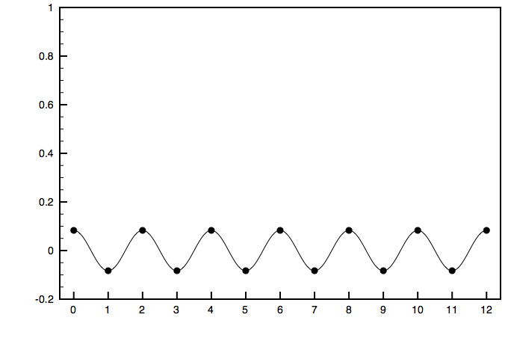
Harmonic qualities
F₄ gives the weighting on the nearest diminished seventh or octatonic scale.
F₅ give the balance on the circle of fifths
F₆ gives the relative weighting on the two whole-tone collections.

Slide 8
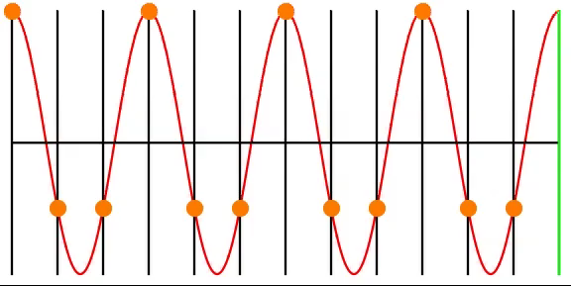
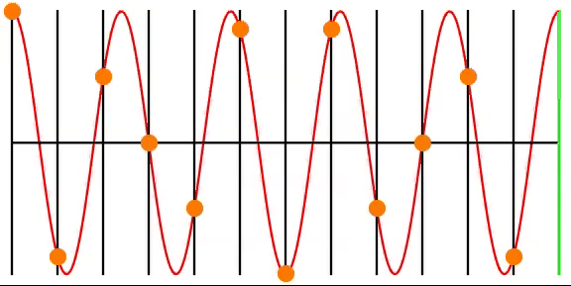
Phases
Continuous Phase-Shift
of the 4th Partial
Continuous Phase-Shift
of the 5th Partial

Slide 9
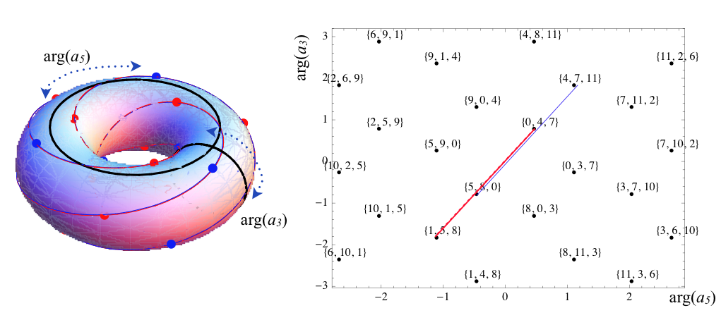
Phase spaces
A phase space is a toroidal space where the axes are phases of two (or any number) selected DFT coefficients.
from
Amiot,
MCM 2013
proceedings

Slide 10
The Mystic Chord
From the tonal period to Prometheus

Slide 11
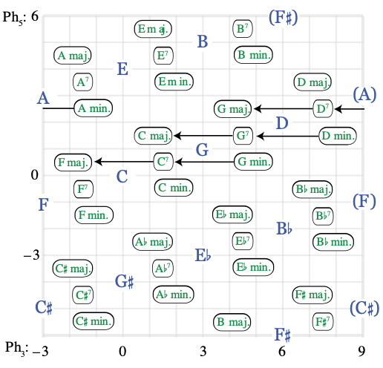
Simple tonal functions are represented by positions in a phase space on two odd DFT coefficients, f₃ and f₅ (equivalent to Krumhansl-Kessler space—see Krumhansl 1990, Cognitive Foundations of Musical Pitch).
Vertical (Ph₅) positions correspond to keys
Horizontal (Ph₃) positions correspond to basic functions, subdominant, dominant, tonic, represented by ii, V⁷, and I chords.

Slide 12
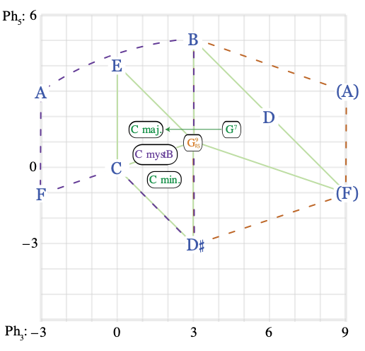
The Mystic chord first appears in tonal contexts. This example from Op. 57/1, “Désir,” is cited by Philip Ewell (2002) (“Scriabin’s Seventh Piano Sonata: Three Analytical Approaches,” Indiana Theory Review 23).
The chord is aligned with tonic, between major and minor. The tritones BF and AD# cancel out for odd-numbered coefficients, making the chord weak in this space.

Slide 13
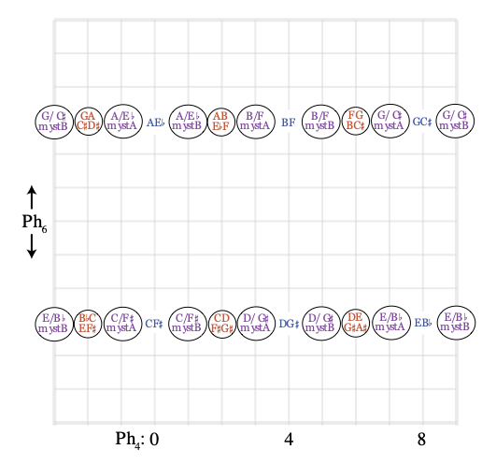
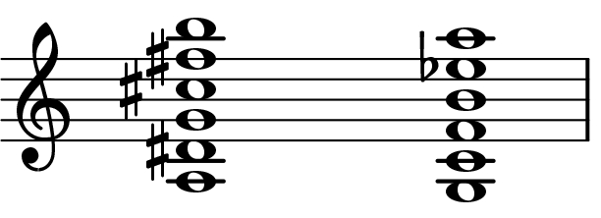
The weakness of the chord in the traditional tonal-functional space is complemented by its strength on even-numbered coefficients, f₄ and f₆. In the later non-tonal music, like Prometheus, these even-numbered coefficients take over the tonality-defining role.
Fr6th
Fr6th
A mystA
A mystB
Hence Scriabin’s claim that the chord on the left (from Prometheus) represents the tonality of A.
The tonality-determining element is now the Fr6th (whole-tone/octatonic) subset, rather than perfect 5th.

Slide 14
Octatonicity and Diatonicity

Slide 15
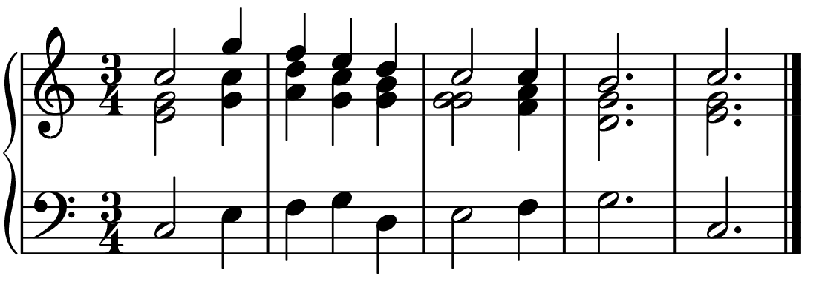
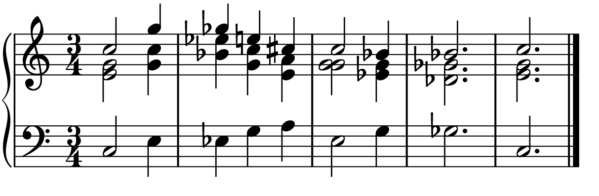
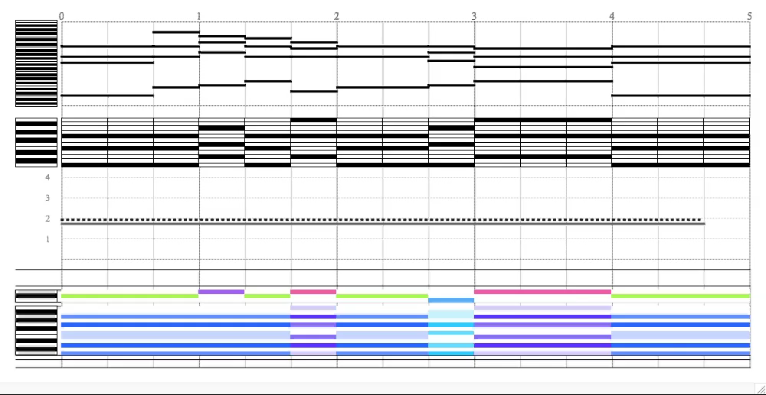
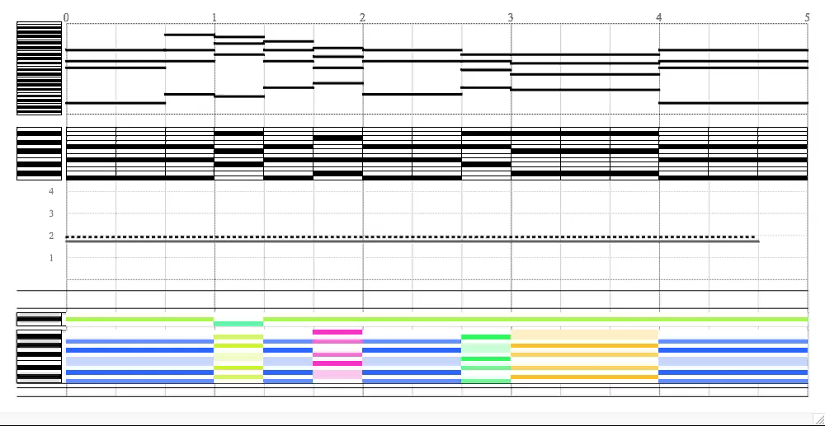

Simplified examples of diatonicity and octatonicity
Conventional tonal progression
Locally triadic, globally diatonic
Octatonic progression
Locally triadic, globally octatonic
Gray line: |f₄|, Dotted line: |f₅|
Below: Colors correspond to phase values

Slide 16
Examples
Op. 11/ 3,4
Op. 35/2
Op. 59/2
Op.74/1-5

Slide 17
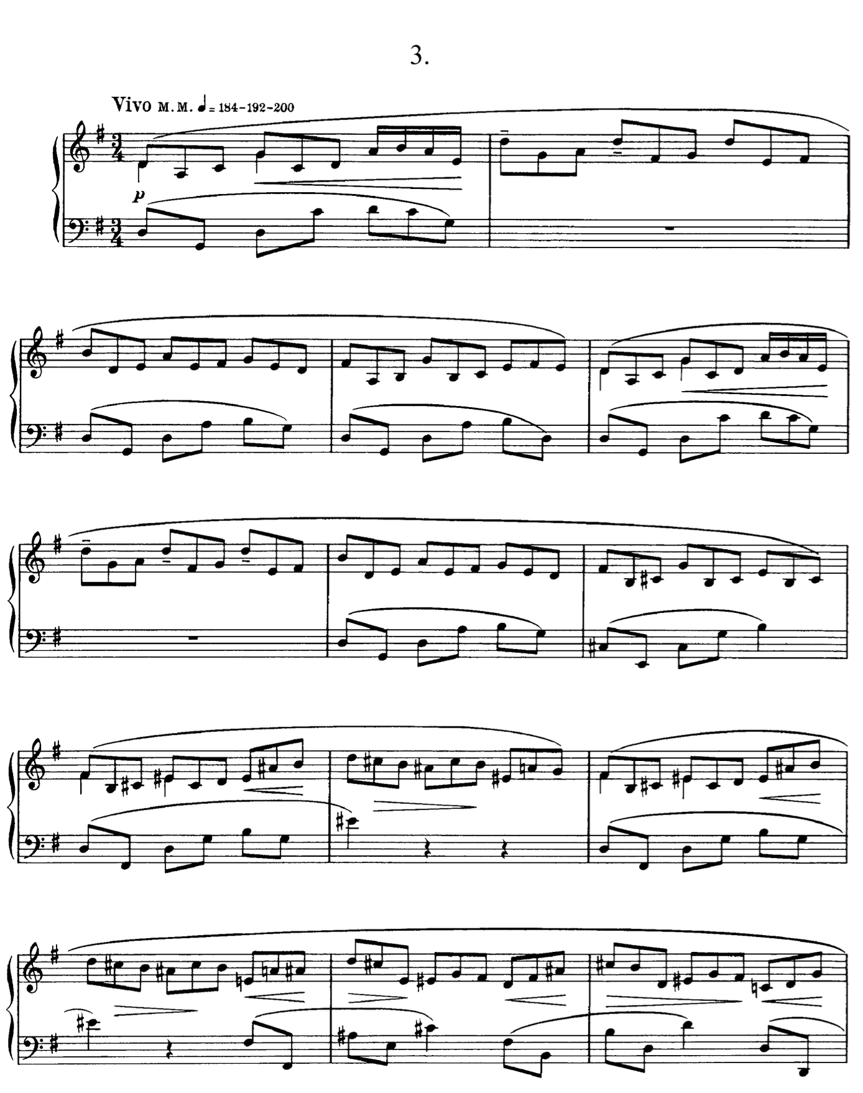
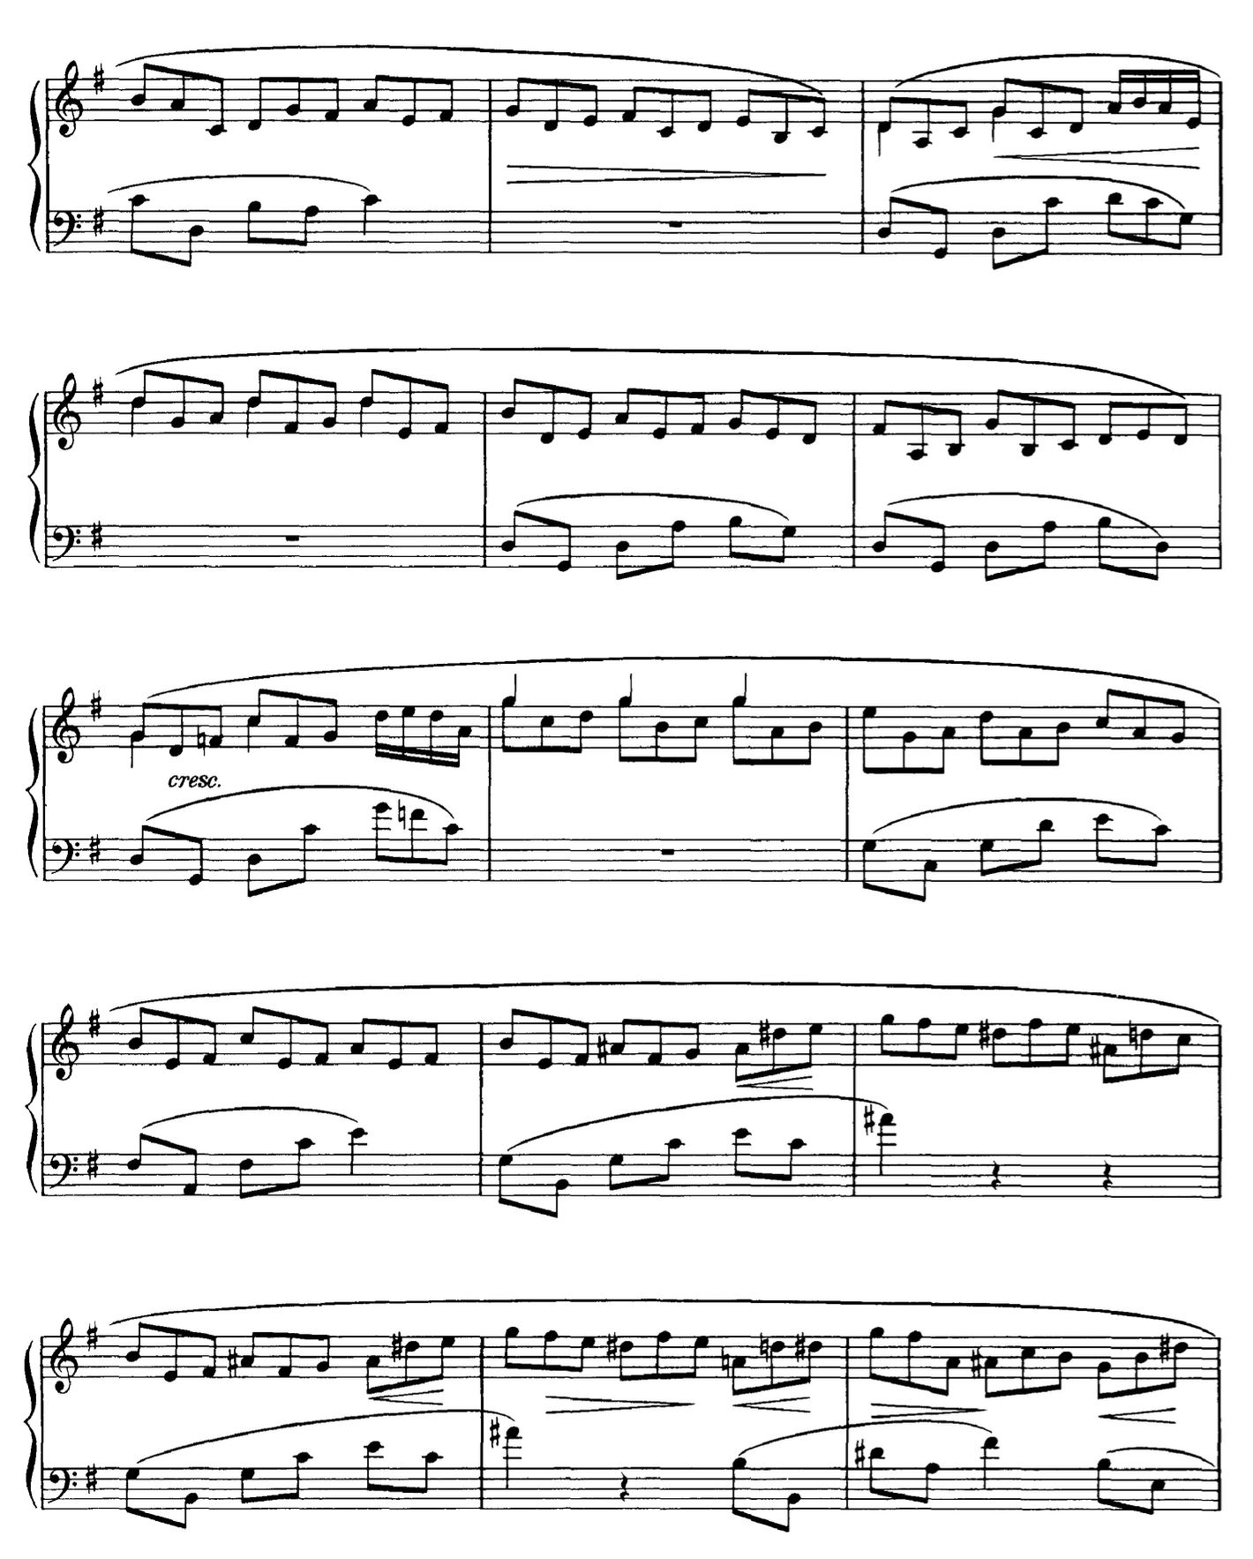
Op.11/3

Slide 18
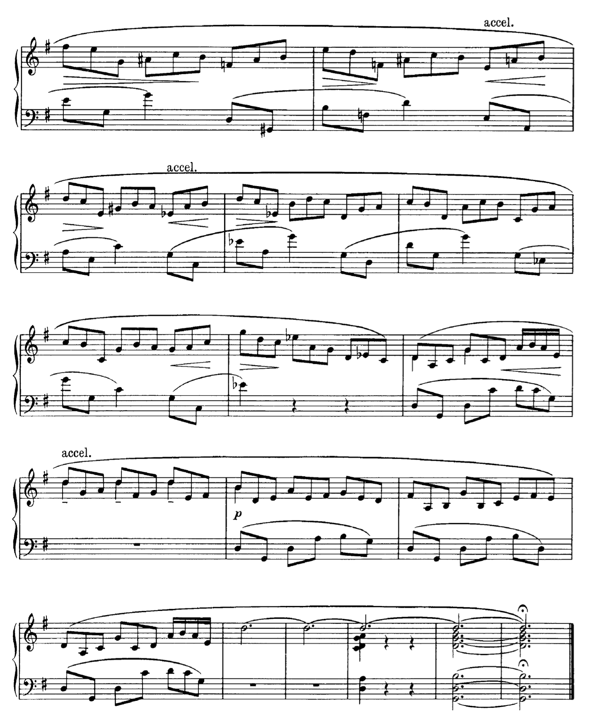
Op.11/3

Slide 19
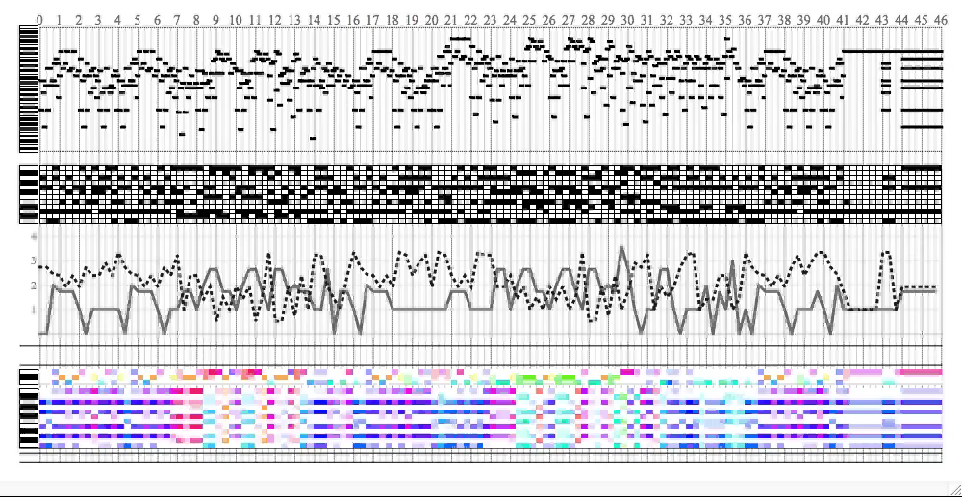
Op.11/3

Slide 20
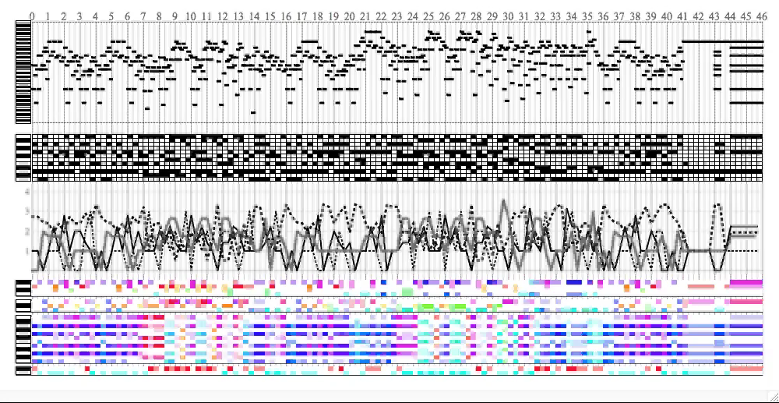
Op.11/3

Slide 21
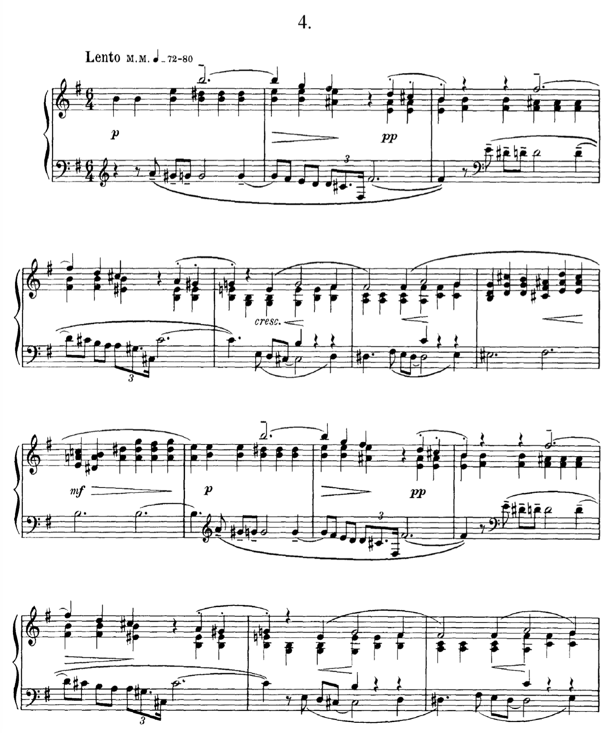
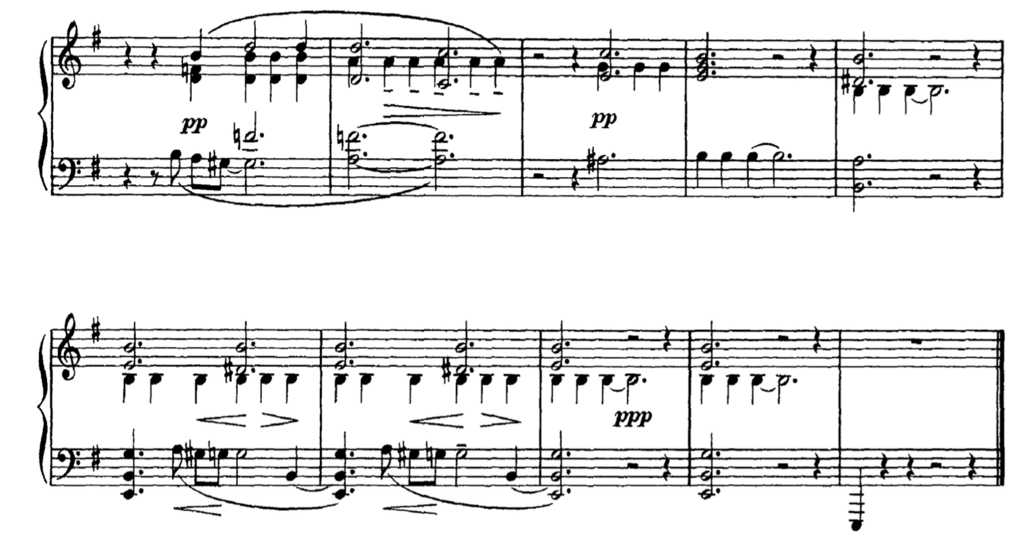
Op.11/4

Slide 22
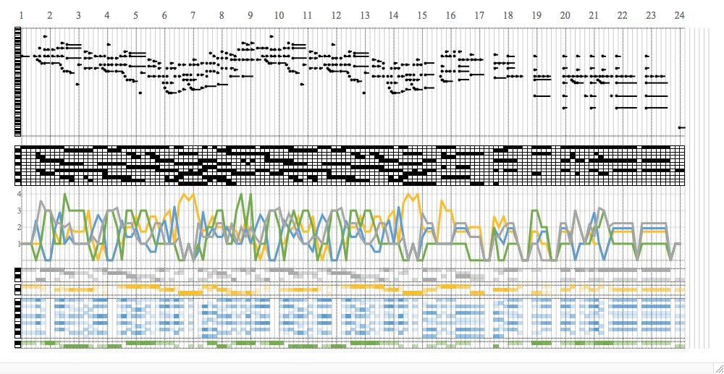
Op.11/4

Slide 23
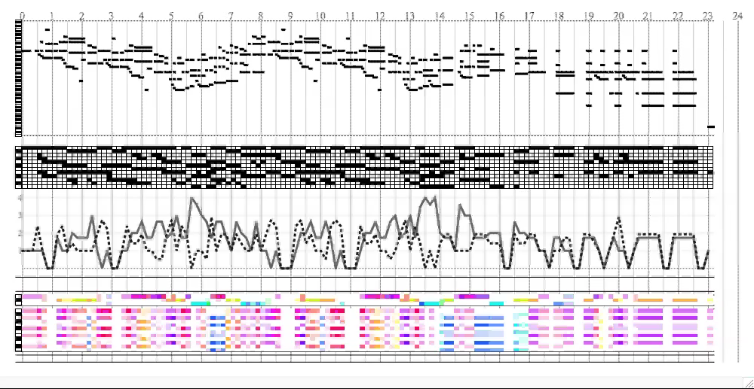
Op.11/4

Slide 24
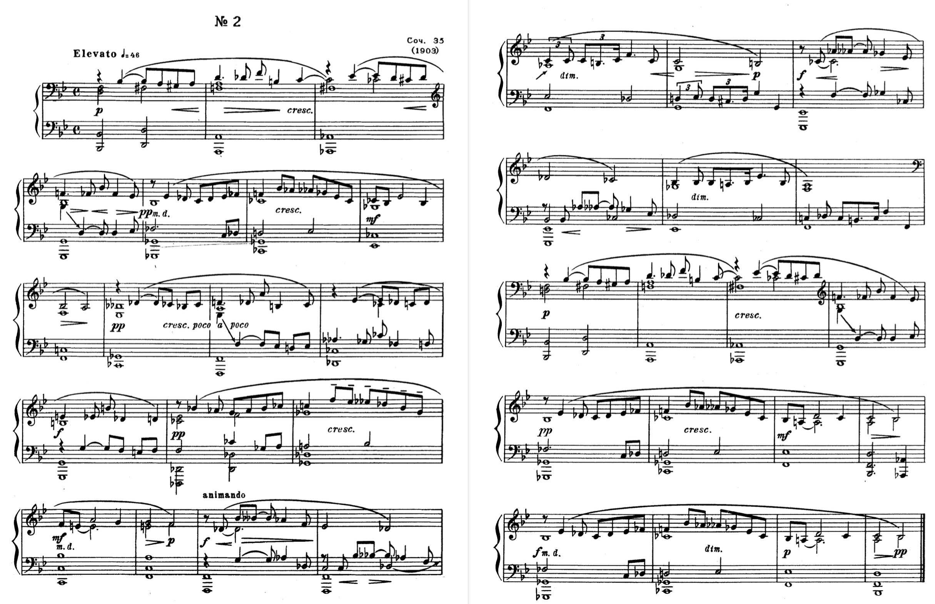
Op. 35/2

Slide 25
Op. 35/2
19
G
Cb/Eb
22
4
F
8
25
„Monte“
Cb
F
Db
12
29
„Fonte“
G
Db
G
15
33
„Fonte“
C
F
Db/F

Slide 26
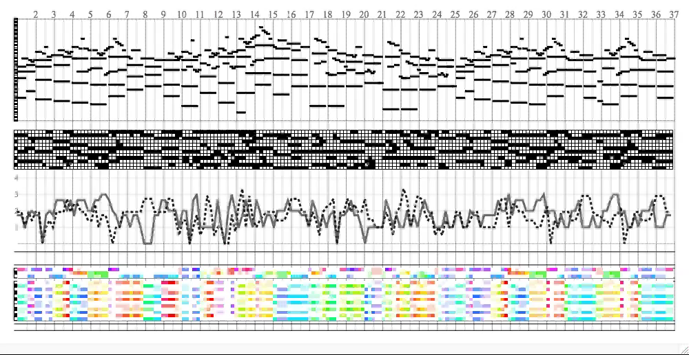
Op. 35/2

Slide 27
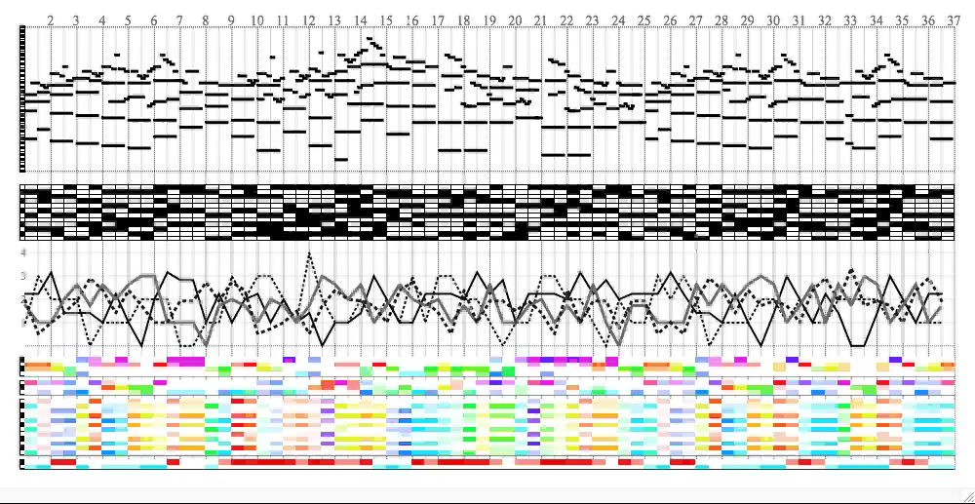

Slide 28
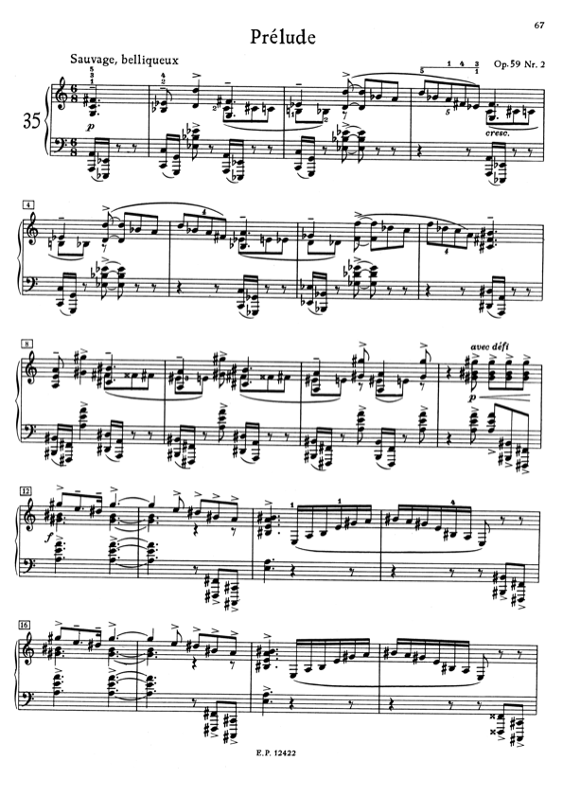
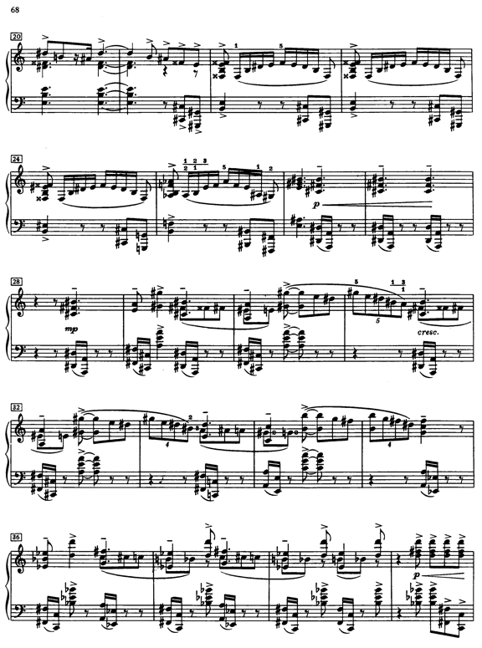

Slide 29
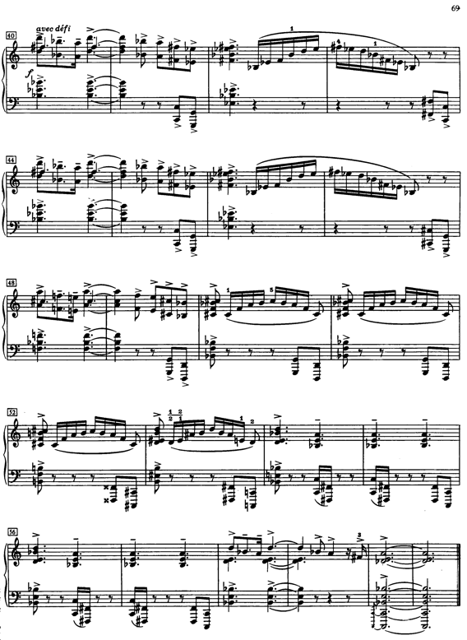

Slide 30
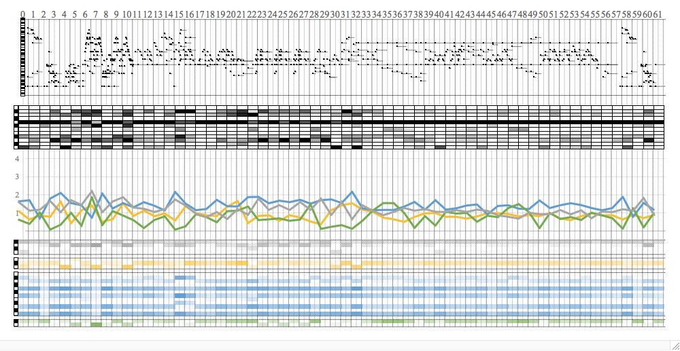
Op. 59/2

Slide 31
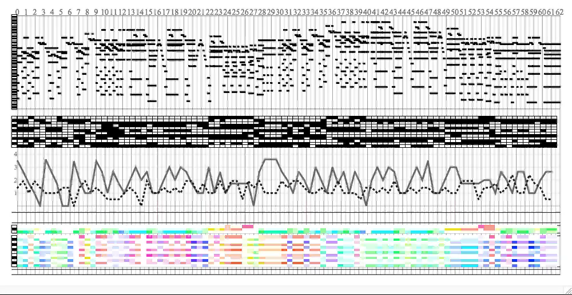
Op. 59/2

Slide 32
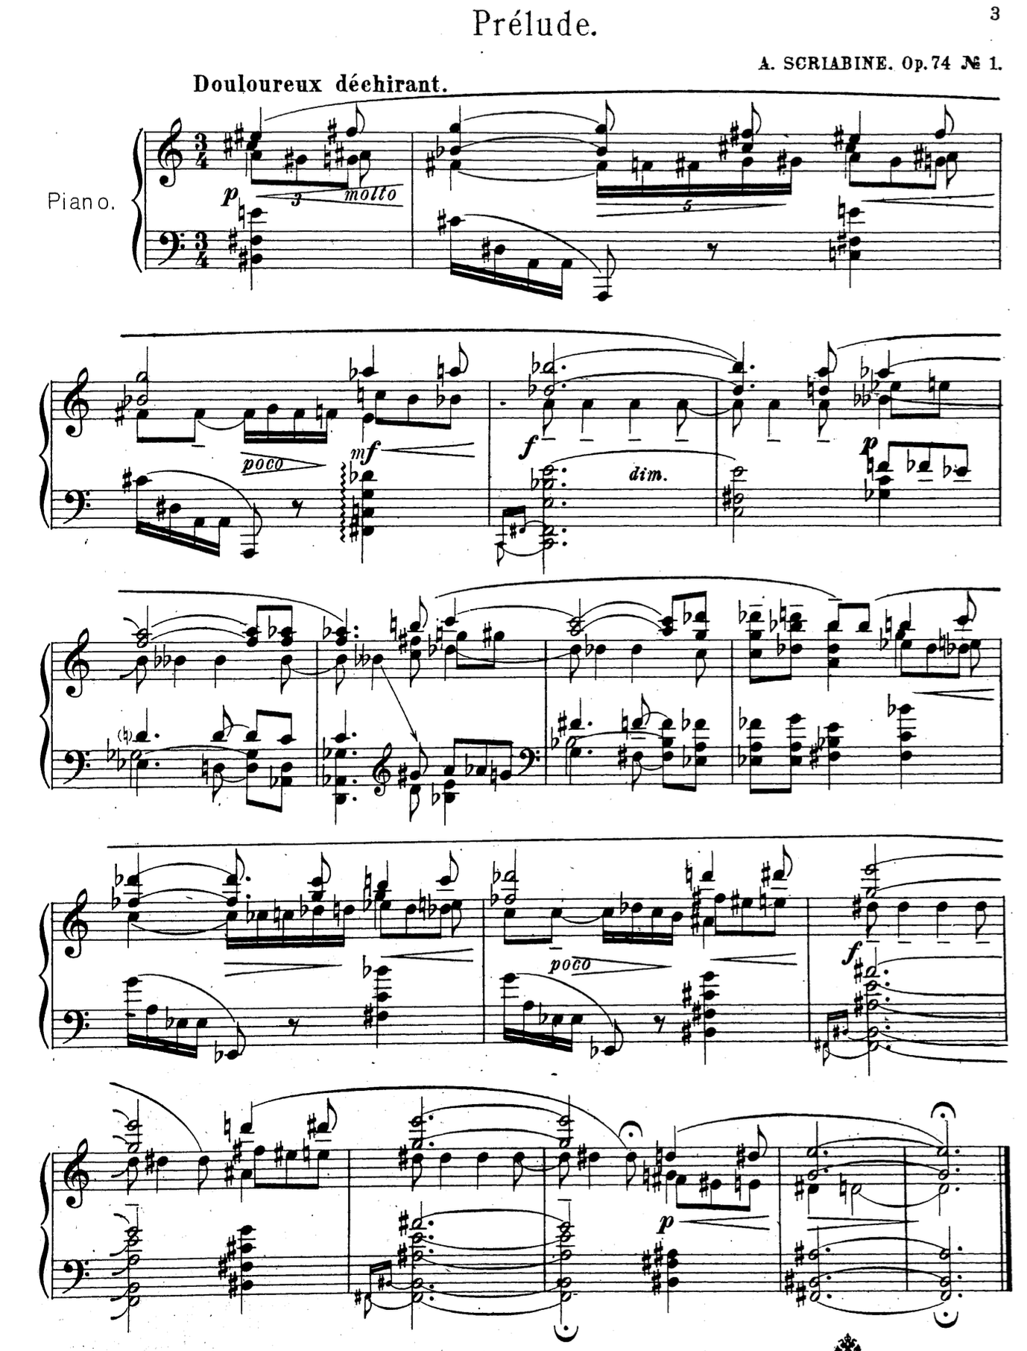
Op. 74/1

Slide 33
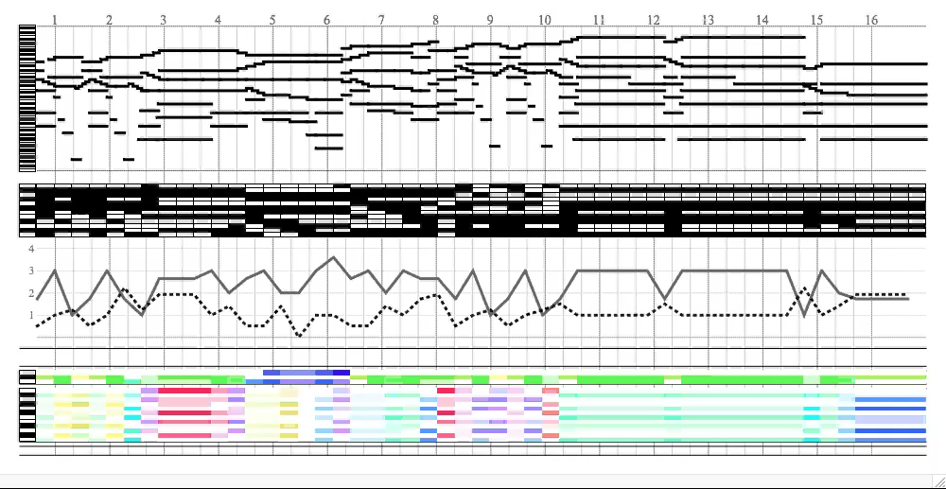

Slide 34
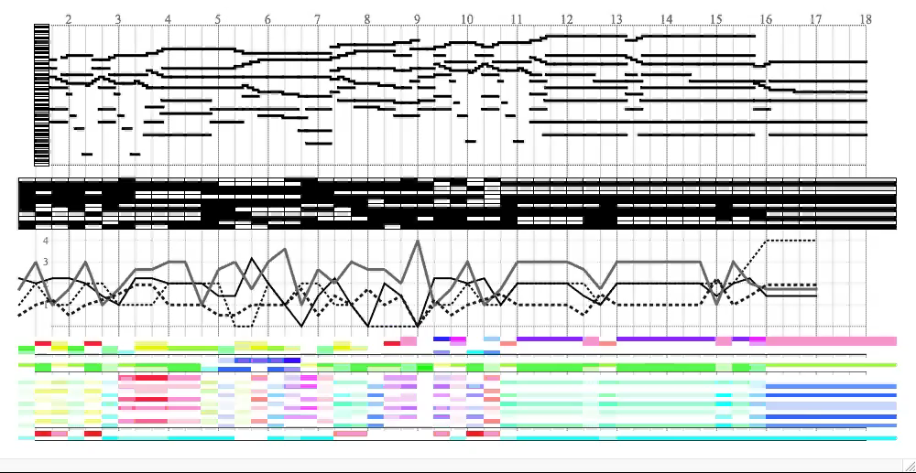
Op. 74/1

Slide 35
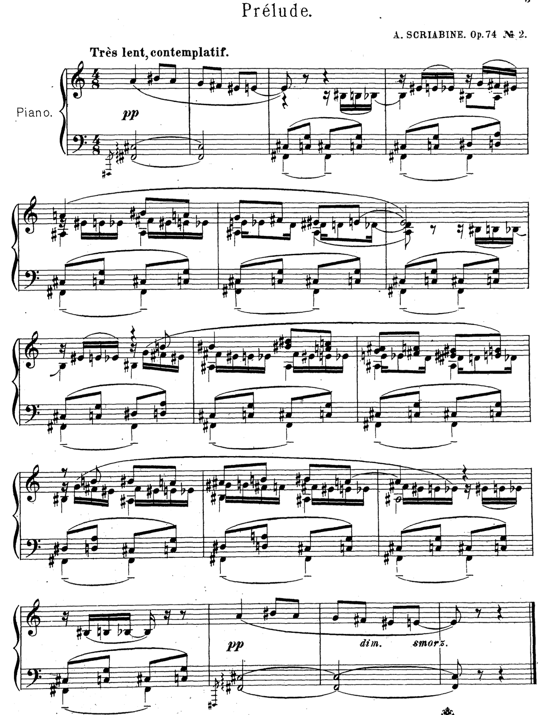
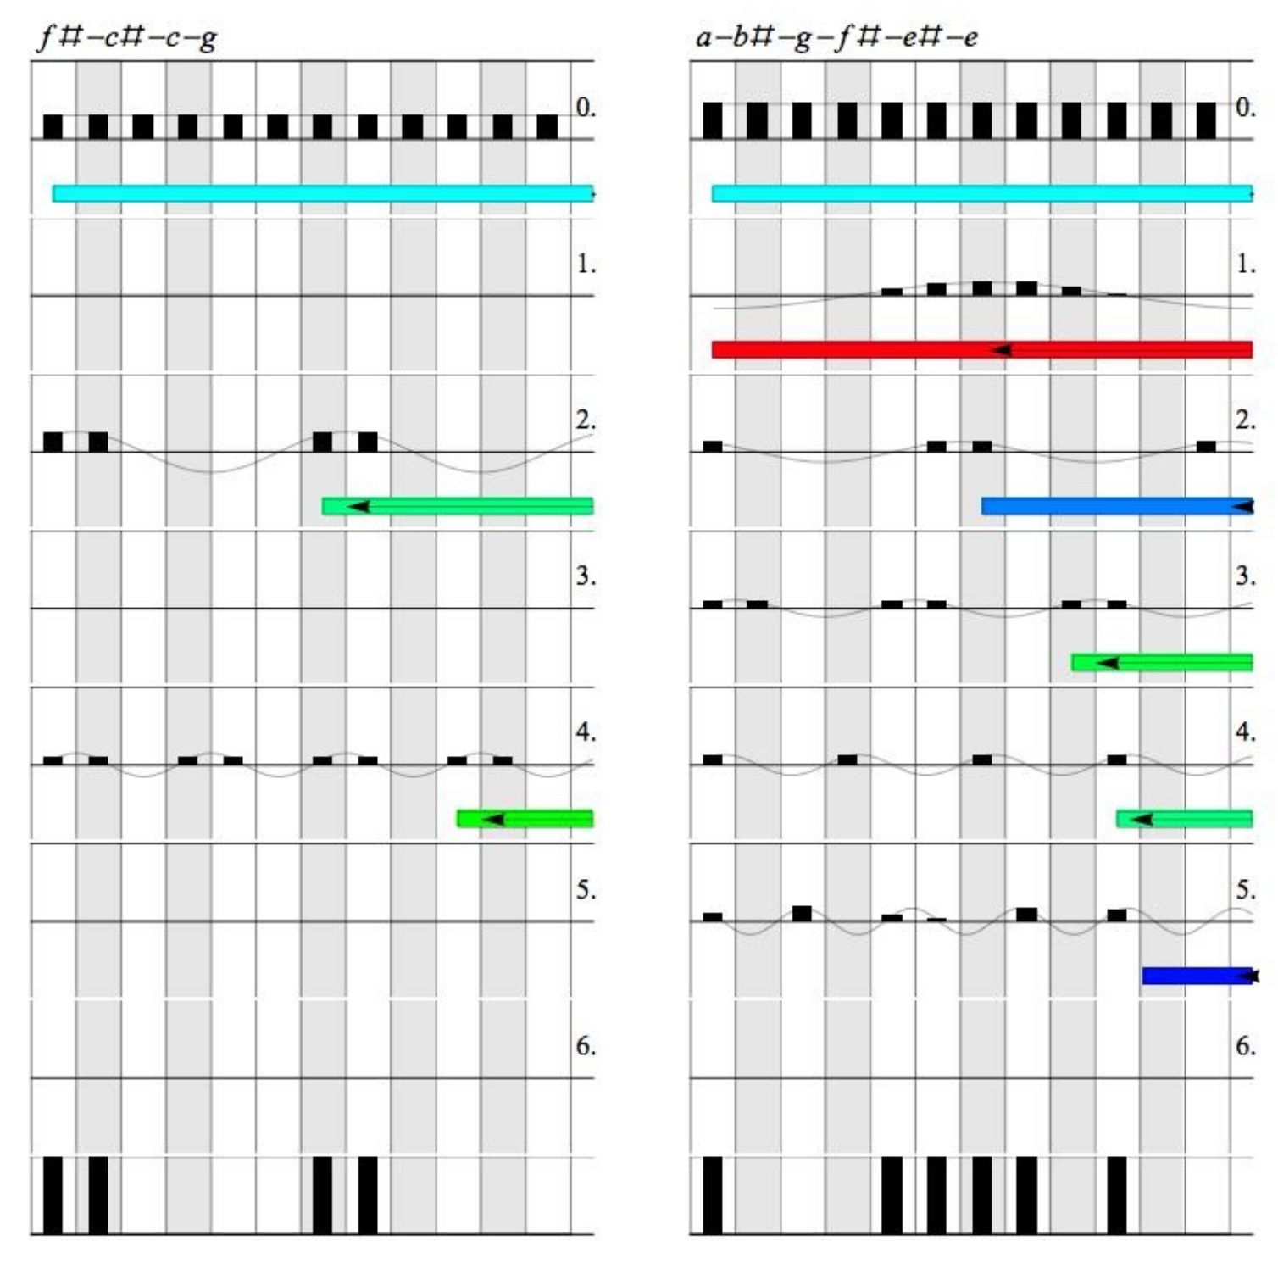
Op. 74/2

Slide 36
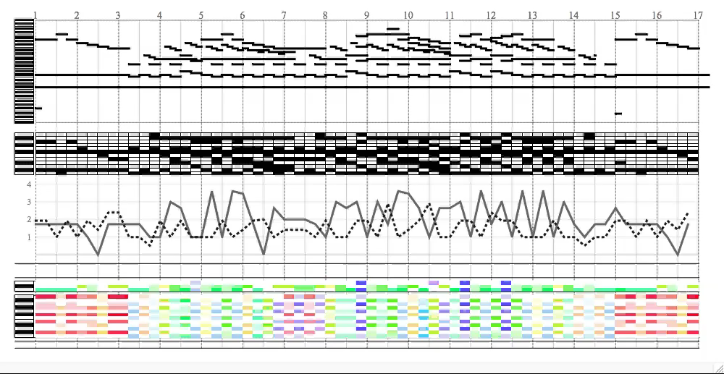
Op. 74/2

Slide 37
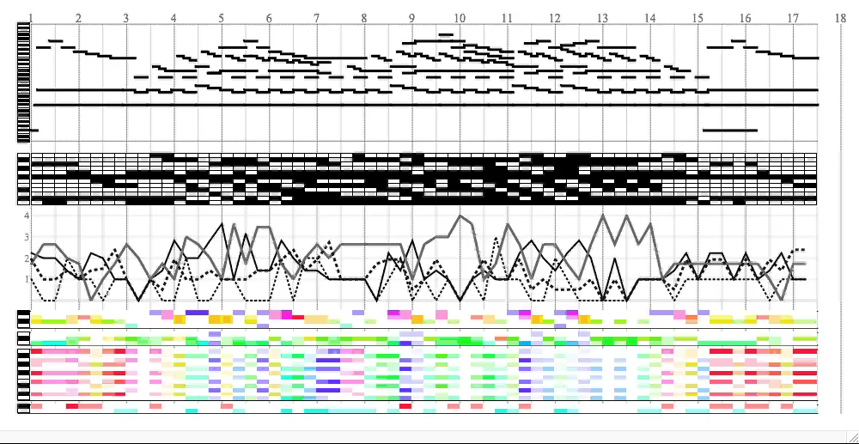
Op. 74/2

Slide 38
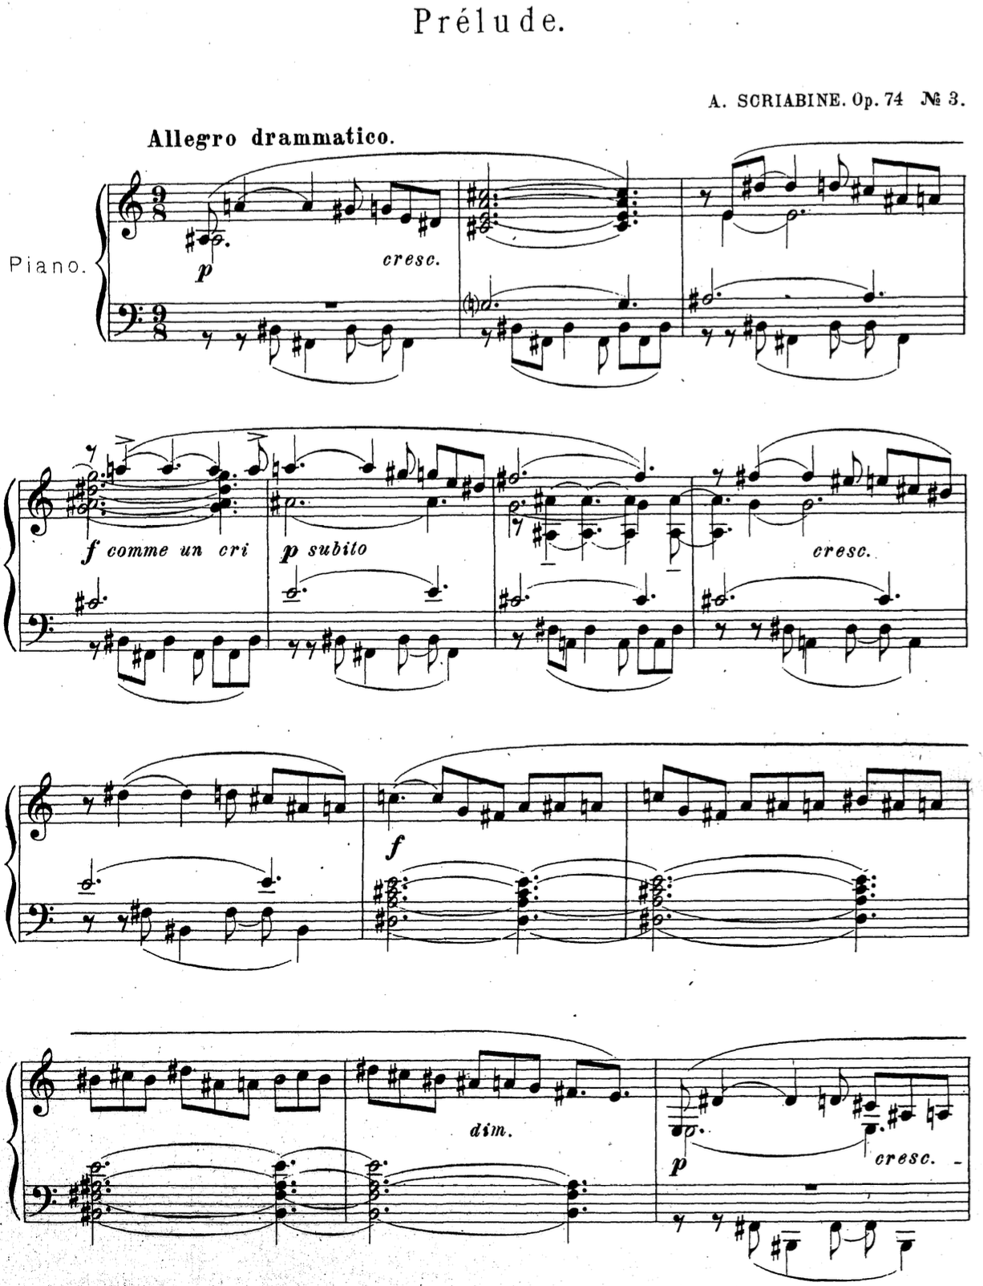
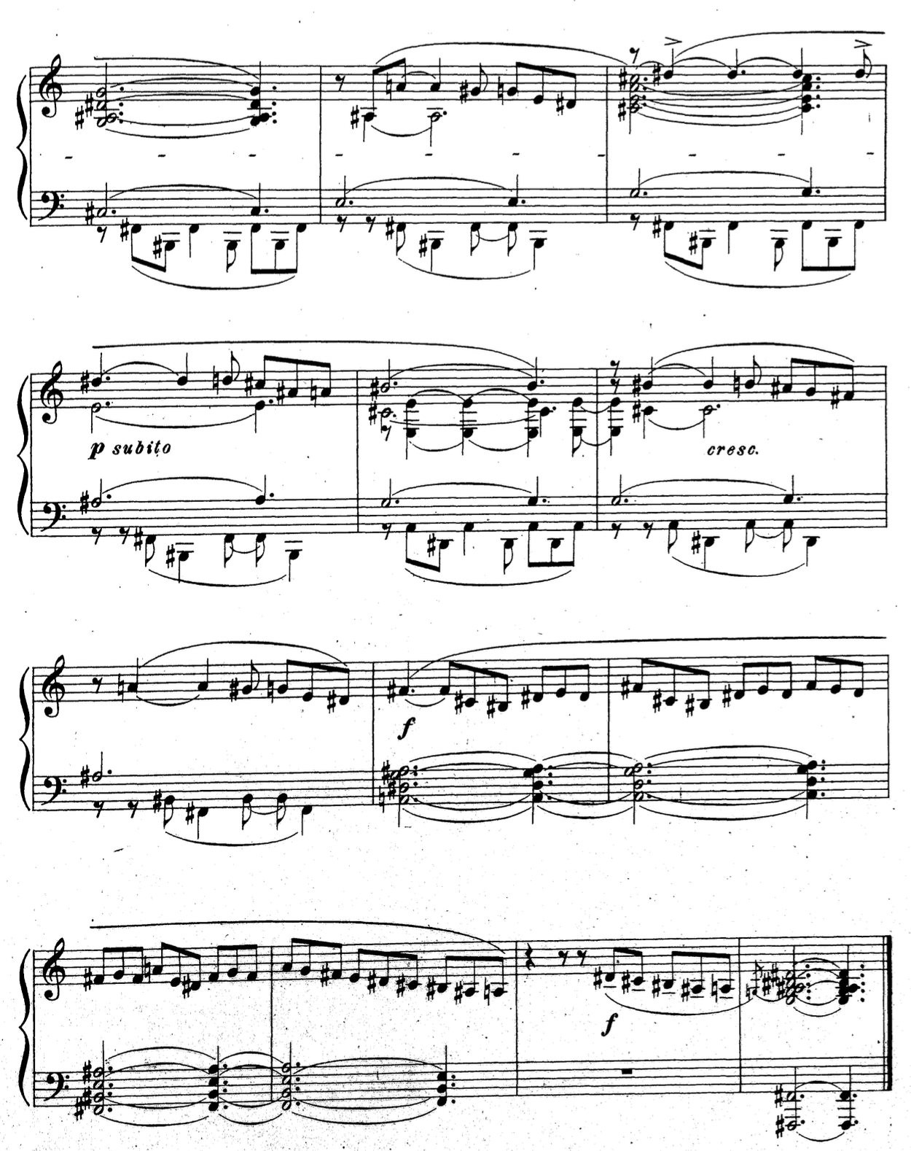
Op. 74/3
Op. 74/3
14
17
4
20
8
11
23

Slide 39
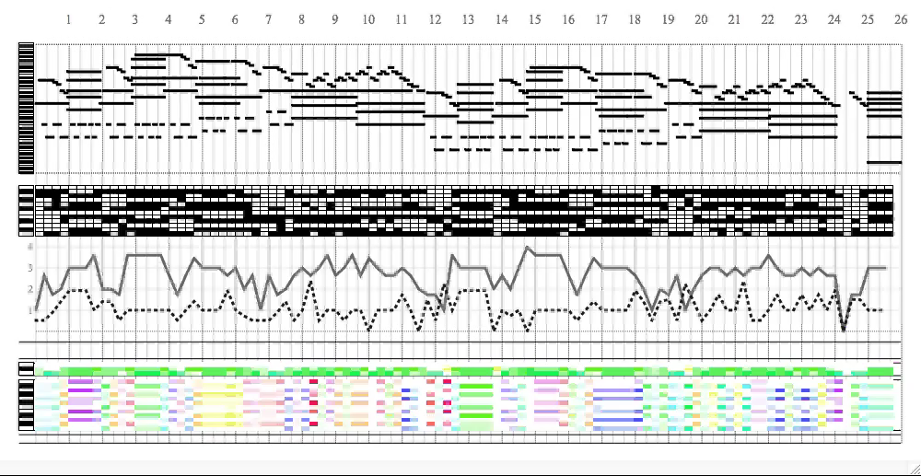
Op. 74/3

Slide 40
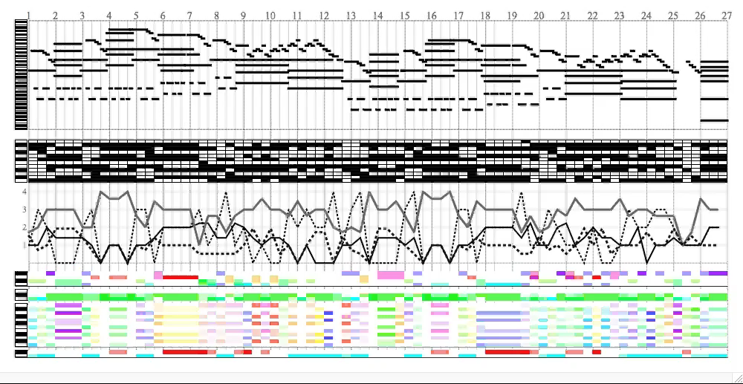
Op. 74/3

Slide 41
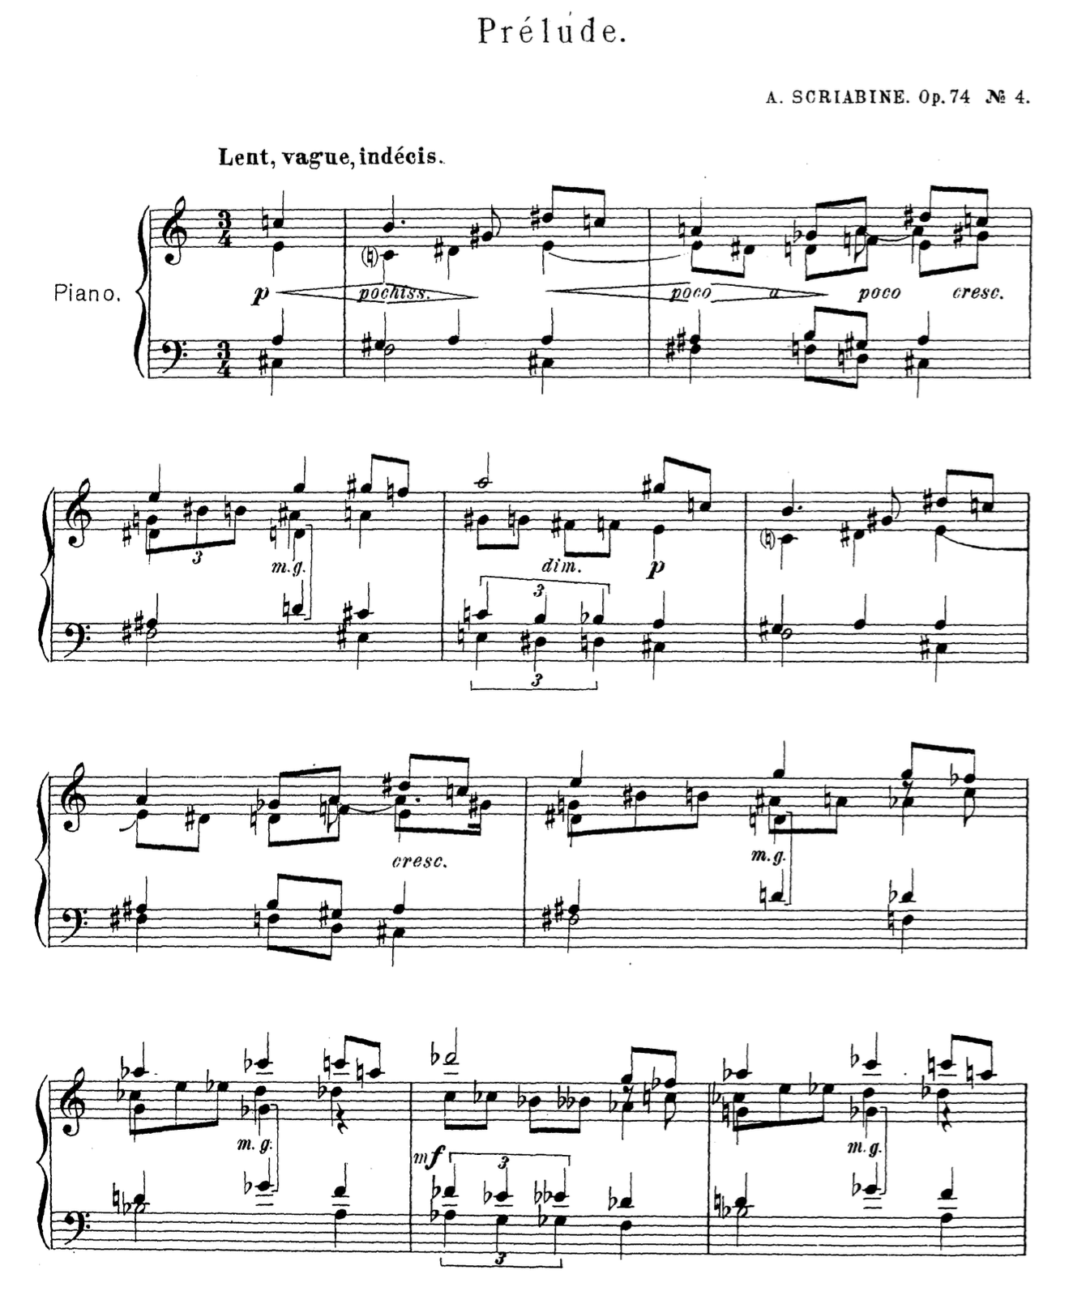

Op. 74/4

Slide 42

Op. 74/4
Hexatonic Tonality: high magnitude and moderate phase activity in the 3rd partial

Slide 43


Op. 74/5
A
A
T₈(A)
T₂(A)
B
T₆(B)

Slide 44

Op. 74/5

Slide 45


Slide 46

Op. 65/3
„Whole-Tone Tonality“

