Slide 1
C.P.E. Bach’s Symphonies and the Composer-Specific Study of Form
Jason Yust
Boston University

Slide 2
Outline
• Caplin’s formal functions and composer-specific formal universes.
• Bach’s symphonies: General features of the first movements.
• Analysis: Symphony in G major, Wq. 182 no. 1.
• Analysis: Symphony in B minor, Wq. 182 no. 5.

Slide 3
Primary Arguments
—Bach’s symphony first movements are not in sonata form, but use a distinct form that shares features with sonata form (much as concerto and sonata-rondo forms do).
—Bach’s first movement form is best described by means of formal functions (drawing on Caplin’s work).
—The essential distinguishing feature of Bach’s first movement form is that the subordinate theme functions are incomplete.
—Bach’s first movement form involves a function not described by Caplin, which I will call ritornello function.
Notes:
What are the defining features of sonata form? If sonata form is a loose collection of typical features, then it is not so much “a form” as a collection of formal functions.
Concerto and sonata-rondo are distinguished from sonata not because they lack something essential to sonata form but because they are a sufficiently consistent and predictable as formal scripts (with at least one additional feature not common to other genres, like ST ritornello or interior refrain).

Slide 4
Formal Functions and Composer-Specific Formal Universes

Slide 5
Formal Functions vs. Traditional Formenlehre
Traditional Formenlehre:
• Normative formal scripts.
• Static relationships between sections (thematic content, key, etc.).
Formal Functions: Characteristic musical processes that fulfill characteristic functions.
• Functions can be narrative: initiating, continuational, cadential.
• They can also be tonal: modulation, destabilization, confirmation.
Notes:
Examples of scripts: so-called “monothematic” design, opposing masculine/feminine themes, continuous exposition.
In traditional Formenlehre we have to treat the formal script as normative because the static, architectural concept of formal design is the only one offered offered.

Slide 6
Typical features associated with narrative functions (Harmony, motive, rhythmic organization)
Initiating gestures: Tonic prolongational harmony, new motives, melodic ideas in two-measure units.
Continuational gestures: Sequential harmony, liquidation of previous motives, fragmentation of melodic ideas into smaller units.
Cadential gestures: Cadential harmony, absence of characteristic motives.

Slide 7
Formal Functions vs. Traditional Formenlehre
In what sense is musical form a language in the later 18th century?
Metaphor of a musical “language”:
• Common across all composers, listeners.
• Not under the direct control of the composer.
Formal scripts are not a language:
• Scripts vary from composer to composer.
• Scripts vary from piece to piece. (The composer is free to manipulate them.)
Formal functions are a language.
Notes:
Metaphor: A poet has little control over which words rhyme, but has complete control over where to place rhymes in the poem (even if there are certain conventional choices such as the couplet).
Example of a formal function: repetition of a new musical idea sounds like an initiating gesture: the composer can take advantage of this principle, but they cannot change it.
The creation of novel formal functions is comparable to inventing new words. It works only in carefully constructed contexts: for example Beethoven’s Tempest Sonata and op. 130 Quartet.

Slide 8
Example
Formal Functions in a Standard 8-m. Sentence:
Formal Section | Narrative Function | Tonal Function
Presentation (mm. 1–4) | Initiation | Establish tonic harmony
Continuation (mm. 5–6) | Continuation
Cadence (mm. 7–8) | Cadential | Confirm tonic key

Slide 9
Example
Formal Functions in a Sonata Exposition:
Formal Section | Narrative Function | Tonal Function
Main theme | Initiation | Establish home key
Transition | Continuation | Destabilize home key
Subordinate theme | Cadential | Confirm subordinate key
Closing section | Post-cadential

Slide 10
Example
Formal Functions in Bach’s Symphony First Movements:
Formal Section | Narrative Function | Tonal Function
Main theme | Initiation | Establish home key
Transition | Continuation | Modulation
Inc. Subord. Theme | Cadence | Confirm subord. key
Ritornello (MT) | Initiation | Confirm subord. key
Transition | Continuation | Modulation
Etc. . . .

Slide 11
General Features of First Movements in Bach’s Symphonies

Slide 12
Features of first movements in Bach’s 18 Symphonies
(Expositions)
• Bach never uses expositional repeats.
• Second appearance of the MT idea is always in the standard SK.
• There is rarely a PAC in the the SK before the reappearance of the MT:
—In three early symphonies there is a PAC immediately before the SK rotation.
—In all other symphonies, the SK rotation is preceded by a HC in the SK or (more commonly) elides a PAC in the SK.
This means that the basic point of articulation of sonata form (the end of the exposition) is absent in Bach’s first movement form.

Slide 13
Features of first movements in Bach’s 18 Symphonies
(Recapitulations)
• Last appearance of the MT (excluding coda) is usually (not always) in the HK (e.g., behaves like a recap.).
• When the last appearance of the MT is not in the HK, it usually appears in the HK in a coda (compensatory function).
• Most of the first movements are run-on (proceed to the second movement without pause).
Bach’s first movement usually have recaps, but are more irregular than we would expect of ordinary sonata-form practice,

Slide 14
Features of first movements in Bach’s 18 Symphonies
Symphony | Key | Date | PAC in SK | Elided SK Rotation | Recap. Rotation | M.T. Coda- | Run-on
Wq. 173 | G maj. | 1741 |  | ✓ | ✓
Wq. 174 | C maj. | 1755 | ✓ |  | ✓
Wq. 175 | F maj. | 1755 | ✓ |  | ✓
Wq. 176 | D maj. | 1755 | ✓ |  | ✓ |  | ✓
Wq. 177–78 | E min. | 1756 |  | ✓ | (no MT B.I.) | ✓ | ✓
Wq. 179 | Eb maj. | 1757 |  | ✓ | ✓ |  | ✓
Wq. 180 | G maj. | 1758 |  | ✓ | ✓ |  | ✓
Wq. 181 | F maj. | 1762 |  | ✓ | ✓ |  | ✓
Wq. 182 no. 1 | G maj. | 1773 |  | ✓ | ✓ | ✓ | ✓
Wq. 182 no. 2 | Bb maj. | 1773 |  | ✓ | ✓
Wq. 182 no. 3 | C maj. | 1773 |  | ✓ | Subdom. | ✓ | ✓
Wq. 182 no. 4 | A maj. | 1773 |  | ✓ | ✓ |  | ✓
Wq. 182 no. 5 | B min. | 1773 |  | ✓ | Subdom. | ✓ | ✓
Wq. 182 no. 6 | E maj. | 1773 |  | ✓ | Subdom. |  | ✓
Wq. 183 no. 1 | D maj. | 1775–6 |  | ✓ | ✓ |  | ✓
Wq. 183 no. 2 | Eb maj. | 1775–6 |  | ✓ | ✓ | Subdom. | ✓
Wq. 183 no. 3 | F maj. | 1775–6 |  | ✓ | Submed. | ✓ | ✓
Wq. 183 no. 4 | G maj. | 1775–6 |  | ✓ | ✓ | ✓ | ✓

Slide 15
Features of first movements in Bach’s 18 Symphonies
(“Odd”? “Unorthodox”? “Eccentric”? “Incoherent”?)
James Hepokoski and Warren Darcy on Bach’s Symphonies:
They “combine an oddity of syntax with the lack of the guidepost of an expositional repeat.”
“The manner of approaching [the second rotation] is extremely unorthodox.”
“Eccentrically ‘wrong’” (referring to a moment in Wq. 182 no. 3).
Charles Rosen on Bach (from The Classical Style):
“violent, expressive, brilliant, continuously surprising, and often incoherent.”
But . . . Bach is remarkably consistent in his “unorthodox” formal principles: perhaps the sense of puzzlement comes from our insistence on shoehorning Bach’s forms into the sonata form model.
Notes:
H/D: p. 265 n. 17, Rosen, p. 44
Rosen, “Striking modulations . . . in C.P.E. Bach have remarkable and sometimes incoherent passion.”
Sonata Forms p. 143
Also:
“CPE Bach’s grandeur lacks breadth just as his passion lacks wit.” Classical Style p. 115
“Haydn’s new ‘classicism’ . . . temper[s] oddity . . . reins in eccentricity.” Classical Style p. 116 (comparison of Haydn and Bach).
Bach is sometimes portrayed as a “pre-Romantic” but his combination of musical proportion and distinct affect reflect a quintessential Enlightenment preoccupation: rational control over the human passions.

Slide 16
Analysis: Swieten Symphony (Wq. 182) no. 1 in G major

Slide 17
Swieten Symphony (Wq. 182) no. 1 in G major
• Written in 1773
• Set of six (Wq. 182) commissioned by Baron van Swieten
• For strings and continuo (no wind parts)
Formal features of the first movement
—The main theme basic idea (MT B.I.) appears five times, in G major, D major, C major, G major, and lastly in G major in a coda.
—There are only two thematic rotations, however, because the MT B.I. appears twice in each rotation.
—The second and fourth appearances of the MT B.I. are set up with a HC. The third and fifth appearances elide a PAC.

Slide 19
Swieten Symphony no. 1 (G major):
Formal features of the first movement
—The first rotation includes the main theme twice, in the HK and SK
Following the HK appearance there is a characteristic transition (featuring inversion of the primary motive of the MT).
Following the SK appearance Bach introduces a characteristic incomplete subordinate theme (featuring a contrasting, lyrical melodic idea).
—The second rotation follows the exact same pattern, except that the main theme appears first in the subdominant, then in the HK.

Slide 20
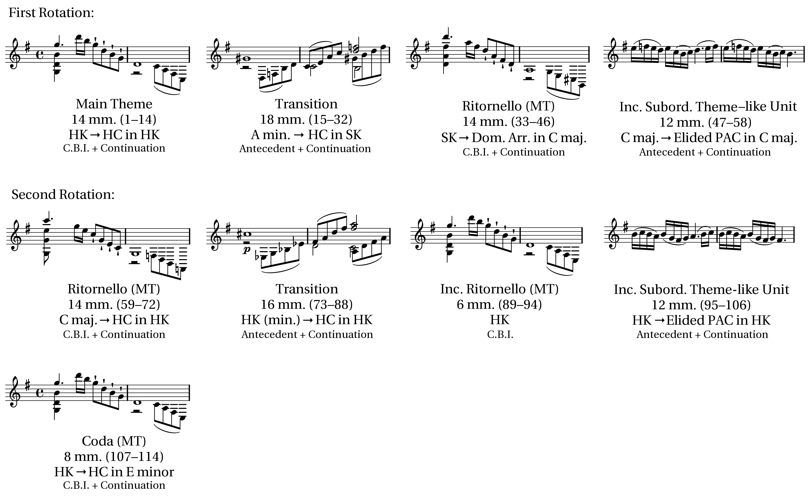
Formal Summary of Swieten Symphony no. 1 (G major)
Notes:
—Five ritornelli but two and a half rotations
—incomplete rotation is a coda

Slide 21
Swieten Symphony no. 1 (G major):
Formal features of the first movement
Hepokoski and Darcy treat the movement as a sonata form, with the C major ritornello as the recap. This implies that:
Either (1) the subordinate theme does not appear in the exposition, and is introduced in the development in the subdominant key. (Suchalla analyzes it this way, but puts the recap. halfway through the second rotation).
Or (2) there is no development, the exposition is monothematic, and the EEC is in the subdominant key. (This seems to be Hepokoski and Darcy’s analysis).
Both of these are implausible: there is no reasonable way to fit the movement into the sonata-form model. Nonetheless, it follows the basic procedures common to all of Bach’s symphony first movements.
Notes:
Elements of Sonata Theory p. 265
Suchalla p. 42

Slide 22
Swieten Symphony no. 1 (G major):
Formal features of the first movement
Formal Proportions
A typical feature of Bach’s style is the balance in the proportions of formal sections. Note here:
• The main theme/ritornello at the beginning of each rotation is the same length (14 mm.)
• The transition is only two measures shorter (16 mm.) in the second rotation.
• The ST-like unit is the same length each time (12 mm.)
• The coda (8 mm.) exactly compensates for the incomplete ritornello in the second rotation (6 mm. instead of 14).

Slide 23
Analysis: Swieten Symphony (Wq. 182) no. 5 in B minor

Slide 24
Swieten Symphony no. 5 (B minor):
Formal features of the first movement
—The main theme basic idea (MT B.I.) appears three times, in B minor (HK), D major (SK), and E minor.
—There is a clear transition and incomplete subordinate theme in the first rotation.
—The subordinate theme has a striking interpolation in a surprisingly remote key (E major). This kind of harmonically anomalous passage is a common feature of Bach’s work.
—In the second rotation the harmonically anomalous passage interrupts the transition and becomes the presentation of the subordinate theme area.
b

Slide 26
Swieten Symphony no. 5 (B minor):
Formal features of the first movement
—The formal functions of the first rotation are laid out clearly and deliberately.
A thematic correspondence is built into the first rotation itself, between the transition and the continuation of the subordinate theme.
—The second rotation modifies the transition idea (inverting one of the motives) and substitutes the interpolation idea for the basic idea of the subordinate theme.
Notes:
(both involve the motive of a descending 32nd-note scale followed by a marcato note on the beat; the continuation of the ST is a fragmented version).

Slide 27
Swieten Symphony no. 5 (B minor):
Formal features of the first movement
—The second rotation has many features in common with Bach’s sonata developments:
• Incomplete thematic and sub-thematic functions (such as the transition).
• Fragmentation by means of accelerating sequence (meas. 25–28 and 31–34).
• Sequential restatement resembling the long sequence of a core (the interpolation theme in mm. 24–26 in F minor repeated in mm. 29–30 in A minor)
#
Notes:
(both involve the motive of a descending 32nd-note scale followed by a marcato note on the beat; the continuation of the ST is a fragmented version).

Slide 28
Formal Summary of Swieten Symphony no. 5 (B minor)

Slide 29
Swieten Symphony no. 5 (B minor):
Formal features of the first movement
—The third rotation restores some of the material eliminated from the second rotation: The transition is complete and the subordinate theme has its original basic idea.
—The interpolation from the subordinate theme appears in every rotation, but changes function at each appearance. Bach recomposes it each time to fit the changing functions.
—The third rotation also incorporates some of the development of material that occurred in the second rotation into the long continuation of the subordinate theme:
• The sequential repetition of the interpolation idea in A minor.
• Incorporation of the MT B.I. into a fragmentation phrase based on different material.

Slide 30
Swieten Symphony no. 5 (B minor):
Formal features of the first movement
This first movement is typical of Bach’s symphony first movements in its incorporation of procedures characteristic of Bach’s sonata forms:
• There are three complete rotations, beginning with (1) MT in HK, (2) Ritornello in SK, and (3) Ritornello in Subdominant or HK.
• The second rotation more loosely organized, and adopts form-functional designs characteristic of development section (incomplete thematic functions, core-like use of sequence).
• However, the second rotation does not confirm a contrasting key through PAC, a typical feature of Bach’s sonata-form developments.
• The third rotation follows the first more closely (like a recap.).
Nonetheless the piece has the essential features unique to his symphony first movement form (incomplete STs and ritornello functions).
Notes:
Cite Perry’s MTS article for the third bullet.
Comparison to the highly sonata-like sonata rondos of, e.g., Beethoven’s op. 2 sonatas.

Slide 31
Summary

Slide 32
Summary
• Bach composes his forms in terms of formal functions, the common language of the 18th century.
• Bach’s symphony first movements, though sharing many of the formal functions of sonata form, are a distinct formal practice:
—They exhibit consistent features that do not belong to the sonata-form model, especially the incompleteness of subordinate themes and the use of the ritornello function.
—Some do not fit the sonata-form model at all (Wq. 182 no. 1).
—Others exhibit a greater frequency of irregularities (subdominant or submediant recaps, recaps without the MT B.I.) and are better accounted for under an alternate formal model.

Slide 33
C.P.E. Bach’s Symphonies and the Composer-Specific Study of Form
Jason Yust
Boston University

Slide 34
Selected Bibliography
Caplin, William. Classical Form: a Theory of Formal Functions for the Instrumental Music of Haydn, Mozart, and Beethoven. New York: Oxford University Press, 1998.
Hepokoski, James, and Warren Darcy. Elements of Sonata Form: Norms, Types, and Deformations of the Late Eighteenth Century Sonata. Oxford University Press, 2006.
Mandelbaum, Karen. “The late keyboard rondos of Carl Philipp Emanuel Bach: Issues of genre, form, and voice leading.” PhD diss., City University of New York, 2008.
Petty, Wayne. “Compositional techniques in the keyboard sonatas of Carl Philipp Emanuel Bach: Reimagining the foundations of a musical style.” PhD diss., Yale University, 1995.
———. “Koch, Schenker, and the Development Section of Sonata Forms by C.P.E. Bach.” Music Theory Spectrum 21/2 (1999), 151–173.
Rosen, Charles. Sonata Forms. New York: Norton, 1980.
———. The Classical Style. London: Faber, 1971.
Suchalla, Ernst. “Die Orchestersinfonien Carl Philipp Emanuel Bachs nebst einem thematichen Verzeichnis seiner Orchesterwerke.” PhD diss., Johannes-Gutenberg-Universität zu Mainz, 1968.

Slide 35
Hidden Track:
Analysis of the Berlin Symphony in E minor, Wq. 178

Slide 36
Berlin Symphony in E minor (Wq. 178):
Formal features of the first movement
The main theme idea appears four times, in E minor, G major, B minor, and again in E minor.
—The last appearance of the MT idea is in a coda.
—The second and third appearances of the MT idea are in the same thematic rotation, a rotation that features typical development-like features.
—There is a third rotation, however, but it begins midway through the main theme, eliminating the characteristic MT idea. Otherwise, the third rotation resembles a recap.

Slide 37
Notes:
—A number of places in the form rely on the unusual procedure of eliding a half-cadence. This includes:
• The beginning of the ST in the first rotation
• The beginning og the ST in the third rotation
• Most significantly, the beginning of the recapitulatory rotation
—One new thematic idea is introduced as a core in the second rotation. It derives from the transition, however, and gets assimilated into the transition in the recapitulatory rotation.
—Suchalla mistakenly puts the third section at the B minor ritornello.
—The strange parallel-minor interpolation resembles the interpolation in the later B minor symphony. It gets reused in the second rotation but never functionally repurposed like the idea in the later symphony.

