Slide 1

Probing Questions about Keys: Tonal Distributions through the DFT
MCM 2017,
Mexico City, 6/28/2017
Jason Yust, .
jason.yust@gmail.com

Slide 2
Outline of the Talk
Diatonicity, triadicity, and dyadicity
(2) Tonal distributions
• Krumhansl-Kessler space and phase space
• Corpus data in phase spaces
• Power spectra of corpus data
• Historical trends (YCAC data)
(3) Behavioral (probe-tone) data vs. corpus data
(4) Key finding: Correlation vs. Euclidean distance
(5) The tonal index: Ph₂ + Ph₃ – Ph₅ ( ≈ 0)

Slide 3
(1) Diatonicity, Triadicity, and Dyadicity

Slide 4
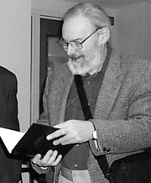


Discrete Fourier Transform on Pcsets
Lewin, David (1959). “Re: Intervallic Relations between Two Collections of Notes,” JMT 3/2
——— (2001). “Special Cases of the Interval Function between Pitch Class Sets X and Y.” JMT 45/1
Quinn, Ian (2006–2007). “General Equal-Tempered Harmony,” Perspectives of New Music 44/2–45/1
Amiot, Emmanuel (2013). “The Torii of Phases.” Proceedings of the International Conference for Mathematics and Computation in Music, Montreal, 2013 (Springer)
Yust, Jason (2015). “Schubert’s Harmonic Language and Fourier Phase Spaces.” JMT 59/1
———— (2016). “Special Collections: Renewing Set Theory.” JMT 60/2
Amiot, Emmanuel (2016). Music through Fourier Space: Discrete Fourier Transform in Music Theory. (Springer)
Notes:
This work is based on the idea of treating a pcset as a signal and taking its Fourier transform to isolate significant intervallic properties. The idea was first proposed by Lewin and further developed by Ian Quinn as a measure of set class similarity. Both Lewin and Quinn focus on magnitudes of the resulting Fourier components, which contain the transposition- and inversion-independent interval information. The current paper and Amiot’s are interested instead in the phases of the components, which contain the residue of transposition-dependent information. The phases therefore can show relationships between instances of the same set class, not just between different set classes.

Slide 5
DFT Components
The DFT is a change of basis from a sum of pc spikes
to a sum of discretized periodic (perfectly even) curves.

Slide 6
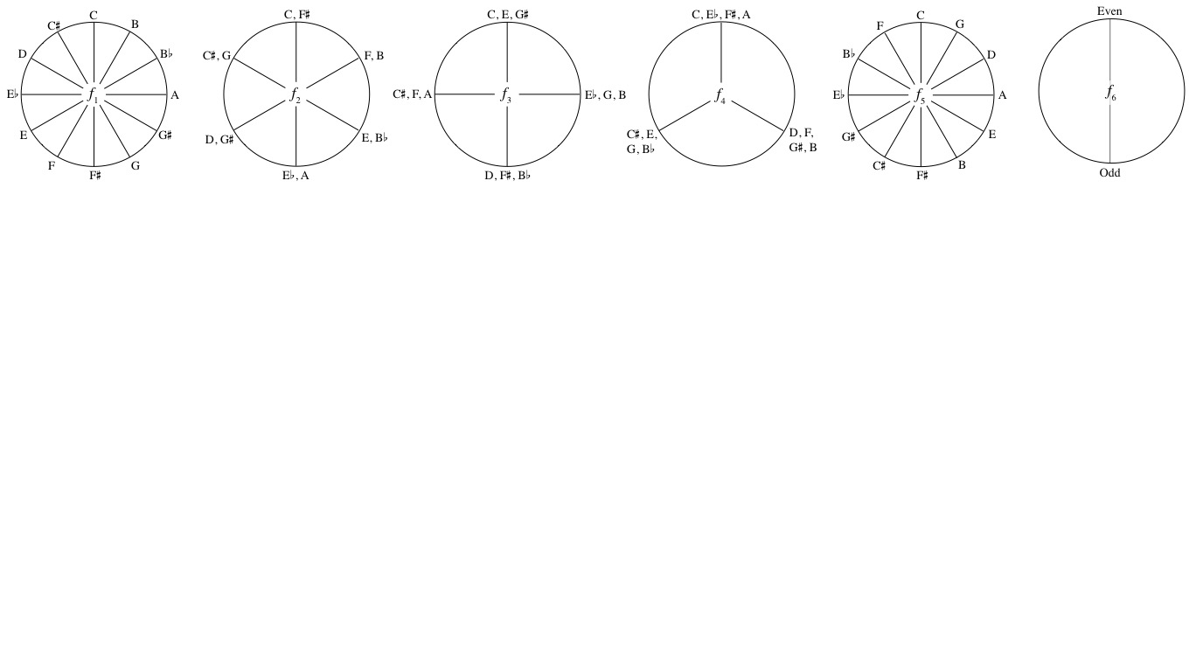
DFT in complex spaces
Each DFT coefficient (f_{n}) is a complex number.
All individual pitch classes are on the unit circle in the complex plane for each f_{n}.
Each coefficient for a pcset can be obtained as a sum of the unit vectors for each pitch class.

Slide 7
DFT in complex spaces

Slide 8
Diatonicity
Notes:
In Ph5 elements of the same key are all close together, and relative keys are close. Parallel minors are a quarter-cycle away (further than most elements of the key). Diatonics are especially large, triads somewhat less so. Major tonic and it’s dominant coincide. Diatonic is close to and in between its

Slide 9
Triadicity
Notes:
In Ph3 space triads are close to their voice-leading neighbors. Different functions in the same key are not close. Diatonics are close to and in between their possible tonics. But tonic and dominant are far apart. Parallel triads are close.

Slide 10
Dyadicity
Notes:
In Ph2 space same-root and fifth related triads are close. Major tonic coincides with dominant. Parallels are close, relatives are far apart. Most tonal set classes are not especially large.

Slide 11
(2) Tonal Distributions
• Relation of Ph₃/Ph₅-space to Krumhansl-Kessler space
• Corpus data in phase spaces
• Power spectra of corpus data
• Possible pcset models

Slide 12
Krumhasl-Kessler and phase space
MDS of Key Profiles from
Krumhansl and Kessler 1982
Ph₃/Ph₅-Space
Notes:
One familiar application of the quantity-of-pc way of thinking is the kind of statistical distribution used in key profiles (e.g. Krumhansl-Kessler 1982, Krumhansl 1990, Temperley 2007). On the left is Krumhansl and Kessler’s multi-dimensional scaling solution for key relatedness based on the correlations of the experimentally derived major and minor key profiles. In these key profiles, “quantities of pc” are average goodness-of-fit ratings for the given pc in the given context. They also have been interpreted as statistical likelihood of a note appearing in a given tonal context, or as the distribution of pcs in an actual musical passage or experimental stimulus (Temperley 2007, Temperley and Marvin 2008).

Slide 13
Krumhasl-Kessler and phase space
MDS of Key Profiles from
Krumhansl and Kessler 1982
Ph₃/Ph₅-Space
Notes:
Krumhansl and Kessler’s key-correlation space is essentially the same as the c4/c5 harmonic phase space, up to an arbitrary 90-degree rotation and reflection, and a normalization of the parameters.

Slide 14
Krumhasl-Kessler and phase space
MDS of Key Profiles from
Krumhansl and Kessler 1982
Ph₃/Ph₅-Space
(from Yust, JMT 2015)

Slide 15
Profiles from corpus data in Ph₃/Ph₅ space
In Ph₃-Ph₅ space: Krumhansl-Kessler and CBMS profiles, corpus data from Temperley 2007, Prince and Schmuckler 2014, Knopf and Hutchinson 1983, Youngblood 1958.

Slide 16
Profiles from corpus data in Ph₃/Ph₅ space
Zooming in on pc distributions in Ph₃/Ph₅-space

Slide 17
Profiles from corpus data in Ph₃/Ph₅ space
Prince & Schmuckler distributions by composer in Ph₃/Ph₅-space

Slide 18
Profiles from corpus data in Ph₂/Ph₅ space
In Ph₂-Ph₅ space: Krumhansl-Kessler and CBMS profiles, corpus data from Temperley 2007, Prince and Schmuckler 2014, Knopf and Hutchinson 1983, Youngblood 1958.

Slide 19
Profiles from corpus data in Ph₂/Ph₅ space
Zooming in on pc distributions in Ph₂/Ph₅-space

Slide 20
Profiles from corpus data in Ph₂/Ph₅ space
Prince & Schmuckler distributions by composer in Ph₂/Ph₅-space

Slide 21
Profiles from corpus data in Ph₁/Ph₄ space
Phase values of Ph₁ and Ph₄ are less consistent

Slide 22
DFT of Major Key Distributions Prince and Schmuckler (2014) data
Composer | |f₁|² | |f₂|² | |f₃|² | |f₄|² | |f₅|² | |f₆|² | Ph₁ | Ph₂ | Ph₃ | Ph₄ | Ph₅ | Ph₆
Bach | 2 | 79 | 150 | 10 | 2095 | 2 | 9.89 | 0.96 | 0.38 | 3.74 | 1.96 | 6
Mozart | 9 | 243 | 310 | 1 | 2158 | 4 | 9.34 | 11.91 | 0.96 | 8.04 | 1.66 | 0
Beethoven | 4 | 182 | 287 | 7 | 1427 | 0 | 8.31 | 11.53 | 1.34 | 6.43 | 1.53 | 6
Schubert | 7 | 127 | 337 | 18 | 1931 | 0 | 8.25 | 0.18 | 1.06 | 7.70 | 1.65 | 0
Chopin | 10 | 186 | 357 | 11 | 1638 | 1 | 7.43 | 11.72 | 1.03 | 8.22 | 1.26 | 0
Brahms | 2 | 49 | 224 | 5 | 1009 | 2 | 7.74 | 0.27 | 0.68 | 9.37 | 1.59 | 0
Liszt | 5 | 85 | 402 | 30 | 394 | 43 | 6.21 | 0.12 | 0.68 | 9.37 | 1.59 | 0
Scriabin | 11 | 117 | 352 | 47 | 2154 | 2 | 8.93 | 1.09 | 0.89 | 7.12 | 1.93 | 6

Slide 23
DFT of Minor Key Distributions Prince and Schmuckler (2014) data
Composer | |f₁|² | |f₂|² | |f₃|² | |f₄|² | |f₅|² | |f₆|² | Ph₁ | Ph₂ | Ph₃ | Ph₄ | Ph₅ | Ph₆
Bach | 8 | 69 | 208 | 49 | 1489 | 3 | 8.72 | 10.80 | 2.29 | 2.60 | 11.60 | 6
Mozart | 17 | 195 | 656 | 10 | 1515 | 6 | 8.97 | 10.53 | 2.24 | 0.15 | 11.91 | 6
Beethoven | 2 | 239 | 457 | 5 | 1150 | 16 | 6.33 | 10.18 | 2.51 | 1.73 | 11.70 | 6
Schubert | 9 | 238 | 540 | 14 | 1815 | 1 | 9.20 | 10.47 | 2.62 | 11.76 | 11.93 | 0
Chopin | 0 | 149 | 336 | 6 | 1002 | 6 | 6.57 | 10.36 | 2.39 | 2.21 | 11.88 | 6
Brahms | 9 | 194 | 390 | 2 | 847 | 19 | 8.23 | 9.89 | 1.87 | 2.14 | 11.68 | 6
Liszt | 0 | 254 | 651 | 1 | 1179 | 14 | 4.83 | 10.75 | 1.75 | 1.30 | 0.40 | 6
Scriabin | 5 | 237 | 399 | 48 | 1524 | 19 | 10.10 | 10.88 | 1.25 | 0.61 | 11.91 | 0

Slide 24
Historical Trends: YCAC data
Power spectra are squared magnitudes (ignoring phase) and allow comparisons between coefficients
Large data set from the Yale Classical Archives compiled with the assistance of Matthew Chiu
Notes:
Historical trend in |f5|, no trend in |f3| is evident, but |f2| also decreases and tracks |f5|. Dips in curve show composers “ahead of their time”: Bach, Scarlatti, Beethoven, Schubert, Liszt! And peaks are more conservative harmonists: Rameau, Zipoli, Mendelssohn, Rachmaninoff.

Slide 25
Historical Trends: YCAC data
Power spectra are squared magnitudes (ignoring phase) and allow comparisons between coefficients
Large data set from the Yale Classical Archives compiled with the assistance of Matthew Chiu
Notes:
Historical trend in |f5|, no trend in |f3| is evident, but |f2| also decreases and tracks |f5|. Dips in curve show composers “ahead of their time”: Bach, Scarlatti, Beethoven, Schubert, Liszt! And peaks are more conservative harmonists: Rameau, Zipoli, Mendelssohn, Rachmaninoff.

Slide 26
Historical Trends: YCAC data
f₂
1600s
1700s
1800s
f₃
Notes:
Effects: Phase shift in minor in f2 (lower group). Increase in f3, lower consistency in minor in 1800s.

Slide 27
Historical Trends: YCAC data
f₄
1600s
1700s
1800s
f₅
Notes:
Effects: In f5, decrease in size, not phase. Strong historical trend in f4 despite small average power

Slide 28
(3) Behavioral data vs. corpus data
• Krumhansl’s distributional model of key
• Behavioral data in Ph₃/Ph₅ space

Slide 29
Probe-tone data and corpus data
Krumhansl hypothesis (distributional model of key):
Listener expectations derive from statistical knowledge of tonal distributions,
Probe tone data should match corpus distributions
Not quite: correlations are relatively high, but phase space plots show that probe-tone data is consistently skewed towards the subdominant.

Slide 30
Probe-tone data and corpus data
Ph₃/Ph₅-plot: KK = Krumhansl & Kessler 1982, C&B = Cuddy & Badertscher 1987, BBJ = Brown, Butler, & Jones 1994, J&al = Janata et al. 2003 , S&S = Smith and Schmuckler 2004.

Slide 31
(4) Key Finding:
Correlation vs. Euclidean Distance

Slide 32
Distributional key finding
Distributional key finding algorithms
(Krumhansl-Schmuckler, Temperley, Sapp, Aarden):
  Compare a given distribution to two standard distributions transposed to twelve possible major or minor keys. The most probable key is the nearest by correlation.
  Albrecht and Shanahan (2013) variation:
  Compare distributions through 12-dimensional Euclidean distance rather than correlation.

Slide 33
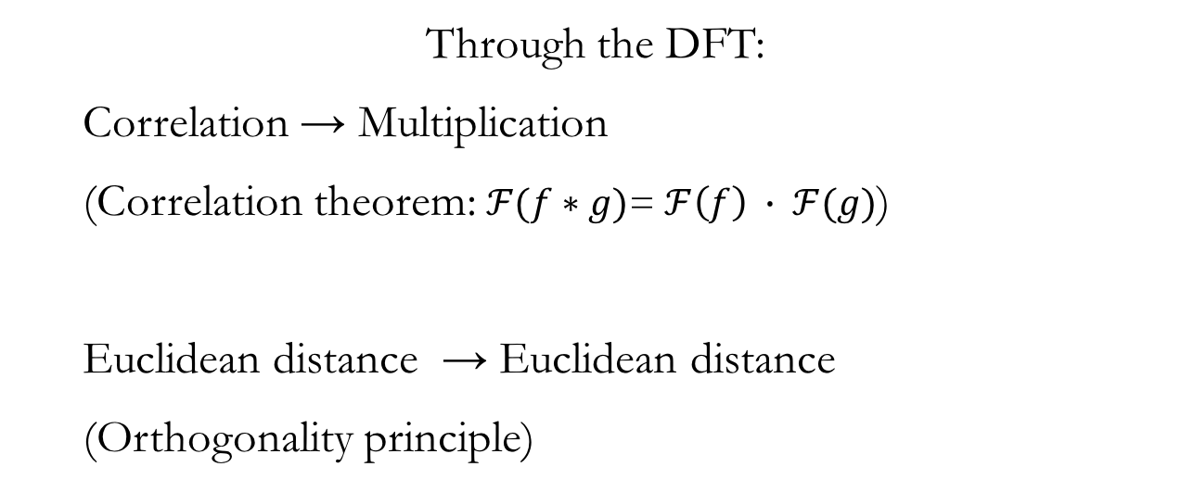
Distributional key finding
Through the DFT:
  Correlation → Multiplication
  (Correlation theorem: $ℱ(f∗g)$= $ℱ\left(f\right) ∙ ℱ(g)$)
  Euclidean distance → Euclidean distance
  (Orthogonality principle)

Slide 34
Distributional key finding
Considerations:
—Key selection requires two dimensions: one for selection of best tonic, and one for selection of mode.
—For regular tonal distributions, both methods will use Ph₅ and Ph₃ distances (or Ph₅ and Ph₂). (It is phase differences that matter, since transposition does not affect magnitudes.)
—If two or more of f₂, f₃, and f₅ are close to zero, key selection becomes less predictable, and the difference between correlation and Euclidean metric comes into play.

Slide 35
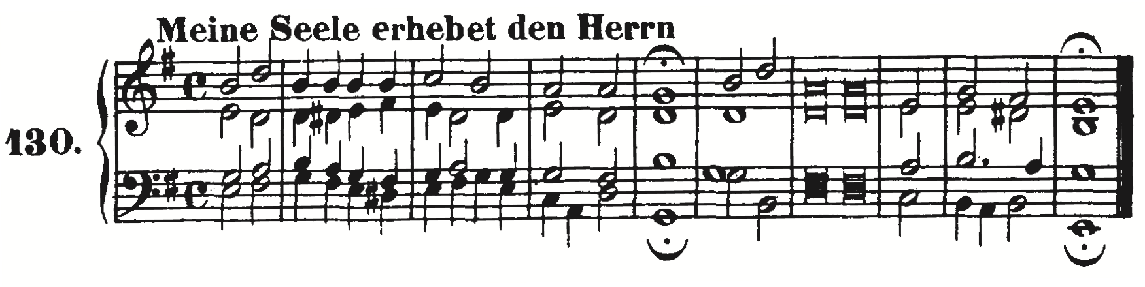
Correlation vs. Euclidean: Examples
J.S. Bach, Chorale 130:
Blue: Correlation
Red: Euclidean
Major keys:
Minor keys:
Methods agree closely when distribution is characteristically tonal:
Here both select
G major (incorrectly).

Slide 36
Correlation vs. Euclidean: Examples
Chopin, Mazurka, Op. 41/2:
Major keys:
Minor keys:
Blue: Correlation
Red: Euclidean
This piece presents a tonal ambiguity, but still both methods agree, correctly choosing
E minor.

Slide 37
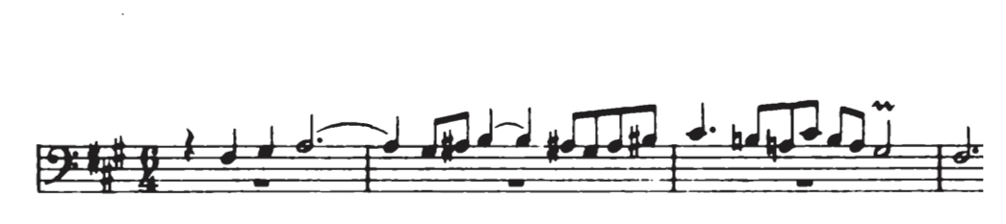
Correlation vs. Euclidean: Examples
J.S. Bach, Well-Tempered Clavier I, F# minor fugue subject:
This distribution has very low f₂ and f₃, limiting the available criteria to one dimension: diatonicity.

Slide 38
Correlation vs. Euclidean: Examples
J.S. Bach, Well-Tempered Clavier I, F# minor fugue subject:
Major keys:
Minor keys:
Blue: Correlation
Red: Euclidean
Correlation chooses
E major, incorrectly, while Euclidean metric correctly chooses
F# minor.

Slide 39
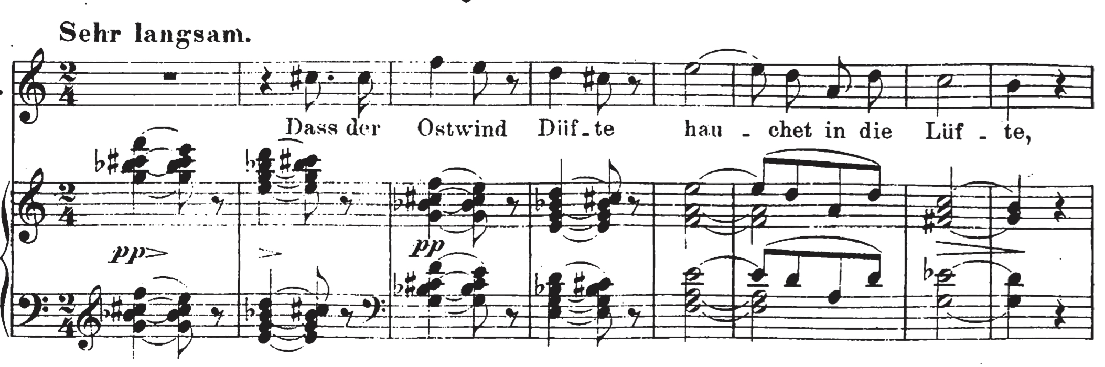
Correlation vs. Euclidean: Examples
Schubert,
“Dass
sie hier
gewesen”:
This distribution has also has very low f₂ and f₃, limiting the available criteria to diatonicity.

Slide 40
Correlation vs. Euclidean: Examples
Schubert,
“Dass
sie hier
gewesen”:
Major keys:
Minor keys:
Blue: Correlation
Red: Euclidean
Correlation correctly chooses C major, while Euclidean metric incorrectly chooses
D minor.

Slide 41
Correlation vs. Euclidean metric
Why? Correlation uses multiplication and therefore will choose the best major key, because major has a higher diatonicity. The Euclidean metric will prefer a key with a more similar f₅ which will be a smaller one, and hence will choose the best minor key.

Slide 42
(5) The Tonal Index,
Ph₂ + Ph₃ – Ph₅ ( ≈ 0)

Slide 43
Tonal index
Observation:
Ph₂, Ph₃, and Ph₅ seem to behave as if linearly dependent in tonal music. (Mathematically they are independent!)
Most tonal sets satisfy or nearly satisfy this equation:
Ph₂ + Ph₃ = Ph₅ or
Ph₂ + Ph₃ – Ph₅ = 0
The equation defines a plane in a three-dimensional phase space.
The quantity Ph₂ + Ph₃ – Ph₅ may be understood as a tonality index.
The tonality index is 0 for single pcs, fifths, and diatonic scales.
It is close to 0 (±0.61) for major and minor triads.
It ranges –1.5 to –0.2 for major profiles and 0.55 to 1.05 for minor in the Prince & Schmuckler data.

Slide 44
The following examples are generated by windowed DFT
analysis of raw MIDI. Paths are tracked over time by showing the shortest path between successive points.
Thanks to Richard Plotkin for helping to write the Python code that generated these graphs.

Slide 45

Mozart, K.310 main theme
Diatonic circle of fifths sequence
A minor
Ph₅
Ph₃
Ph₂
Tonality index: Ph₂ + Ph₃ – Ph₅

Slide 46

Corelli, Op. 4/8 Sarabande
D minor . . .
→ F major
Ascending fifths sequence
D minor

Slide 47
Corelli, Op. 4/8 Sarabande
D minor
Ph₅
Ph₃
Ph₂
F major
Tonality index: Ph₂ + Ph₃ – Ph₅

Slide 48
Corelli, Op. 4/8 Sarabande
Ascending 5ths sequence

Slide 49
Corelli, Violin Sonata, Op. 5/1 mvt. 3
Key changes gradually ascend by fifths
Sequence
descending by fifths
Sequence
Sequence
ascending by step
descending by step
Sequence descending by step

Slide 50
Corelli, Violin Sonata, Op. 5/1 mvt. 3
Key changes gradually ascend by fifths
Sequence
Sequence
descending by fifths
ascending by step

Slide 51
Corelli, Violin Sonata, Op. 5/1 mvt. 3
Sequence descending by step

Slide 52
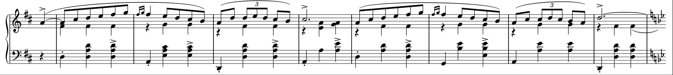
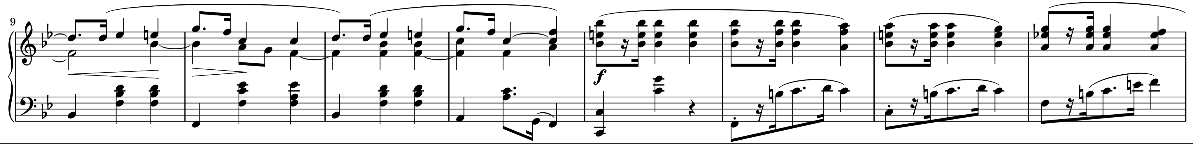
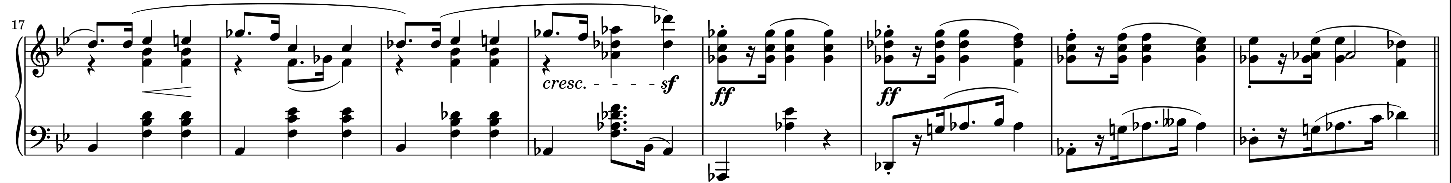
Chopin, Mazurka, op. 33/2
Example of an enharmonic cycle
D major
Bb major
Bb minor
Db major

Slide 53
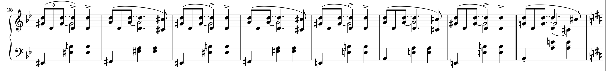
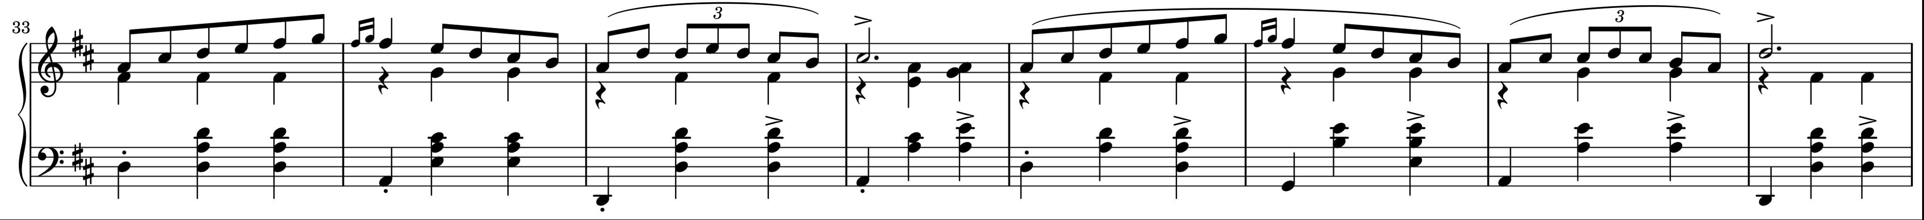
Chopin, Mazurka, op. 33/2
Example of an enharmonic cycle
F# minor
A major
D major

Slide 54
Chopin, Mazurka, op. 33/2
Ph₅
Ph₃
Ph₂
D major
Db major
Bb major
Tonality index: Ph₂ + Ph₃ – Ph₅

Slide 55
Conclusions
• Tonal distributions are dominated by f₅, f₃, and f₂. This suggests the metaphor
of tonality as a kind of band-pass filter for pitch-class distributions. Hearing
tonally means to focus on diatonicity, triadicity, and dyadicity.
• The diatonic, triadic, and dyadic phase components, Ph₅, Ph₃, and Ph₂, describe tonal closeness and distance. Therefore, we can use phase spaces constructed from these parameters to relate keys and harmonic objects.
• Typical tonal distributions are concentrated around the tonal plane defined by Ph₂ + Ph₃ – Ph₅ = 0 in Ph_{2,3,5}-space. Large deviations of the tonality index, Ph₂ + Ph₃ – Ph₅, from zero indicate tonally unstable or non-tonal harmonic states. Tonal music tends to avoid occupying such states for any substantial amount of time.
• Sequential and sequence-like progressions create different kinds of cycles in Ph_{2,3,5}-space. For example,
• Fifth progressions → Complimentary motion of Ph₂ and Ph₃.
• Ascending stepwise → Similar motion of Ph₂ and Ph₃ = tonality index cycle.
• Enharmonicism → Ph₅ cycles.

Slide 56
References
Aarden, Brent. 2003. “Dynamic Melodic Expectancy.” PhD diss., Ohio St. Univ.
Albrecht, Joshua, and Daniel Shanahan. 2013. “The Use of Large Corpora to Train a New Type of Key-Finding Algorithm: An Improved Treatment of the Minor Mode.” Music Perception 31, 59–67.
Amiot, Emmanuel. 2007. “David Lewin and Maximally Even Sets.” Journal of Mathematics and Music 1: 157–72.
———. 2013. “The Torii of Phases.” Proceedings of the International Conference for Mathematics and Computation in Music, Montreal, 2013, ed. J. Yust, J. Wild, and J.A. Burgoyne (Heidelberg: Springer).
———. 2016. Music through Fourier Space: Discrete Fourier Transform in Music Theory. (Heidelberg: Springer)
Amiot, Emmanuel, and William Sethares. 2011. “An Algebra for Periodic Rhythms and Scales.” Journal of Mathematics and Music 5/3, 149–69.
Brown, Helen, David Butler, and Mari Riess Jones. 1994. Music Perception 11/4: 371–401.
Callender, Clifton. 2007. “Continuous Harmonic Spaces.” Journal of Music Theory 51/2: 277–332.
Cuddy, Lola, and Betsy Badertscher. 1987. “Recovery of the Tonal Hierarchy: Some Comparisons across Age and Levels of Musical Experience.” Perception & Psychophysics 41/6:609–620)
Honingh, Aline K, and Rens Bod. 2010. “Pitch Class Set Categories as Analysis Tools for Degree of Tonality.” Proceeding of the 11th International Society for Music Information Retrieval Conference (ISMIR 2010), 459–464.
Janata, Petr, Jeffrey Birk, Barbara Tillmann, & Jamshed J. Bhaucha. 2003. “Online Detection of Tonal Pop-Out in Modulating Contexts.” Music Perception 10/3: 283–305.
Knopoff, L., and W. Hutchinson. 1983. “Entropy as a Measure of Style: The Influence of Sample Length.” Journal of Music Theory 27: 75–97.

Slide 57
References
Krumhansl, Carol. 1990. Cognitive Foundations of Musical Pitch. Oxford University Press.
Krumhansl, Carol, and Edward Kessler. 1982. “Tracing the Dynamic Changes in Perceived Tonal
Organization in a Spatial Representation of Musical Keys.” Psychological Review 89/4: 334–68.
Lewin, David. 1959. “Re: Intervallic Relations between Two Collections of Notes.” Journal of Music Theory 3: 298–301.
———. 2001. Special Cases of the Interval Function between Pitch-Class Sets X and Y. Journal of Music Theory 45/1: 1–29.
———. 2007. Generalized Musical Intervals and Transformations, 2nd Edition. Oxford University Press.
Martorell, A., and E. Gómez. 2011. Two-Dimensional Visual Inspection of Pitch-Space: Many Time-Scales and Tonal Uncertainty over Time. Mathematics and Computation in Music, 3rd International Conference, MCM2011 (ed. C. Agon, M. Andreatta, E. Amiot, J. Bresson, J. Mandreau: 140–150.
Prince, Jon B., and Mark Schmuckler. 2014. “The Tonal-Metrical Hierarchy: A Corpus Analysis.” Music Perception 31/3, 254–70.
Quinn, Ian. 2006. “General Equal-Tempered Harmony” (in two parts). Perspectives of New Music 44(2)–45(1): 114–159 and 4–63.
Sapp, Craig. 2011. “Computational Methods for the Analysis of Musical Structure.” PhD Diss., Stanford Univ.
Smith, Nicholas, and Mark Schmuckler. 2004. “The Perception of Tonal Structure through the Differentiation and Organization of Pitches.” Journal of Experimental Psychology: Human Perception and Performance 30 (2): 268–86.
Temperley, David. 2001. Cognition of Basic Musical Structures. MIT Press.
———. 2007. Music and Probability. MIT Press.

Slide 58
References
Youngblood, J.E. 1958. “Style as Information.” Journal of Music Theory 2: 24–35.
Yust, Jason. 2015a. “Applications of DFT to the Theory of Twentieth-Century Harmony.” Proceedings of the Fifth International Conference for Mathematics and Computation in Music, MCM2015 (Heidelberg: Springer): 207–18.
———. 2015b. “Restoring the Structural Status of Keys through DFT Phase Space.” Proceedings of
the International Congress for Music and Mathematics (forthcoming).
———. 2015c. “Schubert’s Harmonic Language and Fourier Phase Space.” Journal of Music Theory 59/1, 121–181.
———. 2016. “Special Collections: Renewing Set Theory.” Journal of Music Theory 60/2: 213–262

Slide 59
Probing Questions about Keys: Tonal Distributions through the DFT
MCM 2017,
Mexico City, 6/28/2017
Jason Yust, .
jason.yust@gmail.com

Slide 60
Appendices

Slide 61
Possible pcset models of distributions: Minor
The power spectra of distributions are most similar to a diatonic scale with doublings, but the match is not perfect.

Slide 62
Possible pcset models of distributions: Major
Can data be explained by resemblance to common pcsets?
All of these examples are consistently more than a standard deviation from the Prince & Schmuckler data by composer in f₁–f₅.

Slide 63
Possible pcset models of distributions: Minor
Can data be explained by resemblance to common pcsets?
All of these examples are consistently more than a standard deviation from the Prince & Schmuckler data by composer in f₁–f₅.

Slide 64
Stravinsky, Piece for String Quartet no. 3
A non-tonal example

Slide 65
Ph_{2,3}-space
Single pcs and
diatonic scales:
Ph₂ + Ph₃ – Ph₅ = 0
(Ph₅ = 0, 1, 2, . . .)
Fifths:
Ph₂ + Ph₃ – Ph₅ = 0
(Ph₅ = 0.5, 1.5 . . . )
Maj. Triads: Ph₂ + Ph₃ – Ph₅ = –0.61
Min. Triads: Ph₂ + Ph₃ – Ph₅ = 0.61
(Ph₅ = 0.5, 1.5 . . . )

Slide 66
Mozart, K.310 development
Tonality index: Ph₂ + Ph₃ – Ph₅

Slide 67
Tonal Motion
Temperley’s example:
C major
?? (E minor?
A minor?)
Or:
C minor
E minor?

Slide 68
Tonal Motion
FB
CE

Slide 69
Tonal Motion
FC
EB

Slide 70
Tonal Motion
FC
CEb
BD#

Slide 71
DFT Components
Quinn’s generic prototypes are pcsets that maximize a given component by approximating a sinusoidal function of the given periodicity.

Slide 72
DFT Components
We can also define prototypes for mixtures of components by approximating sums of sinusoidal functions

