Slide 1
Philip II of Spain and the Power of Money:
Castile and the Habsburg inheritance
Carlos Álvarez-Nogal (U. Carlos III, Madrid) and Christophe Chamley

Slide 2
References
All with Carlos Álvarez-Nogal
Debt policy under constraints between Philip II, the Cortes and Genoese bankers," (2013), The Economic History Review 192-213.
Philip II against the Cortes and the credit freeze of 1575-1977," (2016), Revista de Historia Economica, 1, 1-32.
Asientos as sinews of war in the composite superpower of the 16th century," (2021),The European Review of Economic History, 25, 703-722.
Renancing short-term debt with a xed monthly interest rate into funded juros under Philip II: an asiento with the Maluenda brothers," (2018),The Economic History Review, 1100-1117.

Slide 3
Doxa (economic history)
Conklin, J. (1998). “The Theory of Sovereign Debt and Spain under Philip II, Journal of Political Economy, 106(3), 483-515.
  Application of Sovereign debt model with penalty for default.
Drelichman M. and H.-J. Voth (2014). Lending to the Borrower from Hell, Princeton U. Press.
Reinhardt, C. and K. Rogoff (2009). This Time is Different: eight Centuries of Financial Folly, Princeton U. Press.
  “Serial defaults”, “Spain’s thirteen defaults from the 1500s on”. Spreadsheet history.

Slide 4
This book
Three suspension of payments to the bankers (1557-1560, 1575, 1596)
Not sovereign loans, (Genoese bankers agents of the Crown)
Analogy: 2011 U.S. debt-ceiling crisis
The Cortes resisted a ceiling on the interest payment of the debt (equiv. to a stock on the debt)
1575-77: attempt by Philip to triple the taxes for debt service
Payment stop to the bankers freezes the credit market for more than two years. At the end, doubling of the tax
Other suspensions, same issue.
Main lesson: use the economic mechanism for a better understanding of the relation between the Crown and the realm of Castile in the 16th century, here Philip II and the Cortes (which represent the main cities).

Slide 5
Overall structure
1: Castile in the 16th century: markets, banks and credit
  Cities
  Commercial fairs
  Revenues
  Long-term debt
  Model
2: The upward phase of the reign (1550-1571)
  The 1557-60 debt restructuring and new encabezamiento (contractual contribution of the cities)
3: The main confrontation with the cities (1572-1577)
  Obstruction in the Cortes, towards the crisis (1572-1575)
  The Decreto of 1575
  The crisis in the credit market
  War of attrition between the Crown and the cities (1576-77) and resolution
4: The latter part of the reign (1580-1598)
  Financing in Flanders
  Exploiting the Armada’s disaster: the Millones
  Two asientos:
    (Fiesco asiento: from fountains in Castile to streams in Flanders
    The Maluenda asiento: mesadas with an option to refinance in juros
  The failure to renew the millones and the last crisis

Slide 6
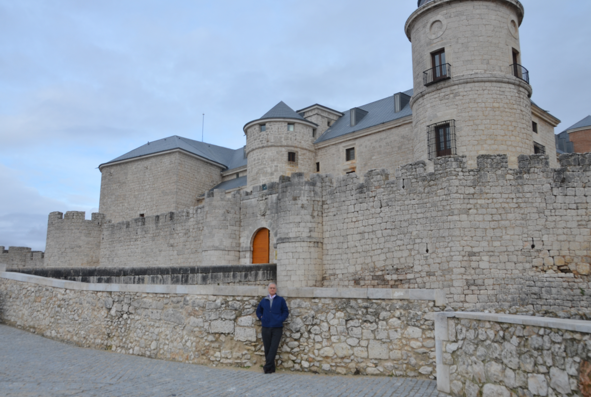
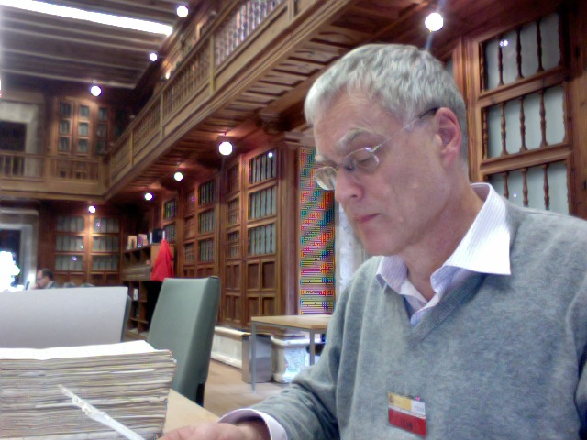
Asientos (contract with bankers)
Archival research in Simancas (200km NW of Madrid)
Philip II was a man of paper
Castle set by Philip II
to hold the archives

Slide 7
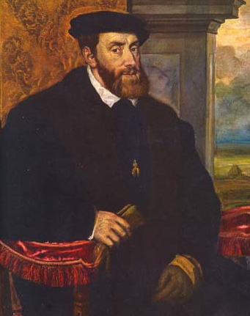
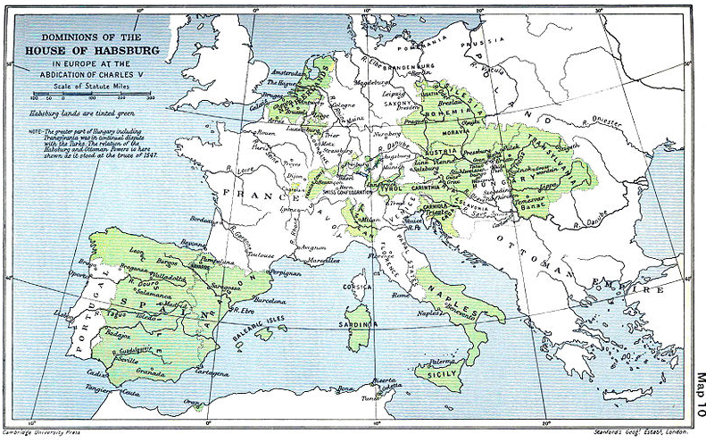
Charles V (Carlos V), 1519-1556

Slide 8
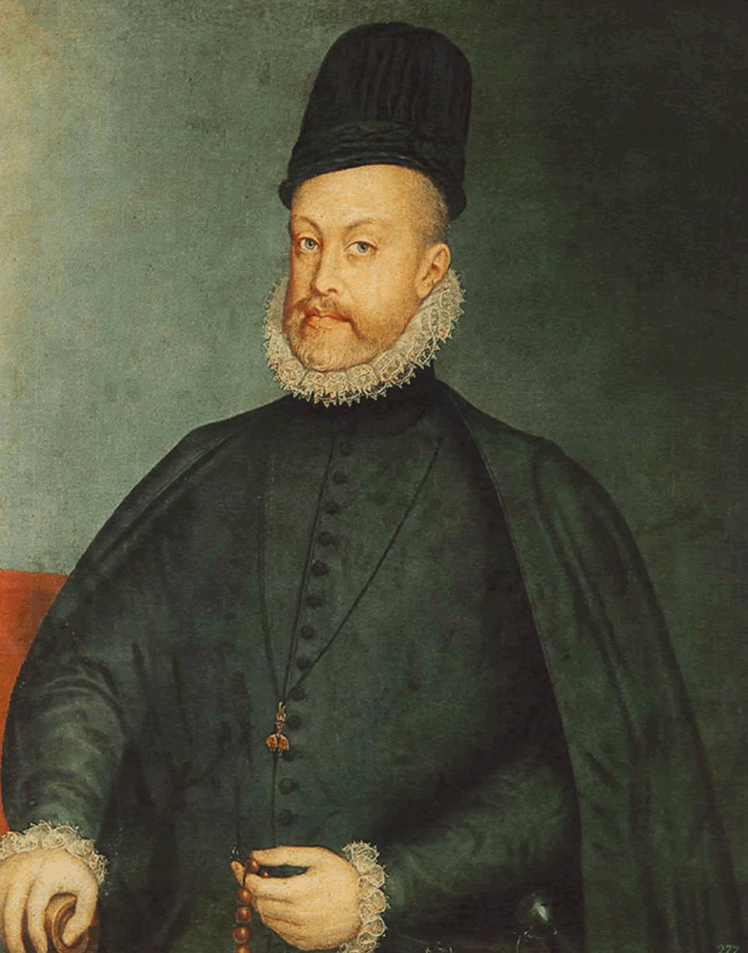
Philip II, 1556-1598
Only super-power (budget more than 10 times that of England)

Slide 9
Power and money
Philip to his father at the beginning of the reign:
  “I would very much like to explain my actions before the world, to demonstrate that I have no claims to the territory of others, but I would also like it to be understood that I must defend that which Your Majesty has granted me.
One of the most important financial advisors:
  “His Majesty is Lord of the States of Flanders and is determined to retain and not to lose them. He is also Lord of the Kingdoms of Naples and Sicily and is resolved to supply and maintain them and not to lose them. The same could be said of Milan and the other Kingdoms of Spain and Aragon, namely, that He is determined not to lose them… And all in the end comes down to providing sums of money to maintain the armies.
When only a regent
  The main foundation on which the war can be sustained is money and credit and without those, one cannot do anything.

Slide 10
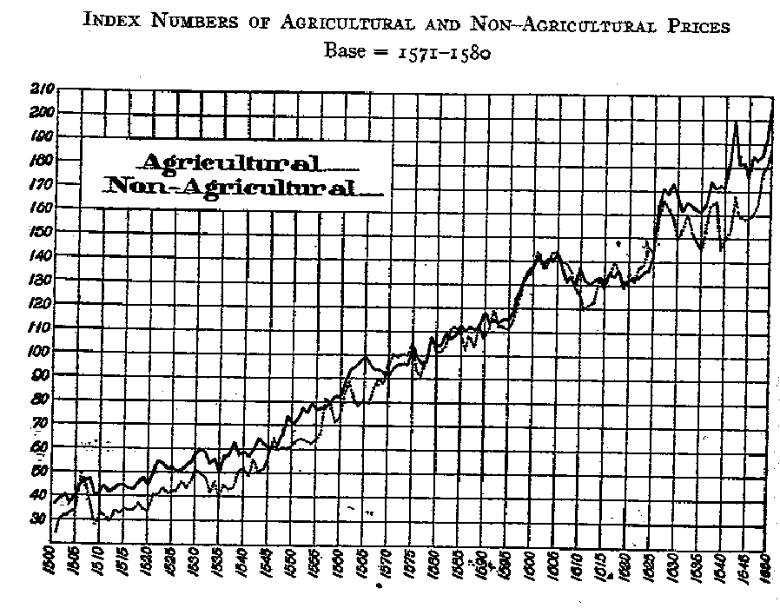
Currency
Many currencies in Europe
1 ducat = 375 maravedis (mrs).
1 real = 3.5 gr silver (93%)
1 ducat ˜ 11 real ˜ 35 gr silver, weekly wage for lowest skill level, about 2 kg per year.
Recall, Roman legionnaire 1 kg of silver per year
No seignorage in the 16th century
Inflation (annual ˜1 percent)
1600

Slide 11
Three main players
Crown
Cities
Bankers

Slide 12
1. Cities
The Cortes (parliament)
  Long tradition since 12th century, originating in the north of Spain (before Magna Carta).
    León in 1188.
  Relation with the Reconquista: fiscal need to include the merchant elites of the cities
  Development up to the 16th century
  In the first half of the century (Carlos V), Church and nobility do not participate anymore: main purpose is taxation bargaining
  19 cities (and surrounding regions) are represented (2 delegates per city)
Revolt of the Comuneros (1520-21), to a large extent fiscal revolt
  Memory of it important for Philip II.

Slide 13
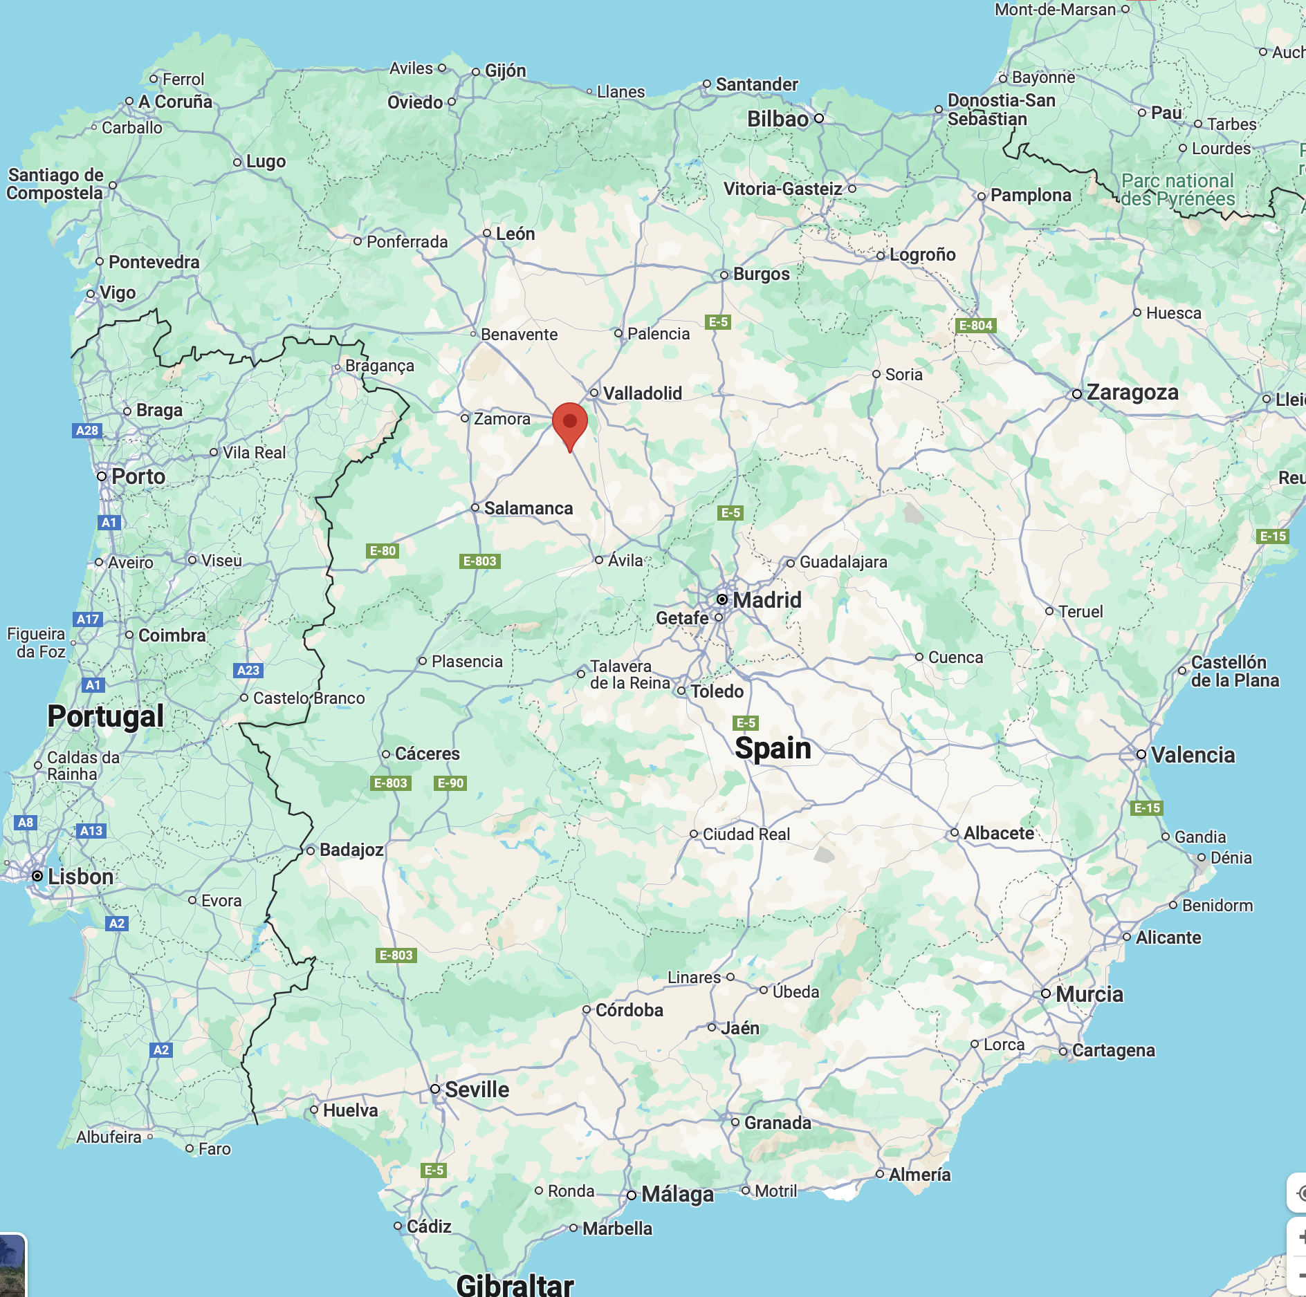
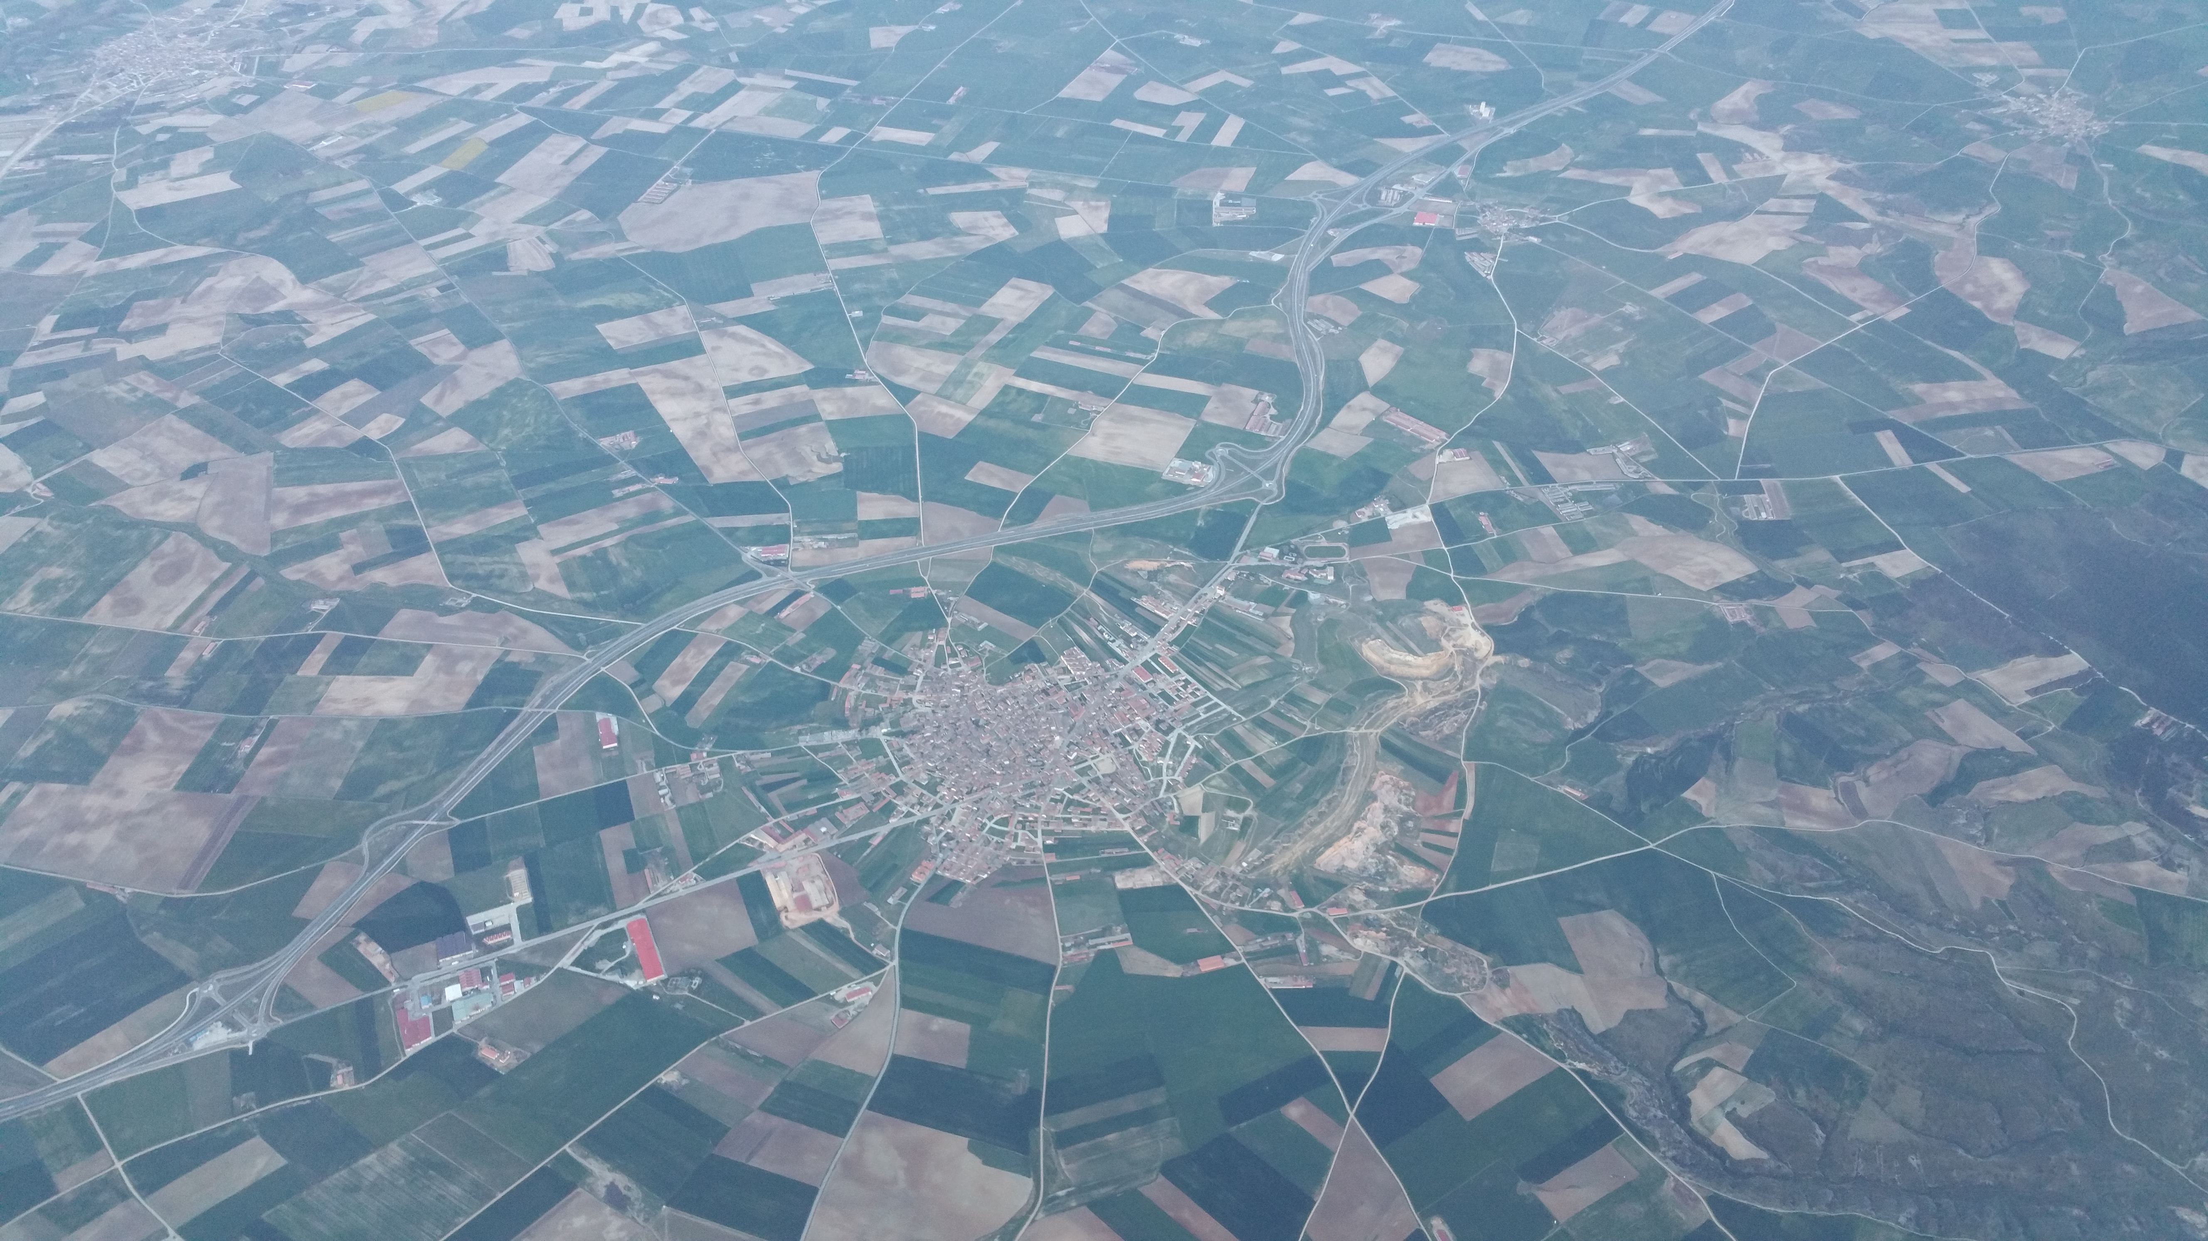
2. Commercial Fairs
Medina del Campo
  About 20,000 people (then,… and now)
  Bi-annual fairs (1-3 months)
  Increasing return to trading opportunities
  Financial contract often contingent on a particular fair.
  Trade needs credit and credit needs trade
  Some fairs are postponed, and then merged with a subsequent fair

Slide 14
Holding all the commercial fairs

Slide 15
3. Public banks
Private banks. Part of the credit system that will be affected by the crises.
4. Administration
No administration to collect revenues or manage the debt.
Rev collection through tax farmers and delegation to the cities
The system is based on posterior verification
  Very powerful administration of accountants in all fiscal matters
On financial matters, the merchant-bankers (mainly but not exclusively from Genoa act as agents of the Crown

Slide 16
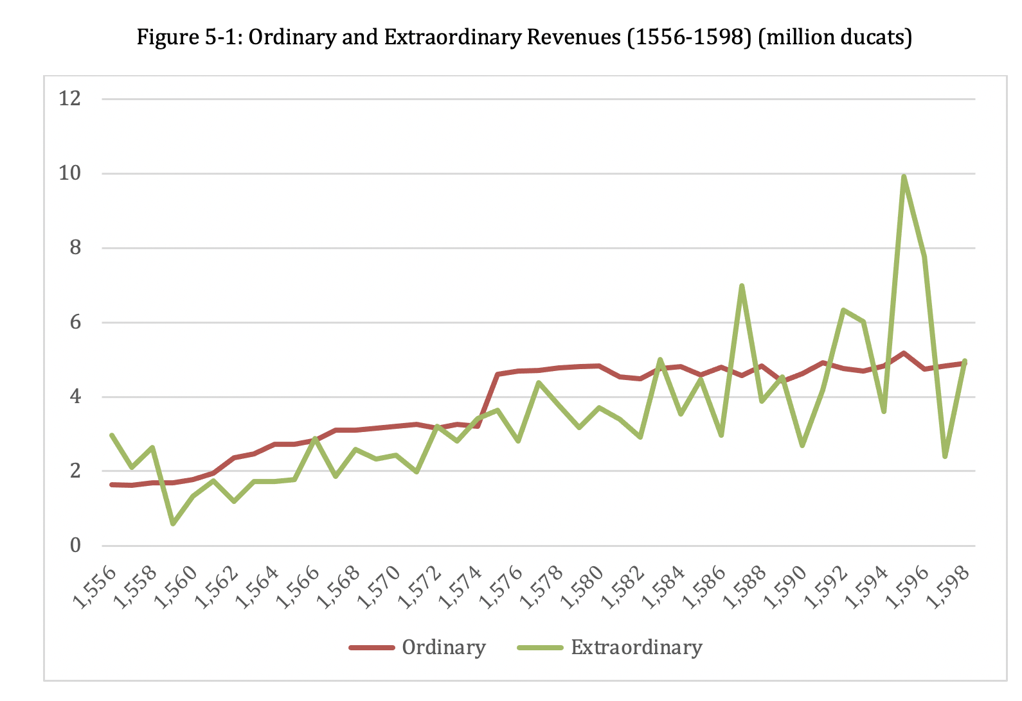
5. Revenues (1)
Ordinary
extraordinary

Slide 17
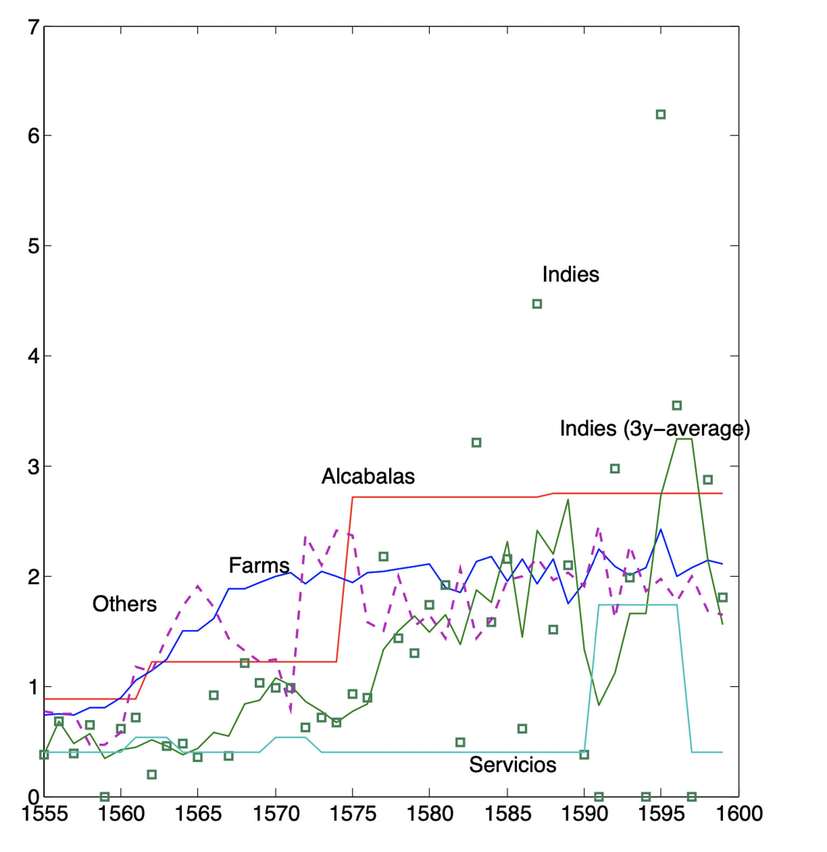
Decomposition of revenues
Ordinary
  Farms (monopolies, imports, others…)
  Alcabalas: encabezamiento, fixed contribution by the cities, negotiated in the Cortes
  Stable juridical foundation, stable revenues
  The only revenues that can service the long-term debt.
Extraordinary
  Church
  Servicios (other tax temporarily granted by the Cortes)
  Silver from the Americas
  Cannot service the long-term debt
Crown “controls” only farmed rev and silver
  Not more than a quarter of revenues for the debt service.

Slide 18
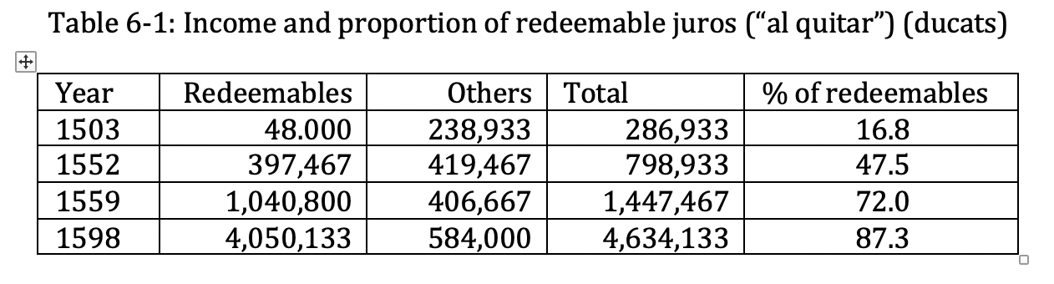
6. The long-term debt: the juros
History (from 14th century, rewards for the Reconquista)
Funded on a specific tax revenue
Redeemable
Tradable (secondary market)
Local service (often, same office collects taxes and pays coupons).
Never any default, but some local delays could occur.
Archival work: many examples, illustration through the history of the juro purchased by Teresa Núñez
  6000 ducats in 1565 at 7.14 percent 427 ducat income, 277 on the alcabalas of Murcia. Sale in 1577, transfer in 1580, bequest, ..redeemed in 1607 and “increased” to 5 percent.

Slide 19
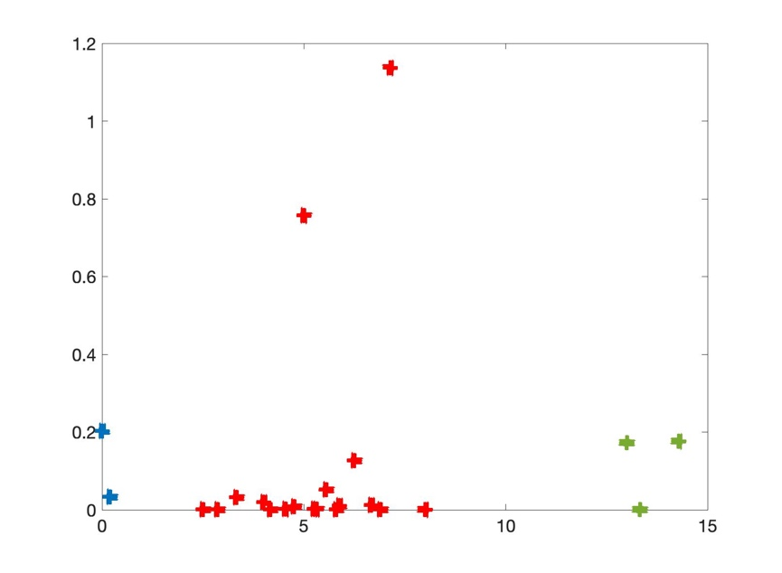
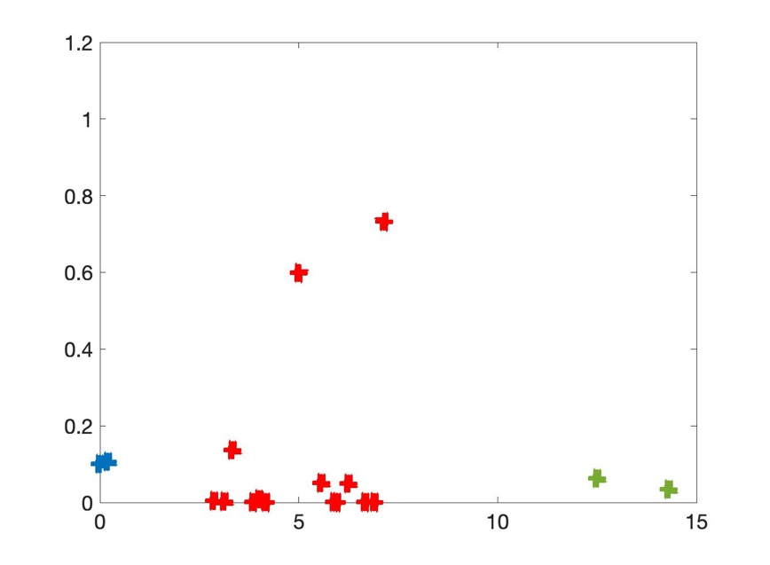
Distribution of the yields of juros
(7.14%)
(5%)
Non-
nég.
al quitar
Life annuities
Juros on alcabalas and tercias Juros on other revenues

Slide 20
7. Crecimientos
A juro is a claim on a specific revenue.
The claim has a face value.
Secular trend of the interest is downwards.
The juro is redeemable. Redemption frees the tax revenue from the mortgage, but there is not general revenue (like in England 2 centuries later).
The same revenue is mortgaged on a juro with juro with a higher face value.
Because of the fragmentation of the fiscal system (revenues and debt), a reduction of the coupon is not feasible.
Essential to understand debt settlement (no default)

Slide 21
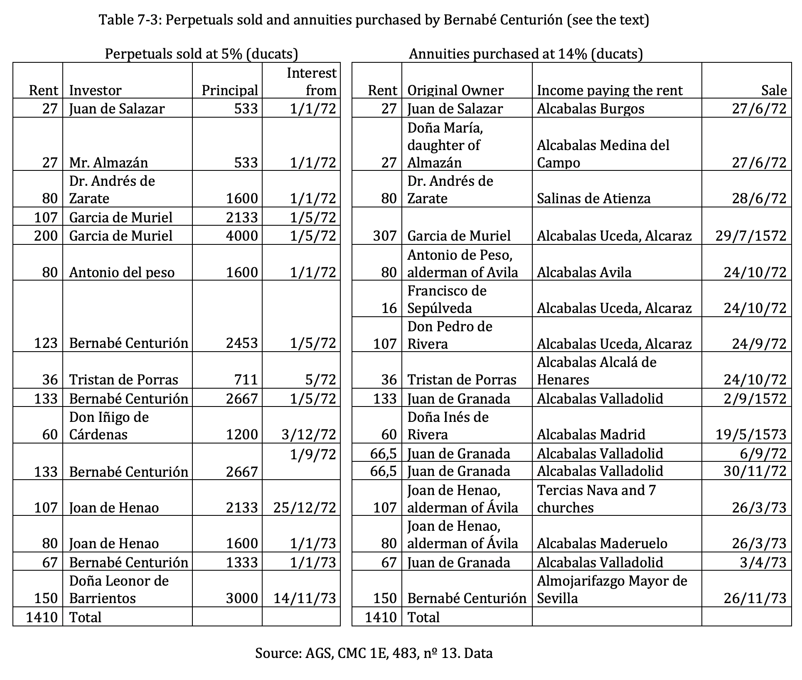
Examples of crecimientos
Bankers could be repaid by a license to augment the face value of juros.
Two juros merged

Slide 22
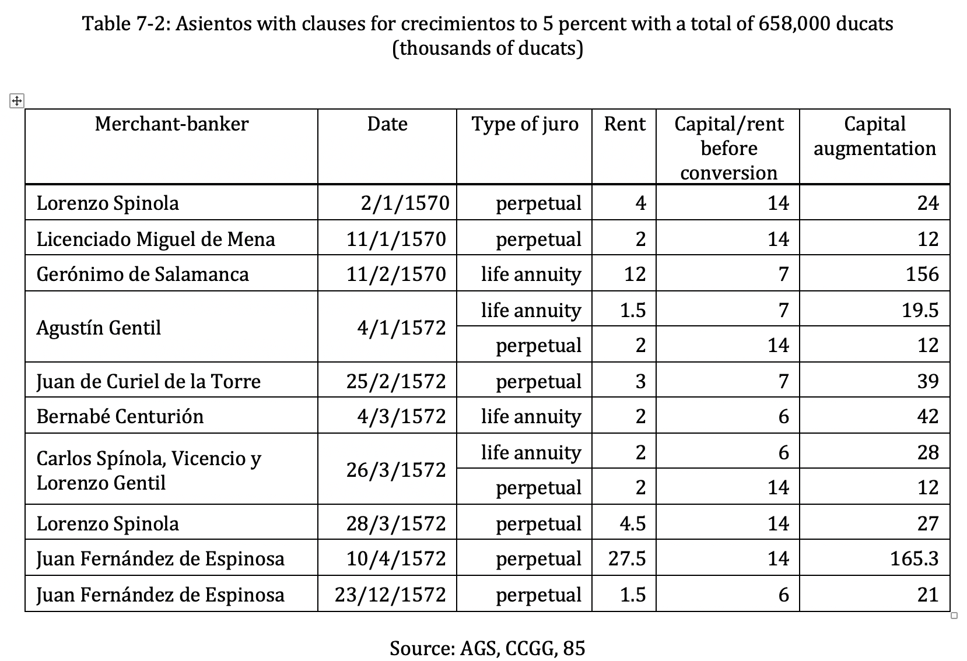

Slide 23
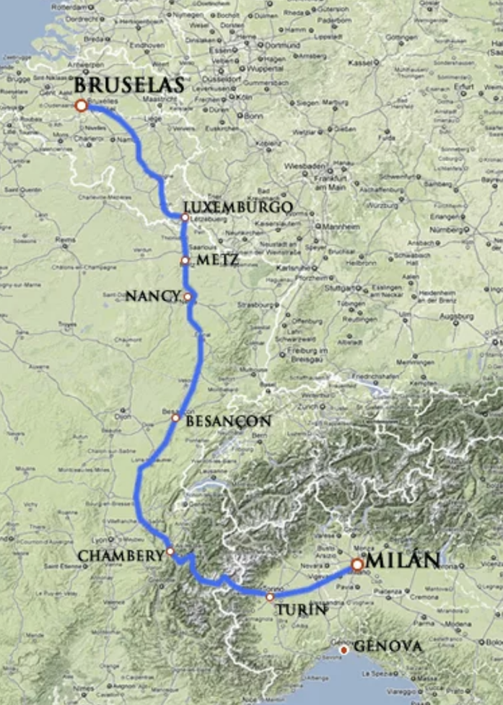
The Fiesco contract,
3/4/91
Monthly deliveries for a year
The short-term debt: asientos
Lo que por mi mandado se asienta y concierta con Tomás Fiesco ginoves sobre trescientos mil escudos que por servirme a de proveer en Amberes o Dunquerque o Lila o Namur de los mis estados de Flandes,
The Spanish road
o Viçanzon o Gray del mi condado de Borgoña,
o Monluel o Chamberi en el ducado de Saboya es lo siguiente:

Slide 24
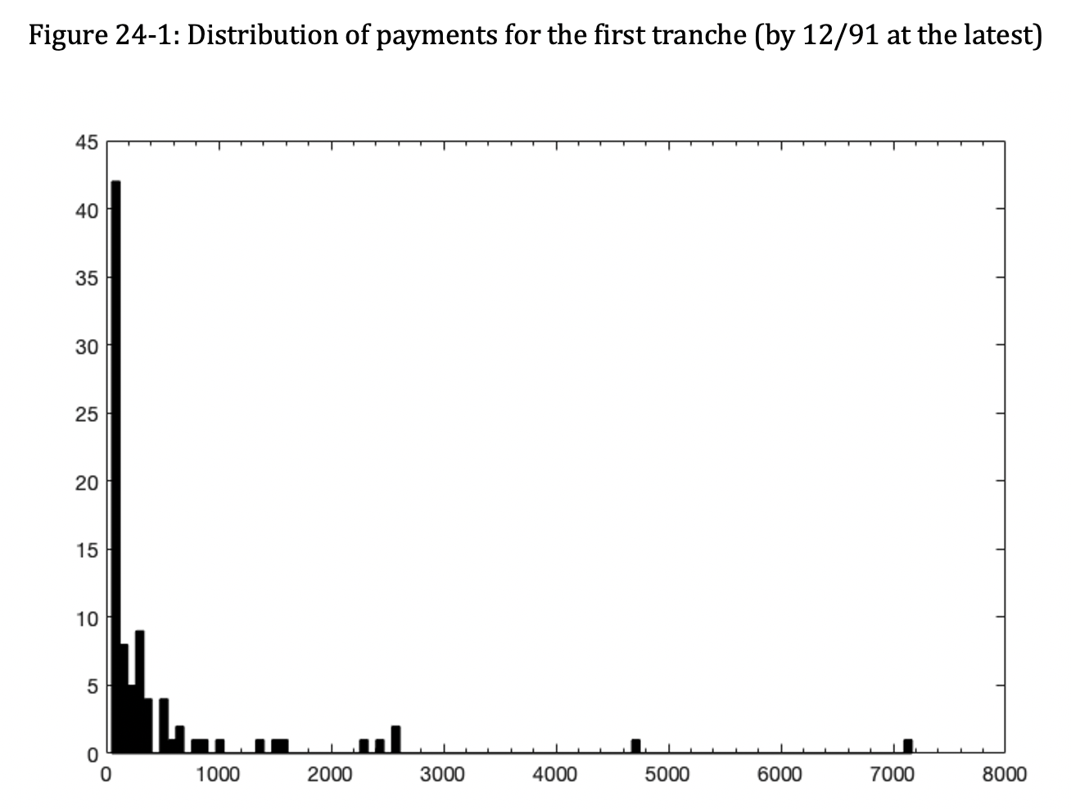
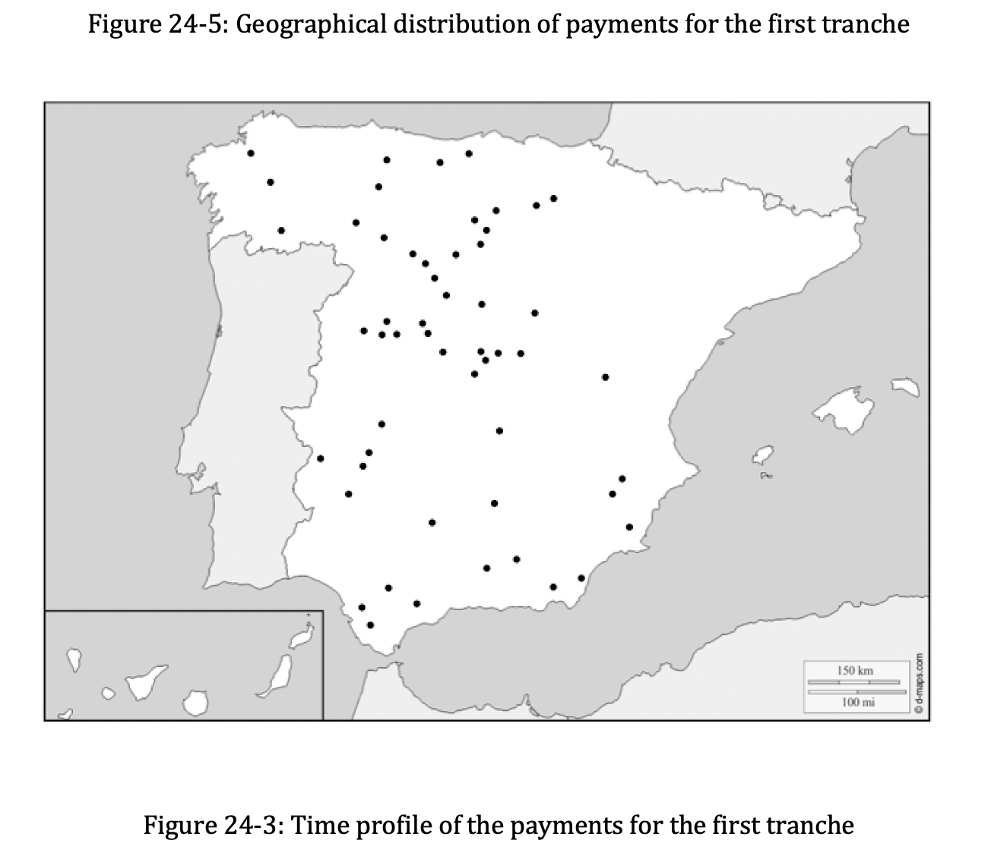
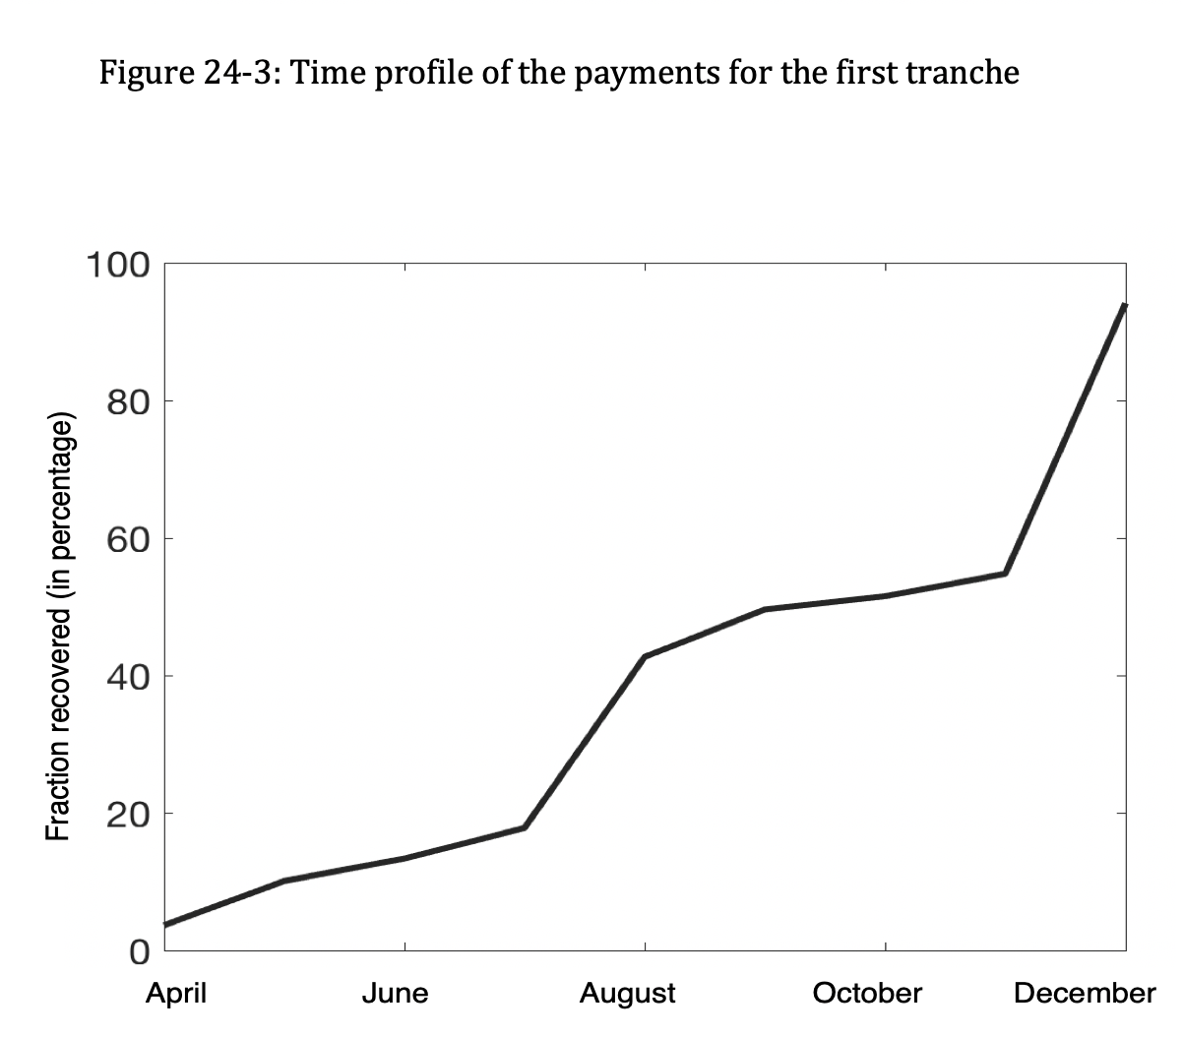

Slide 25
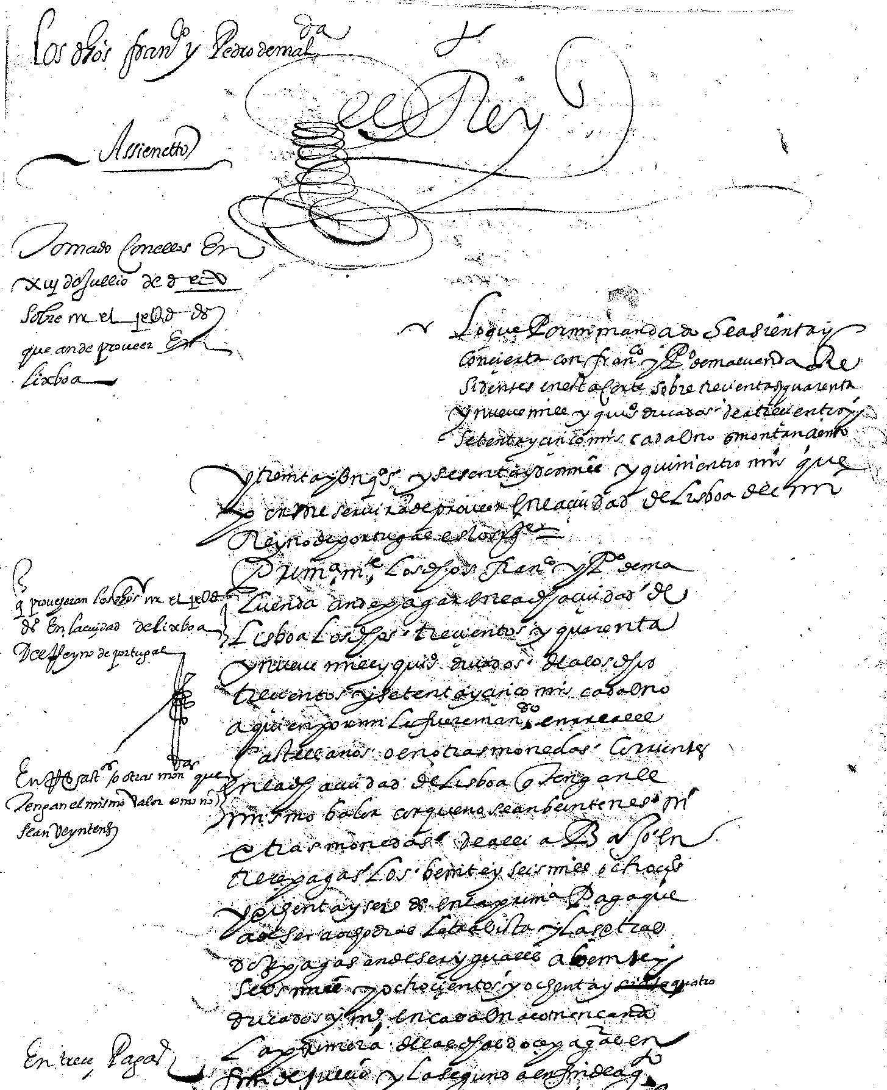
14. Options to repay the bankers in long-term debt: the Maluenda contract
Monthly deliveries for one year in Lisbon
Lo que por mi mandado se asienta y concierta con Francisco Y Pedro de Maluenda residentes en esta Corte sobre trescientas y quarenta y nueve mil y quinientos ducados de a trescientos y setenta y cinco maravedís cada uno que montan ciento y treinta y un quentos y sesenta y dos mil y quinientos maravedís que por mi servirán de proveer en la ciudad de Lisboa de mi Reyno de Portugal es lo siguiente=

Slide 26
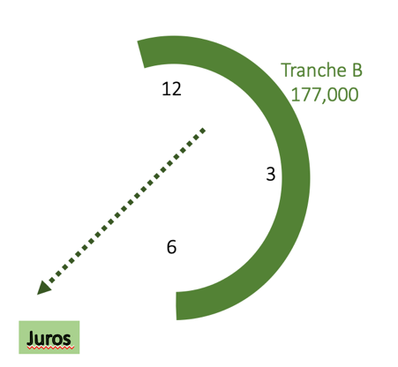
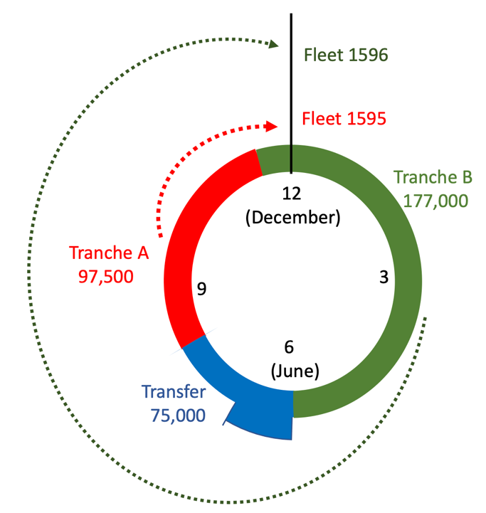
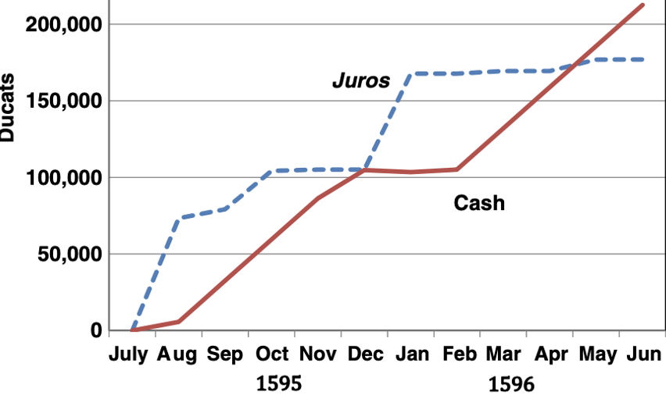
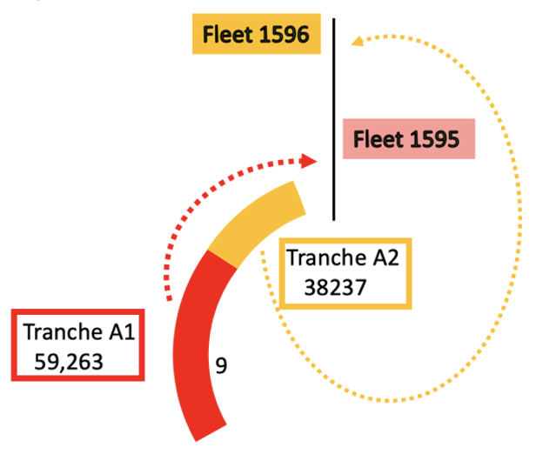
Contrat
et … execution

Slide 27
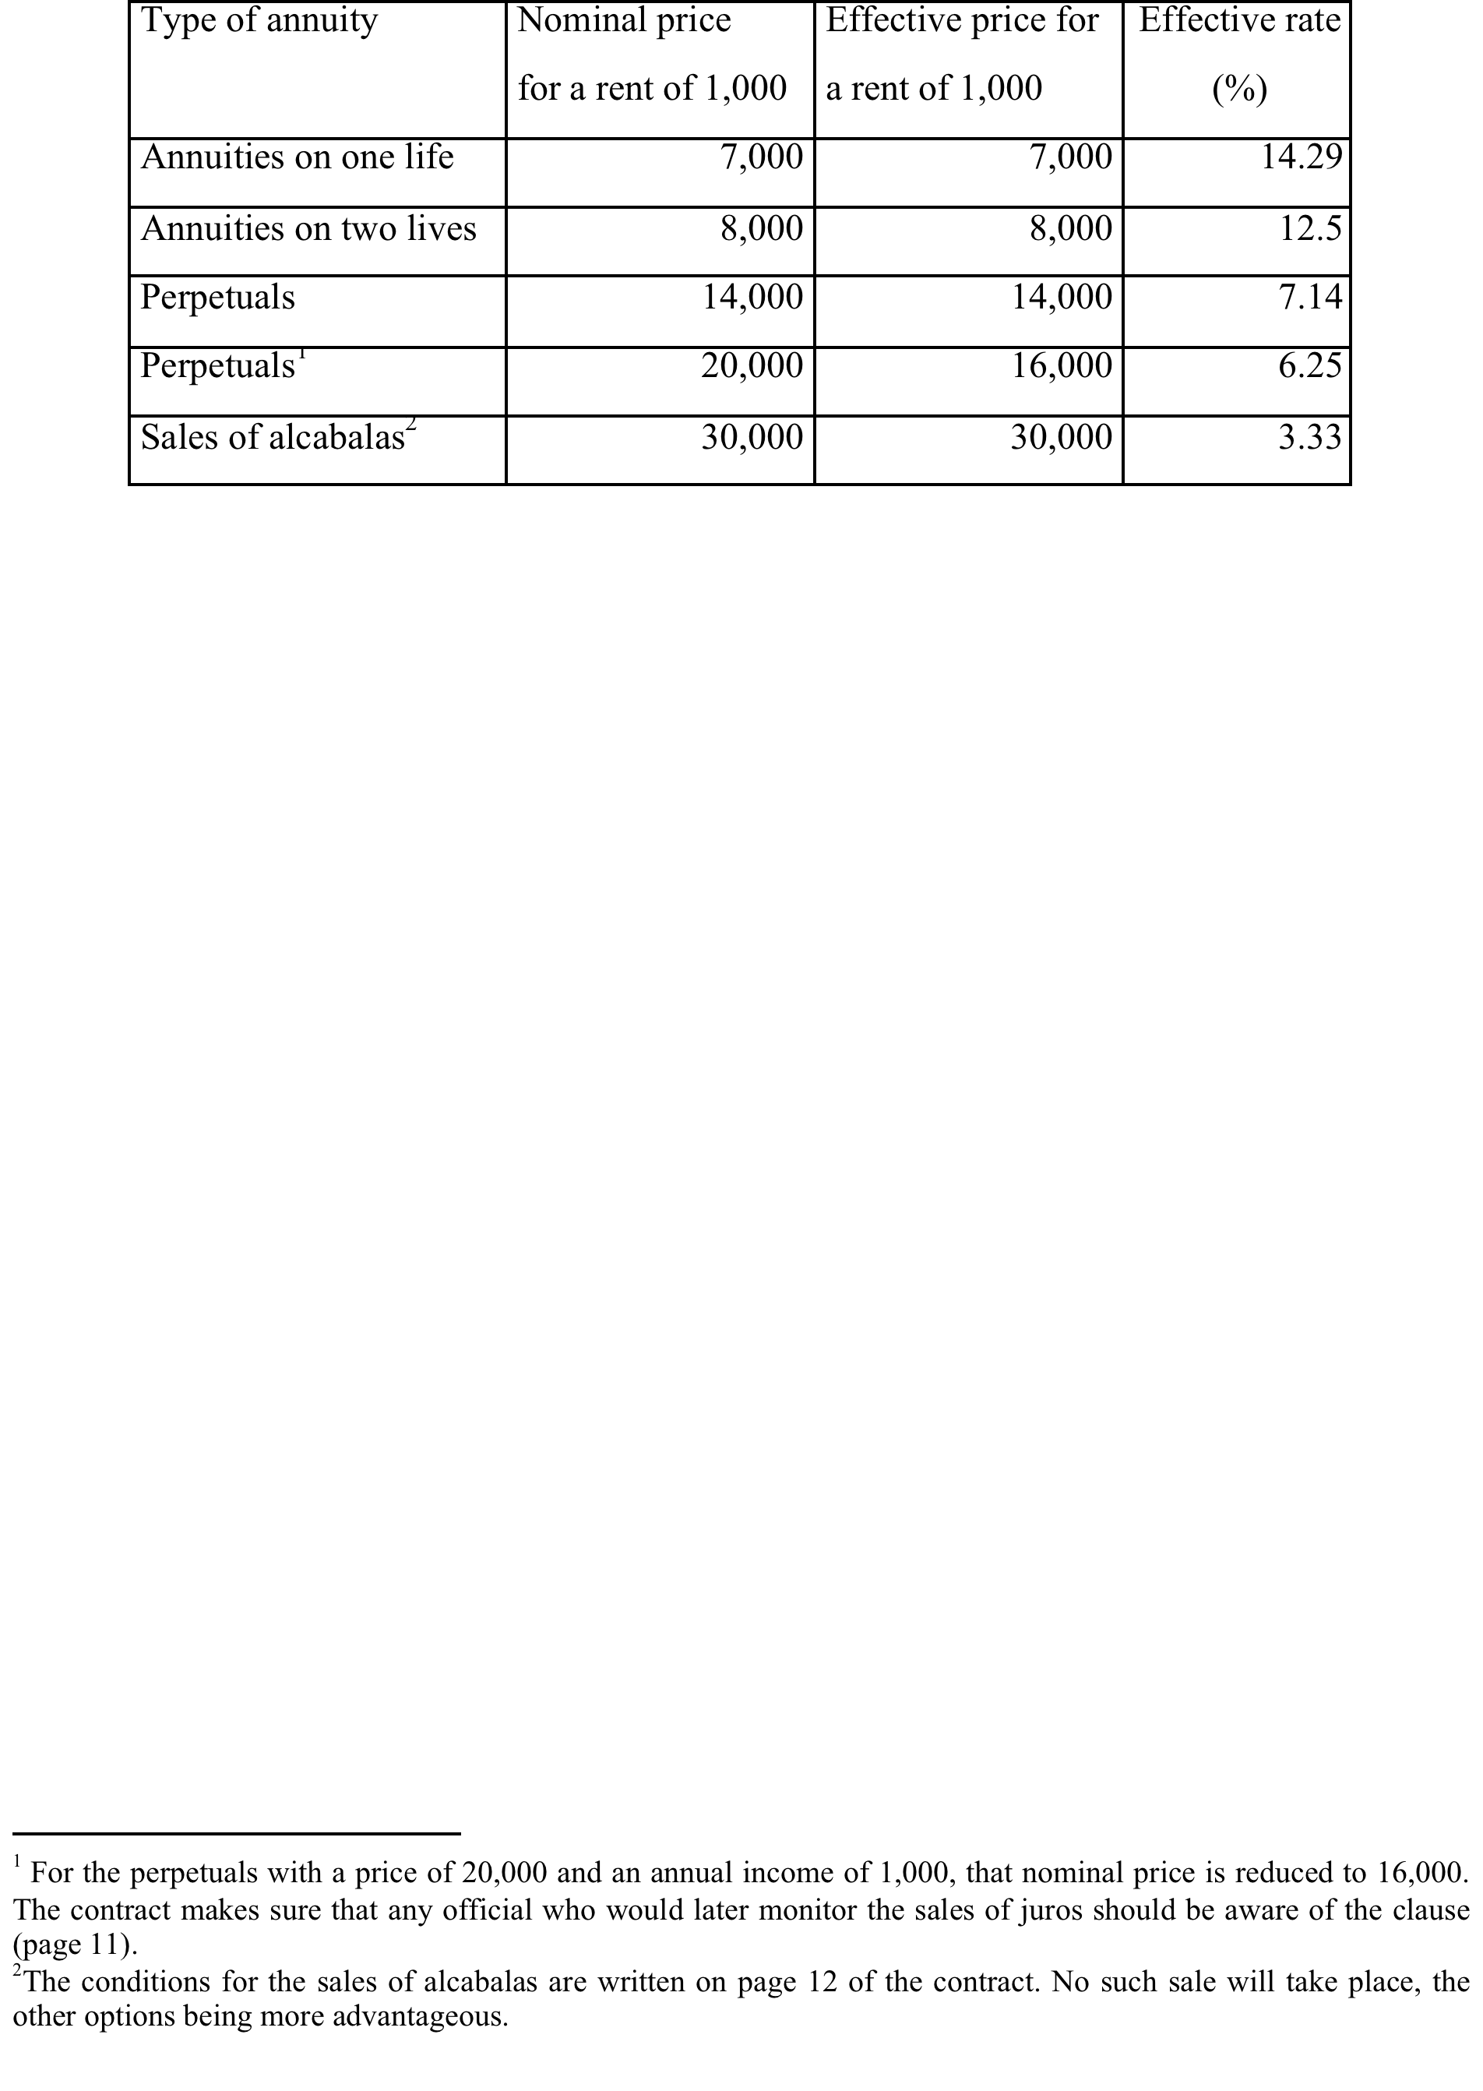
Menu of juros for the option

Slide 28
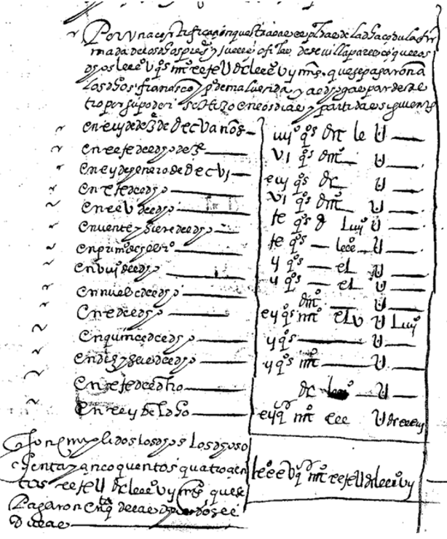
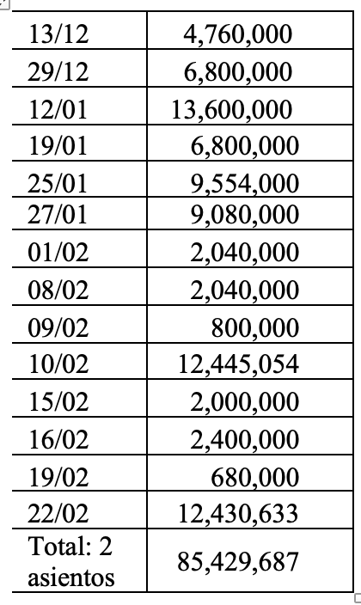

Royal accountants: interests on tranche
A1
Fleet arrives 17/09/95
Crown pays back between 13/12/95 et le 22/02/96
  2 asientos
  Staggered payments are equivalent to a unique payment on 25/01/96
XXXX,DCC,LX,000: 4,760,000

Slide 29
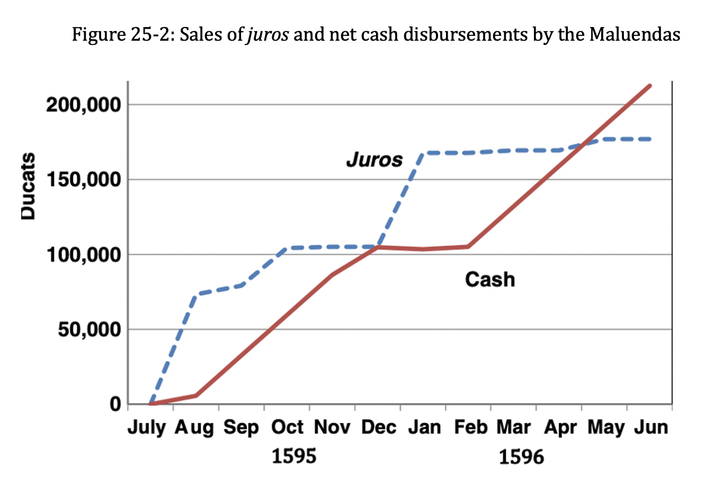

Slide 30
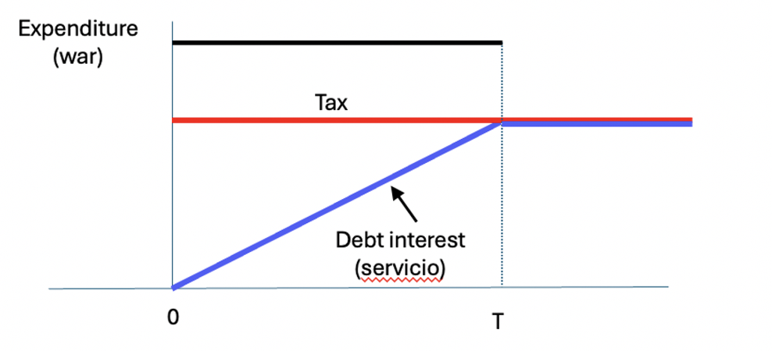
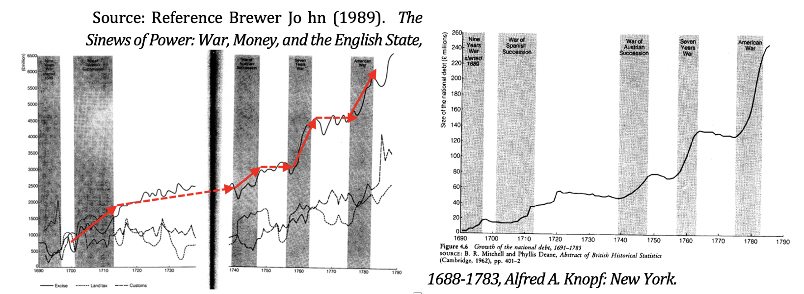
8. Framework
Efficient taxation of a fixed war
Theory of public finance
Central government controls taxes and expenditures
Illustration: England 18th century

Slide 31
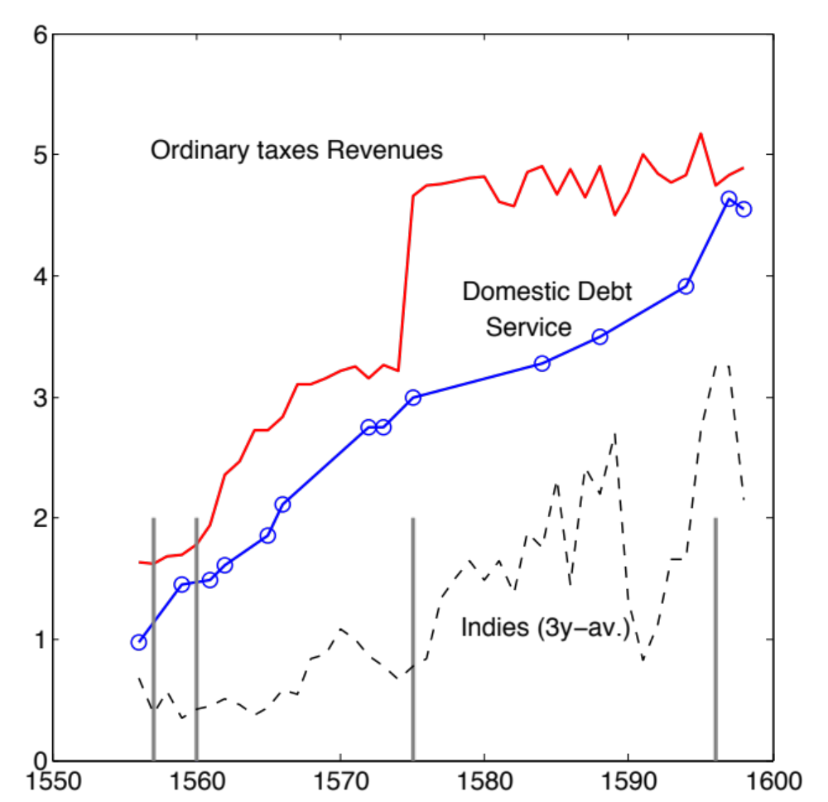
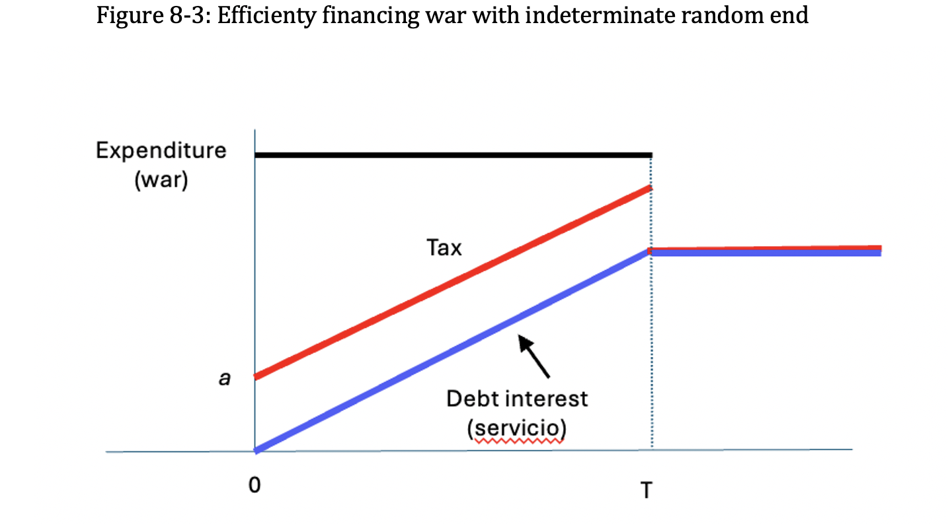
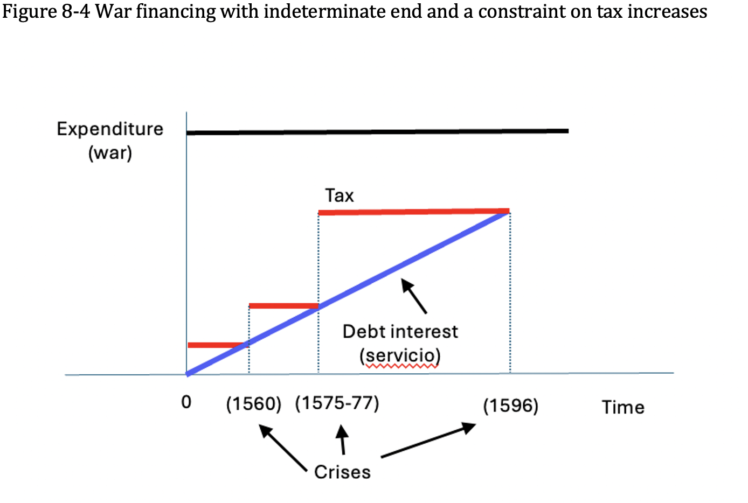
Spain

Slide 32
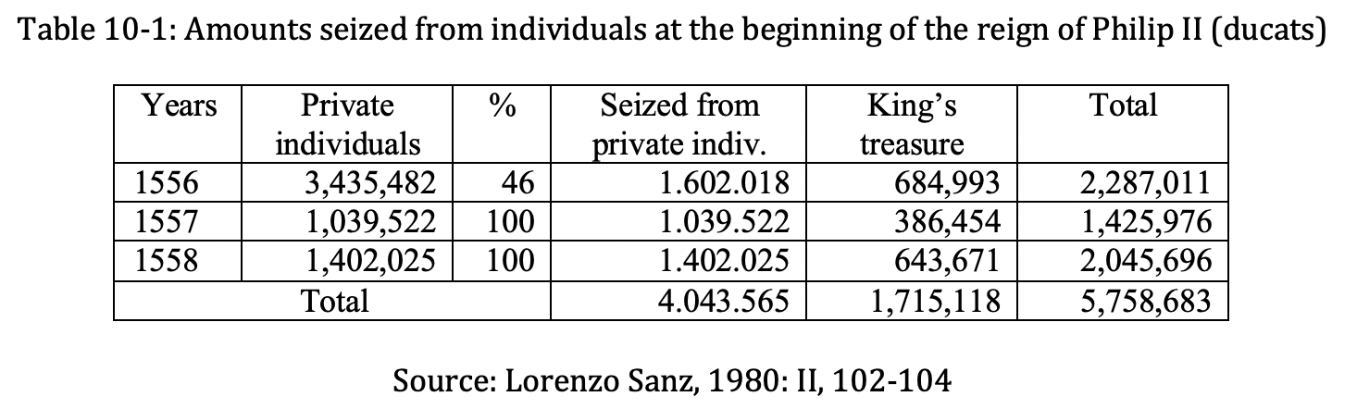
10. First test: the 1557 debt restructuring and the war
Summer 54, Philip (age 27) goes to London to marry Mary (idea of his father, Habsburg method).
Summer 55, he goes to Brussels to inherit his part from his father, Carlos V. (Tearful ceremony in Brussels but at home, the Castilian elite do not support the strategy)
Summer 56, financial war against the new pope who wanted to capture Naples.
Preparation for the war against France (arch-enemy of his father)
  New team bypassing the “old guard” at home
  Confiscation of silver in Sevilla (forced loans)

Slide 33
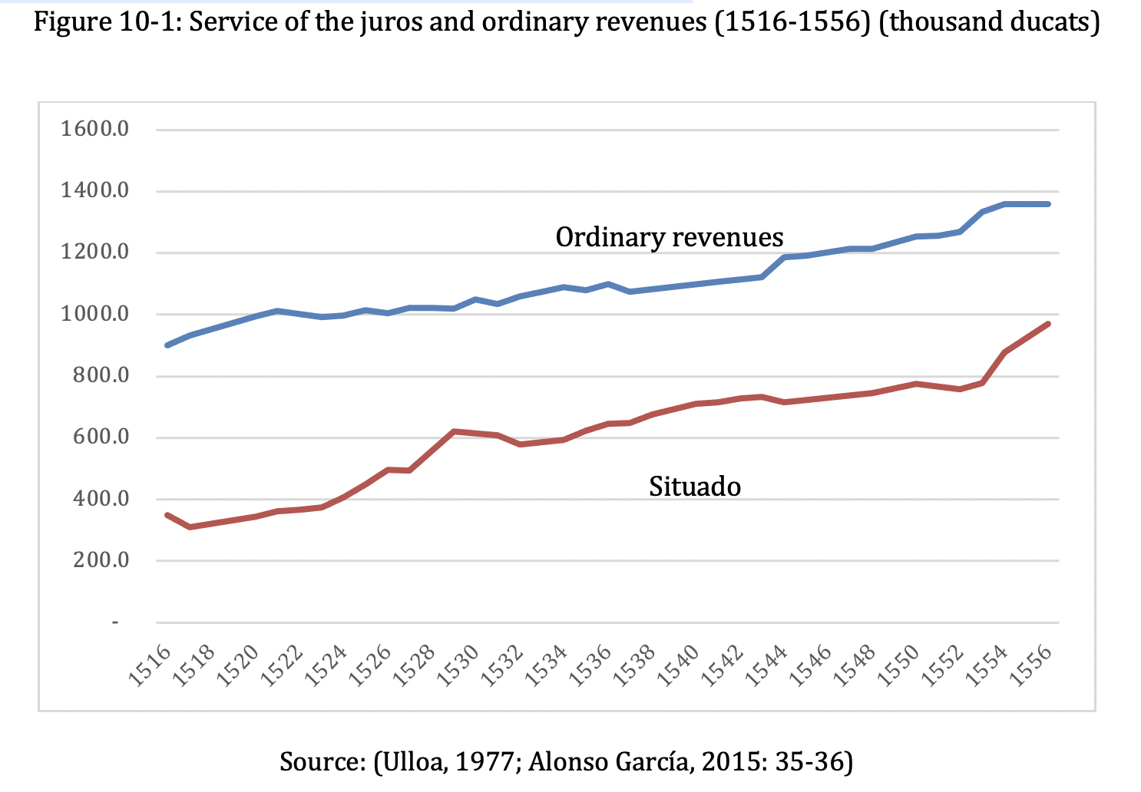
10. Issues
Refinancing the short-term debt of 7.5 M into juros.
Juros can be serviced only by ordinary revenues
Surplus of about 330,000
Two problems:
  The surplus was used by the elite for benefits
  Which interest rate?
    Crown wanted 5%
    Bankers wanted 7.14%
April 57 Letter (from London) to stop payments on the short-term debt.
  Not applied by the old guard, repeat in June.
  Not a default (never any mention of this, see the letter)

Slide 34
Letter of April 17, 1557
“We are aware of the large sums that we owe to merchants for exchanges (`cambios’) made and remitted to these kingdoms by the emperor my lord and by myself, and of the growing interests that are running from day to day, and that if we do not take some time to settle them, they will grow to such an extent and put us in such a state that we will come doubt what can be more easily accommodated now. We have written to you in past days to look into this and discuss what could be done, and even though you have discussed it up to now, no resolution has been made, […] and considering how much these and the principal amount and the ordinary and extraordinary expenses of these kingdoms and those that in them and outside of them are made and will be made because of the war, and our wealth being as it is, we have determined and resolved that an account be made with all the merchants of the total that is owed in principal and interest until the end of the past year of one thousand five hundred and fifty-six, and that what this amount be given to them in juros at the rate of twenty thousand maravedis per thousand, aided for this by the appropriations of the House of the Most Serene Prince, my son, and of the President and the Councils and other officials of our House and Court, “tenencias and continos,” and of the juros that would have been given in collaterals to people and merchants with previous­­­­­­­ asientos.

Slide 35
1557-1558
August 10, 1557, crushing defeat of France, in Saint Quentin.
May 1558, asiento of one million with Nicolao de Grimaldo.
  Clause to convert previous short-term debt in juros at 10 and 7.15 percent
  April 1557 letter is not applied.
July 1558, another defeat of France, near Calais (Gravelines, July 1558).
Autumn 58, death of Carlos V and of Mary, Queen of England
Marriage of the daughter of the King of France in June 1559
Return to Spain in August 1559.

Slide 36
11. The 1560 Cortes: a new relationship
Necessity to settle the affairs at home.
Encabezamiento (lump-sum contribution of the cities) not changed since 1536 (absences of Philip and his father).
February 1560: new session of the Cortes
November 1560: decree suspending payments to the bankers.
Two parts:
  First part for the Cortes
  Second part: the bankers

Slide 37
The first part of the Decree of 1560: for the Cortes
Because having seen and understood the state in which our wealth is, and the great difficulties that occurred for the procurement of the necessary and necessary things from these kingdoms, and to be able to comply and pay what is owed to merchants and other persons in such large sums and amounts, and the delays and suspensions and disorder that in the fairs and trade and commerce [1] because of our necessities there have been and are, and the many and notable inconveniences that would result to us and to our kingdoms and states as well as to our subjects and natives if we did not try to remedy them, the business having come to such a time that it could not be deferred or delayed or remedied by the means that have been used up to now, and having been requested and begged by the procurators of these kingdoms on their behalf [2] to try to remedy it, we ordered some of our council and other persons of authority to come together, and zealous for our service and the public good to discuss and discuss what order and form could and should be taken in the commission and fulfillment of the extraordinary and forcible things of these kingdoms, guards and galleys and frontiers and royal houses and of the councils and other ministers, [3] ,… that likewise they should try and discuss what order and form they could and should have in the payment and fulfillment of what we owe by entries, bills of exchange or on account of our bonds or in any other way to merchants who have contracted with Us, and to other persons, which are large sums and amounts and of which there is great interest, on the assumption that we wished and it was our will that it be satisfied and fulfilled with all in the best way possible and that the state of our estate would suffer.”
Key issues : (1) the concern for the fairs and the impact of their disruption on trade; (2) the Decreto is at the request of the Cortes; (3) the issue of the 300,000 ducats of ordinary revenues that have been diverted from the expenditures listed here to the service of new juros has to be resolved (see the previous chapter); (4) the debt to the bankers will be paid.

Slide 38
The second part of the Decree of 1560: for the bankers
Philip’s key tactical move in all the payment suspensions of 1560, 1575 and 1596. In each of them, the suspension of payments was presented as a punishment of the bankers, who were so unpopular in the Cortes, in the expectation that the Cortes would pay him back by agreeing to an increase in taxes.
The second part orders the conversion of all short-term debt to juros at 5%.
The bankers accepted but the next asientos contained clauses to sell juros at a higher rate (unseen by the cities)
The Cortes accepted a 37% increase of the encabezamiento.

Slide 39
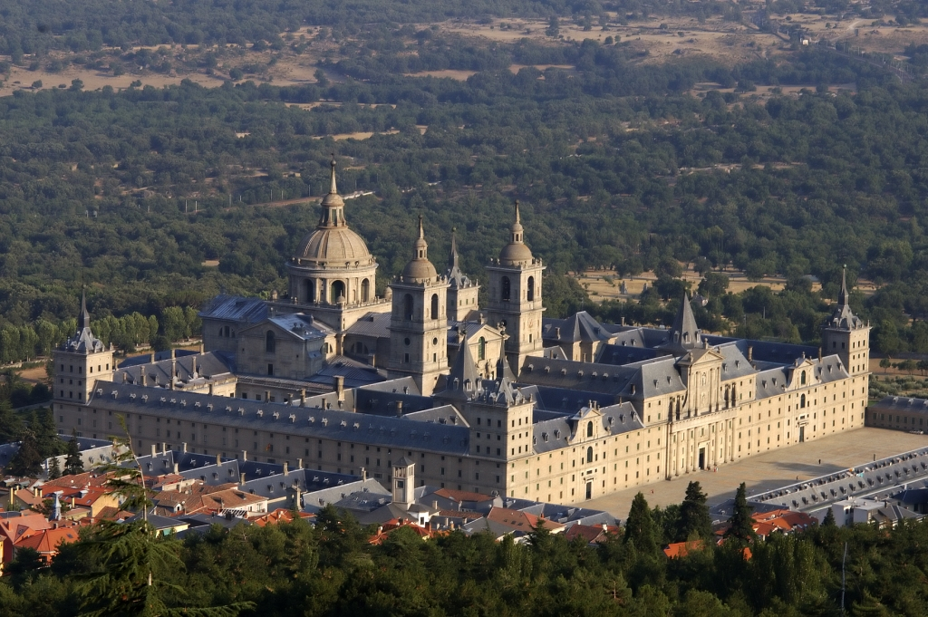
The sixties
Contributions of the Church (chapter 12)
Taxation in the Netherlands (chapter 13)
1564-65, beginning of the rebellion in Flanders (Netherlands)
Asientos (chapter 14)
  Collaterals: juros de resguardo
  Example of the financing of the Escorial (10,000 ducats per month, 69-72)

Slide 40
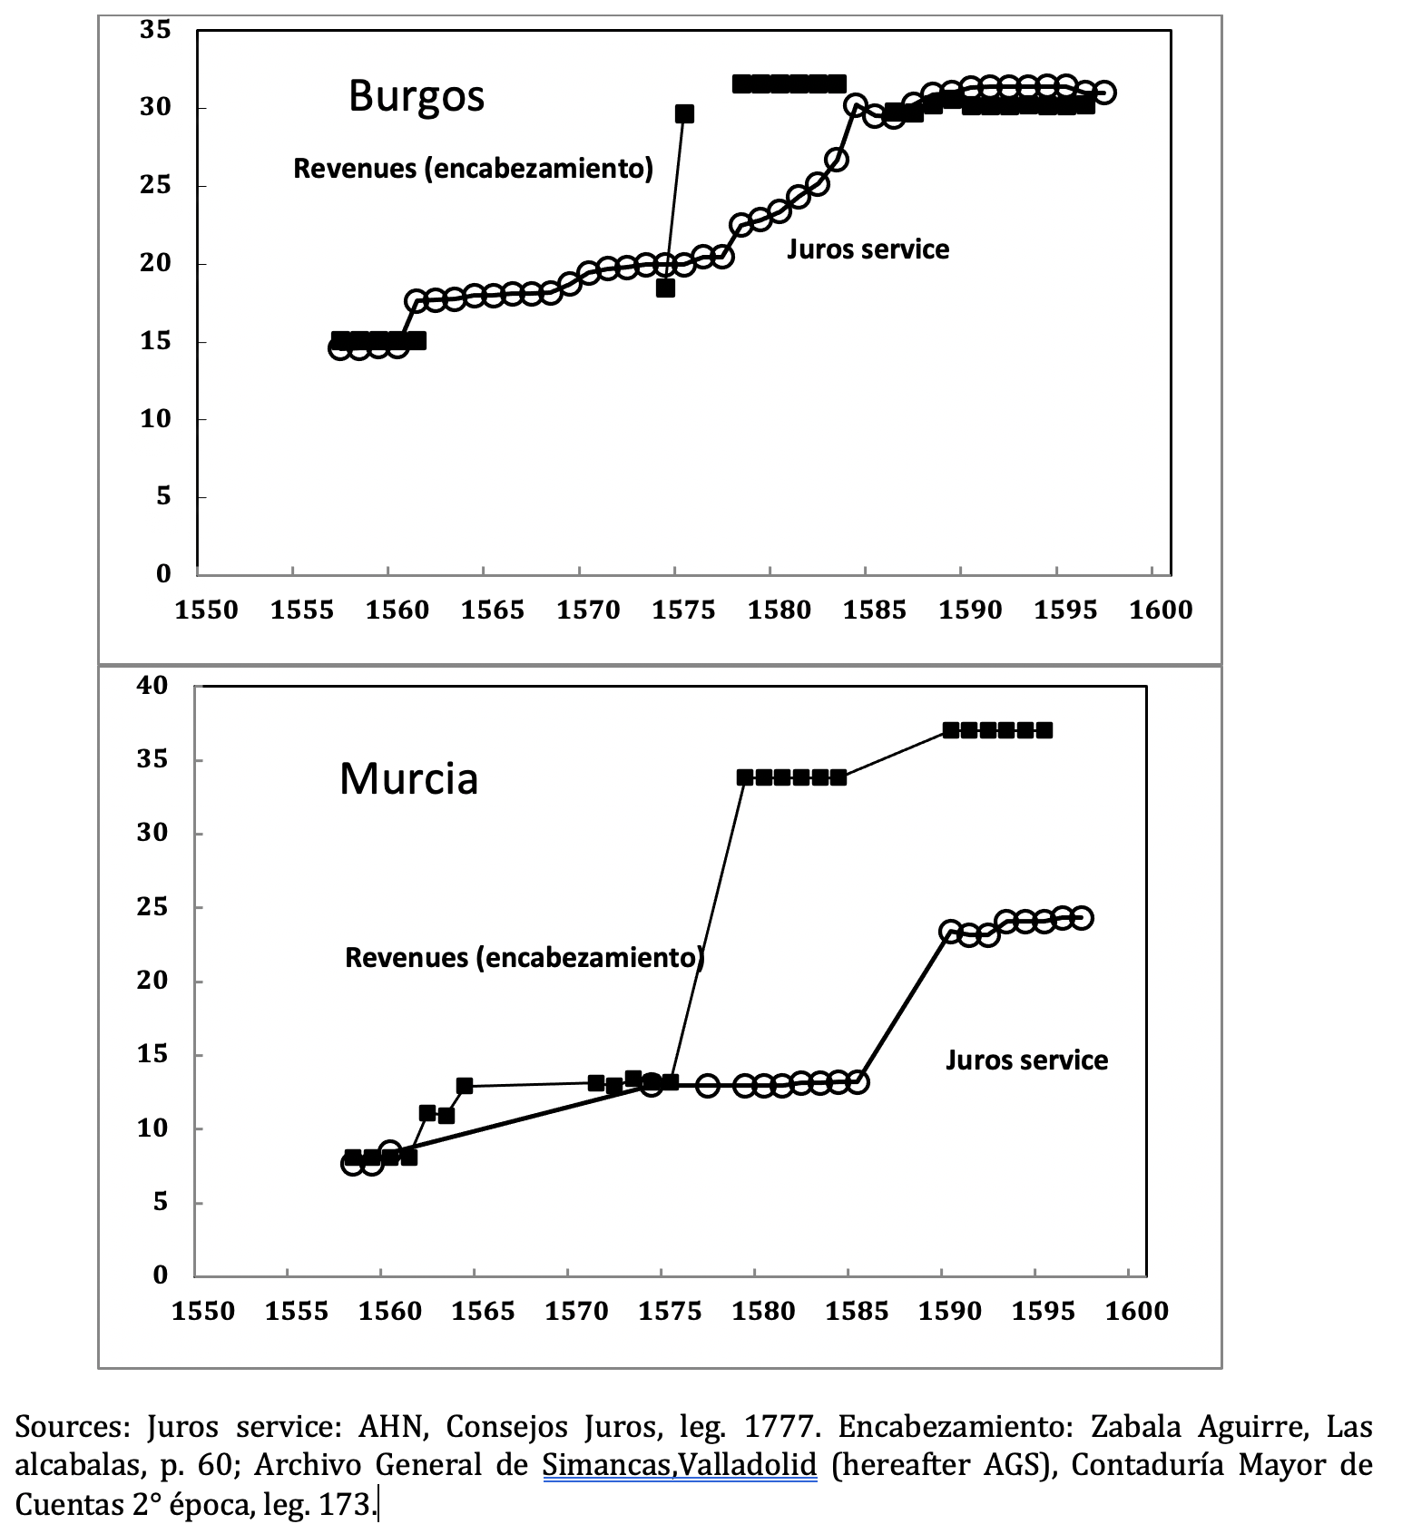
16, 17. Obstruction in the Cortes (1572-1575)
Alcabalas (sales tax) in two cities (north and east coast)
Service of juros

Slide 41
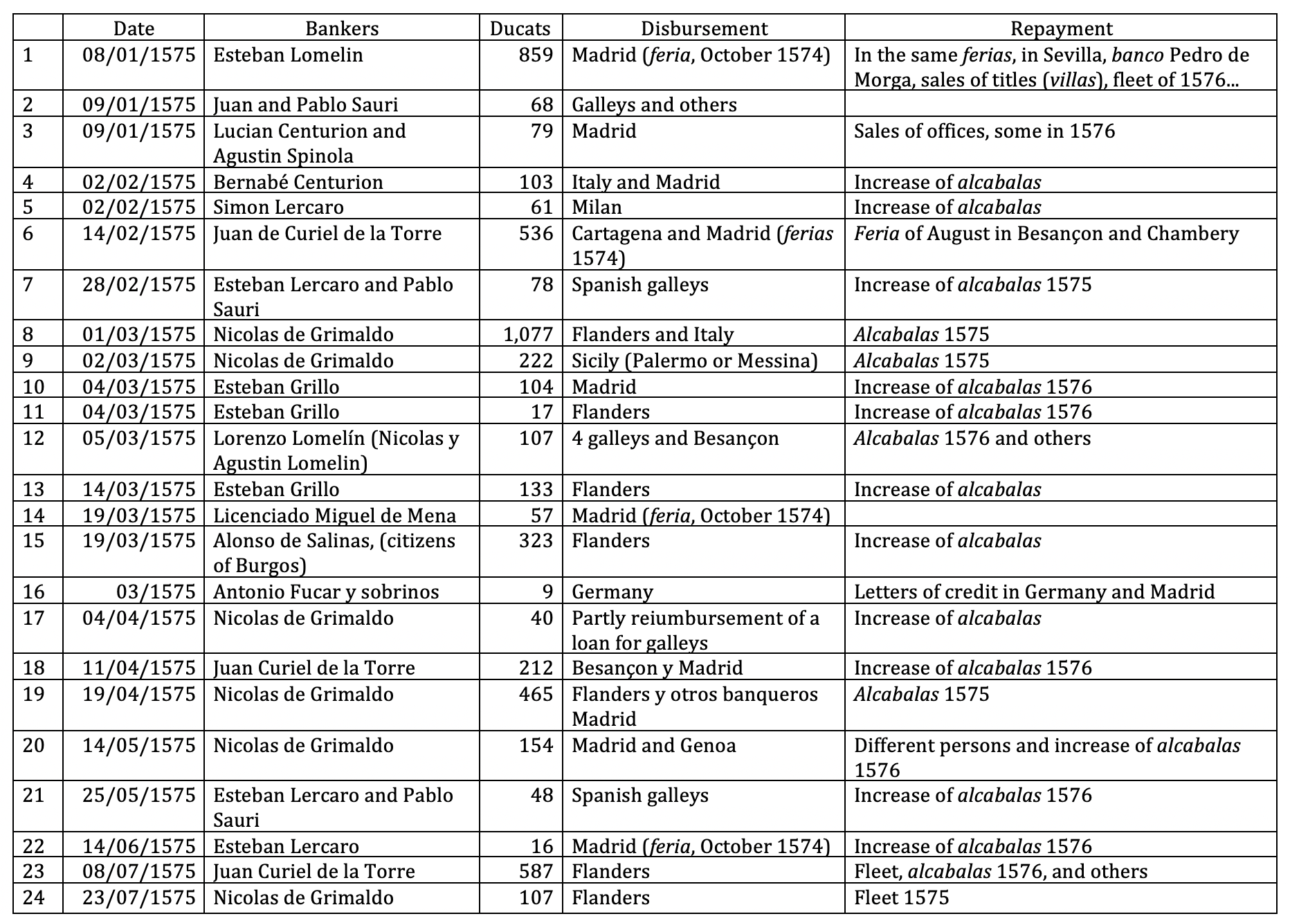
Moving on, 1574 / 75
Summer 74, plan for a payment stop, discarded.
Fall 74, Philip II triples the encabezamiento
March 75: the delegates signed the tripling
The king keeps them in Madrid
Record of asientos
Constitutional crisis
Tax resistance of the cities
  Numerous incidents (archives)

Slide 42
Decree of 1575
9/1: Secret instructions by the Crown to stop payments to the bankers
9/15: official announcement,... to the Cortes. Two texts (as in 1560)
  For the Cortes (1500 words) pandering to their wishes and resentment against the bankers
  For the bankers (7500 words): technical description on how the debt will be paid.
    All the asientos to be reviewed, and 12 percent paid on the revised balance in each year.
    Critical issue: the collaterals (juros de resguardo)
  Kind of a large accounting exercise (˜ Gale-Hellwig model of ”bankruptcy”)
    Analogy with Chapter 11 in U.S. bankruptcy code
Reaction of bankers: insist on legal protection from their creditors
  Amount: about 15 million asientos (but much collateralized or not yet disbursed)
  Intermediaries for Castilian depositors

Slide 43
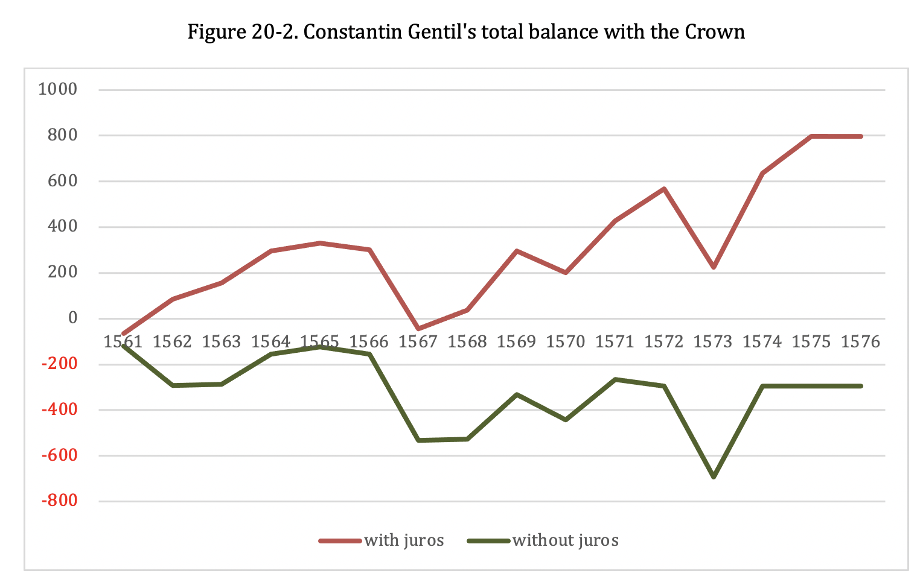
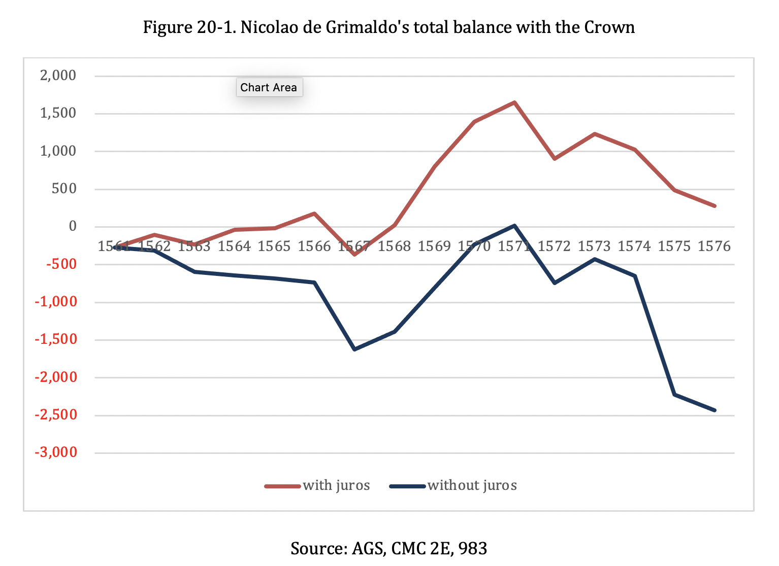
Juros de resguardo
Bankers had permission to sell them (and return them if loan was repaid
Equivalent to have a 7 percent loan from the Crown to lend at 12 percent or more
Example of balances

Slide 44
14. Credit crisis (archives)
“We have no other funds to satisfy our creditors except those that are owed to us by those who are affected by the decree. In effect, our funds were converted in the service of Your Majesty and without these funds, this financial support of Your Majesty could not have been provided
Frozen credit market
From Loan de Lago, in Burgos:
“ The delay in payment leads to our complete ruin. Your Majesty's officials issue orders in such a way that we cannot assert our claim for payment and credit... Nicolao de Grimaldo and our other debtors are protected by YM in such a way that we cannot ask the law to confiscate their property and imprison them. They also keep their books and papers as before (...) This causes us considerable damage, because they enjoy the use of the funds that they have to pay
“We have completely lost the credit, which is the nerves, the soul and the strength of commerce.”
AGS, CJH, 154. Note of the secretary, 1576.

Slide 45
Stop of the commercial fairs

Slide 46
1577
Agreement with the bankers in the Spring, but more negotiations in the Cortes
“Since you have sent me these reports on the matter of the Medio General [agreement with the bankers], and of the encabezamiento, [increase of the contribution of the cities], I have examined and reflected with great care on the former and the latter. […] I hold each matter to be much dependent on the other.”
The following month, the Treasurer General of Castile relayed strict instructions from Philip II’s secretary
“See to it that the negotiators have neither power, nor opportunity, nor license to err on matters so important and so few, namely these two issues /Medio/Encabezamiento.”
Smoking gun

Slide 47
Resolution
November 16: final agreement in the Cortes. Compromise with a doubling of the contribution
December 5: signing of the agreement with the bankers
Philip justifies to the cities his agreement with the bankers:
"...and adding to all this the demand that was addressed with particular insistence about the same affairs by the delegates of the Realm who are assembled in the Cortes that we are holding at the present time in Madrid"

Slide 48
The disaster of the Armada and the Millones
1588: the Great Armada almost entirely lost by a storm off the west cost of Ireland (on the return to Spain)
Great opportunity for Philip II
  Uses patriotism to obtain a contribution in the Cortes, much higher than the cost of the Armada
Temporary contribution for 6 years, 8 million ducats
The only time when the Cortes granted a contribution (when the service of the debt was not contrained by the ordinary revenues)
1589, English Armada with Drake. Same losses of ships (˜40) and men (˜15,000) History….

Slide 49
Last crisis
Fall 1596: The Millones come to an end.
Cortes refuse to extend them.
Philip II attempts to replay the same game: suspension to the bankers.
Quick settlement with the bankers using crecimientos
No tax increase granted by the Cortes
Negotiation will continue in the next reign.

