Slide 1
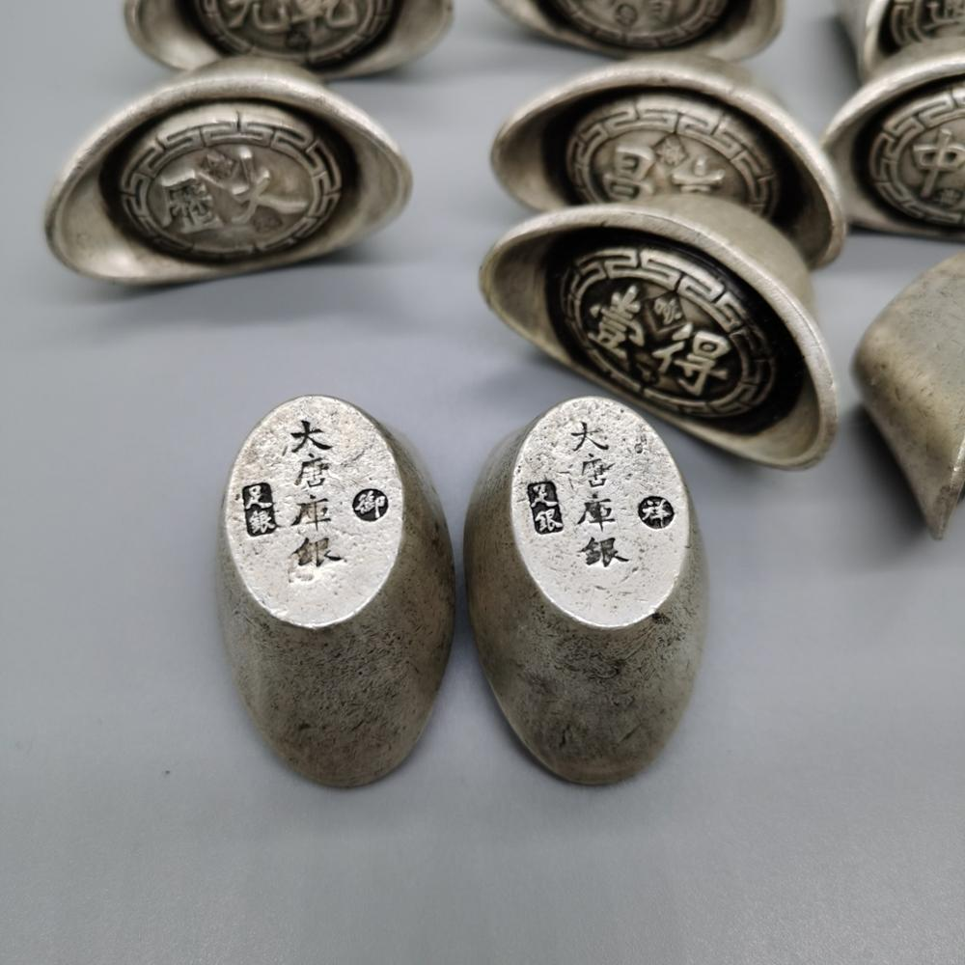
Reform the Coinage: The Rise and Fall of the World’s First Paper Currency System

Slide 2
Chronology
Paper money system was established by the Song Dynasty (960-1279) in 1024
The Mongol regime followed the tradition (1279-1368)
The Ming government (1368-1644) abandoned the institution around 1430
Most Chinese historians took it for granted that this abandonment was due to the continued inflation resulting from over-issuance

Slide 3
Unit Conversion
Money:
16 liang (两) = 500 grams
1000 wen (文) = 1 guan (贯)
Food (rice):
1 dou (斗) = 15 kilograms
1 shi (石) = 59.2 kilograms (“凡石者以九十二斤半为法,乃汉秤三百四十一斤也“)

Slide 4
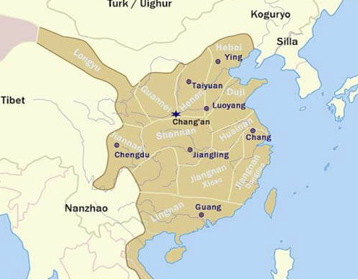
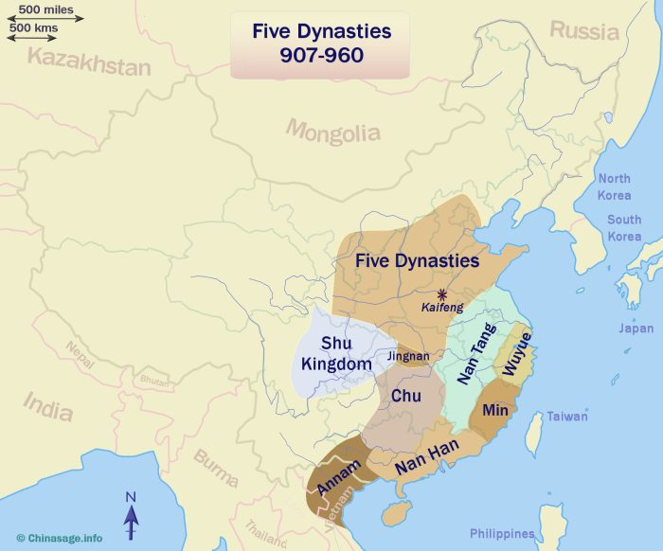
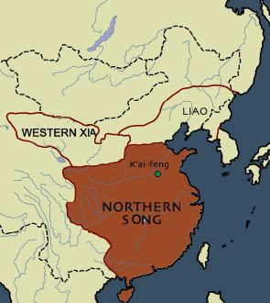
Map of China from Tang (618-907) to Five Dynasties and Ten Kingdoms Period (907-960) to North Song Dynasty (960-1127)

Slide 5
Brief History of Tang’s Currency (618-907) and 5 Dynasties’ Currency (907-960)
Tang China had very close trade with Byzantine and Prussia
Copper coin and silk (绢帛) were the main currency
Silk was a supplement to coins due to the lack of copper
Central Asia influence on silver as a currency
5 Dynasties and Ten Kingdoms had a very messy currency format
Iron coins became popular in regions without copper

Slide 6
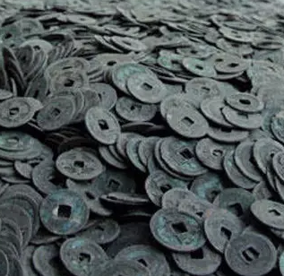
The Motivation for Paper Money
The Song Government promoted commercial activities, demanding currency to be transferrable in large quantities
Copper money carried the risk of currency outflow and was scarce
Neighboring countries demanded silver as tribune because they traded with central Asia
The Song Government used paper money to finance the war against the Jin Dynasty (金 1115-1234) and the Mongolians/Yuan Dynasty (蒙古/元 1235-1271).
Notes:
The Copper money was low in face value already, having paper money is not that big of a deal given they have copper money

Slide 7
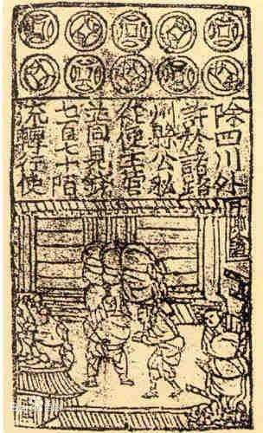
The Origin of the Paper Currency (交子)
Originated in the Sichuan area during the North Song Dynasty (960-1127)
Stage one: individual issuance
Stage two: a joint issuance by 16 wealthy families
Stage three: a government official issuance (益州交子务)

Slide 8
Stage one: Individual Institution
The institution for paper currency was more like a safe keeper
The currency was the receipt of the total amount of coins a businessman has stored at the institution
There were not a unified version of the receipt throughout the region

Slide 9
Stage two and three: Supervision
Wealthy individuals in the region gathered and distributed a consistent currency throughout the region
Transaction fee of 30 wen for exchanging coins
Copper plate printing press technique (Printing press invented in 700s)
Conflict about default forced the government to take over the entire system, establishing an official institution in the region
Copper was scarce (Government took copper furniture from citizens)
Only used locally (failed attempts in Shaanxi 陕西)
Issued every 3 years, old currency were exchanged for new ones to establish credibility
Government later issued Qianyin (钱引) in parallel to Jiaozi (交子), pegging copper coins, silver coins, salt, and other commodities, Jiaozi was abolished 4 years later in Sichuan

Slide 10
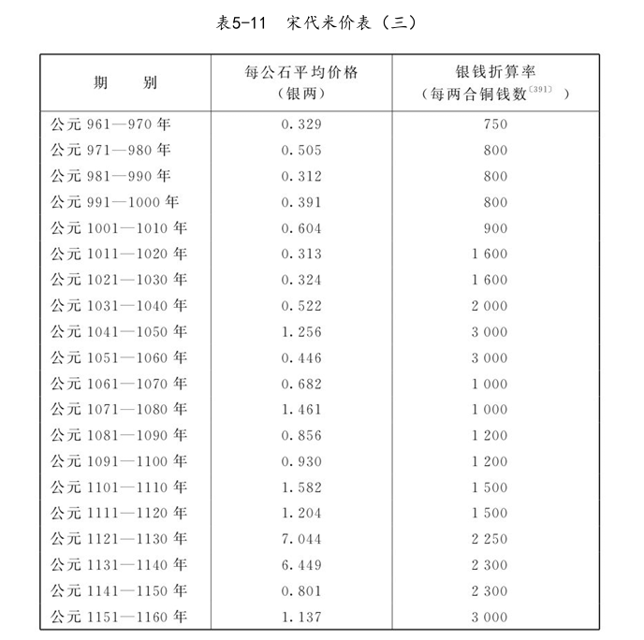
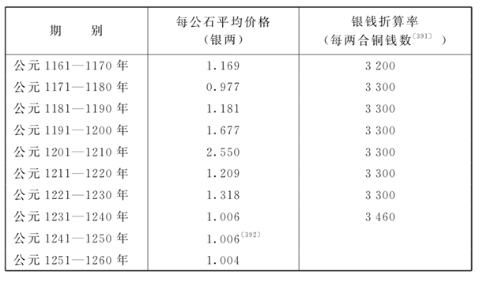
Purchasing Power of Silver and Copper (with respect to Rice)
Price of 1 Shi of Rice in Silver (Liang)
Price of 1 Liang of Silver to Copper coins
Year
South Song Income:
On average, blue-collar workers make 1 shi of rice per month in 1100, but about 0.75 shi in 1200

Slide 11
The Call of War and the Need for Money
Jin Dynasty (金) took over half of China and adapted the paper money system due to lack of copper mines
The South Song Dynasty used a paper currency called Huizi (会子) pegging on copper and silver coins
2% of the Song coins discovered were from South Song Dynasty
Devaluation of paper money with respect to silver coins due to constant warfare
Counterfeit was a huge problem for the government
Silver became the main denominator for both Jin and South Song
  Song: 4 guan = 1 liang silver Jin: 2 guan = 1 liang silver (initially)

Slide 12
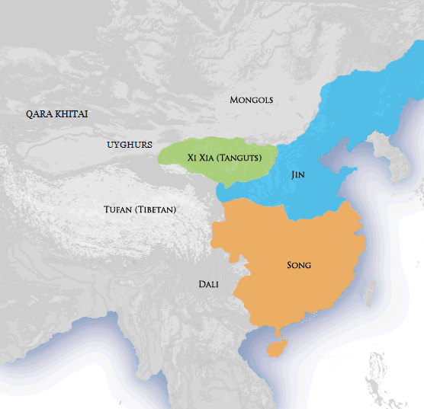
Jin-Song War

Slide 13
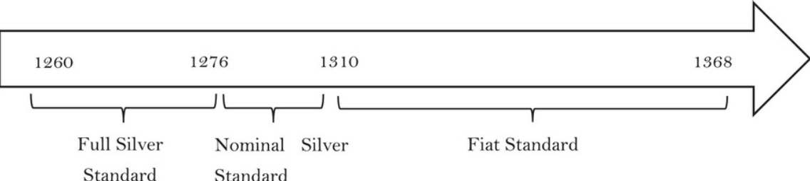
Yuan Chronology: Currency with Respect to Silver
Four circulations of paper money
Full silver standard: fully backed by silver
Nominal silver standard: integrated Song's money, no longer fully backed by silver
Fiat Standard: silver had no reserve role after Zhidachao (3rd circulation)

Slide 14
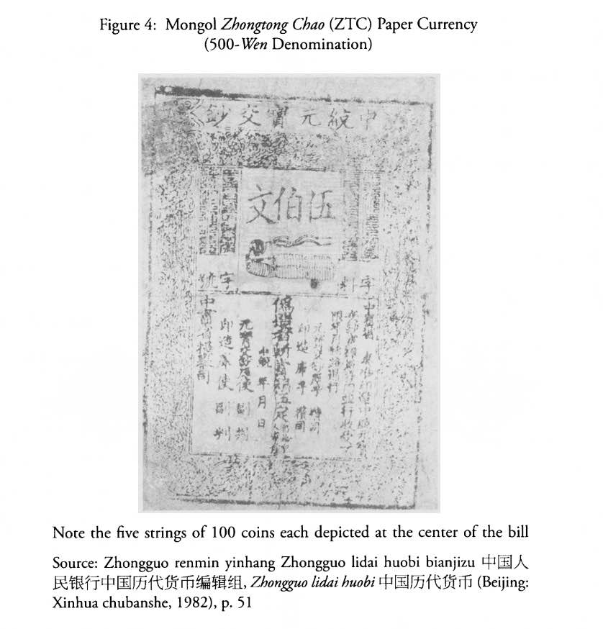
The Mongolian Takeover (1260-1638)
The Mongolians abolished the Song system
Mongol administrative system adapted the same style of Jin's paper currency system after taking over
The Yuan dynasty (1279-1368) adapted a silver-based currency, although also established conversion rates to copper coins
Harsh conversion rate for Song paper money to Yuan paper money (1 guan of Mongolian money = 50 guan of South Song money)
Known to be the most successful dynasty for paper money, but very short lived (only 90 years)
Inflation occurred due to constant warfare

Slide 15
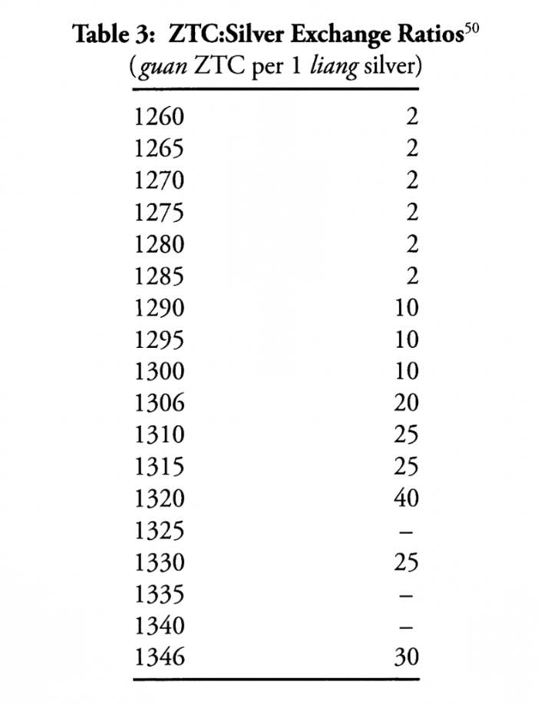
The 4 Paper Monies & Conversion Rate
 | Period of Circulation | Zhongtongchao (guan) | First Zhiyuanchao (guan) | Zhidachao (guan) | Second Zhiyuanchao (guan) | Zhizhengchao (guan) | Silver (liang) | Rice (Shi)
Zhongtongchao (中統鈔) | 1260-86 | 1 | - | - | - | - | 0.5 | 1
First Zhiyuanchao (至元鈔) | 1287-309 | 5 | 1 | - | - | - | 0.5 | ~0.5
Zhidachao (至大鈔) | 1310 | 25 | 5 | 1 | - | - | 1
Second Zhiyuanchao (至元鈔) | 1311-51 | 5 | 1 | - | 1 | - | 1 | ~0.3
Zhizhengchao (至正鈔) | 1352-68 | 10 | 2 | - | - | 1 | 1

Slide 16
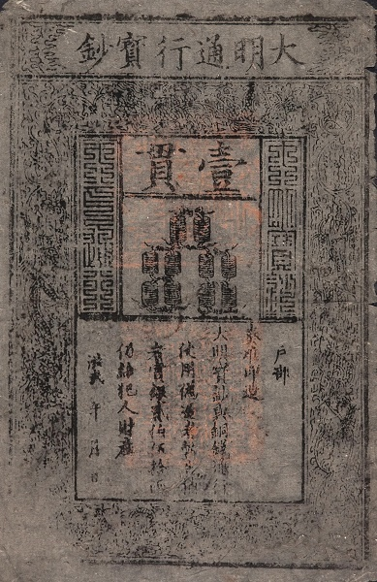
The Decline of Paper Currency in Ming (1368-1644)
Early Ming rulers did not use paper money for fiscal purposes as the economy was sound
Early rules: paper money if >100 wen, coins if <100 wen
Paper money depreciated to 3% of the original price against silver only after 40 years
Completely vanished after 60 years of the establishment

Slide 17
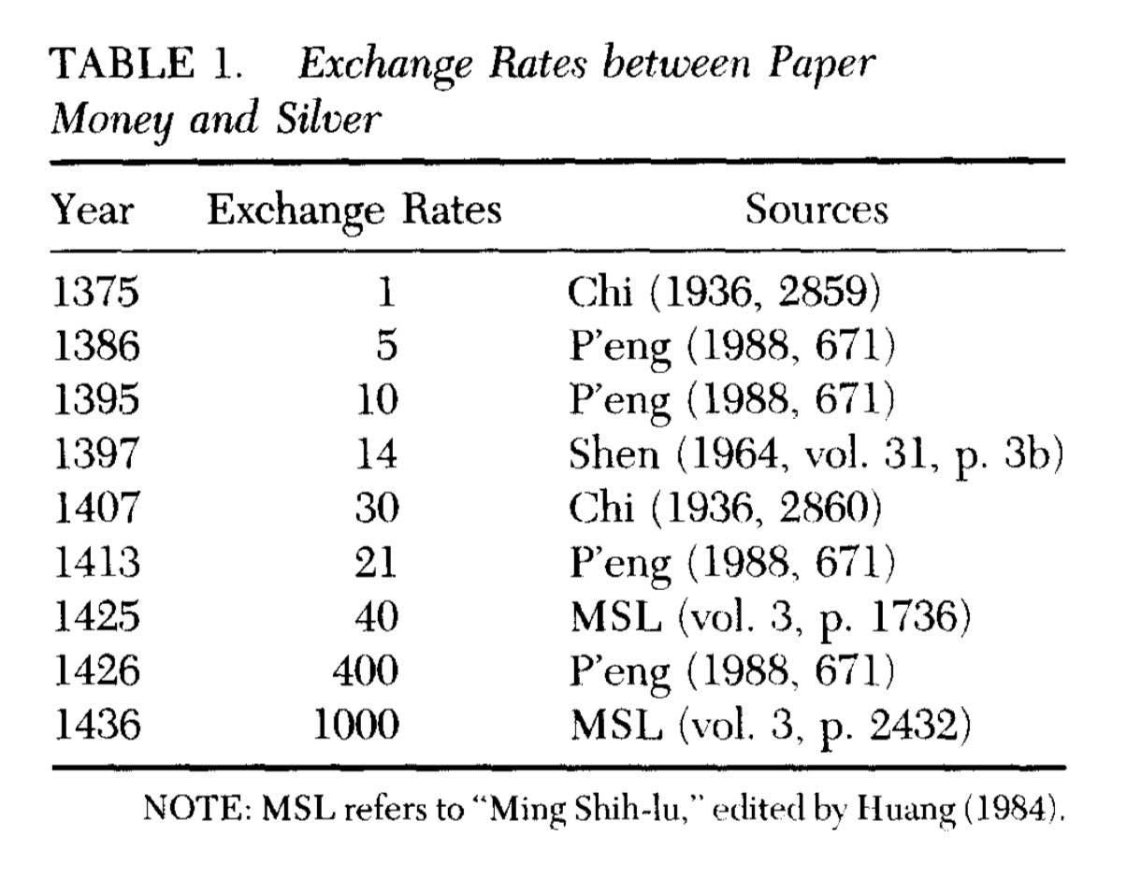
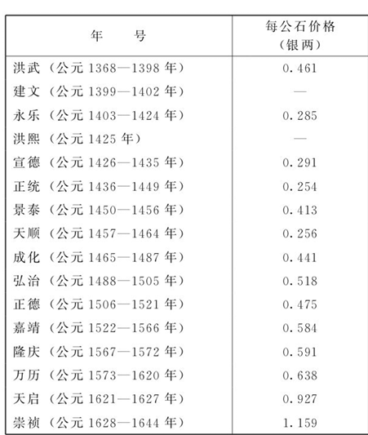
Exchange Rate to Silver in Ming and Purchasing Power of Silver
Price of 1 Shi of Rice in Silver (Liang)

Slide 18
Theories about the Sudden Decline
Inflation:
Counterfeiting was a huge issue (250 liang bounty)
1377: 1 liang = 1 guan = 4 shi of rice, 1297: 1 liang = 2.5 guan = 4 shi of rice
“朝廷出钞太多，收敛无法，以至物重钞轻” 御史陈瑛 (The government distributed too much money and couldn’t repurchase, hence inflation)
Tough Competition:
Inflation continued even after the government has stopped printing money
Regarding Song Dynasty’s success against inflation: “paper money supply always increases more than in proportion to the rise in prices under such a feedback rule of money supply, real balances and the price level move in the same direction”

Slide 19
Reference/Reading List
Chau-Nan Chen, Pin-Tsun Chang, Shikuan Chen, The Sung and Ming paper monies: Currency competition and currency bubbles,Journal of Macroeconomics,Volume 17, Issue 2, 1995, Pages 273-288, ISSN 0164-0704, https://doi.org/10.1016/0164-0704(95)80101-4.
Glahn, Richard von. “Monies of Account and Monetary Transition in China, Twelfth to Fourteenth Centuries.” Journal of the Economic and Social History of the Orient 53, no. 3 (2010): 463–505. http://www.jstor.org/stable/20789802.
Guan, H., Palma, N., and Wu, M., ‘ The rise and fall of paper money in Yuan China, 1260–1368’, Economic History Review, 77 (2024), pp. 1222–1250. https://doi-org.ezproxy.bu.edu/10.1111/ehr.13305

