Slide 1
Ec 565
9/12
Remarks on Greece
Rome: history Remarks on the empire
Inflow of precious metals
Budget
After year 180

Slide 2
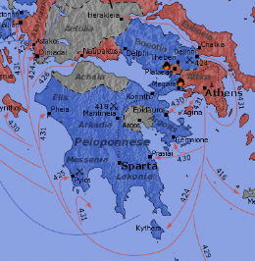
Athens: the Peloponnesian War( 431 BC-404)
Thucydides (460-400)
  Greatest historian in antiquity
War between Athens and Sparta
Cause of the war
  Fear of the ascendency of the other
“Thucydides trap”
  (Graham Allison)
History of P W (HPW)

Slide 3
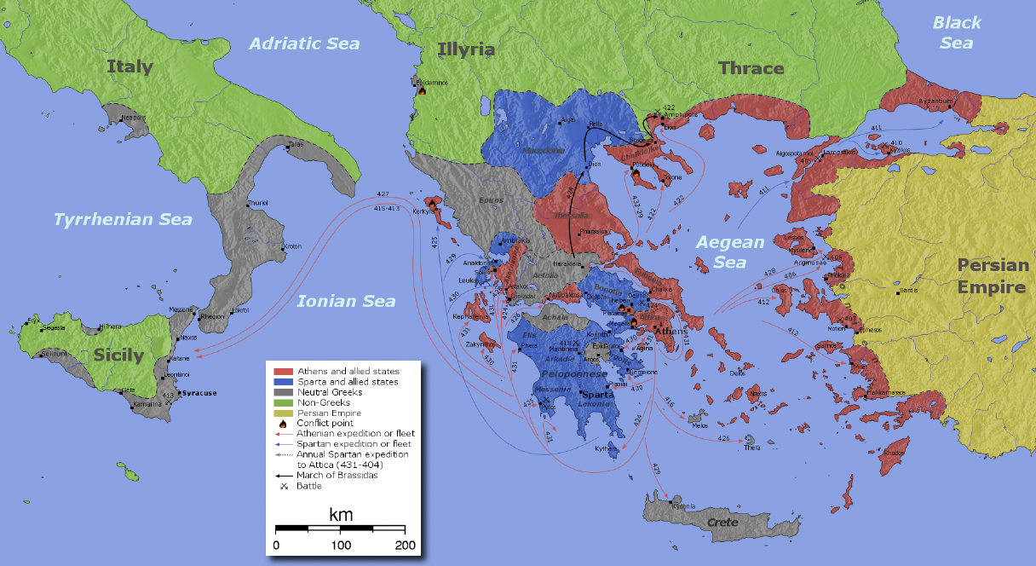
Athens/Sparta and allies

Slide 4
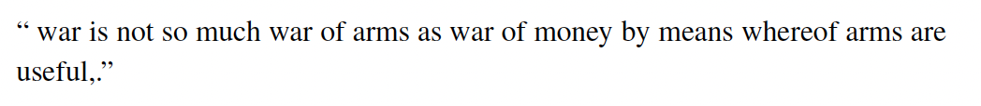
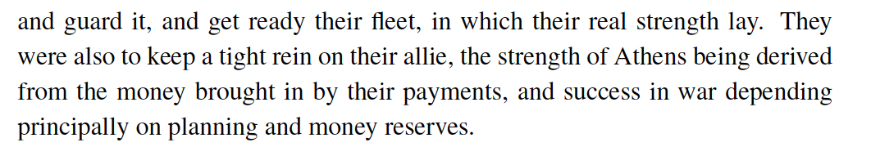
War and money
Archidamos (CIC in Sparta)
Pericles
Silver mines near Athens
  Saving for the naval battle of Salamina (483 BC)

Slide 5
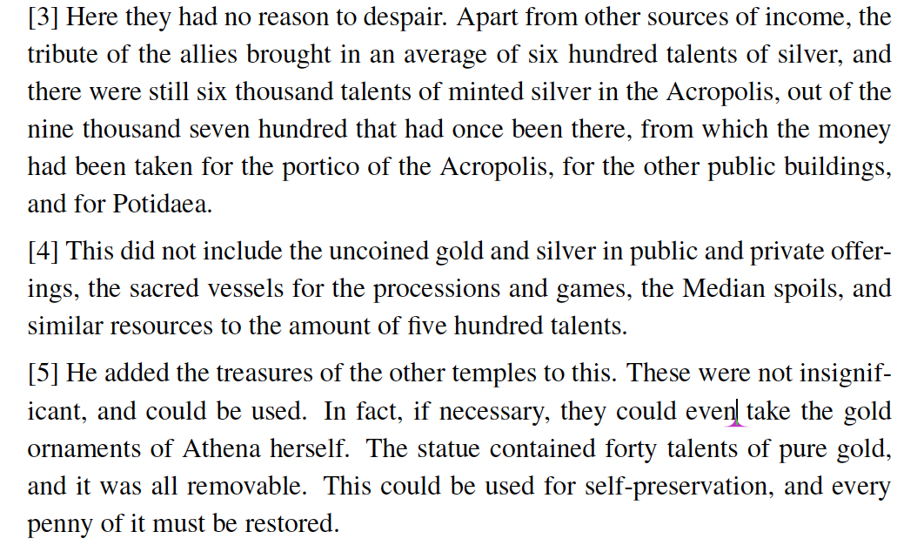
Money reserves

Slide 6
Rome, (Ec 365, 9/12)
Founded around 750 BCE
  Long period of fighting with other groups in Italy
  Gradual growth and expansion in Italy
  Build up of the infantry and the social structure
    Standard career in the elite: army, public jobs, senate, consul
    Importance of the language
Shock/Impulse to expand to imperial dimension: Punic wars against Carthage
  250-150 BCE
  Started with call for help from some people in Sicilia, (against Carthage)
  Expansion to “global power”
Last days of the Republic (power of the senate): continuing expansion around the Mediterranean Sea
Main power: infantry. The legion (about 5 500 legionnaires) superbly trained. A trained force is much more powerful (repeated observations in history)

Slide 7
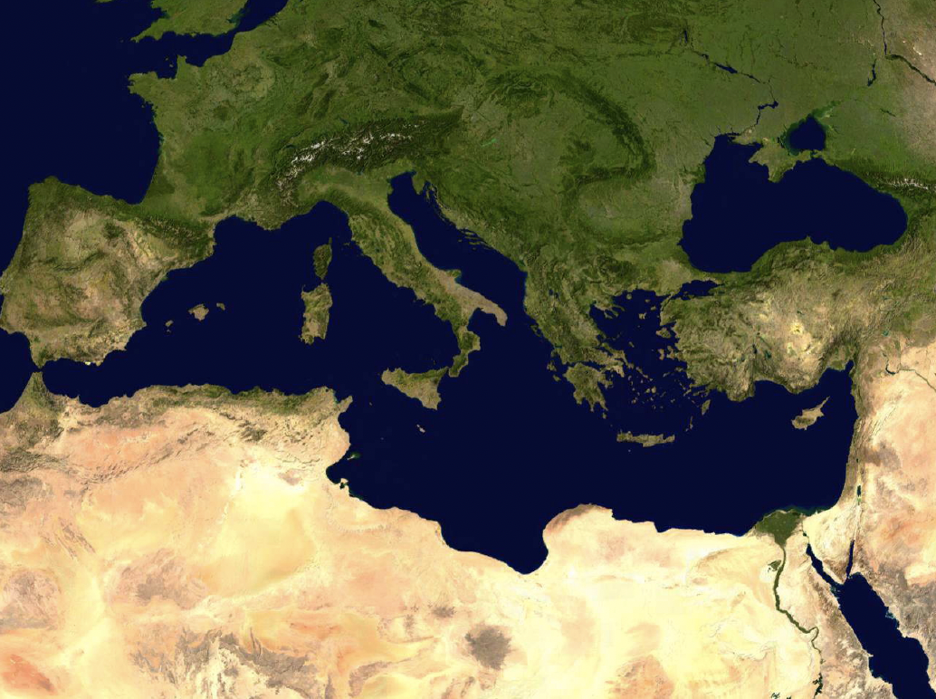
Geography: the Mediterranean Sea

Slide 8
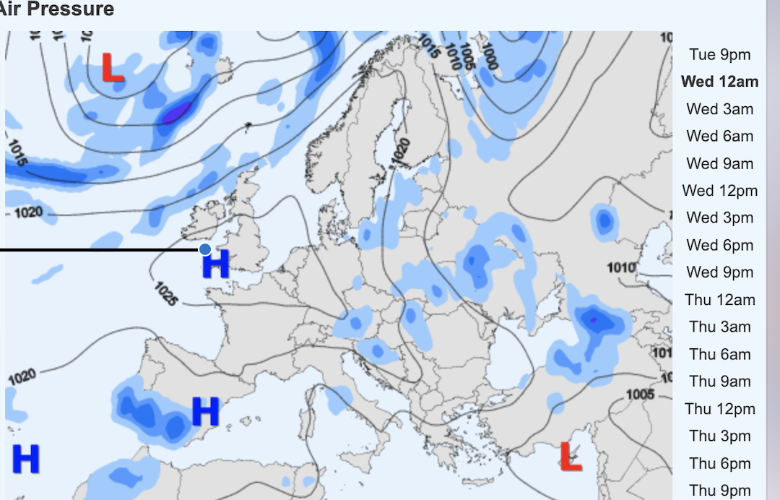
The spine
Travel by water is much cheaper (bulky goods)
The M. Sea has a culture in itself
Travel in the summer
Winds (Pliny)
Meltem
  Now

Slide 9
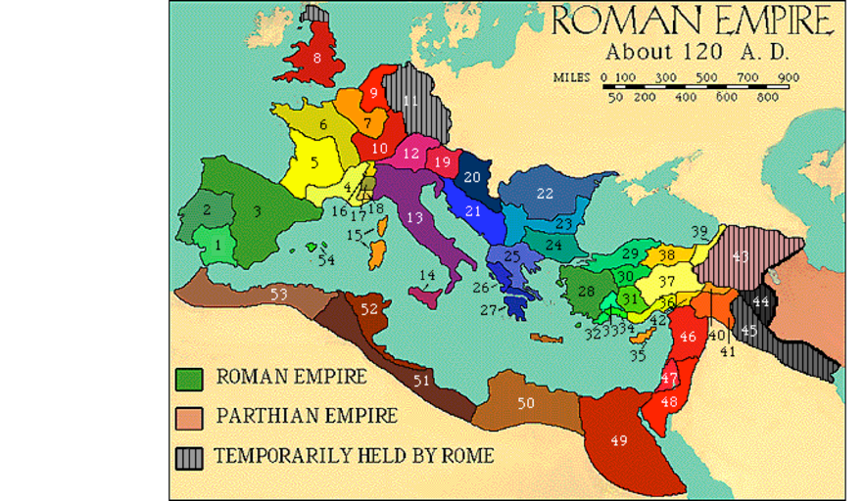
The Roman empire
Gradual growth in BCE
Empire begins with the “principate” of Augustus (31 BCE)
Gibbon: The Decline and Fall of the Roman Empire (1776):
“If a man were called to fix the period in the history of the world, during which the condition of the human race was most happy and prosperous, he would, without hesitation, name that which elapsed from 100 to 180
  Nerva, Trajan, Hadrian, Antonius, Marcus Aurelius (Antonine)

Slide 10
Principle of the empire
Travel spine: Mare nostrum
  Extension of the Nile…
  Not much in the winter however (e.g. letters of Cicero and Plinus)
The empire provides peace and saves on the costs of fightings between regions.
  Only the external border, and that is essentially Germany and the Orient.
  Romans were well aware of the benefits they brought: Pax Romana.
  Analogy with modern time
Actually very little effective power for enforcement, hence the devices to bring cohesiveness
  ideology of the emperor and tolerance for local religions (divisions minimize threats); (incompatible with Christian view).
  Some autonomy given to the regions (Plinus).
  Balance between overall stability and saving on local information/enforcement.
  Very harsh penalties (Spartacus rebellion)
  Balance between totalitarian and tolerant state

Slide 11
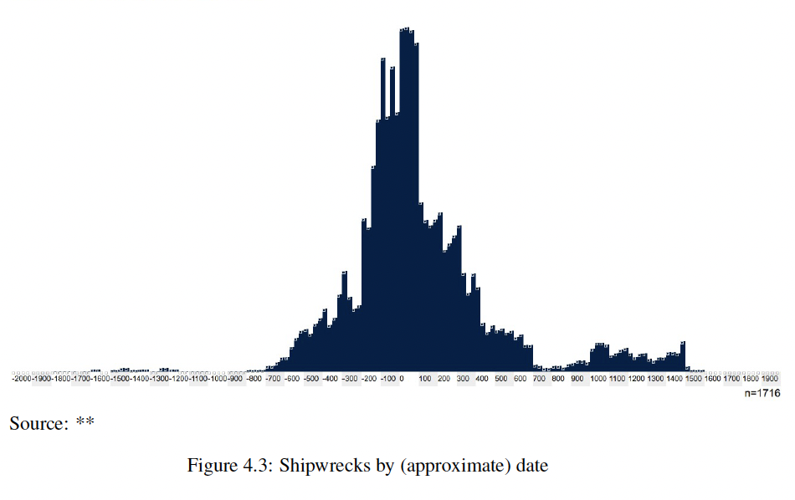
Trade
Index of Mediterranean trade:
shiwrecks

Slide 12
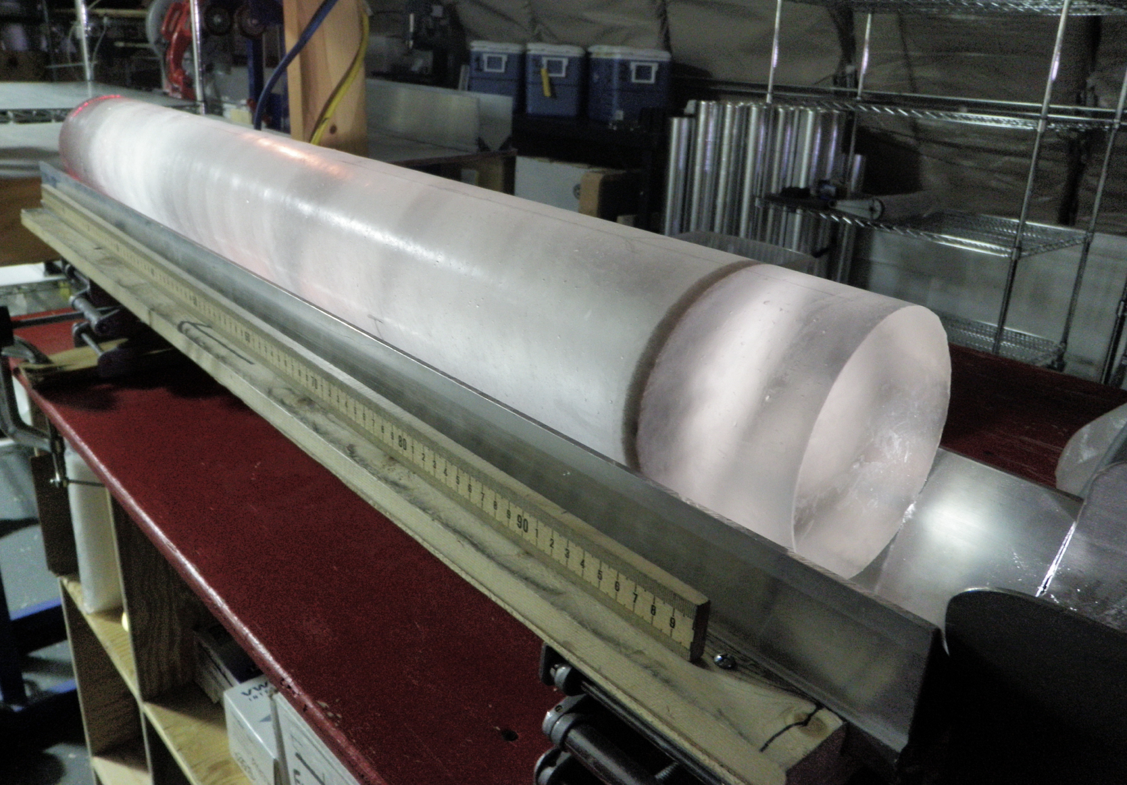
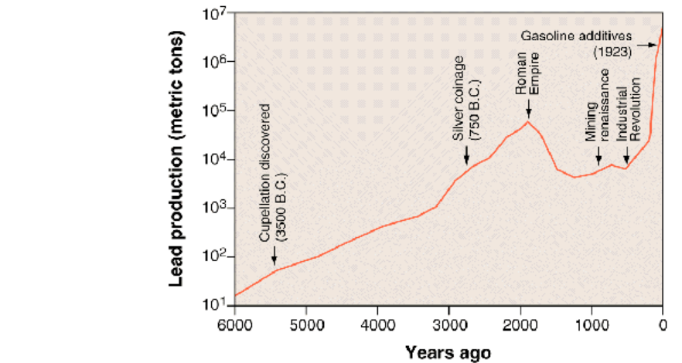
Inflow of precious metals
Extraction of gold linked to separation from lead in ore
How much was extracted? And when?
Two types of evidence
  Discarded ore around mines
  Pollution in the atmosphere
    Measured now in arctic ice and swiss bogs.
  Both evidences seem to agree
Ice core

Slide 13
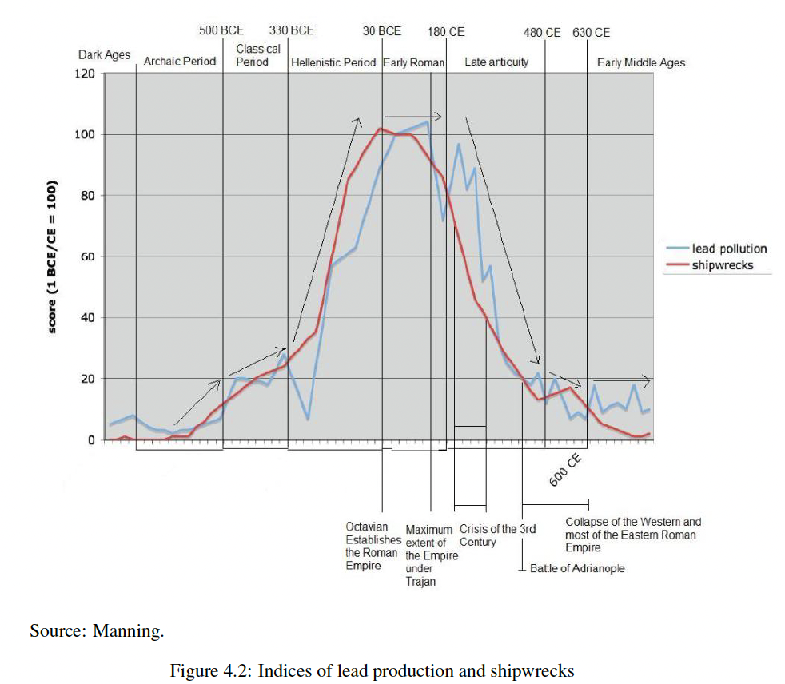
Trade / silver

Slide 14
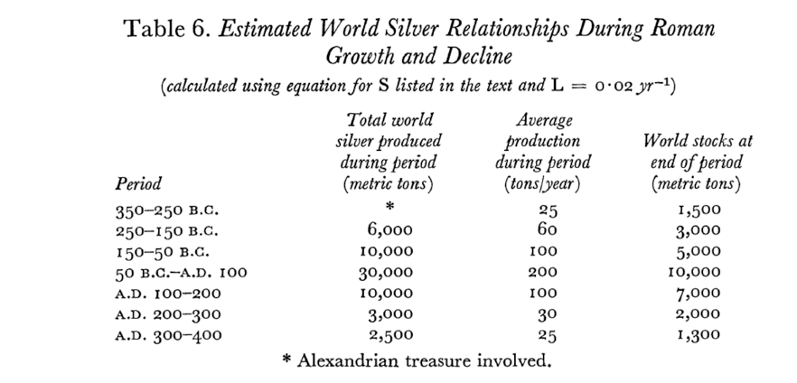
Record from mines
Patterson (1972)

Slide 15
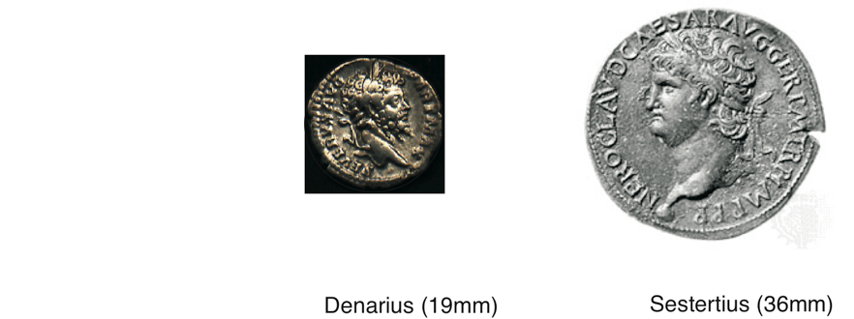
Gold and silver coins
Small value coins cannot be in gold
Large value coins cannot be in silver
Hence, bi-metallic system
In place, theoretically until the 20th century
In Rome
    1 Aureus (gold) = 25 denarius (silver) = 100 sesterces (bronze)
    1 Aureus struck at 40-45 to the pound (327 gr), about 8gr
    Today, 1 ounce (28gr) is about $1000 (comment), aureus about $300
    1 HS about $3 (according to the weight in precious metal– comments)
    Difficulty in comparing developed and underdeveloped economies.

Slide 16
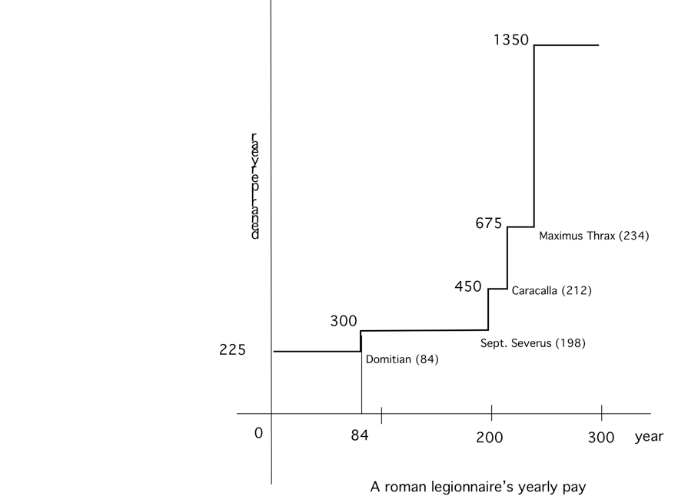
Legionnaire annual pay
Paid in aureus three times a year
Pay in denarius withy round numbers: 9 aurei per year = 225 denarii.
Pay increase: 1 aureus = 3 aureii per year = 75 denarii (in y. 84)
About 900 HS during 1st cent. CE.
Legionnaire had to buy his own equipment
Retirement benefit (land)

Slide 17
Methods of estimation
No statistics. Numbers were there, but we have to find them indirectly.
Yearly pay in 3 installments
  probably as a multiple of the Aureus (25 Denarii)
Available evidence:
  225, 300,
  Sept. Severus increased the pay
  Caracalla raised the pay by 50 percent
  Some (vague but independent) estimate of the total cost for Caracalla’s raise
Inference:
  Severus’ raise was an even number of Aurei, 2 or 4 (per installment)
  Given the total cost for Caracalla, the number must be 2 per payment or 6 per year.

Slide 18
Taxes
Like in other aspects of Roman rule, the tax system rested on traditional customs and legality. The tax system of local entities were just enforced by the Roman governors.
  Ex. Egypt; in Sicily, .
Private wealths had always a large impact on public expenditures (army, buildings game). Julius Caesar had a huge inheritance (around 700M sesterces)
Extended use of tax farmers during the republic (B.C.), publicani. Less so during the empire where governors were in charge.
Reform of Augustus:
  wealth tax
  poll tax both rates were low
  harbor tax (5 percent) long tradition...
very rigid system - no debt yet (not much of a capital market), but tax farmers could be bankers and finance commercial enterprises.
Sudden requirements met by sales of (real estate) assets, confiscations and seignorage.

Slide 19
Computing the size of the overall budget (and tax burden)
1 soldier = (about) 1 worker
Total population about 50 M
Evaluating the size of the army
  Legion (infantry) about 5 500 soldiers
  Auxiliaries
  Cavalry
  Officers
  Navy

Slide 20
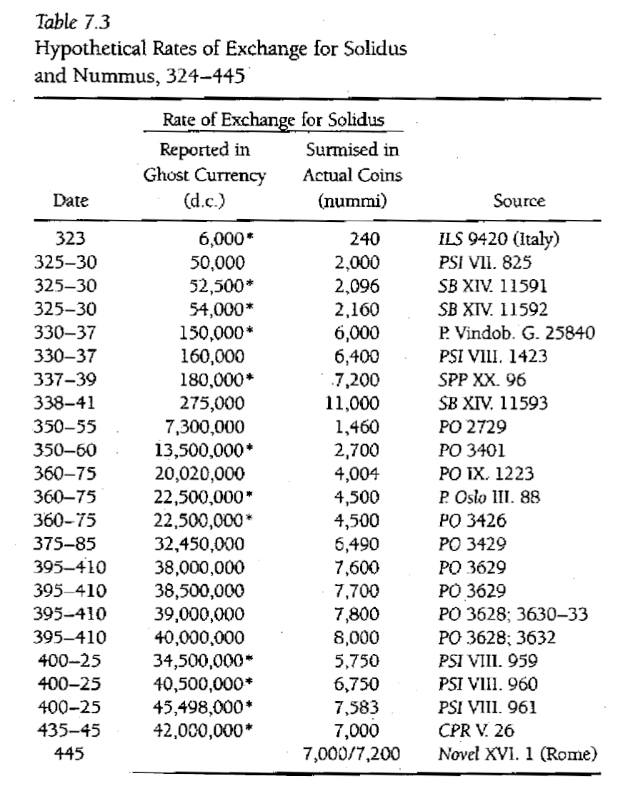
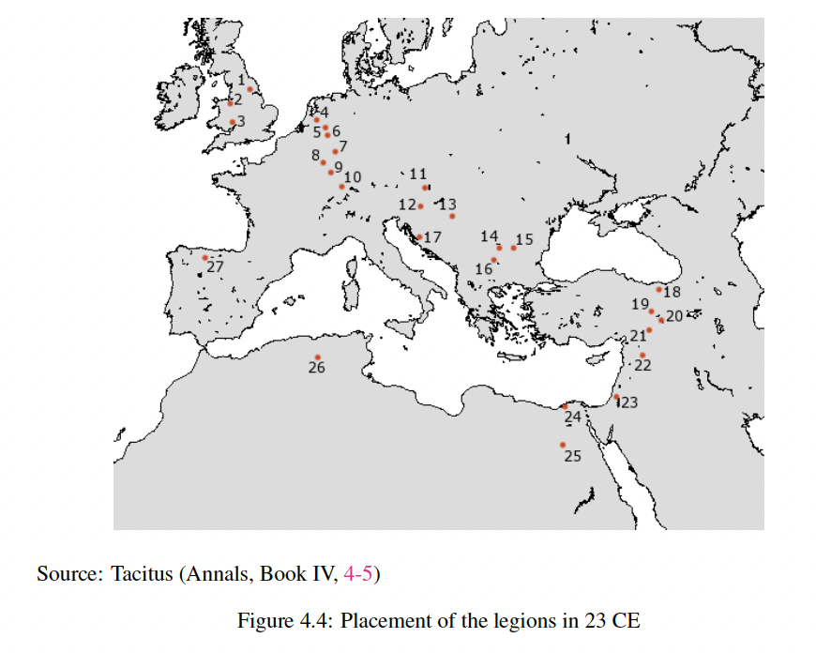
Legions around year 100 (Legion ˜ 5,000)

Slide 21
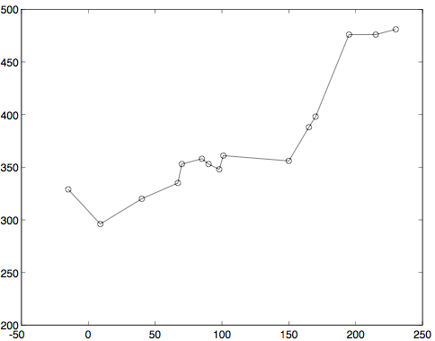
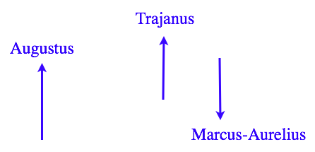
Evolution of the size of the army (in thousands)

Slide 22
Tax burden
About 0.4/10 = 4 percent…
With other costs, may be 8 percent (max): See Hopkins
No serious public work financed in addition
  Roads: work of legionnaires
  Many public works : private donations
  Some local public works and taxation however: (Plinus)

Slide 23
Inflation and seignorage
Pay raises, sure sign of inflation
Causality?
  Higher pay cause or consequence?
For an economist, always monetary cause
Difficulties of the state already during the best days of the empire
  No possibility to borrow, but a surplus was possible. Antonine raised a surplus of 700 millions denarii (seems very high), spent by Marcus Aurelius.
    by that time, the pay for GI’s in a legion was 5000x1200 denarii = 6M denarii per year, at 70 legions, 420M
  Evidence that Marcus Aurelius reduced the silver content of coins (denarius to 75 percent).

Slide 24
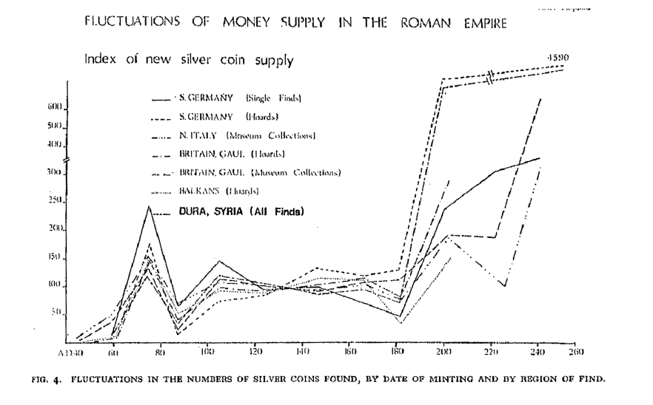
Coin supplies

Slide 25
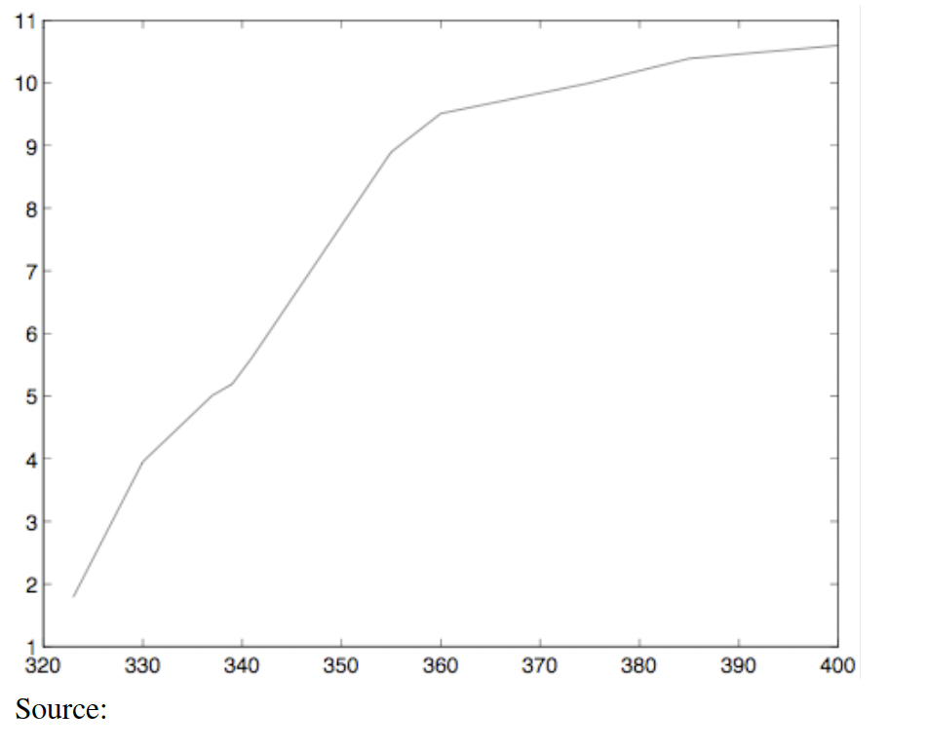
After 170
Antonine Plague (165-189)
Climate?
Civil wars in 3d century
Reforms of Diocletian and Constantine (around 300)
  Price controls (tables)
  New currency: solidus
Invasions
Continuation of inflation

Slide 26
Case of Egypt:
Coins found in Egypt are “local” and different from coins found in other provinces.
Evidence (temporary) that Roman taxes were probably in kind.
Direct evidence (?) with shipping of wheat to Rome (and possibly other legions in other provinces.

