Slide 1
Interest reduction in England
Ec 565
October 10, 2024

Slide 2
Map
1688-1815: a Golden Century of public finances
  1688: Glorious Revolution in England: change of regime
  France goes on in the Ancient Régime
States’ finances related to different histories and current political systems
Second Hundred Years War
  Military confrontations push the fiscal regimes to their limits
    or extend the limits
The regime in France breaks fiscally and politically
  French Revolution (1789) triggered by the public debt problem
Napoleonic wars
  End at Waterloo (1815)
19th century until 1914.

Slide 3
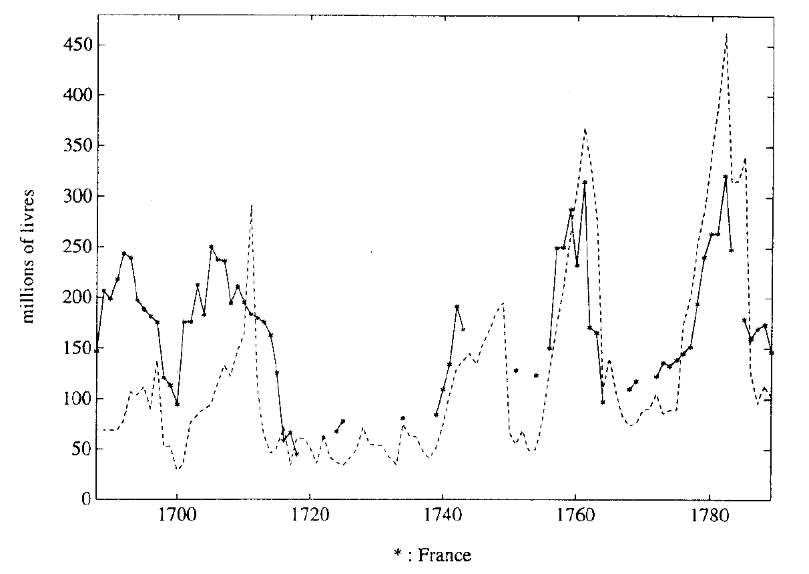
The second hundred years war military expenditures
England
France

Slide 4
Plan
Expenditures in England and France
Taxation in England
  Tax reforms: from private farms to government administration
Theory of “tax smoothing”
  The public debt is almost a side show.
Debt instruments
  Fixed terms
  Callable bonds
The war of the Austrian Succession (for England 1742-1748)
Refinancing after the war
  The game where the government won (1748)
  The game where the government lost (1737)

Slide 5
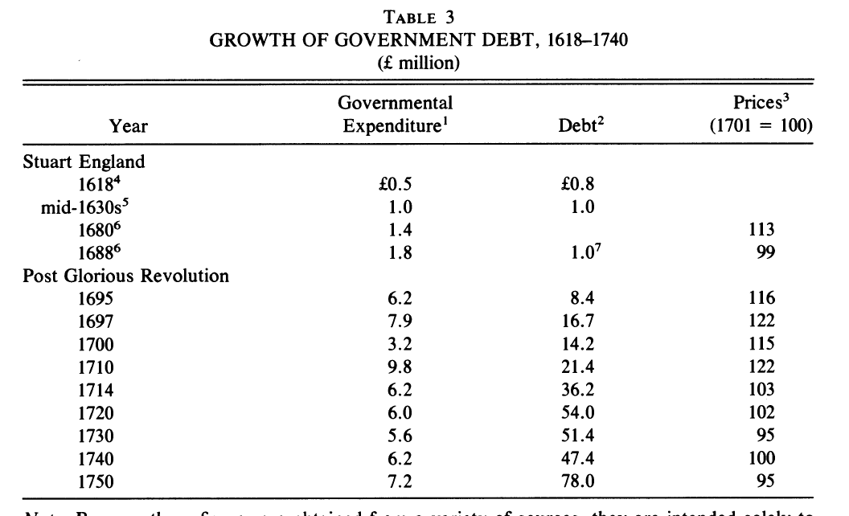

Slide 6
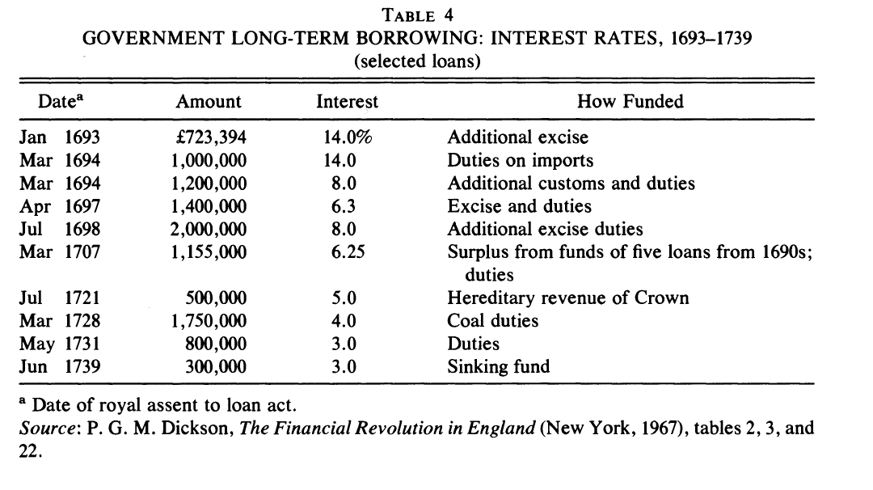

Slide 7
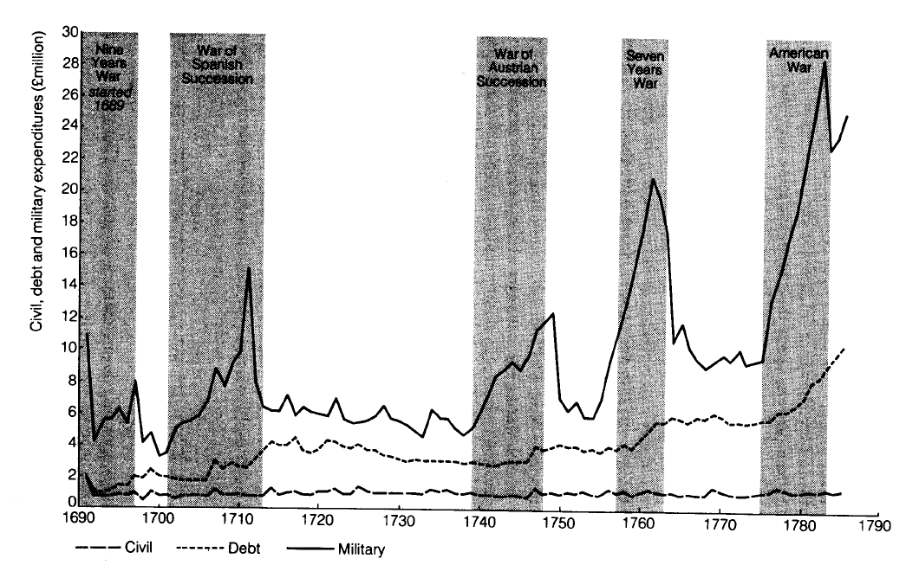
Public Finance in the Second Hundred Year War: 1688-1815
Critical for political evolution
Public expenditures in England

Slide 8
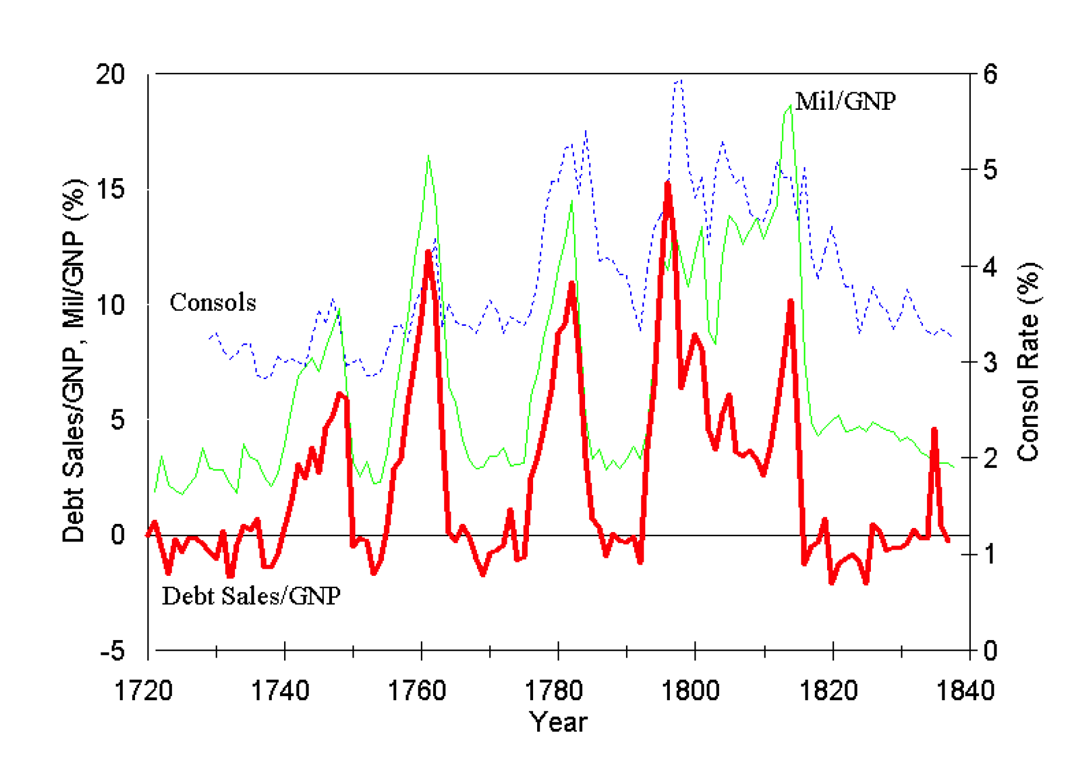
Military expenditures / GDP

Slide 9
Tax reform
Main bases
  Land
  Customs
  Excise
Tax administration
Groundwork under the late Stuarts. Termination of
  customs farm (1671)
  excise farm (1683)
  hearth tax farm (1684)
  Transition was gradual (keeping the staff)

Slide 10
Land tax
  Small administration. Assessors and collectors appointed by local tax administrators. Low monitoring, sometimes slow payments.
Customs
  Separate administration, under the conrol of the Treasury. Gradual deadwood. Traditions and special interests.

Slide 11
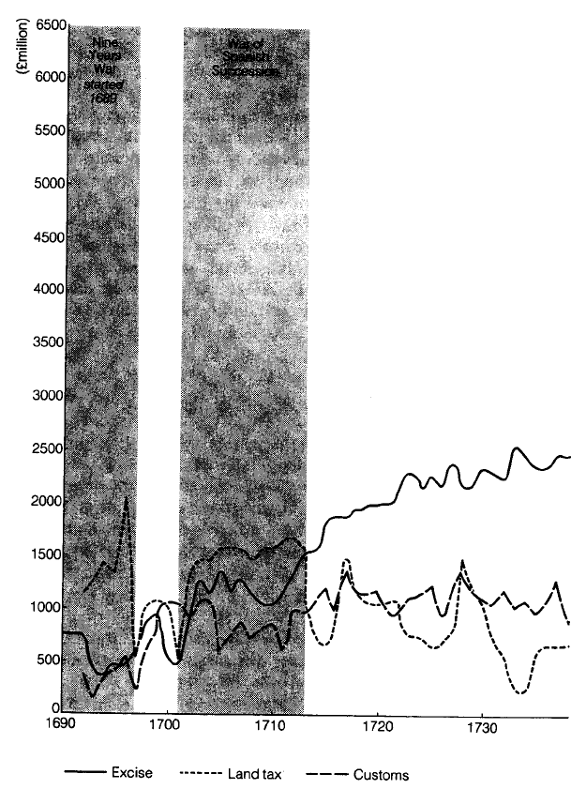
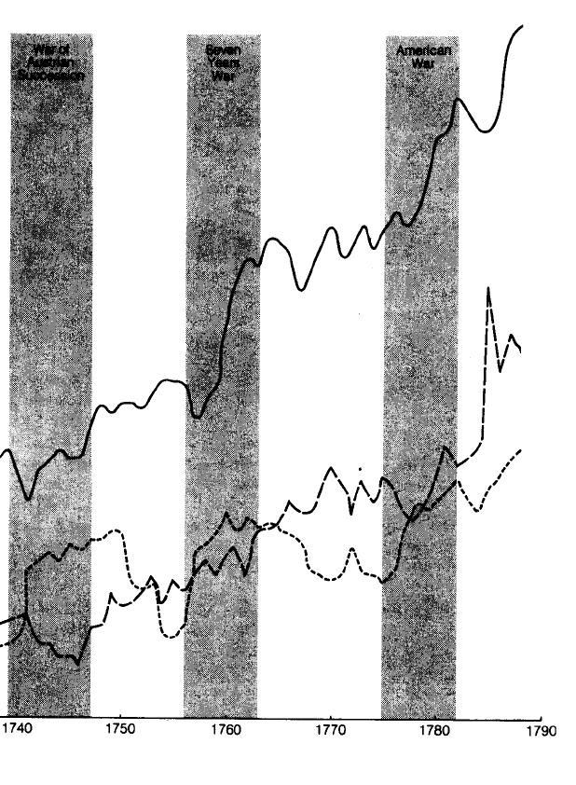
Tax Revenues in England
Excise
Land
Customs

Slide 12
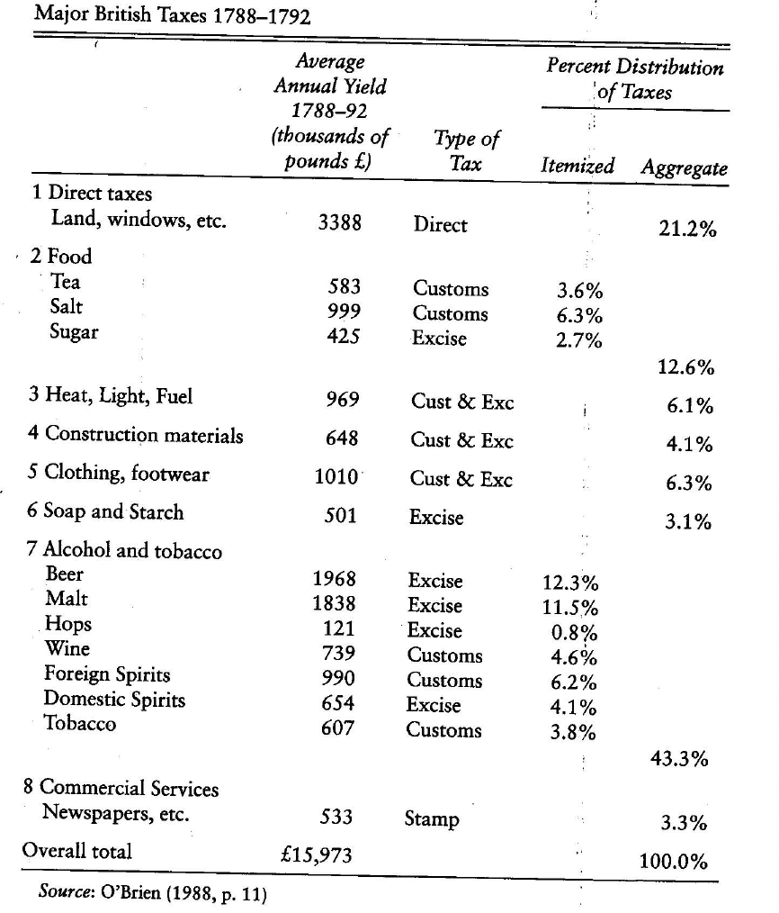
Actual tax policy

Slide 13
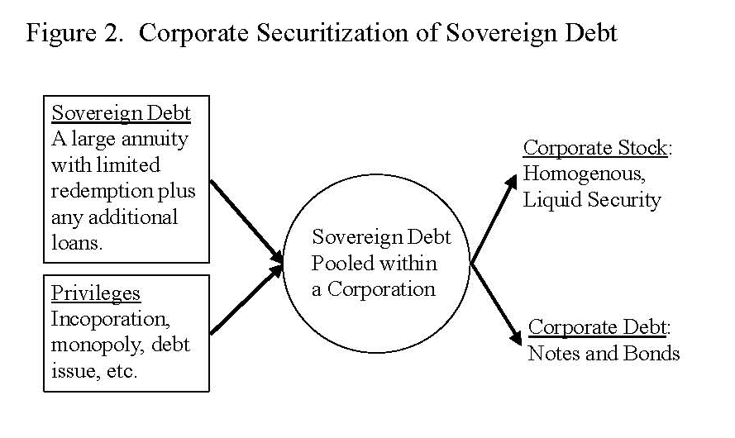
Ref: Quinn

Slide 14
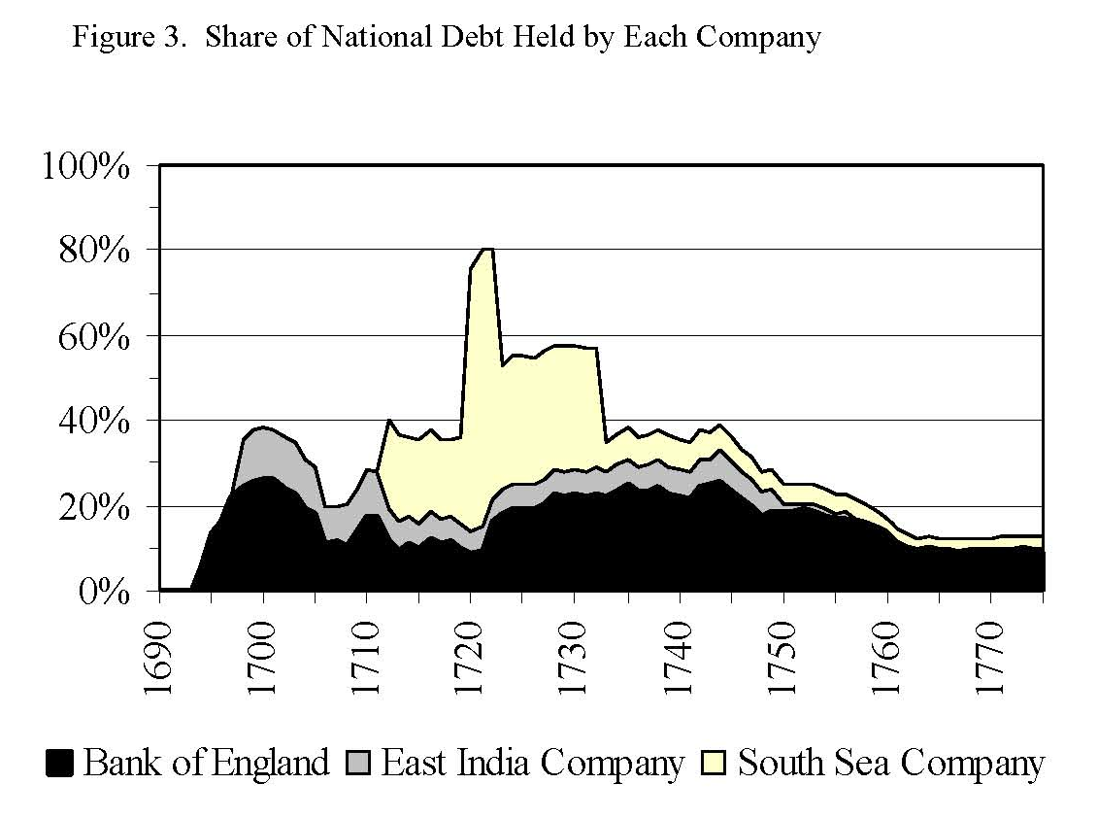

Slide 15
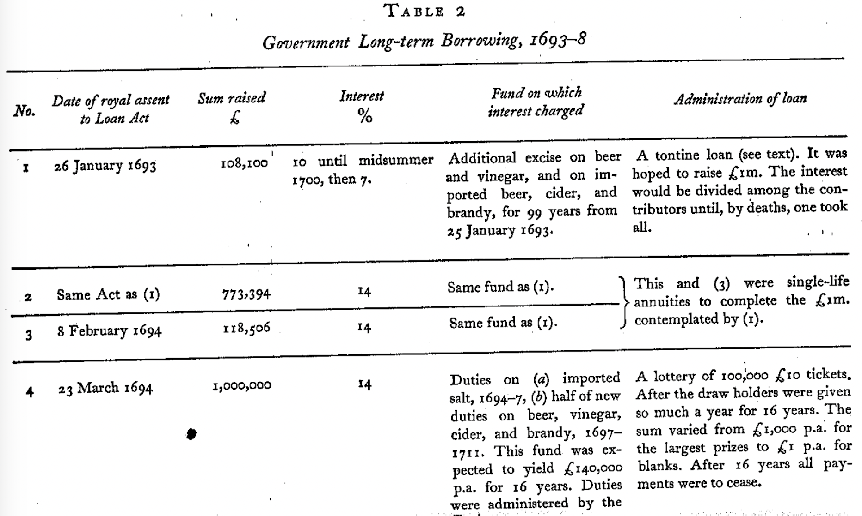
Funding of the debt

Slide 16
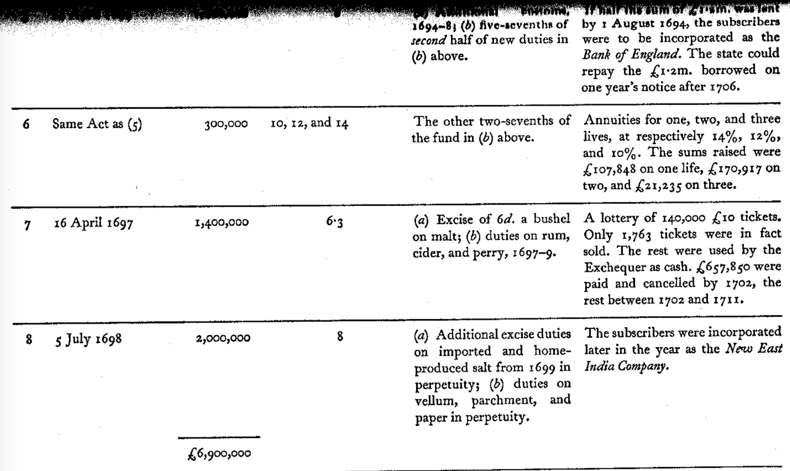

Slide 17
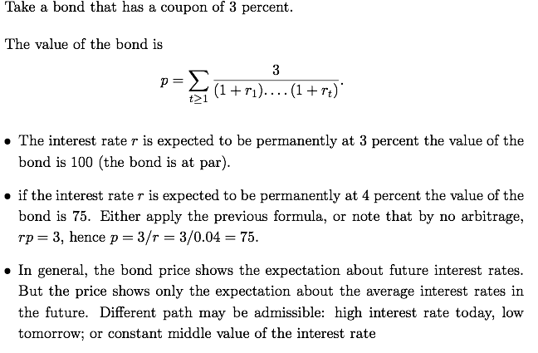
The pricing of a bond

Slide 18
Callable bonds
Callable bonds can be reiumbursed at par (at the face value)
They will be if the interest rate is lower
In general, it is issued (at 4 percent) when the interest rate is higher than 3 percent. If the interest rate falls, the government can refinance the debt.
The 4 percent loan is refinanced by a new loan at 3 percent.
Easier to “reduce the interest rate” from 4 percent to 3 percent
Actually, the reduction is phased in over the next seven years (example of 1749)
Important feature: contingent debt instrument: the government pays a smaller interest rate when the market rate falls after the war
France with lifetime annuities did not have such a feature
18

Slide 19
Lowering the cost of the debt: issues
Development of financial market in England
Contrast between England and France
England
    All debt before 1750 was redeemable at par
    Loans during the Seven Years war (1756-1763) had a fixed term
    Loans during the American war were redeemable again
Today: we focus on two events
  1737: failure
  1749: success
France
  redeemable debt was used under Louis XIV
  Colbert managed a successful reduction of the interest rate in the 1680’s
  Law experience
  Not one redeemable bond in the 18th century, all life-time annuities (like retirement account) and loans with fixed time of reimbursement

Slide 20
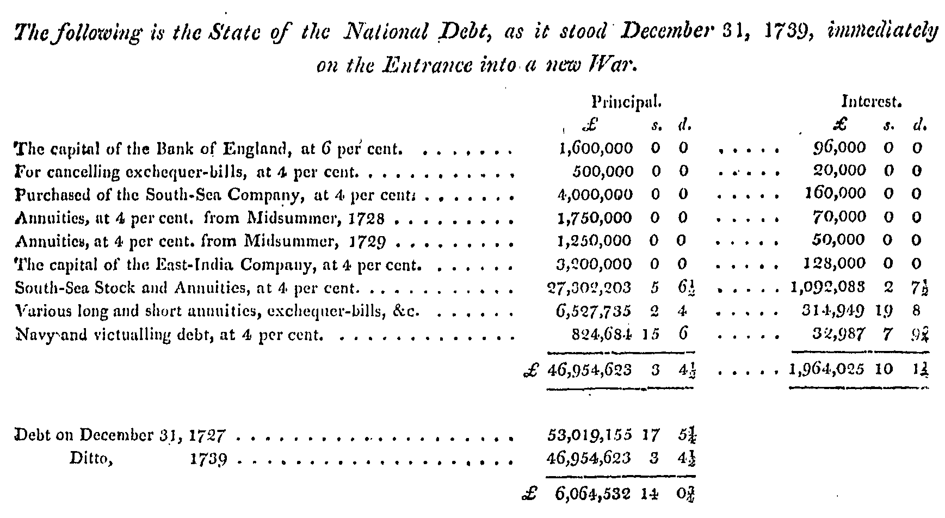
In the 30’s most of the debt is at 4% or higher
Source: Grellier (1810)

Slide 21
Possible financial policies
Fixed term loans of 10, 20, 30 years or life-time annuities
  Method in France: very expensive since the terms of the loans are set during the war when the interest rate is high
During the war, issue short-term debt and refinance after the war (when the interest rate has fallen again)
  Some have alleged that this was the method in England
  No data that this refinancing took place (a little more after 1783)
Policy actually followed: issue long-term debt that is redeemable
  The government (borrower) can buy back the bond (annuity) at the face value, is at “par”, usually 100.
  To buy back old loans, the government would need to issue new loans (at the current interest rate that would be lower)

Slide 22
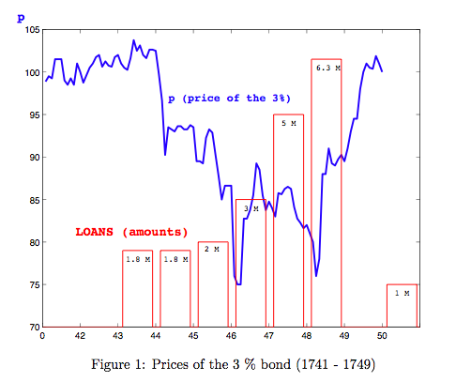
Overall view
During the war, the price of the consol falls : the interest rate rises
Let p be the price of a perpetual annuity (consol) with payment (coupon) c per year
Long-term interest rate R
Then: p = c / R
Borrowing is high when its cost (the interest rate) is also high

Slide 23
In the 30’s most of the debt is at 4% or higher
Source: Grellier (1810)

Slide 24
Policy discussion
Loans are expensive to issue
If the 3 percent is at par, paying back 4 percent bond by a new loan at 3 percent is the same as reducing the rate of interest on the bonds from 4 to 3 percent.
Not exactly the terms of the loans; hence some bargaining from the bond holders who would like to extract the benefit from saving on the fixed cost of a new loan.
If the 3 percent falls back to say, 90, the intererest reduction cannot be done, (may be at 3.5 percent, but this is half measure and not worth the trouble perhaps). To give some insurance against a fall of the the 3 percent when the reduction is actually implemented, some additional premium (phased in interest reduction)
Standard arguments of the widows, etc..
More interesting: government wants to avoid inside trading )
Previous shows that: price of the 3 percent must be stable at the time of the call
24

Slide 25
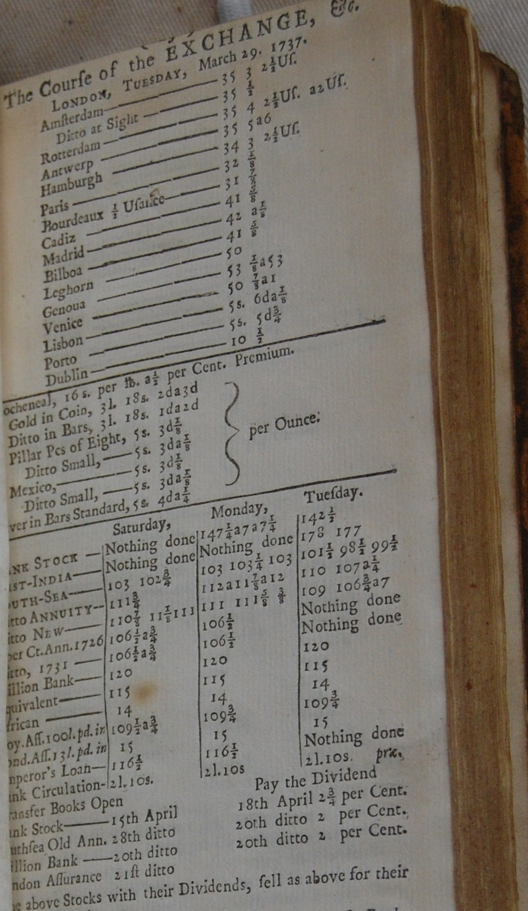
Course of the exchange

Slide 26
Expectations
Let p and q be the prices of the 3 percent bond and of the 4 percent callable bond
The price difference q-p is the present value of the excess coupon (4-3=1) over the years during which the 4 percent is not recalled and the present value of the “final payment” (3.6 in the case of 1749).
How did the market anticipate the interest reduction ?
In how much time would the interest reduction take place ?
Application about the expectations by contemporary individuals on how the market would “absorb the public debt”, i.e., how long it would take for interest rate to fall after the war.

Slide 27
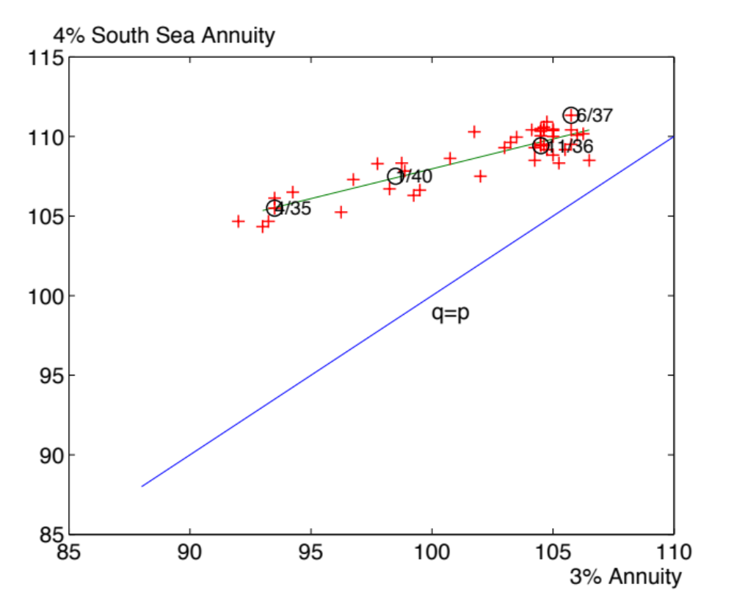
The mid-thirties:

Slide 28
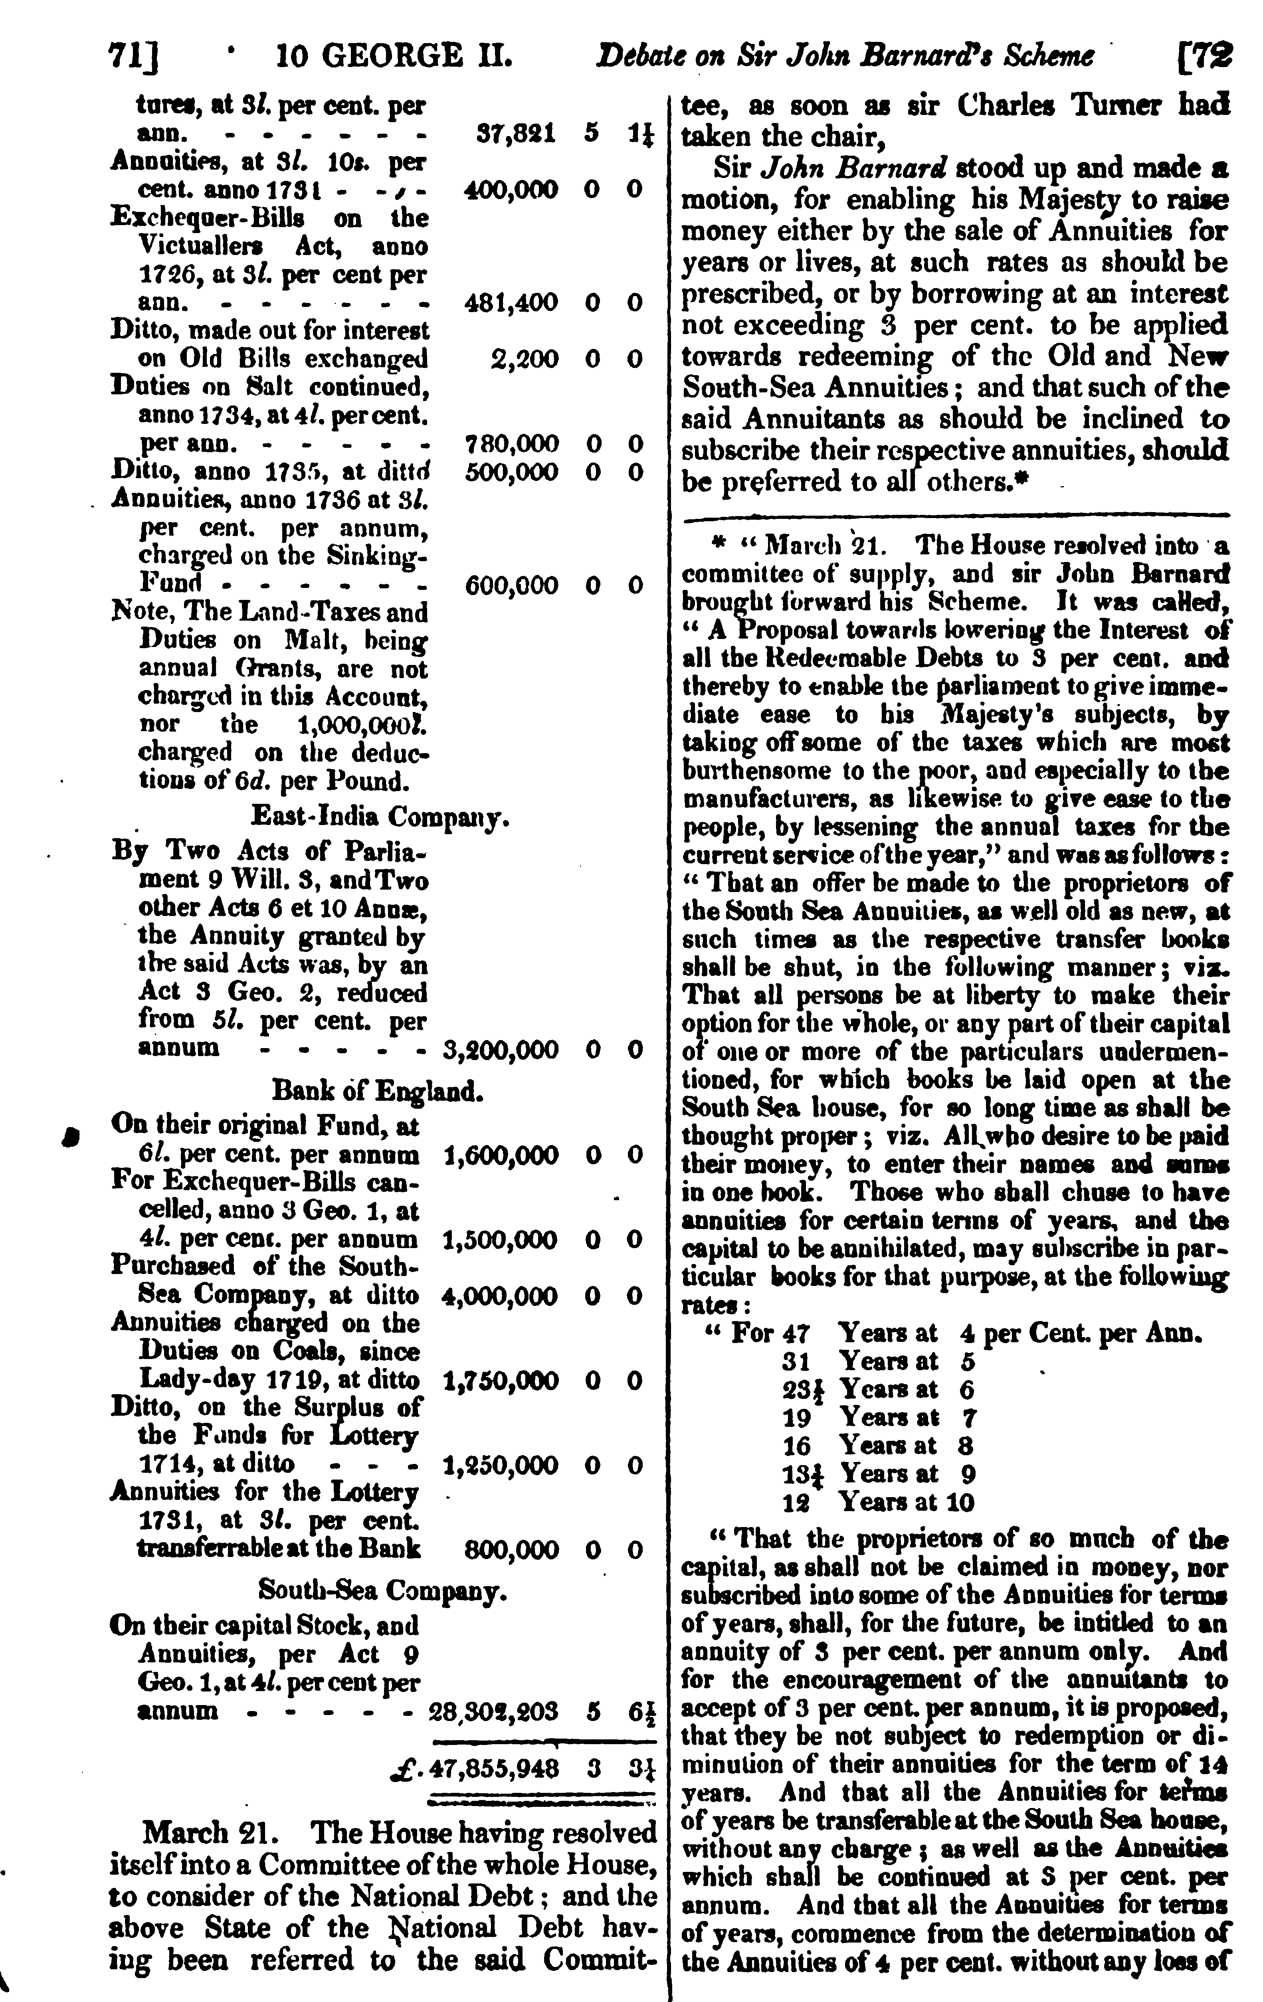
The proposal of Barnard

Slide 29
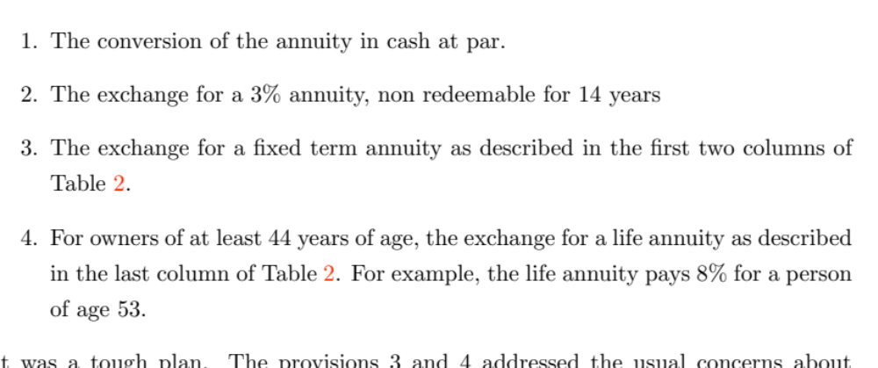
The proposal of Barnard

Slide 30
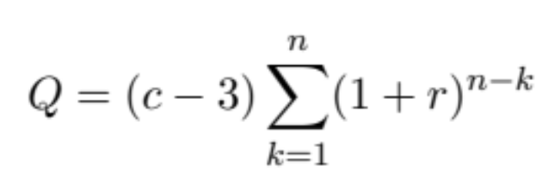
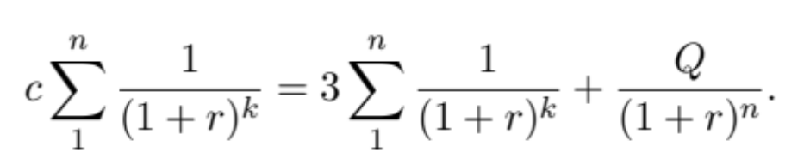
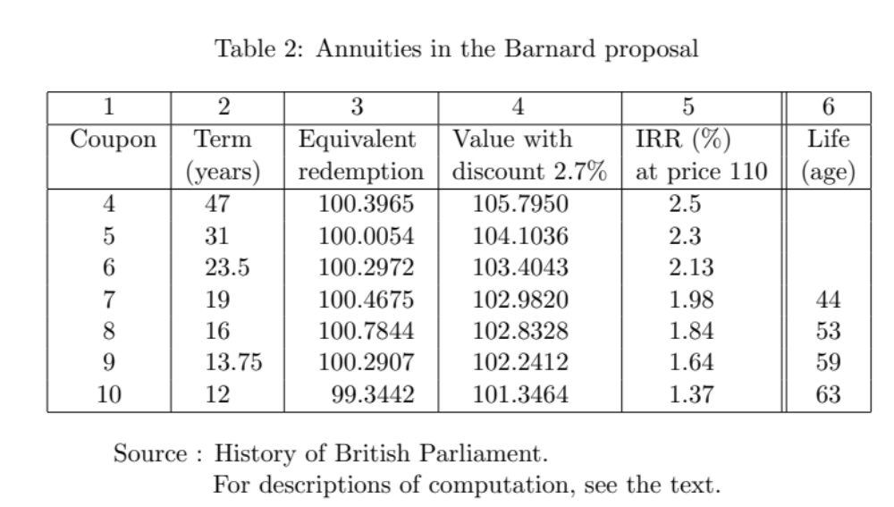
Evaluation of the proposal
Equivalent to the present discount value of the coupon = the present discount value of 3.
Take r = 3%
1. Choose c
2. For any value of the maturity n, the formula gives Q
3. Choose n (up to a quarter) that produces the Q closest to 100

Slide 31
Impact

Slide 32
The market was not prepared

Slide 33
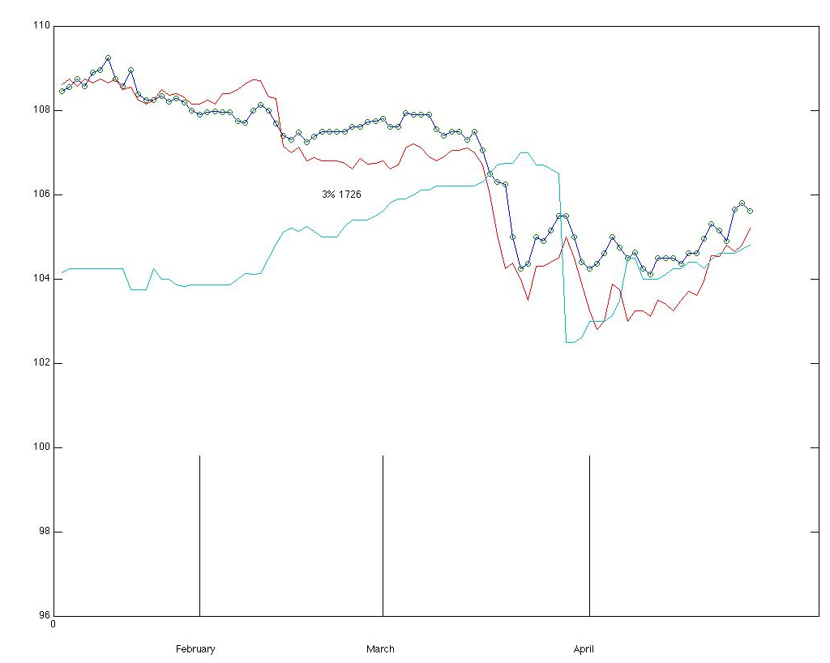
Two shocks
(i). Barnard’s presentation
q – p +100
p
(ii). March 29

Slide 34
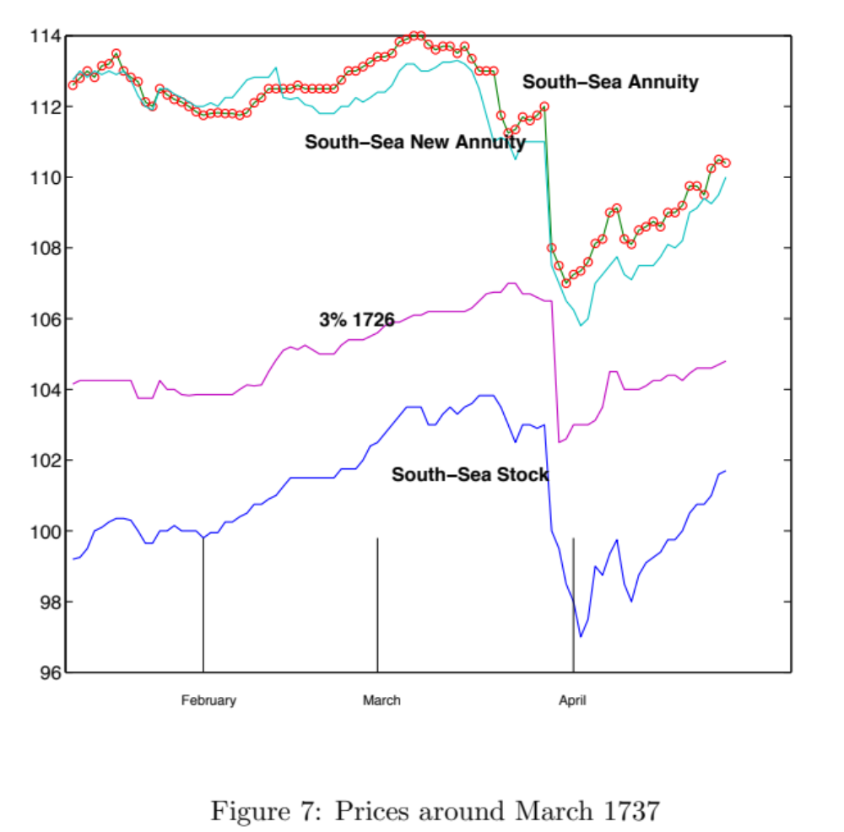

Slide 35
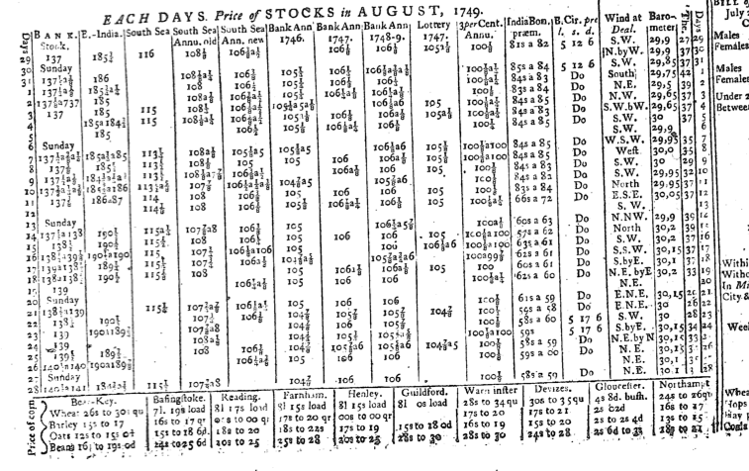
The interest reduction in the Fall of 49
Prices of 3% at par for a while (see previous figure)

Slide 36
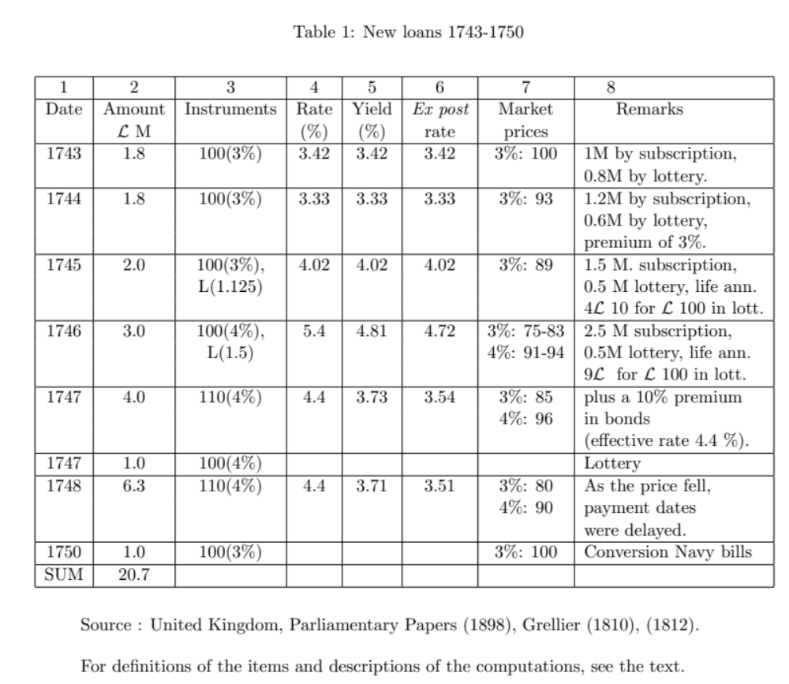
Debt instruments

Slide 37
Most of the national debt is at 4%
Interest rate has decreased to 3%
  A bond that pays a coupon of 3 per year is priced at 100 (par):
    p = c / R or c = Rp or 3 = 3% 100.
If the market expects the debt not to be redeemed, then a bond that pays a coupon of 4 should be valued at 4/3 the price of a 3% bond, therefore 133.33
  If the bond is redeemable, the government should buy it back at 100.
The expectation that the bond will be redeemed drives down the price of the bond.
  Suppose the price of the bond at 4% (with a coupon of 4) is q and the price of the bond at 3% is p.

Slide 38
Overall view
During the war, the price of the consol falls : the interest rate rises
Let p be the price of a perpetual annuity (consol) with payment (coupon) c per year
Long-term interest rate R
Then: p = c / R
Borrowing is high when its cost (the interest rate) is also high

Slide 39
Relative prices of annuities
Suppose
  3% annuity (annuity at face value 100 with a coupon of 3 per year)
    Not redeemable perpetual (just as an assumption)
    price p
  4% annuity (annuity at face value 100 with a coupon of 4 per year)
    redeemed when the 3% annuity is a par (and the long-term rate is 3%)
      The policy of redemption is anticipated by the market
    price q
The difference between the two assets is the difference of coupons: 4 – 3 = 1, before the redemption. That contingent annuity is priced by the market (anticipations) at
q - p

Slide 40
Actual interest reduction of 1749
Conversion into bonds that provide (about) coupons of
  4 in 1750
  3.5 for 6 years (non redeemable)
  3 afterwards
Late subscribers (March) received slightly less favorable deal
  Multiple equilibria in the game
For those who do not want the exchange, payment through cash

Slide 41
Expectations
How did the market anticipate the interest reduction
  If well anticipated, the policy is perhaps less impressive
Source: prices of the 3 percent and 4 percent bond
One may assume that the 3 percent is not redeemable (changed into consols in 1753-- the main financial instrument of the public debt in England)
The 4 percent is redeemable.
The price difference q - p is the PV of the coupon of 1 per year (actually 0.5 every six months) until the redemption plus the premium at the time of redemption

Slide 42
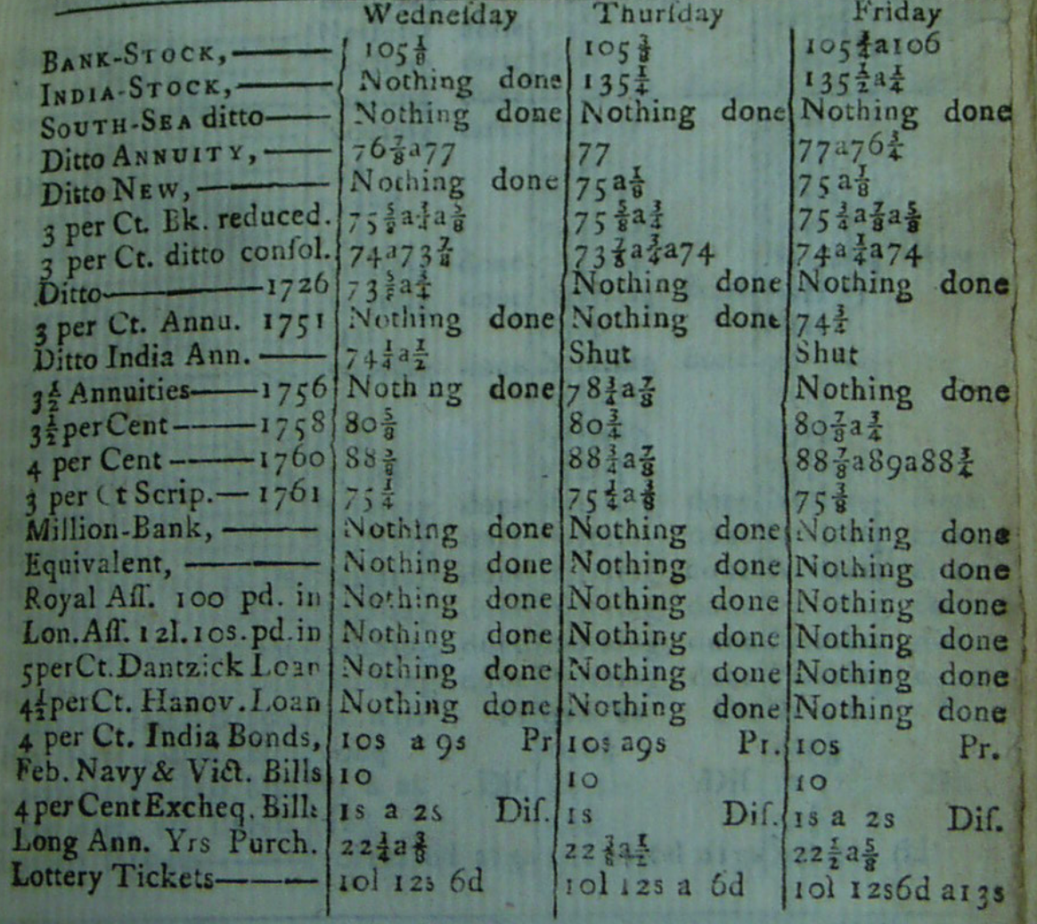
Course of the Exchange

Slide 43
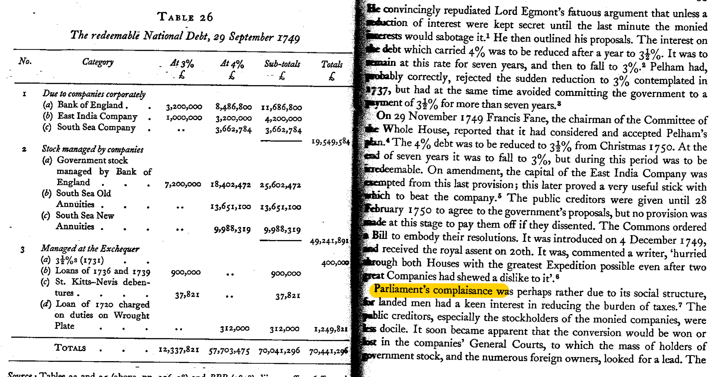
Dickson’s account (1967)

Slide 44
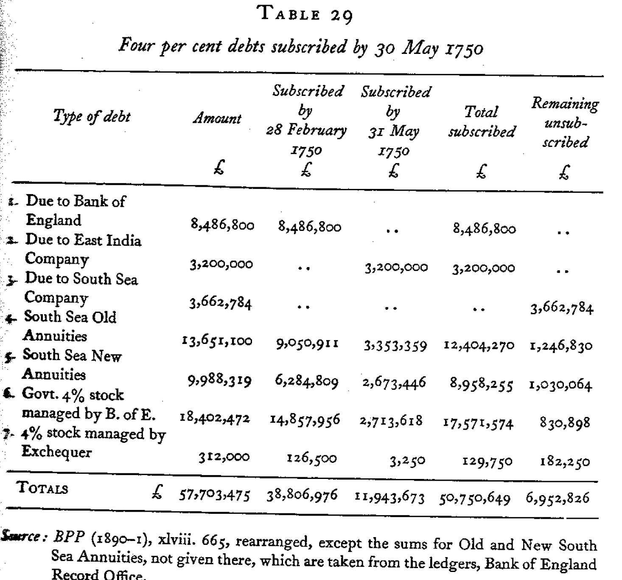
Dickson’s account (1967)

Slide 45
Ref: Quinn

Slide 47
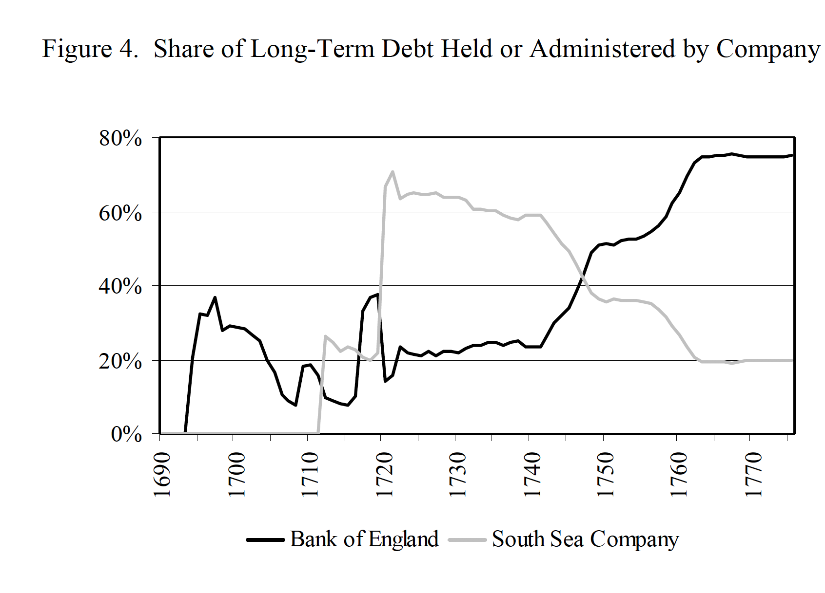

Slide 48
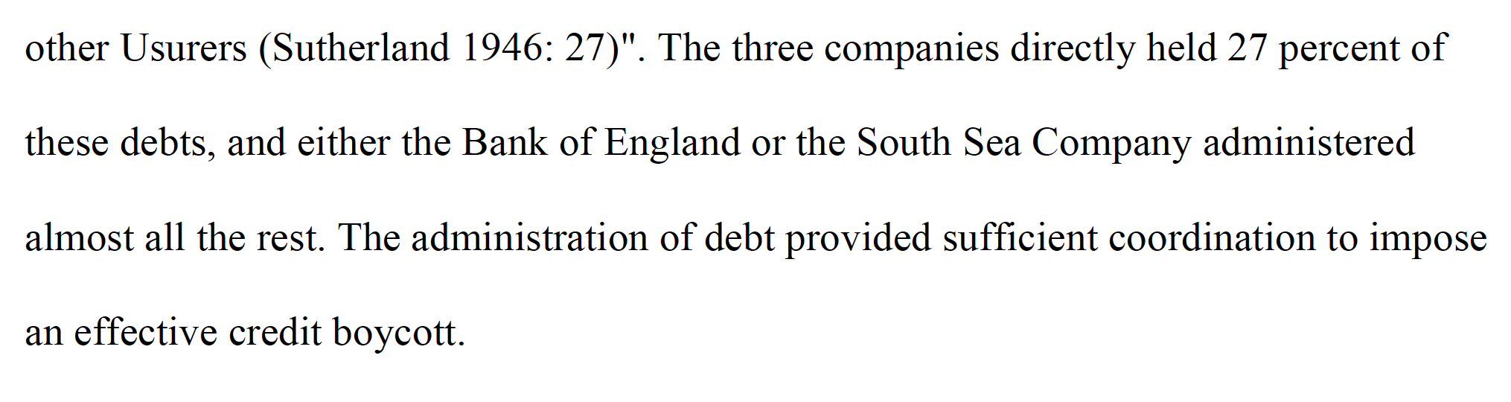
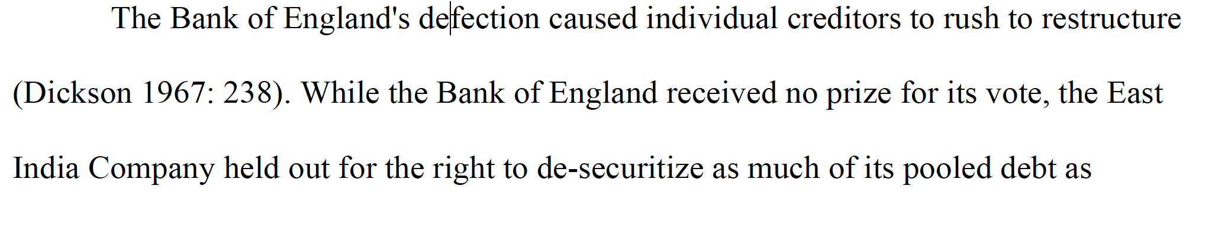
Dickson (in Quinn, 2008)

Slide 49
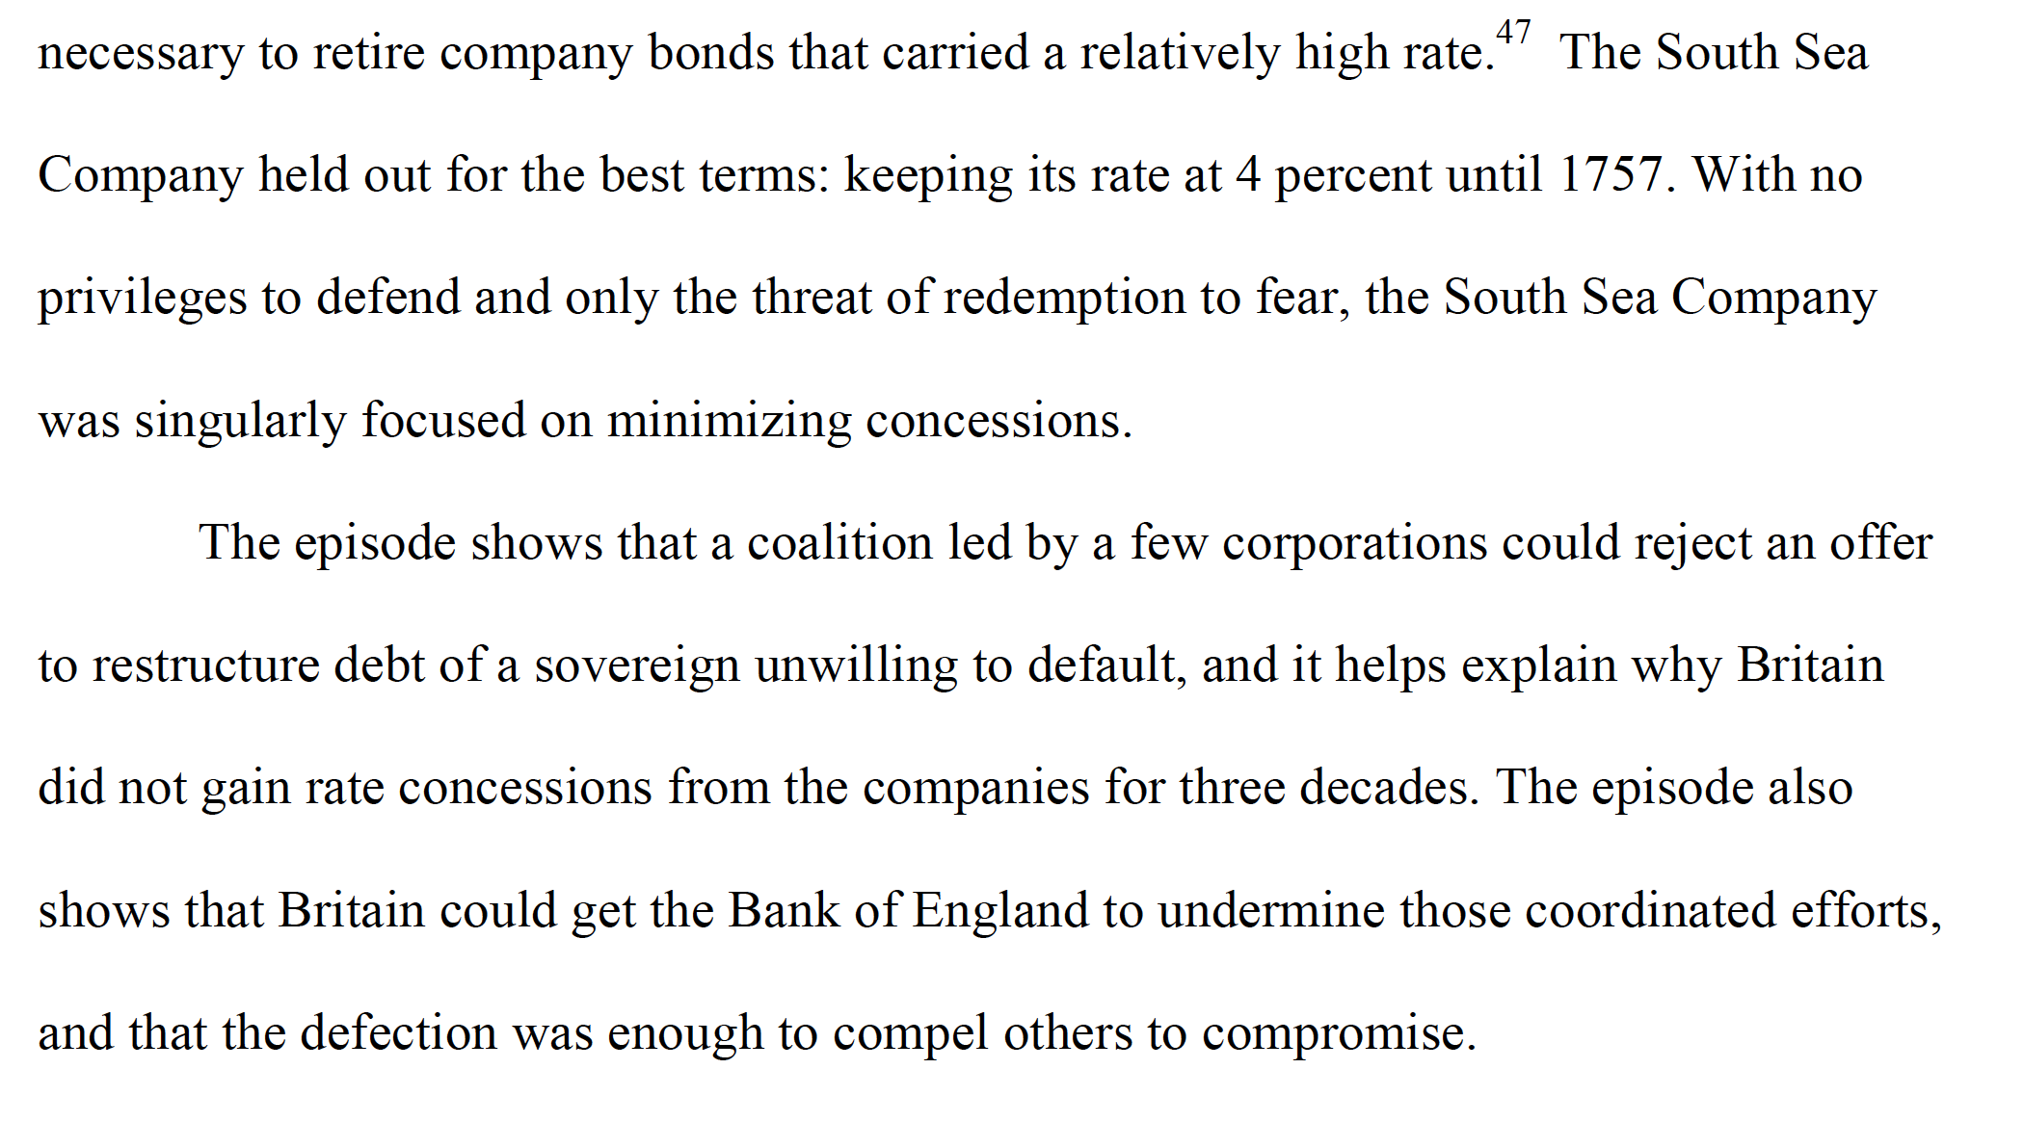

Slide 50
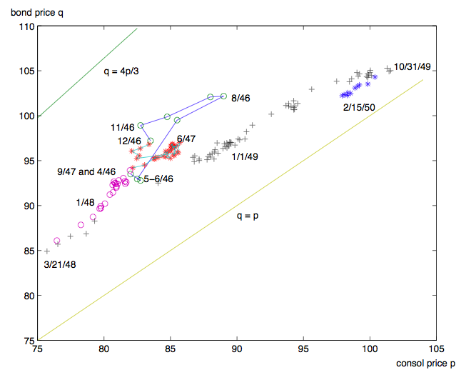
Prices Consols and Bonds 1746- 1750
Assumptions
  3 percent is perpetual
  4 percent is callable
q - p

Slide 51
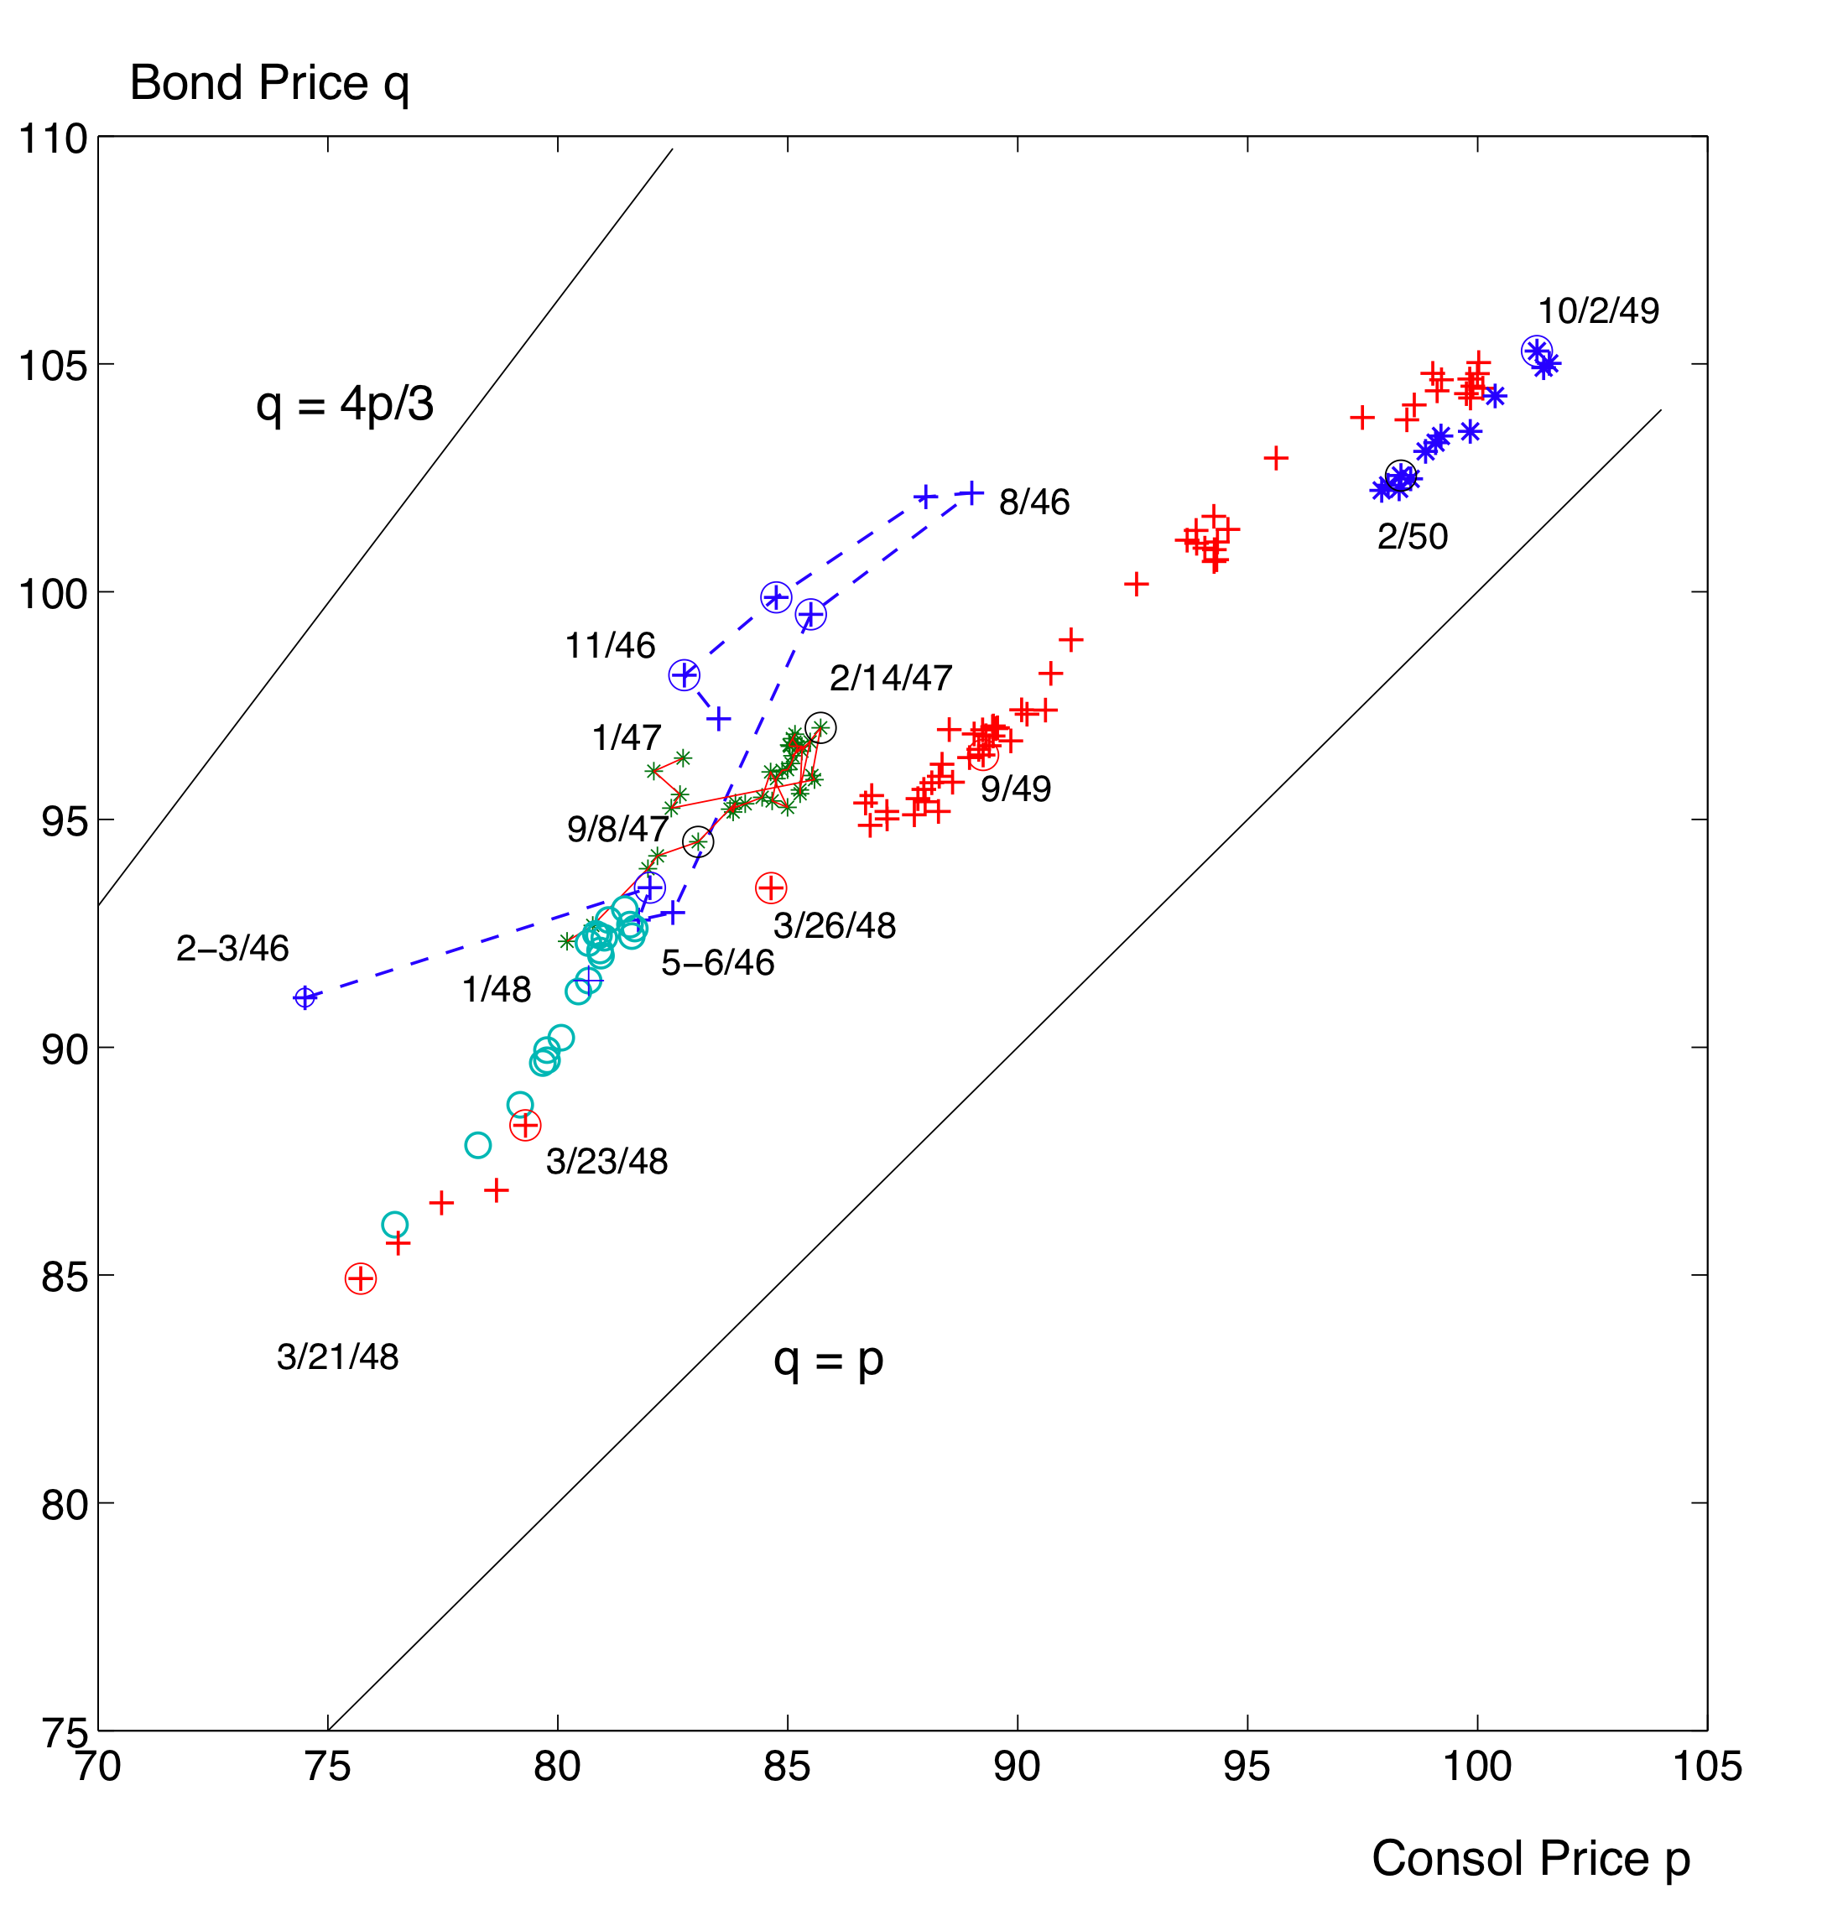
“consol” pays 3
“bond” pays 4
  (redeemable)

Slide 52
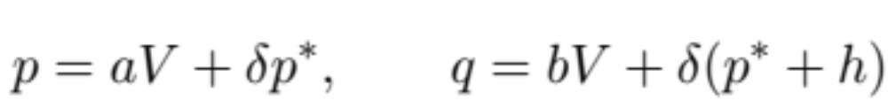

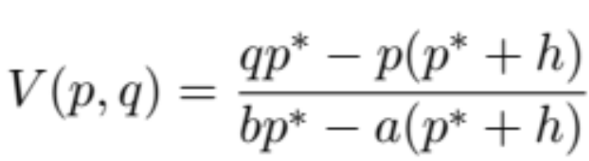
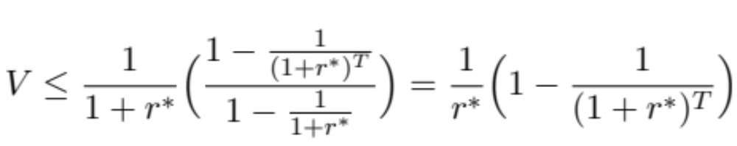
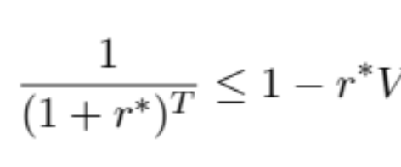
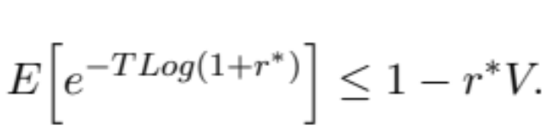
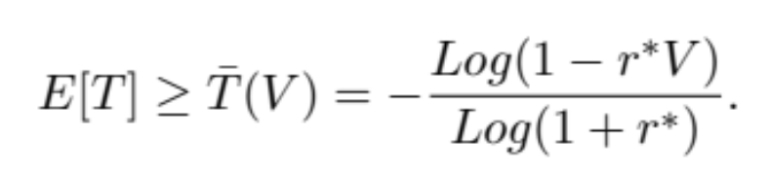
Lower bound for the expected time to reduction
Assumptions
  p* price of consol when the bond is redeemed
  T time to reduction (random variable)
  value of 1 pound, delivered at time T and viewed at time 0.
  p price of consol; q price of bond.

Slide 53
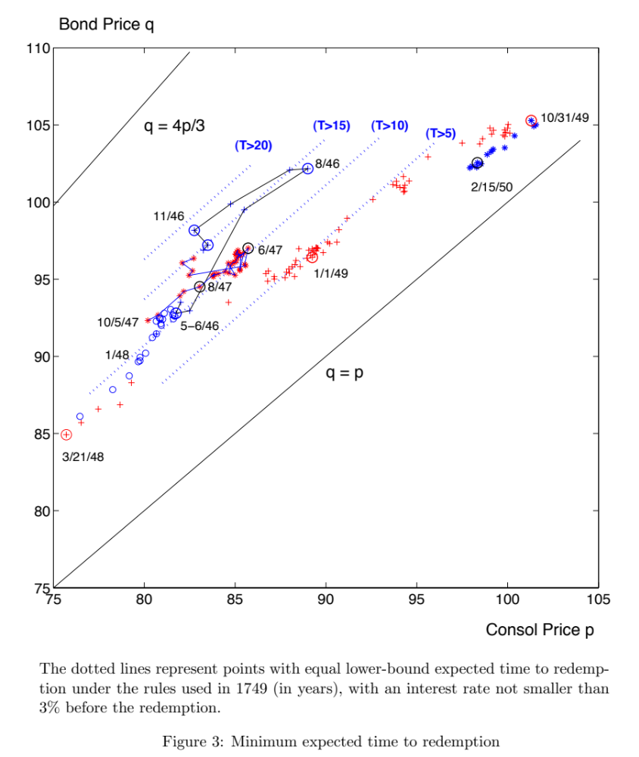
Lower bound for the expected time to int. reduction
People were “too pessimistic”

Slide 54
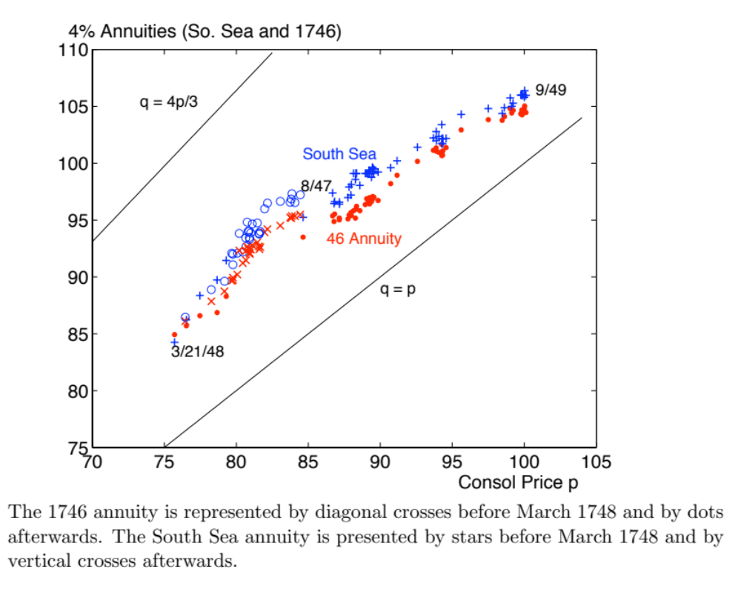
Older annuities: different expectations
People were too pessimistic:
Expected a long time before the interest reduction

Slide 55
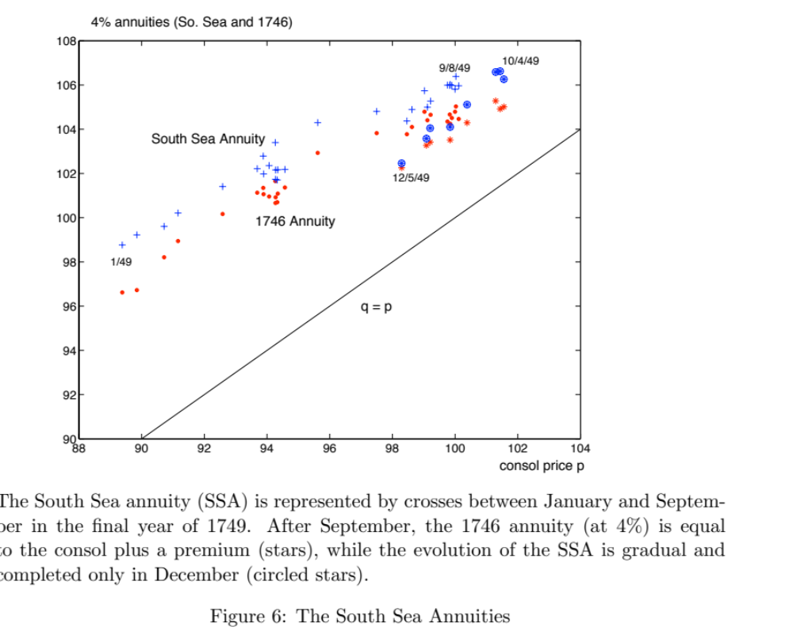

Slide 56
The Public Debt and the French Revolution
Ec 565
October 10, 2024

Slide 57
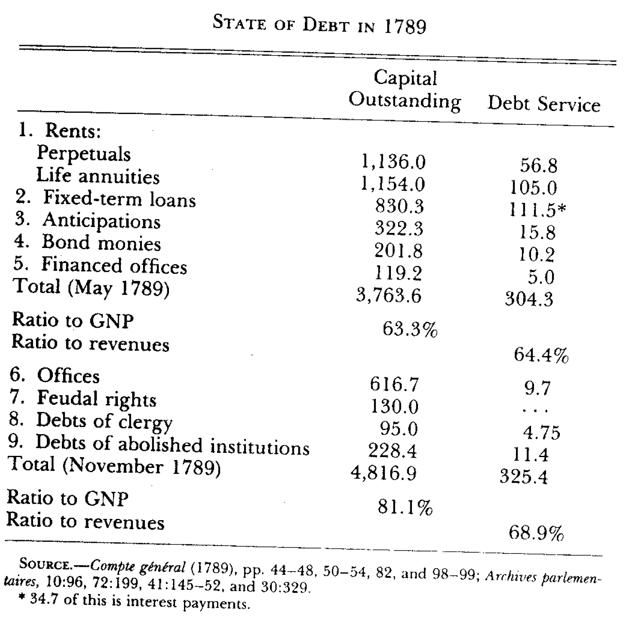
Composition of public debt in 1789
(Sargent & Velde)
Inflated number
(reduce by 50%)
from the Law system

Slide 58
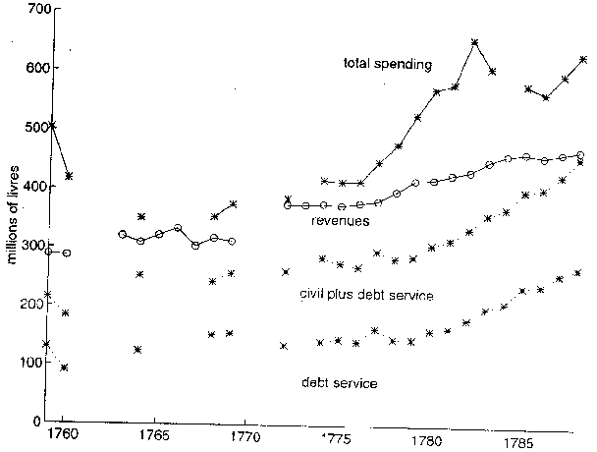
The crisis of the eighties
Budget crisis

Slide 59
Final act
Options in 1788
  Primary surplus is negative
  choice to default
  (resistance to taxation)
  calling the Estates Generals for May 1789
    this time to avoid default and increase taxation
    Mirabeau: “blessed public debt”
Meeting of the Estates in June 1789
  first move: double representation of the Third Estate
  famous essay of Sieyès:
    “What is the Third Estate? - everything
    What has he been so far in the political order? - nothing
    What does he want? - to be something”.
privileges (no taxation) of the first and second order abolished in August 1789.
Church domains nationalized in the Fall of 1789

Slide 60
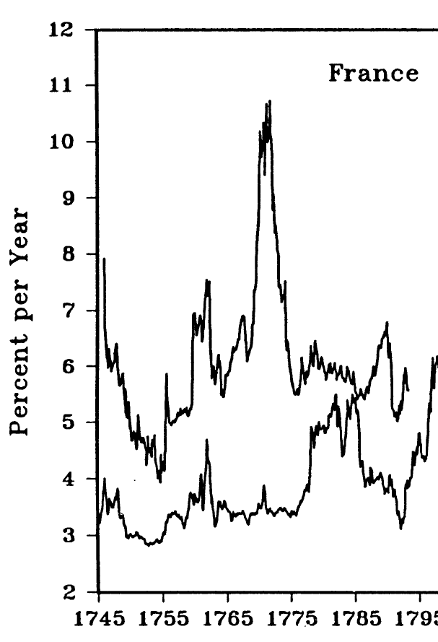
Interest rates

Slide 61
National domains
National domains: about 2400 millions
Essential issue: how sell the national domains
Method: issue shares:
Bills which are claims on the national domains.
When the national domains will be sold, assignats will be used to buy the domains.

Slide 62
Assignats I
Assignats were negotiable
What are they? bond or money?
Initially they were of high denomination
Because of the need for money, business opportunity:
enterprise: financial intermediation

Slide 63
Assignats II
Bank notes are more valuable than assignats because they provide transaction services.
The private bank provides these services and makes a profit.
State reclaimed the supply of liquidity for transaction and suppressed the banks in the summer of 1992.
The state issued small denominations.
Debate on the role of assignats.
Frontier between counterpart of estates and currency became fuzzy.
Need for more revenues because of wars.

Slide 64
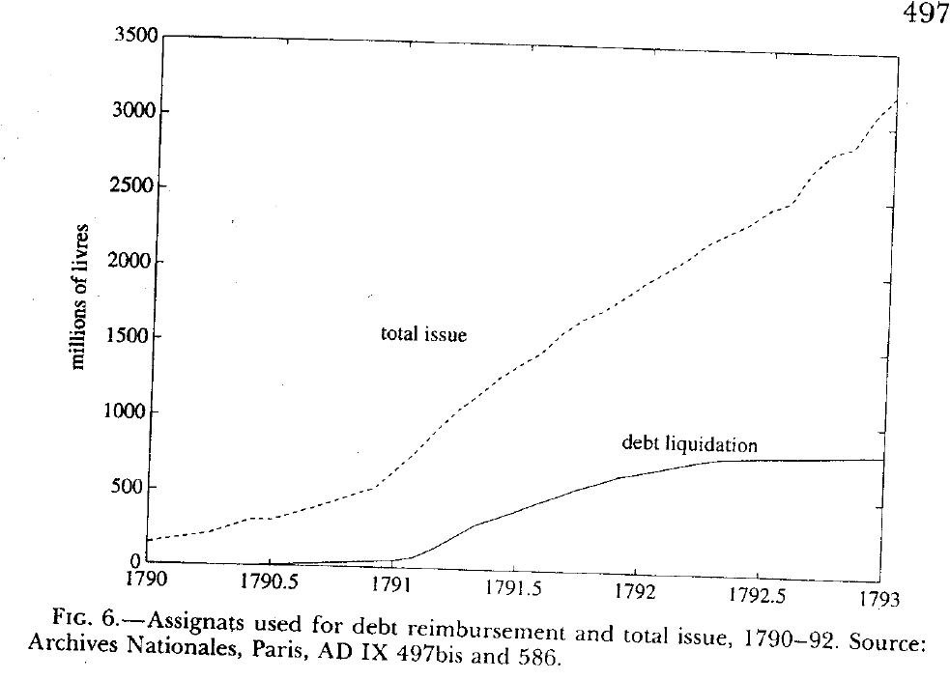
New issues

Slide 65
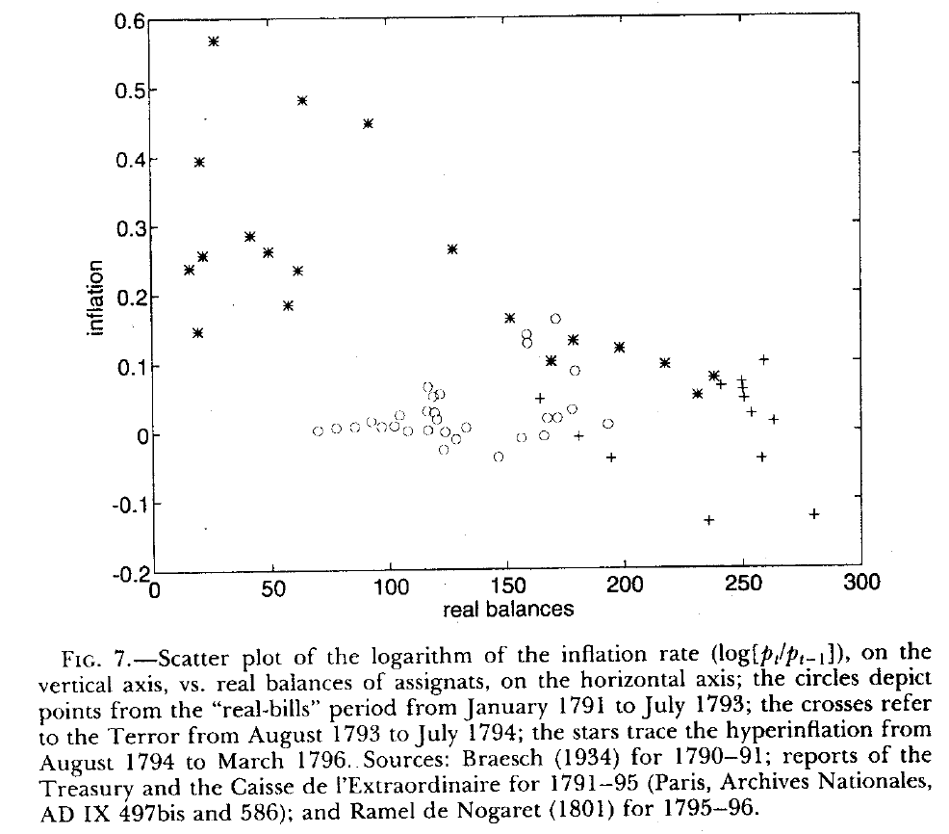
The demand for money

Slide 66
Three regimes
Real bills
Terror and price controls
Money and high inflation

Slide 67
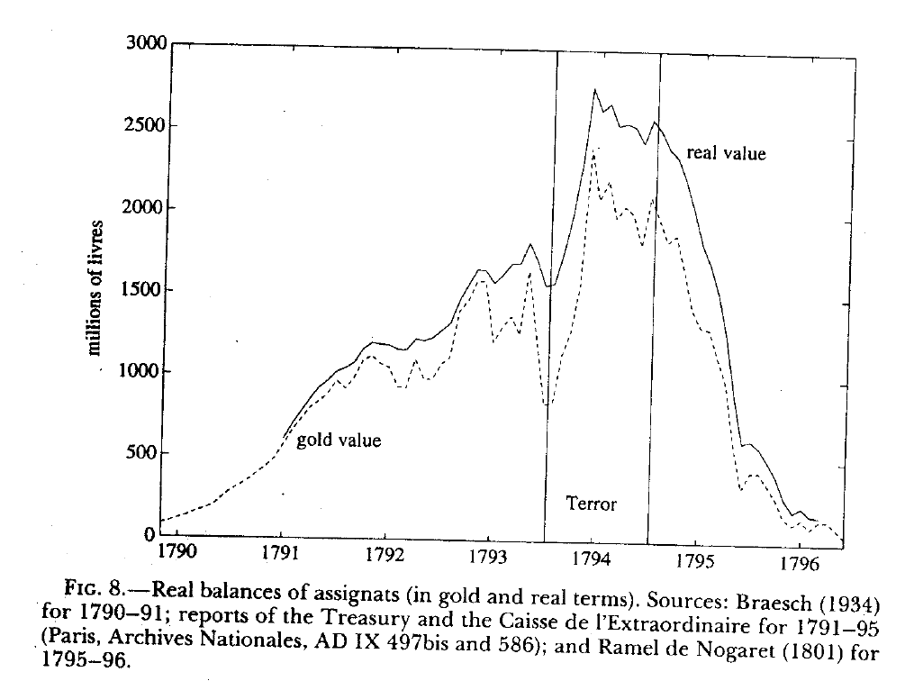
The real value of assignats

Slide 68

Tax revenues

Slide 69

Seignorage revenues

Slide 70

Last budget of the Ancien Régime
Indirect
Direct
Direct / Rev = 162 / 425 = 38 %
[ Total - domain = 475 - 50 = 425 ]
Interest payments

Slide 71

Goethe (1749-1832)

Slide 72


Faust II (Goethe)
"To whom it may concern:
The present bill is a thousand Kronen worth.
Secured by a sure mortgage
A fortune buried in the Kaiserground.
It is ensured that the abundant treasure,
as soon as raised, will serve as substitute."
Mephistopheles
Recent Reference
by the chairman
Of the Bundesbank

