Slide 1
The South Sea Bubble
Ec 565
September 26

Slide 2
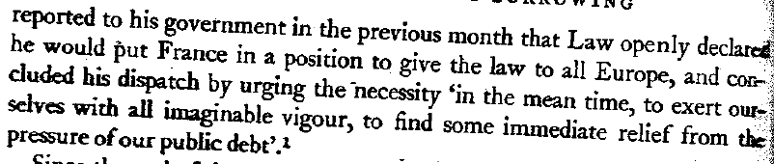
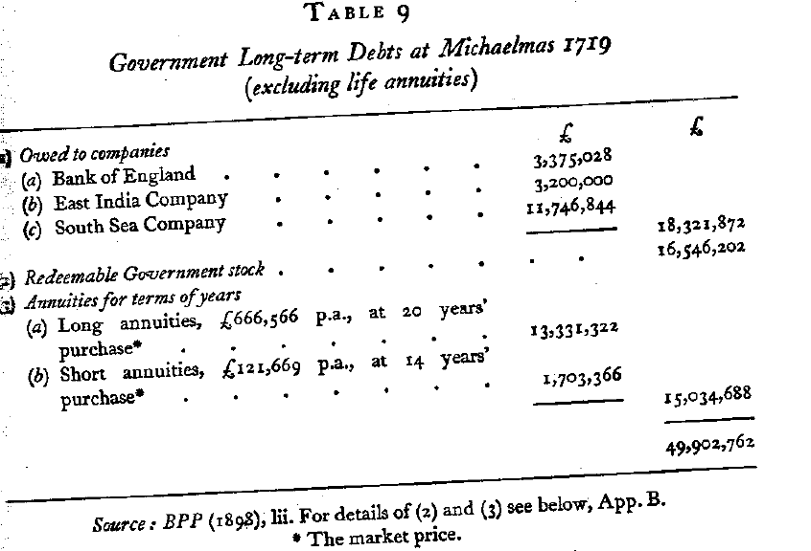
Background
John Law
(D-91): The English Ambassador at Paris, Lord Stair, nervously:

Slide 3
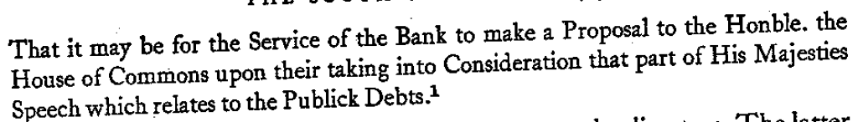
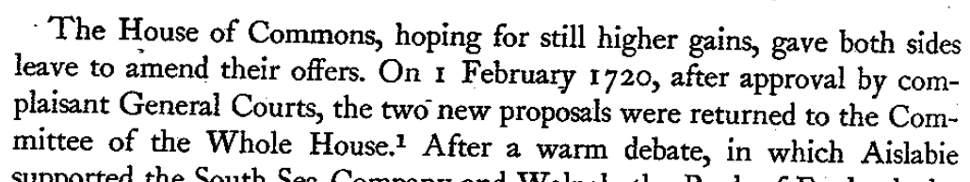
Plan of 01/21/20 (D-97)
Proposal:
  SC buys redeemable and non-redeemable in exchange for stocks (in SC)
  Pays gov 1.5M and max 1.58M on non-redeemables (prop to sales)
Immediate Reaction by BoE
Refusal by SC to share with BoE: “No Sir, we will never divide the child.”
02/01/20:

Slide 4
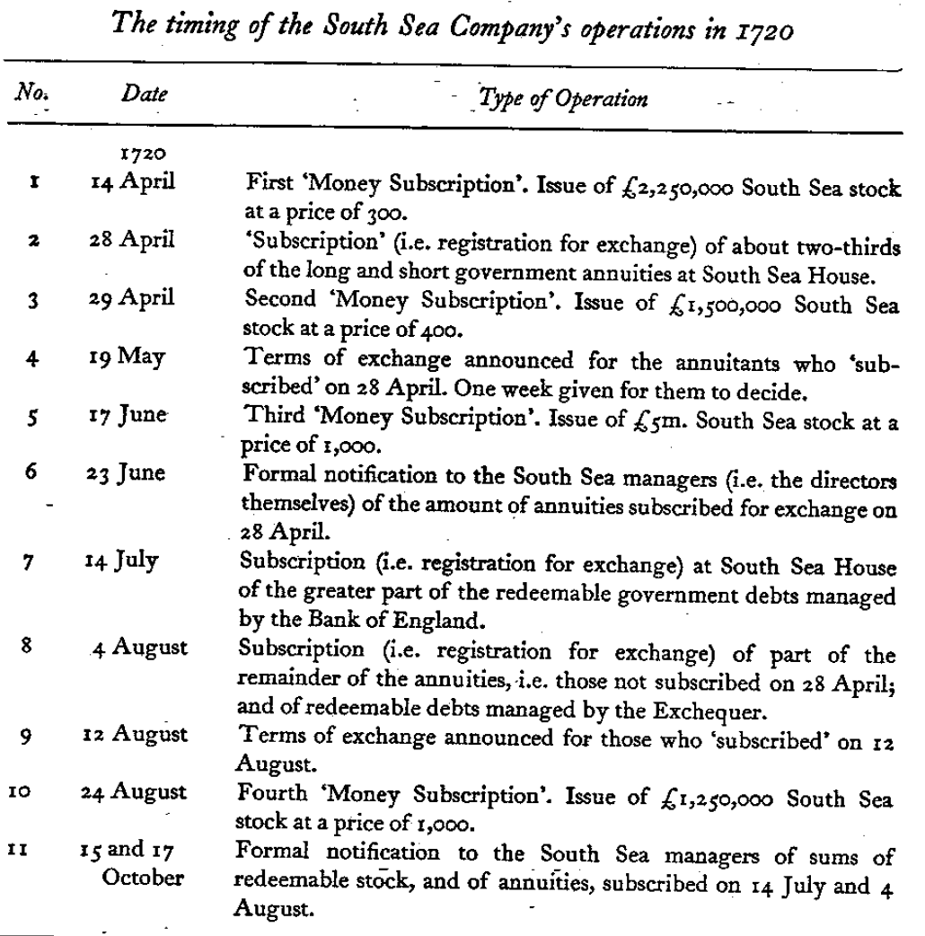
Chapter 6
Dickson

Slide 5
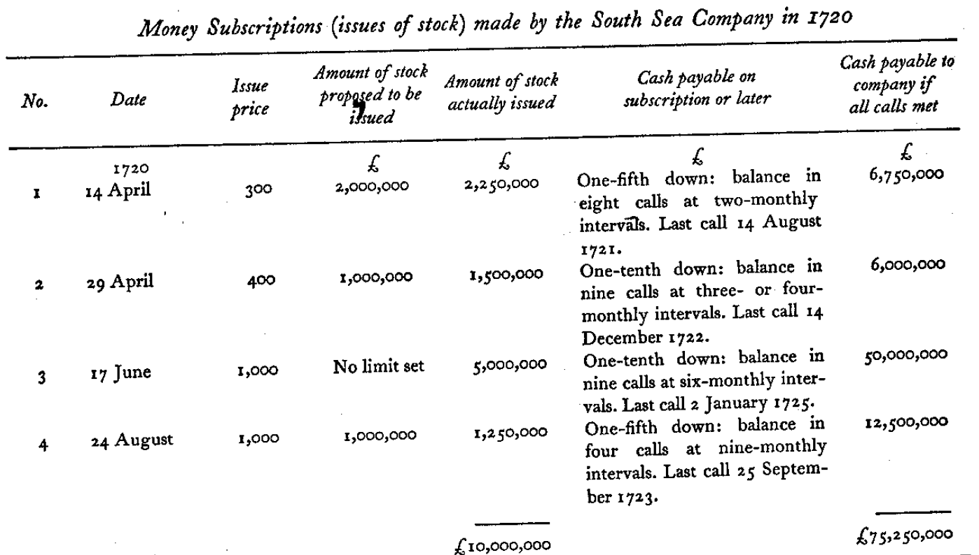
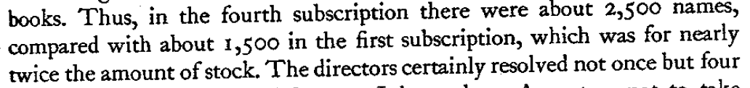
References
Dickson

Slide 6
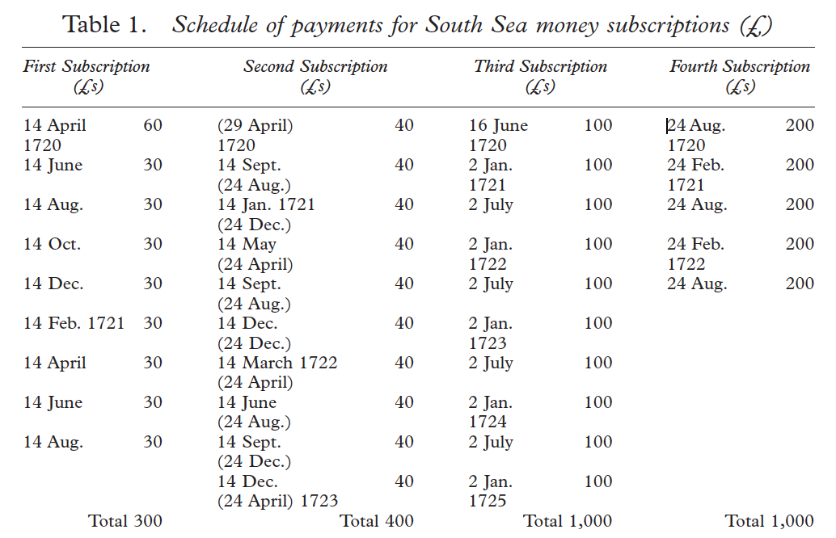
R. Dale

Slide 7
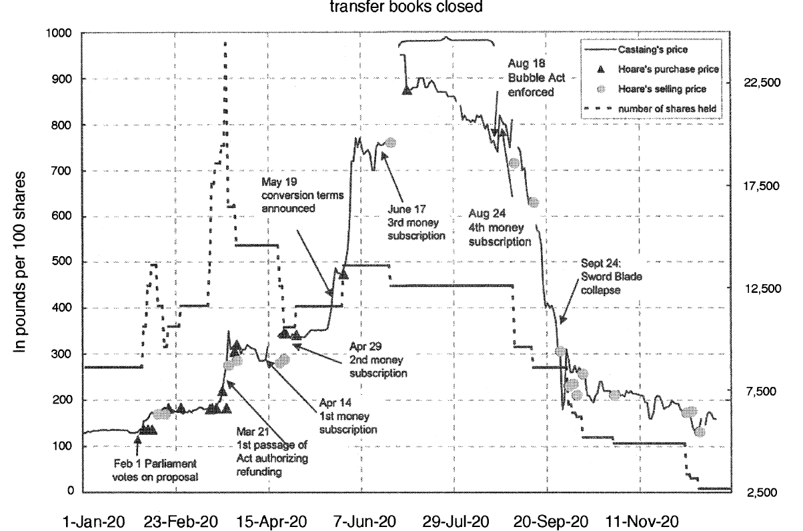
References

Slide 8
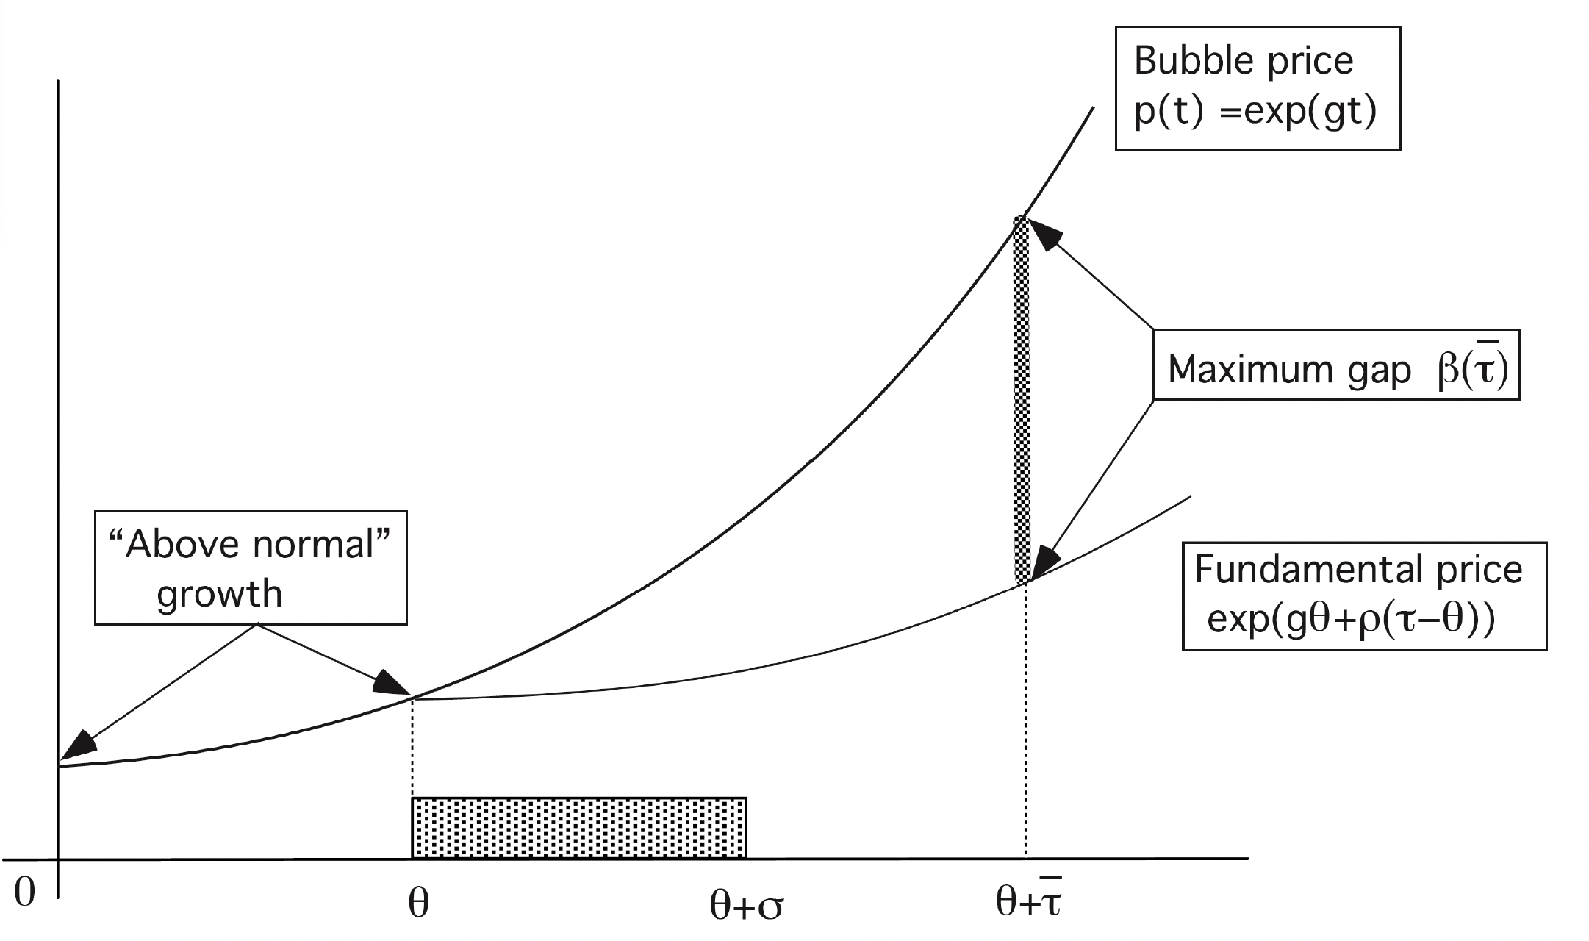
Model of Abreu and Brunnermeier
A bubble may go on, for a while, when everyone knows it’s a bubble
But there is no common knowledge: “everyone knows that everyone knows that…

Slide 9
The Law affair
The economic setting
The intellectual setting
The beginning 1715-1719
Expansion and price rise Fall 1719
Inflation Spring 1720
The end of the system

Slide 10
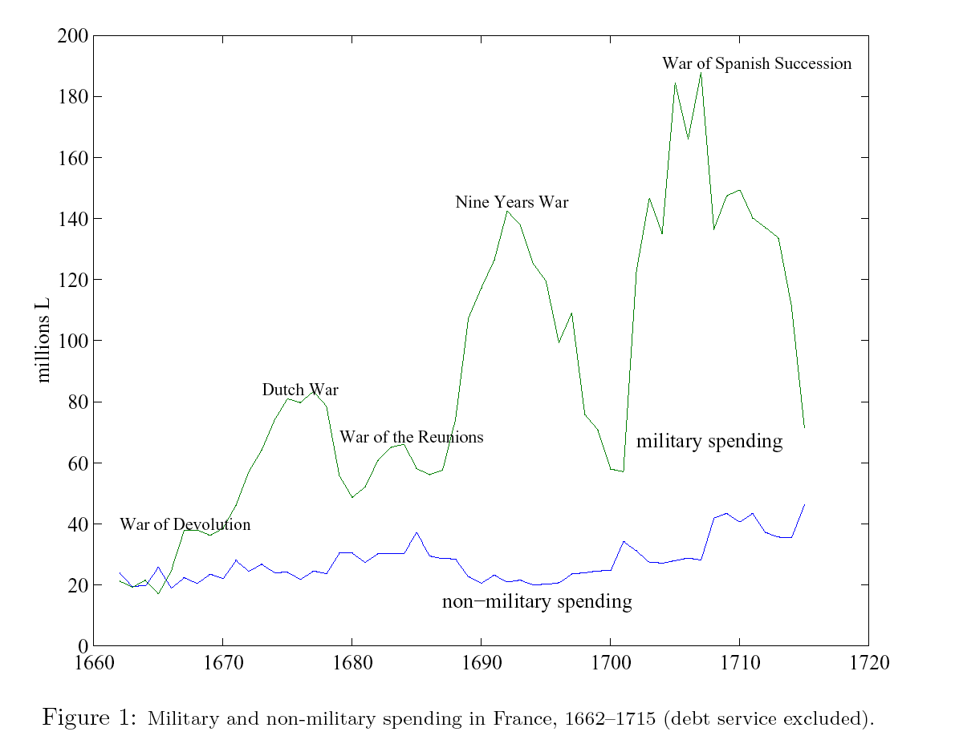
Spending under Louis XIV

Slide 11
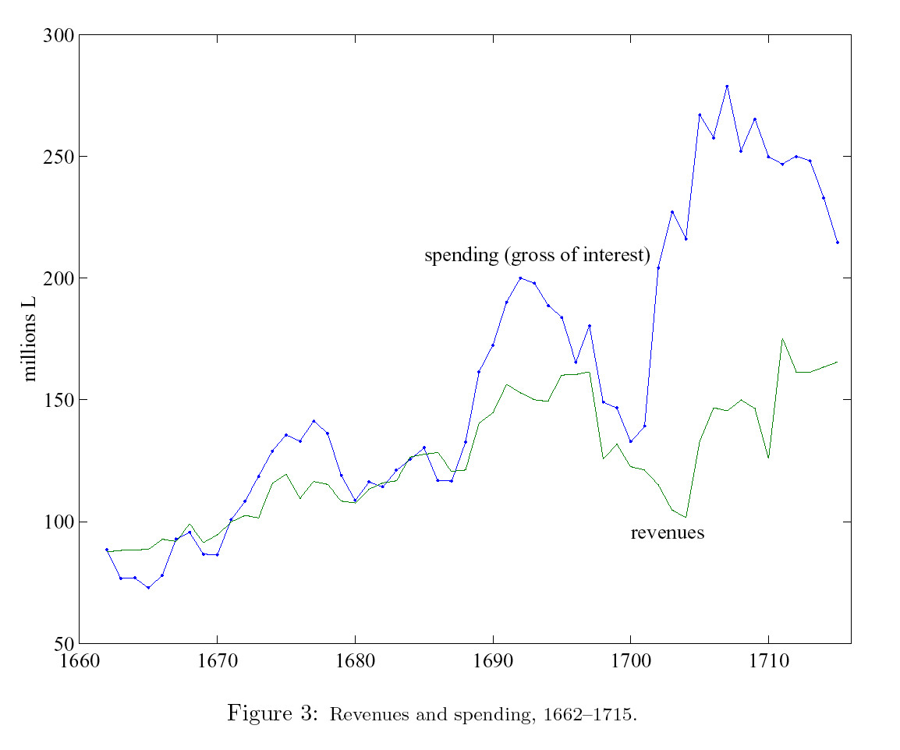

Slide 12
Debt instruments
Short-term
  Treasury orders (guaranteed on tax revenues in the immediate future, with seniority over other debts).
Long-term:
  Annuities (rentes)
    perpetual
    life
    Various types of guarantees: (Rentes de l’Hotel de Ville de Paris): rentes on the city hall of Paris (serviced by taxes collected by the city).
  Offices
    The office is a job that provides pecuniary or non pecuniary payoff. (It is like a bond that generates income).
    agent buys the office: ready cash for the government.
    The office is thus like a financial asset with no capital market.

Slide 13
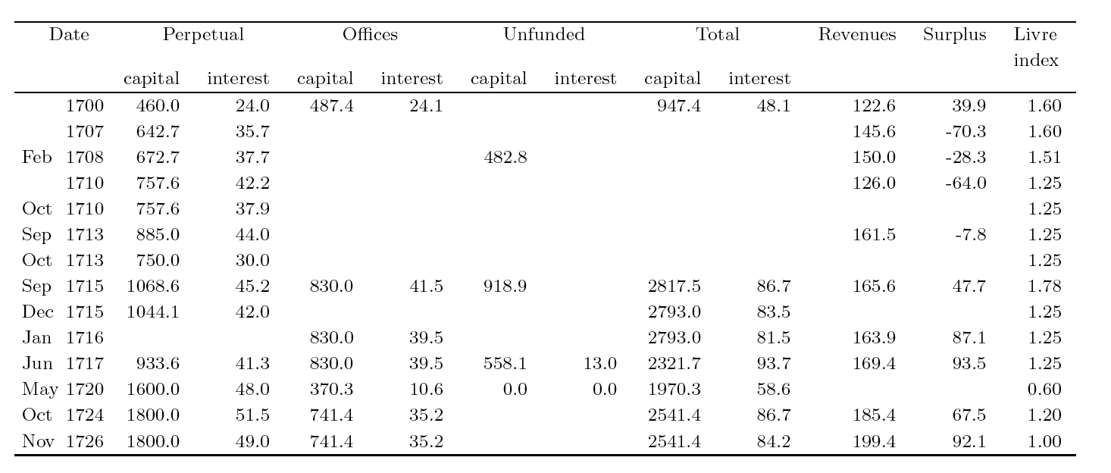

Slide 14
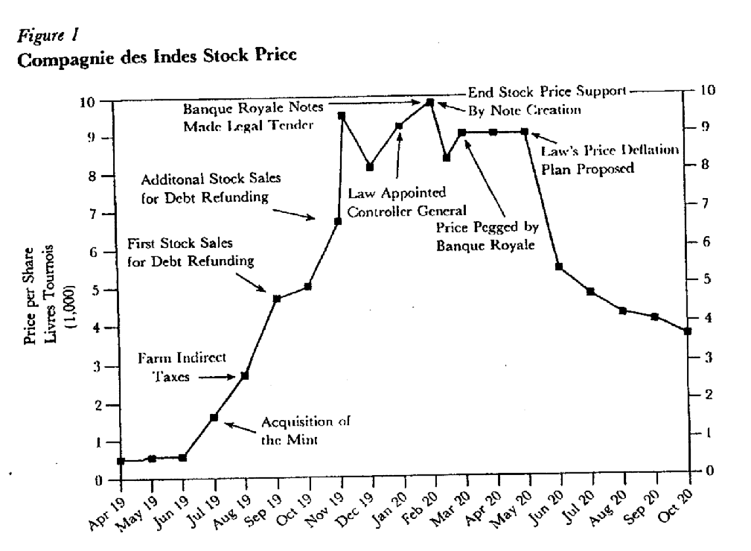
Share prices of the Company of the Indies
Is this a bubble (with crash) ?

Slide 15
State of the economy in 1715
Wars up to 1713
Failed attempts at tax reforms (capitation, tenth)
Disorganization of the public finances
GDP about 2300 million livres
Public debt about 2000 million livres
Tax revenues (when not pledged away) around 160 M

Slide 16
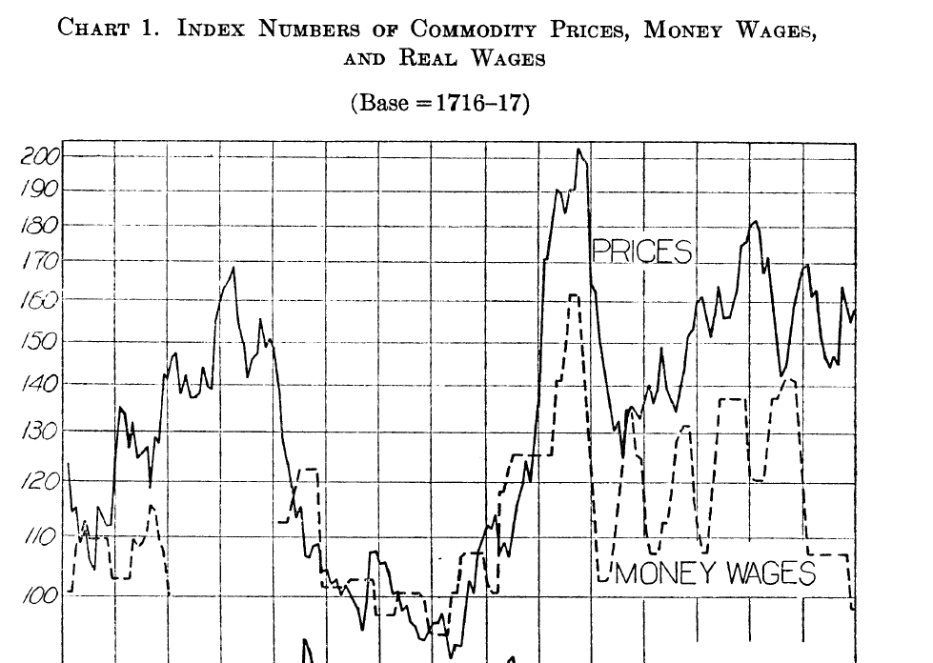
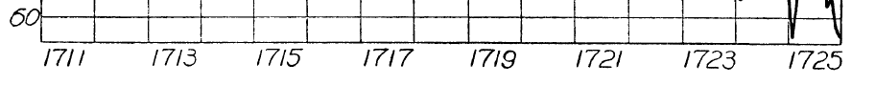
Price level (Hamilton)
Commodity prices (from invoices of a hospital in Paris). Not including rents or real estate.

Slide 17
John Law’s views
At the time, most credit is trade credit
Main argument: too little liquidity in the economy
First revolutionary idea: the state should manage the monetary policy
With more supply of liquid assets, interest rate would decrease to low level, perhaps 2 percent

Slide 18
Doctrine of real bills
Precursor for later doctrine of real bills
  The monetary authority should monetize all goods in process:
  Firms can borrow against good in process: they receive money against them through a loan.
  Balance sheet of the central bank has loans (against real goods) on left hand side and bank notes on liability side.
Difference is that Law was more interventionist: the supply of liquidity anticipates growth in activity.
Since there was little control of the supply (and many incentives to have it grow), it grew out of control.
Doctrine of real bills still discussed today.

Slide 19
Privatization of the public debt
Historical context of a state with embryonic tax structure and administration
Problem of the credibility of the state
One method is to form an intermediary with higher credibility
  Example: rentes de Paris (of the City Hall of Paris)
  City managed some taxes used for the service of the debt
  State borrows from the city which in turn gets the financing from the issuance of its own bonds. (Right to collect the taxes).
  City is cartel-like in the representation of the bond holders
This method was the idea behind the Bank of England. Individuals would not deal directly with the state.

Slide 20
Trade companies and the public debt
South Sea company was founded in 1711.
Problem of lower interest rate in time of peace
Lowering interest rate would be resisted by bond holders.
Founding of new company
  Grant from the government to receive a annual payment (usually reduced over the years)
  Grant of a monopoly charter for trading (better than tax the imports)
  Forceful exchange between governmet bonds and shares of the new company
  (Apparent compensation in future dividends from real activities)

Slide 21
The beginning of the system
Lobbying in September 1715
Foundind of the newly chartered Banque Générale in spring 1716
  Apparently little leaway to invest. But probably got around restrictions
  Personal investment of John Law.
  Quiet operations for a while
Expansion to real activities: Company of the West (fall 1717)
  The Mississippi ! (the whole basin from Louisiana to Minnesota)
  Payment of shares in government bonds (discounted): not much cash for capital and investment. (see the South Sea)
Fairly modest activities until the summer of 1718

Slide 22
Consolidating the base
Price level is stable from 1715 to 1718.
Devaluation of May 1718.
  Major struggle with the Parlement (bond holders loose part of their wealth)
  Parlement wanted to prevent mint workers from their job
  Major confrontation in lit de justice, that the Parlement was bound to loose.
  Diminished role of the Parlement after and higher power for Law.
August 1718: the contract with indirect farms has to be renegotiated with new bids (every 6 years). Law helps the Pâris brothers to get it.
December 1718, Banque Générale is transformed into a Banque Royale.
The company of the West does not seem to do that much investment). Some people sent forcefully to Louisiana. (Novel of Manon Lescaut).

Slide 23
Mergers and Acquisitions: 1719
May 1719: Acquisition of
  the Co of the East Indies
  the Co of China
New company is: Company of the Indies
  June: acquisition of the Company of Africa
  Share price is still around face value of 500 a share
New shares issued
  Payable in 20 monthly installment (method of Law)
  4 old shares needed to buy a new one (marketing ploy)
  By July, capital is more than doubled.
July: acquisition of the Mint
Share price begins to rise
  Natural thing to do in view of the acquisitions

Slide 24
Acceleration
August 1719: Acquisition of the Farm (indirect taxes)
  the previous rent with Pâris is broken
September 1719 Very large issue of new shares
New company is: Company of the Indies
  June: acquisition of the Company of Africa
  Share price is still around face value of 500 a share
New shares issued
  Payable in 20 monthly installment (method of Law)
  4 old shares needed to buy a new one (marketing ploy)

Slide 25
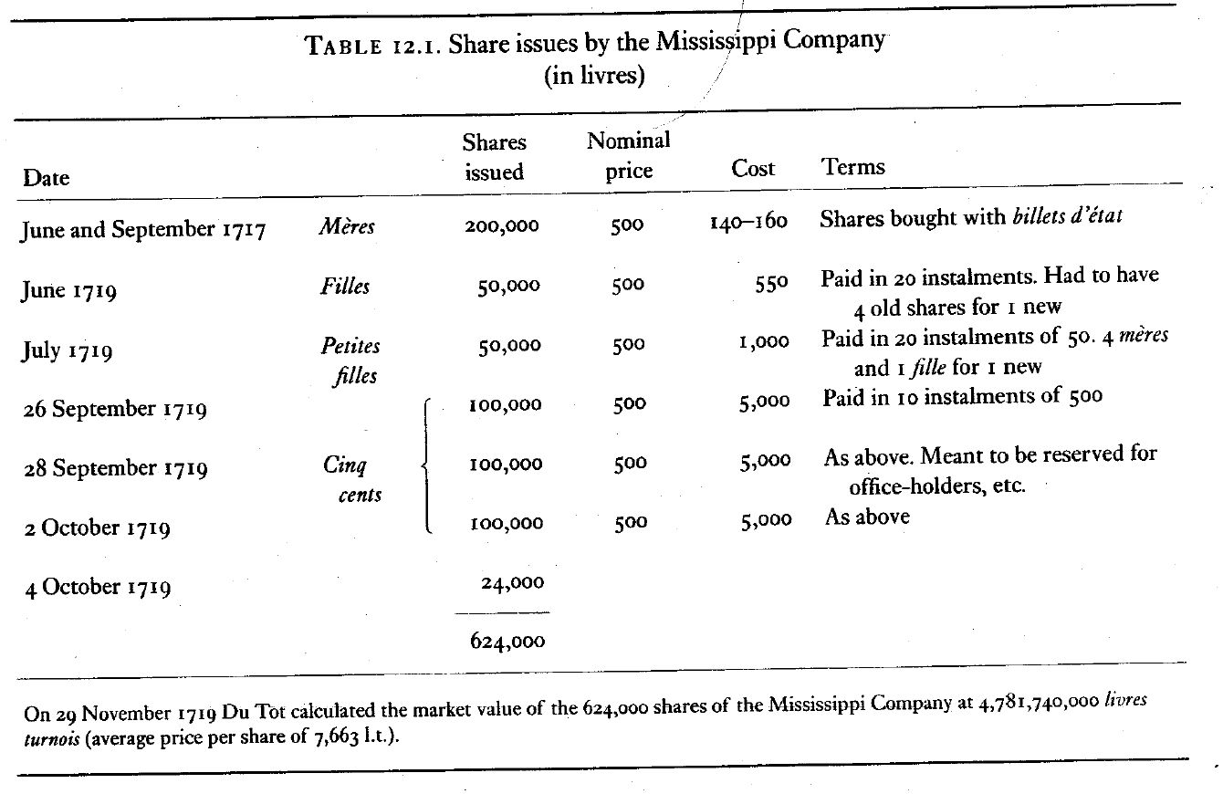

Slide 26
Paper money
Fall 1719: substitution of bank notes (notes of the Banque Royale) as legal tender
Always part of Law’s view (in his system)
Increase of notes by about 1 000 million livres
Substitution of paper money for commodity money does not necessarily increase the money supply
At the same time, the BR could provide credit to buy shares
Goal of a large amount of liquidity to lower the interest rate

Slide 27
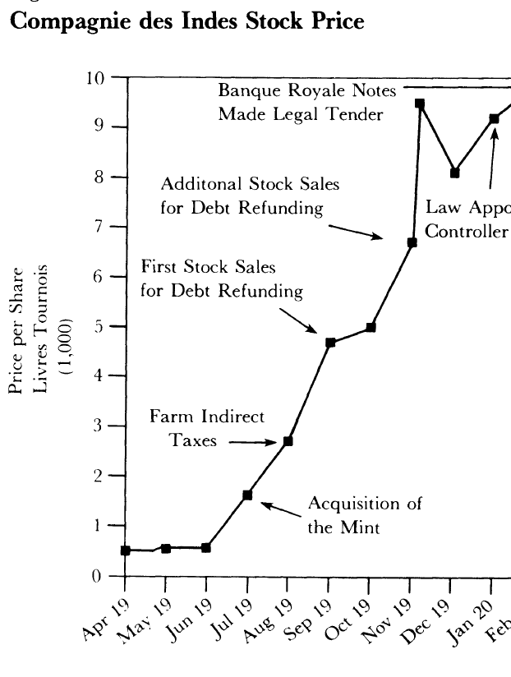
Goal 10 000
Some real growth
Some appreciation because of large liquidity
Some bubble demand (buy because the price is expected to rise.

Slide 28
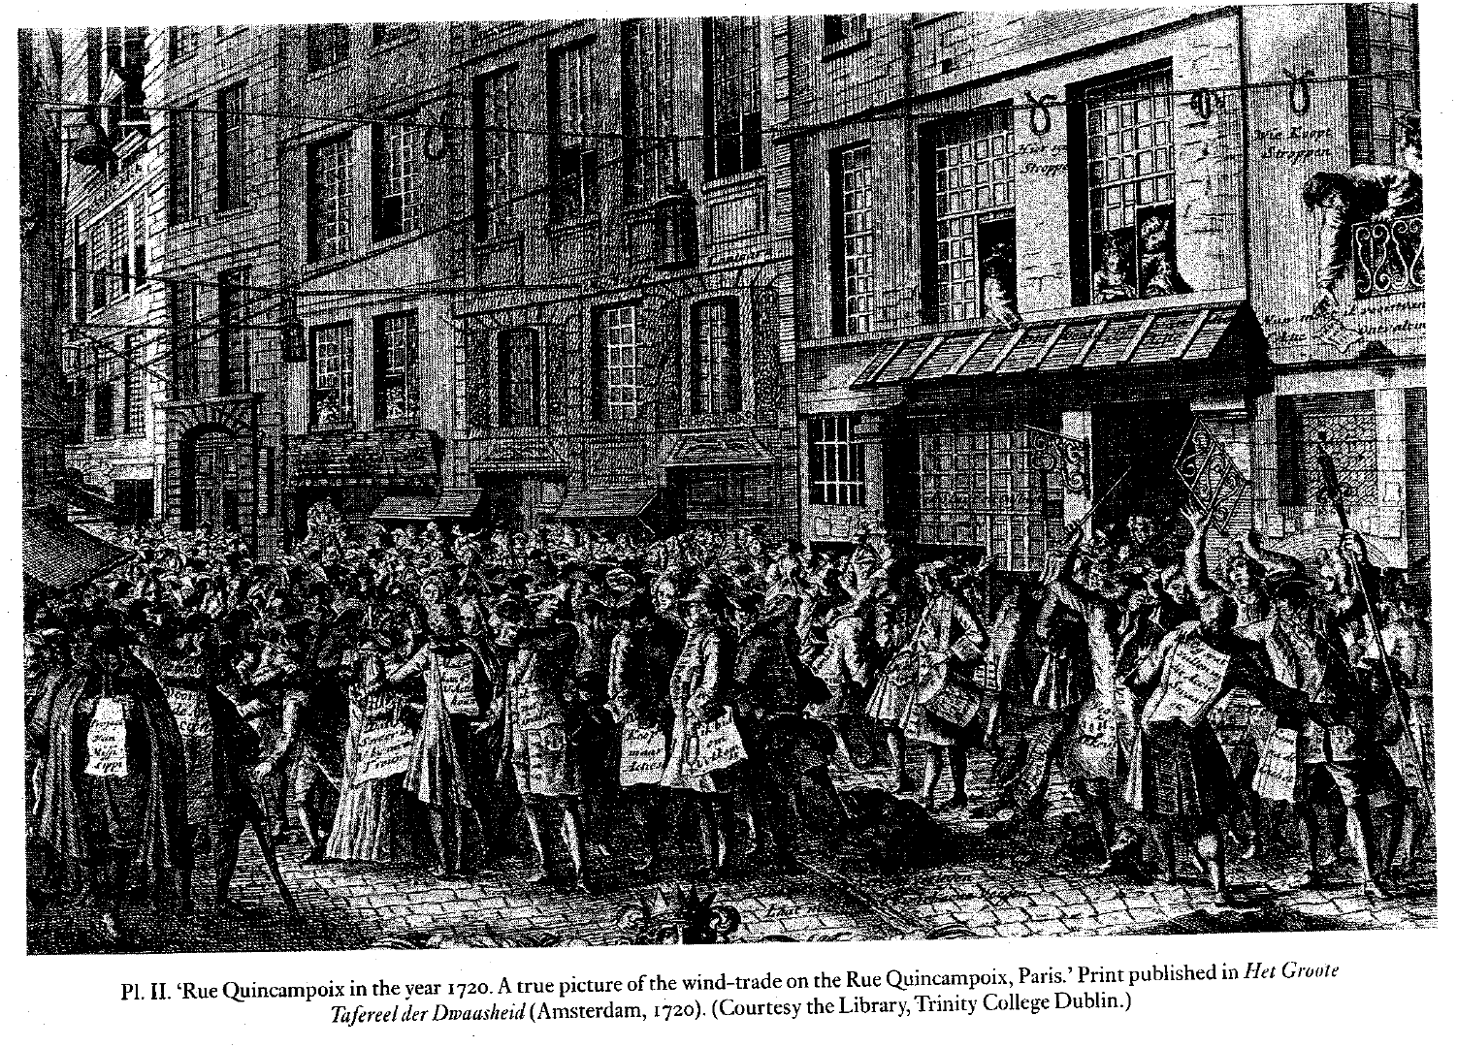
Fever : the trading alley (rue Quincampoix)

Slide 29
Shares as money
January 1720, John Law is Controleur Général
  Finance minister
  In charge of monetary policy
  In charge of the collection of all taxes
  In charge of all the external trade
When shares hit 10 000, some wobbling
Banque Générale guarantees the price of 9000.
At that moment, shares are equivalent to the money
Sum of notes and shares around 5000M in the spring of 1720
Was this feasible?
Depends on the demand and the sustainability of a low interest rate:
  At 2 percent, PV of 100 M per year (tax farm of 80M plus some revenues) is 5 000 M. Feasible
  But, the price leve started to rise.

Slide 30
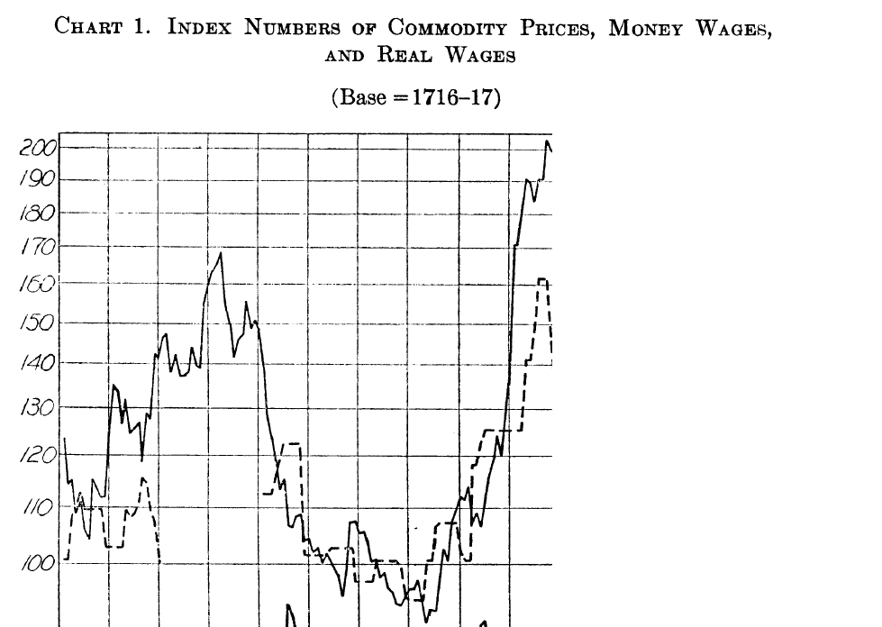
Inflation

Slide 31
What could be done?
Money had been created in three manners
  Monetization of the public debt and capital values of tax farms, Company of the Indies
  Elimination of gold and silver as support of money
  Capital gain on the shares when the price went from 5000 to 9000 (priced guaranteed in the spring 1720). The capital gain was induced by future prospects (true or false) and by the lowering of the interest rate
Too much money had been created
  Demand could not be perfectly known, but inflation shows that even in the system (that was new), the demand was less than the supply
Something had to be taken back
  It would have been possible to validate the inflation. In that case the creditors would have lost. Probably, they had more power.
  Law proposed to eliminate gradually the capital gains. If it had been the same people owning the shares in May 1720 as in September 1719, would have been fair. But,...

Slide 32
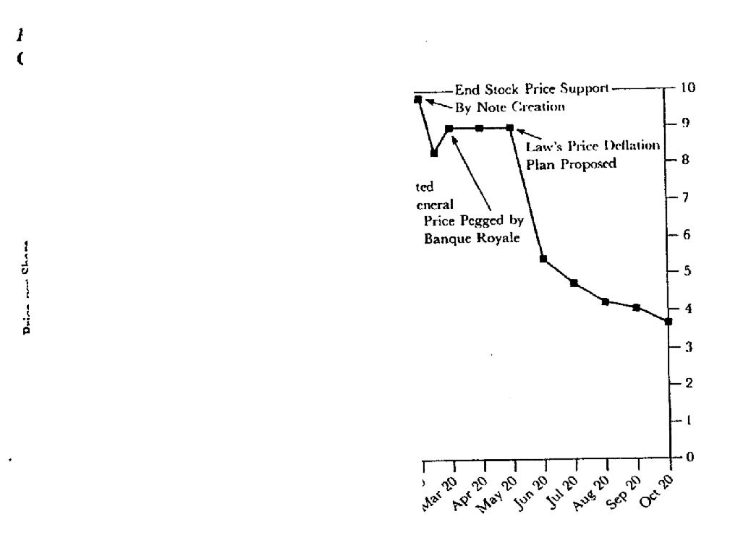
The retreat
May 1720: Law recognizes that the inflation does not fit with the theory.
Announces a plan of gradual reductions of the guaranteed value of the share
Plan lasts only for a few days. Opposition of creditors and Parlement.
When removed, the share price is reduced

