Slide 1
The Economics Effects of the Abolition of Serfdom: Evidence from the Russian Empire
By Andrei Markevich and Ekaterina Zhuravskaya

Slide 2
What was serfdom?
A key institution in Russian history. Existed in its most severe form between 1649-1861 (around 212 years).
The paper defines a serf as a member of the rural population bound to forced labor under the ownership of the gentry, with limited personal freedoms.
Originally, Russian peasants were free and could migrate across estates.
  1649 Code of Law (Sobornoye Ulozhenie) proclaimed that peasants were the property of their estates and made migration a criminal offense.
Serfs had to fulfill obligations in the form of in kind payment (quitrent) or labor (corvée) for their landlords.
The landlords had (almost) full discretion over the amount and the form of these obligations.
The landlords also had the right to sell, to buy, or to lease their serfs.

Slide 3
Emancipation of Serfs
Occurred in two stages:
  Emancipation occurred in 1861
    At time of emancipation, obligations of serfs to landlords were fixed as rent payments for land use
    After emancipation, Landlords lost the right to change the level of peasant obligations, to sell, buy, lease, punish, or imprison peasants (no more coercion incentives and no more ratchet effect)
  Land reform implementation took place over next 20 years
    Abolishment of any obligations of former serfs to landlords by transferring land rights to peasant communes, in return for redemption payments
    Emancipated serfs (peasants) had an obligation by law to buy out the land from the landlords as a commune
An important impact of Serf emancipation was the cessation of the Ratchet Effect

Slide 4
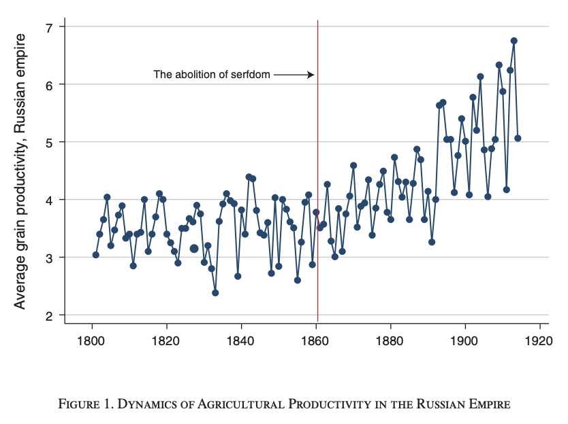
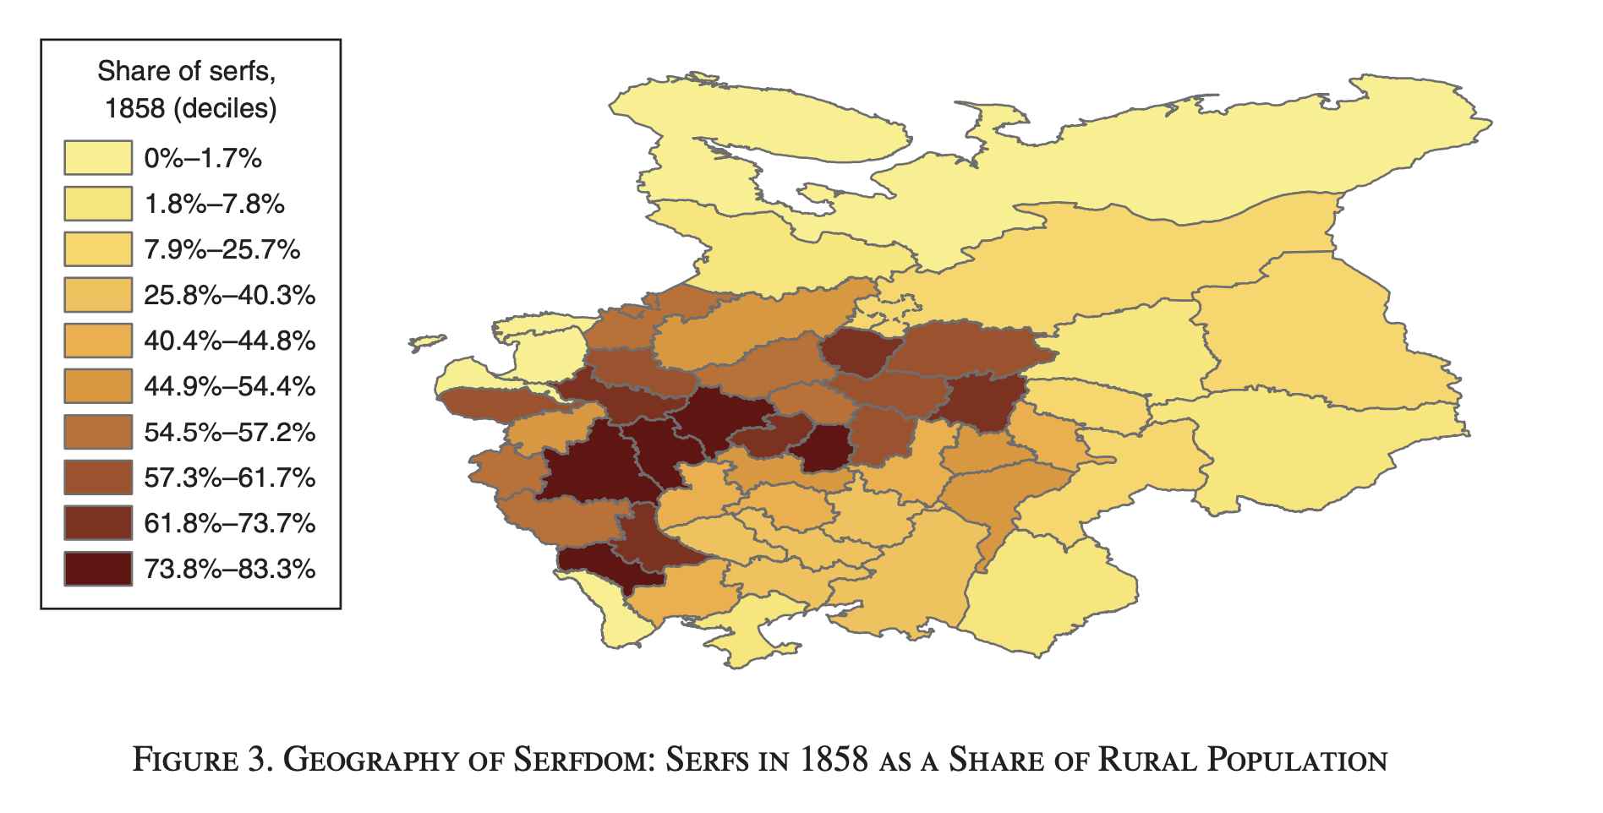
A Brief History

Slide 5
Hypotheses / Expectations
Effects of emancipation on agricultural productivity are ambiguous.
  Alleviation of coercive methods used by landlords has an ambiguous effect on Serfs’ incentives to be productive.
The expected effect of the land reform is ambiguous.
  Peasants might invest more in their own land or development could have been stifled by the power of the newly established commune.
Could expect a positive effect of the abolition of serfdom on the development of industry, but still ambiguous.
  Now that serfs are free, some would move to cities to find manufacturing work; but, the communes regulated who was allowed to leave the land.
Effect of emancipation on peasant nutrition is also ambiguous.
  Serfs were a valuable commodity, landlords made sure they were well fed. Would they be able to provide for themselves as sufficiently?
Notes:
Add sub items from notes

Slide 6
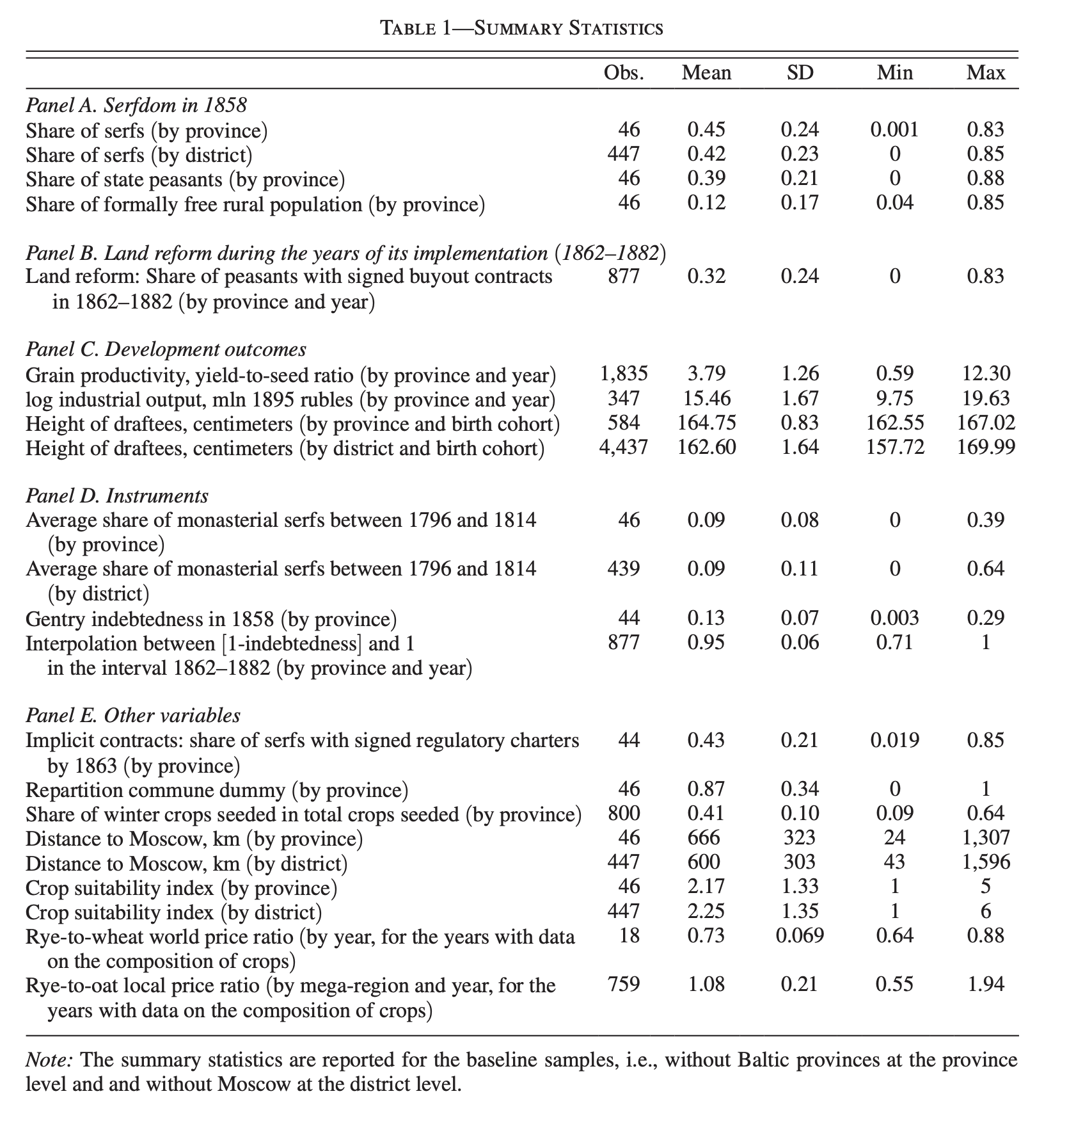
Data
Province-level panel dataset on the development of 46 European provinces of the Russian Empire

Slide 7
Data
Outcome variables:
  Grain productivity: measured as the grain yield to seed ratio, as a proxy for agricultural productivity
  Industrial development: measured by log industrial output in constant rubles of 1895
  Peasant nutrition: measured by the average height of 21 year old draftees by birth cohort and province or subprovince (district) of residence
All outcome variables available at provincial level

Slide 8
Data
Main explanatory variables
  Prevalence of serfdom: measured by number of serfs divided by population, across provinces and districts
  Land reform implementation
Instrumental variables
  Monasterial serfs: share of serfs that belonged to monasteries and clergy before their nationalization
  Gentry debt: debts of the gentry a state bank and other state financial institutions before the emancipation

Slide 9
Data
Additional variables
  Repartition communes: a dummy variable for whether repartition commune
  Share of serfs who agreed to sign regulatory charters in a province: a proxy for prevalence of implicit contracts under serfdom
  Crop suitability index: constructed using annual mean temperatures by province and year
  Distance to Moscow
  Grain prices (by year)

Slide 10
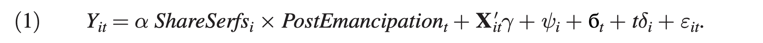
Methodology
i,t index province and time periods
Time periods are either years or a series of consecutive years (i.e. decades) depending on data availability
Y denotes outcome variables grain productivity or log(industrial output) in province i at time t
ShareSerfs: share of privately owned serfs in a province in 1858
PostEmancipation: dummy indicating the time after emancipation of serfs (i.e. the dummy switches “on” in 1861)
Coefficient of interaction term is main variable of interest (α), is DiD estimator
Ψi: province fixed effects
бt: year fixed effects
tδi: control for province specific linear trends (for grain productivity and industrial output)
Xit: accounts for the correlations between the share of serfs with the distance from Moscow and soil quality; authors control for the interactions between the post-emancipation dummy and log distance from Moscow and land suitability, minus their respective sample means

Slide 11
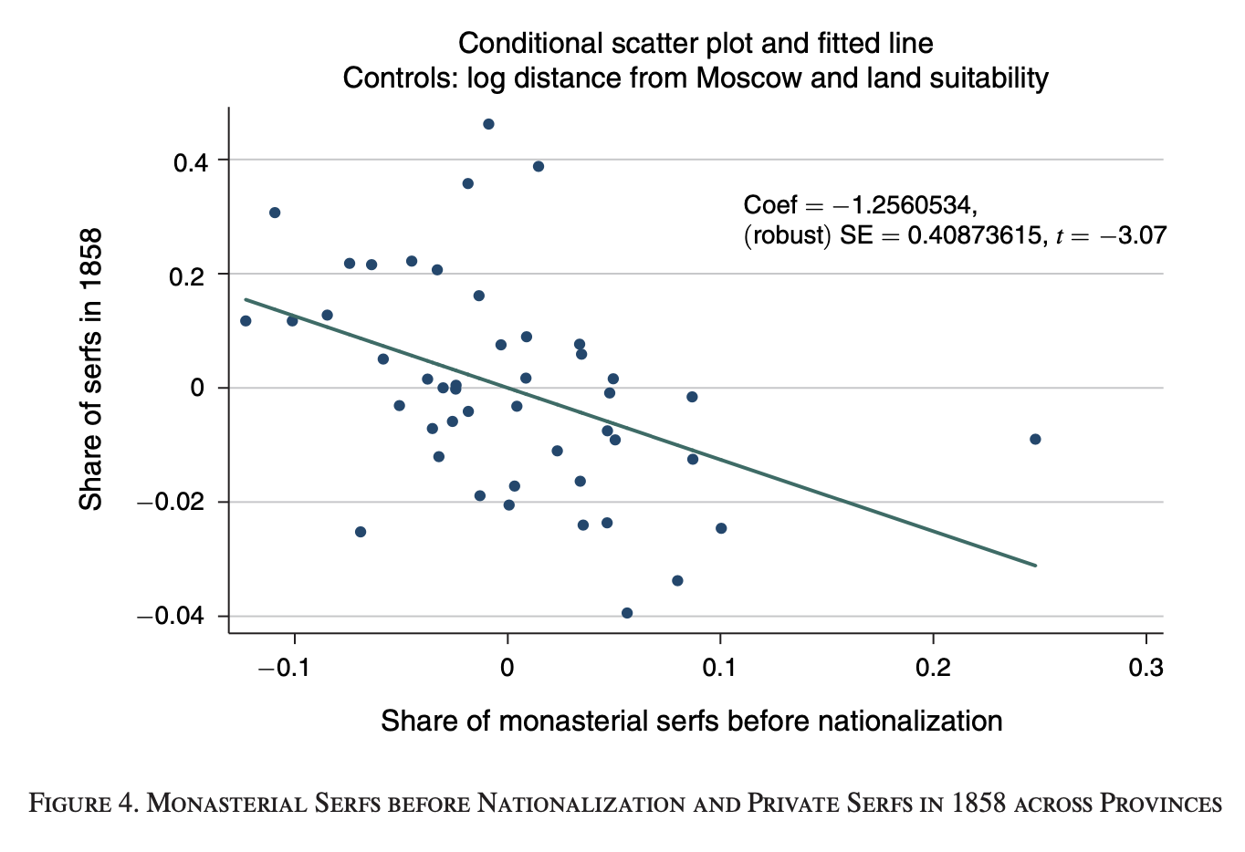
IV Regression
Differences in prevalence of serfdom are not random, so authors also introduce IV strategy to estimate (1)
Instrument ShareSerfsi × PostEmancipationt with MonastSharei × PostEmancipationt.
IV 1: gentry’s debt levels, which influenced the timing of land reforms, are used to control for land reform variables, allowing for causal interpretation of land reform impact.
IV 2: addresses potential endogeneity by isolating serf prevalence from economic factors that might affect both serfdom and productivity (cross-province variation in serf distribution due to Catherine the Great’s nationalization of church lands and serfs)
Notes:
Graph: The negative coefficient indicates that as the share of monasterial serfs increased, the share of serfs in 1858 tended to be lower. This supports the idea that church-owned lands, once nationalized, were less likely to convert peasants into serfs under private landlords. The "negative share" here reflects that regions with higher shares of monasterial serfs before nationalization actually had lower shares of serfs among the total population by 1858.
This implies that monasterial serf distribution is a valid instrument for total serf prevalence, as it introduces exogenous variation not driven by economic or regional productivity factors.

Slide 12
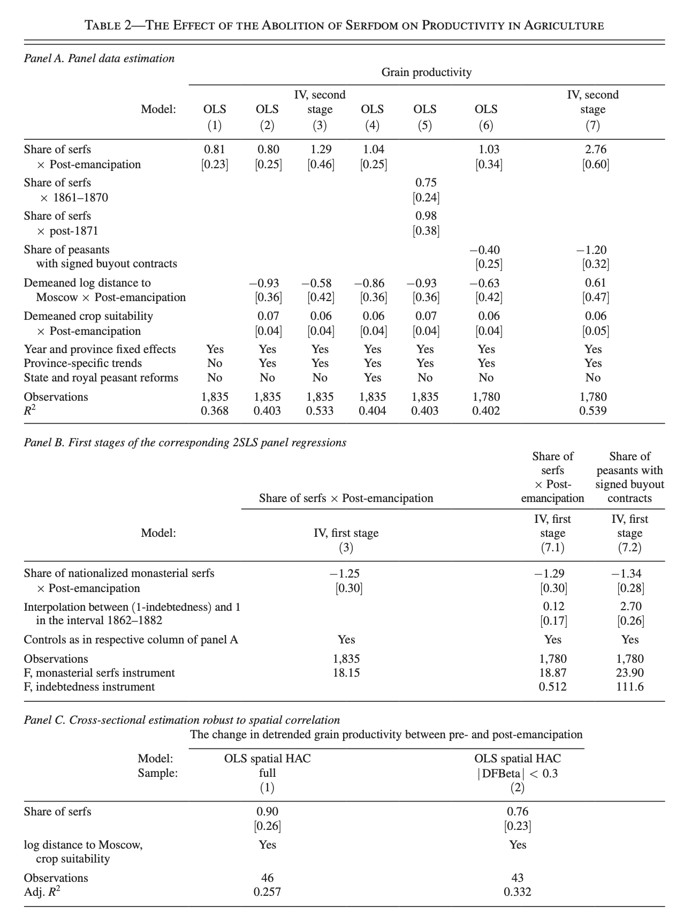
Main Results: Grain Productivity
In all specifications, authors find positive and statistically significant estimates of the effect of the abolition of serfdom, estimated by the coefficient on the interaction term between the share of serfs and post-emancipation dummies (DiD variable)
  Ratchet effect
Main observations:
  Magnitude of the coefficient of interest is somewhat larger in the IV specification (3) compared to the OLS, probably due to an inherent measurement error bias in OLS estimates as authors measure prevalence of serfdom at one point in time, in 1858, whereas the share of (former) serfs year-to-year differs, for example, as a result of idiosyncratic shocks to mortality due to infectious diseases
  Difference in the magnitudes of the coefficients presented in (5) suggests that three-quarters of the overall effect on grain productivity for the nineteenth century was realized in the first decade after the emancipation

Slide 13
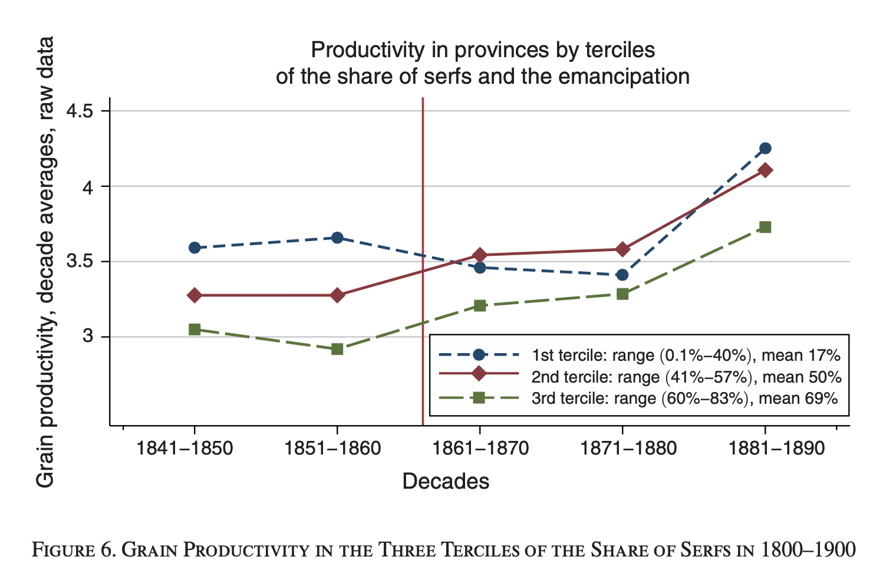
Main Results: Grain Productivity
Before emancipation, provinces with a larger share of serfs lagged behind those with a smaller share.
Productivity in first tercile provinces fell during the first two decades and recovered in the third decade.
This fall could be a result of…
  Confounding negative macro shocks (e.g., climate).
  General-equilibrium negative on provinces that relied on free labor in agriculture before emancipation.
  Productivity in the high-serfdom led to an increase in the demand for nonlabor production inputs which could have led to an increase in the price of these inputs which could have had a negative effect on the productivity in the provinces which were more productive to start with.

Slide 14
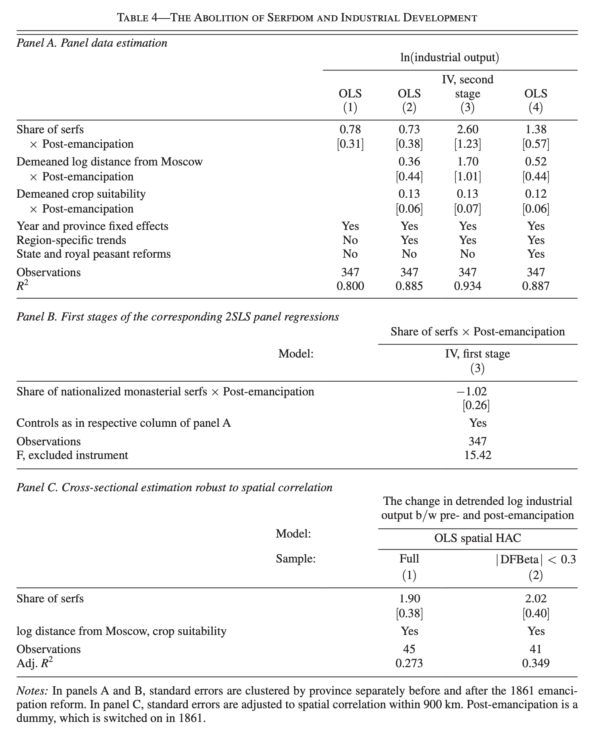
Main Results: Industrial Development
Estimate the effect of emancipation in high-serf provinces on log industrial output in constant rubles of 1895
Estimation results in Table 4, Panel A, use ShareSerfs × PostEmancipation as the primary interaction term
Find a positive and statistically significant effect of the abolition of serfdom on industrial output in all specifications
IV estimates showing a larger effect (39% increase in an average high-serf province, 45%+)
Notes:
Clarify what industrial development means (how is it measured?), talk about the economic intuitions (why industry grows?)

Slide 15
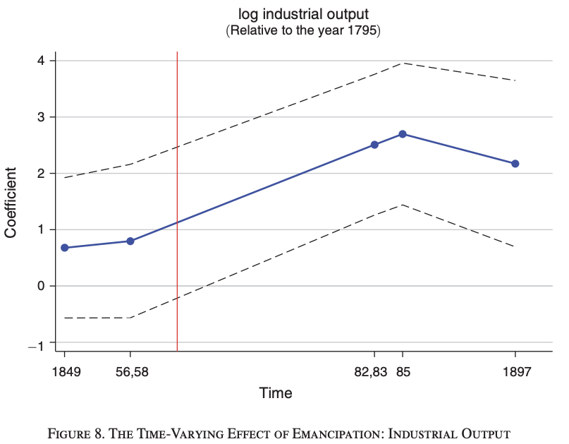
Main Results: Industrial Development
Large magnitude of the effect on industrial development is in line with findings on the substantial migration within provinces from villages into the provincial industrial sector
  in spite of the constraints erected by the peasant commune
Figure 8 presents estimates of the dynamics of the effect of the abolition of serfdom on industrial output
Demonstrates the absence of pre-trends as the estimates for the years before the emancipation are small and statistically insignificant
  Only become large and significant after the red line (emancipation)

Slide 16
Methodology: Peasant Nutrition (side note)
To study effect of emancipation on nutrition (the last outcome variable), authors also use DiD approach
  Main difference: do not observe height of draftees before the reform
  To account for differential trends:
Hic: Average height of draftees in cohort c, i indices either provinces or districts
  c acts as a time proxy as it represents a specific birth year
αc : series of coefficients that estimates the dynamics of the effect of emancipation height across cohorts
ShareSerfs𝑖: Proportion of serfs in province 𝑖 before emancipation, indicating exposure to serfdom.
Dc: Dummy variable for each cohort, capturing cohort-specific differences in emancipation exposure.
  Hypothesized that how long emancipation was after birth/conception would play a significant role in height levels.
Summation due to multiple cohorts for each birth year
Xic′γ: Control variables for demographic or regional factors affecting height.
ψi & 𝛽𝑐: Fixed effects for province 𝑖 and cohort 𝑐 controlling for unobserved province or cohort characteristics
By interacting ShareSerfs and D_c for each cohort, this equation leverages variation in serf prevalence and timing of emancipation. Since younger cohorts experienced more of their formative years post-emancipation, a significant 𝛼𝑐 suggests that exposure to emancipation correlates with increased height, isolating the reform's nutritional impact.

Slide 17
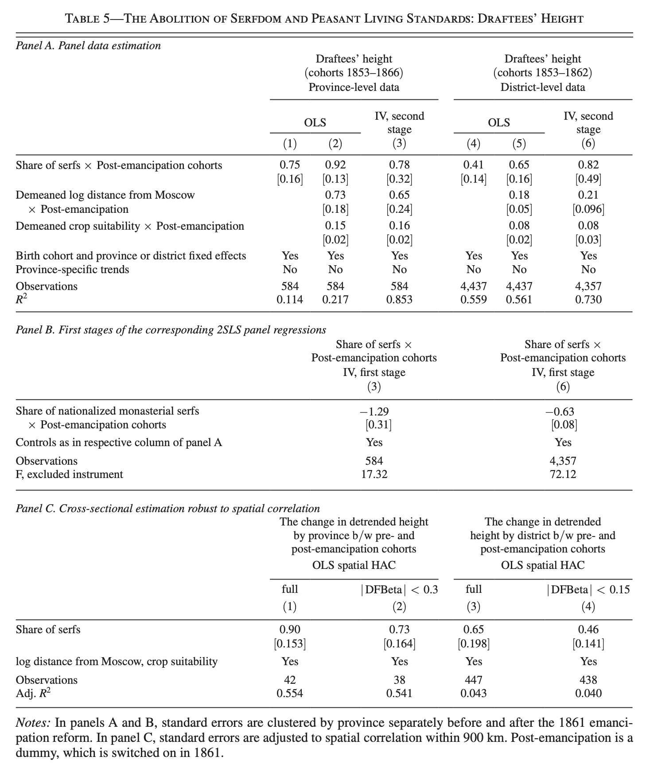
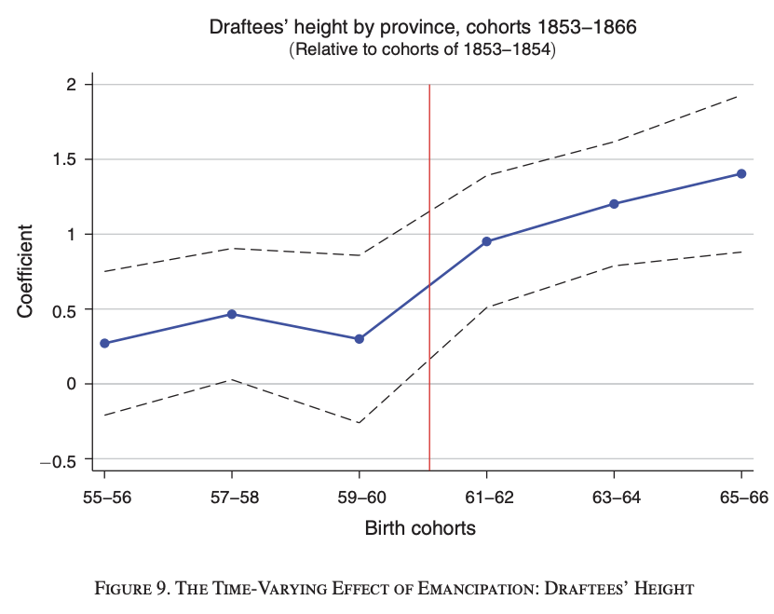
Main Results: Peasant Nutrition
The positive and statistically significant coefficients across OLS and IV models suggest that emancipation led to improved nutrition for former serfs, as reflected in increased height of younger cohorts who grew up in the post-emancipation period.
Largest increase is between the period immediately before and immediately after emancipation, consistent with nutrition in early infancy having the most important effect on height during adulthood

Slide 18
Conclusion
Abolition of serfdom had a substantial positive effect on agricultural productivity, industrial development, and peasants’ nutrition in nineteenth century Russia
Improvements amounts to about 17.7 percent increase in Russia’s GDP in second half of 19th century\evidence suggests primary reason for large effect of abolition on agricultural productivity was the dramatic change in the incentive structure
  43 percent of Russia’s rural population was transformed by the 1861 emancipation from serfs with no rights over their own labor or human capital into free small-scale farmers.
  This change led to a greater effort, better use of local conditions, and better use of available agricultural knowledge and technologies.
However, the abolition of serfdom would have contributed to even faster development if the land reform had transferred ownership rights over land to peasant households rather than the commune, or at the very least to hereditary rather than the repartition communes. The increase in the power of the repartition peasant commune (designed by the land reform) was the most likely mechanism behind the negative effect of the land reform.

