Slide 1

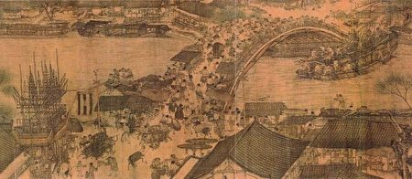
The effect of the Grand canal on Chinese regional development
“於是自淮而南，邦国之所仰，百姓之所输，金谷财帛，岁时常调；舳舻相衔，千里不绝。越舲吴艚，官艘贾舶，闽讴楚语，风帆雨楫。联翩方载，钲鼓镗鎝，人安以舒，国赋应节。”

Slide 2
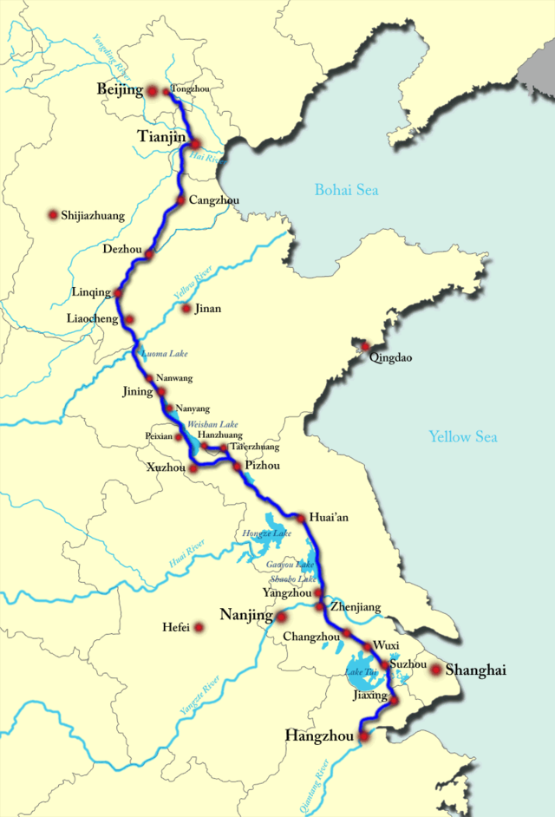

The grand canal Overview
“So also parallel to this great street, but at the back of the market places, there runs a very large canal, on the bank of which towards the squares are built great houses of stone, in which the merchants from India and other foreign parts store their wares, to be handy for the markets.” – Marco Polo

Slide 3

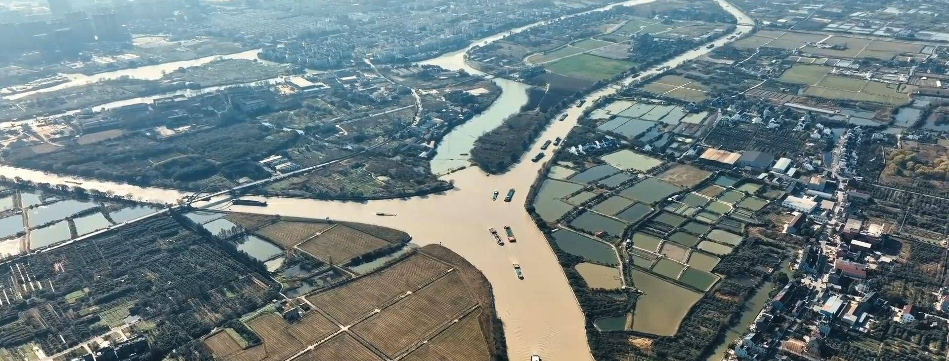
Timeline
“南方水多，北方水少，如有可能，借点水来也是可以的。” ——毛泽东，1952
[Warring States ]
486 BC
[Sui Dynasty]
605
[Yuan Dynasty]
1281
[Late Qing]
1850
[Modern China]
1981

Slide 4
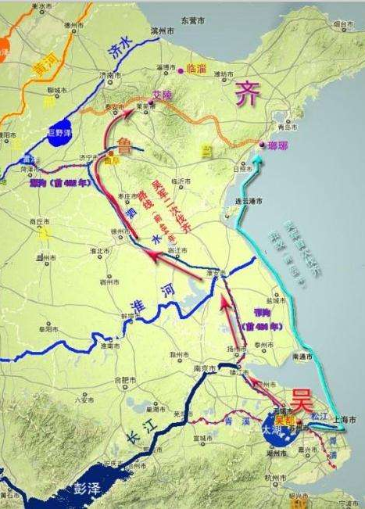
Early canal in the warring state era (480 bc)
Fuchai (夫差) of Wu Kingdom build the Canal in Yangzhou area to attack the Qi Kingdom.
Most canals connected two natural waters together.
Hwai River and the Yangtze River were connected.

Slide 5
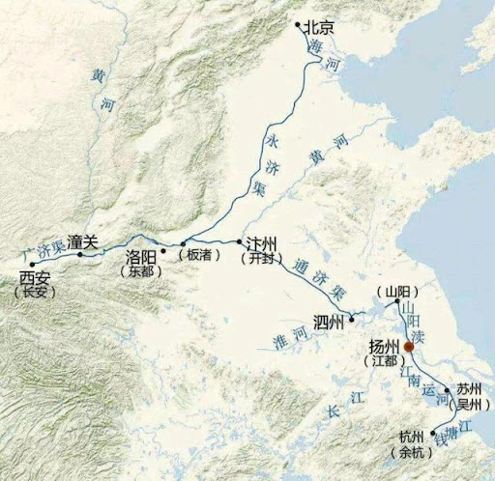
Sui Dynasty (581-618)
It connected Hangzhou and Beijing to Luoyang.
Many northerners escaped to the south due to constant warfare.
The north lacked food and other resources.
The canal is great to send troops to both directions.
The emperor could travel to the south easier.
The canal connected the southern part of China to the Silk Road.
Yangzhou became the economic center of China.
Tang Dynasty (618-907) was greatly benefitted from the canal.
Notes:
War in the north. The canal can carry the food from the south to the north directly

Slide 6
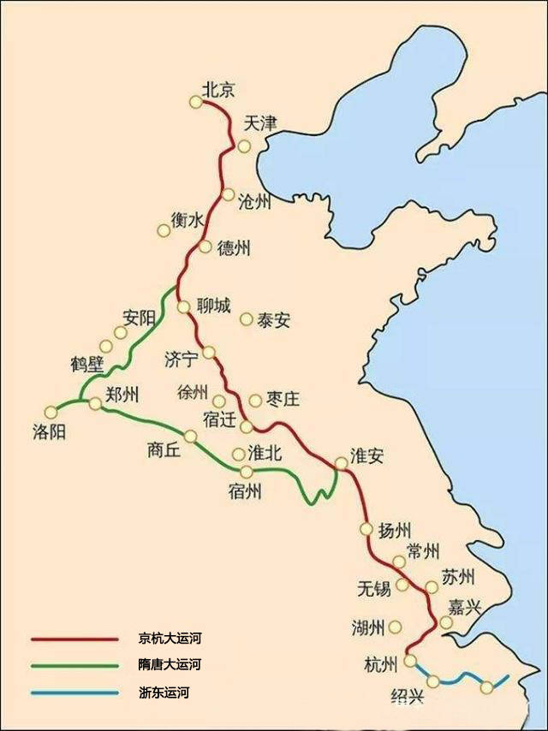
Yuan dynasty (1271-1368)
Mongolians ruled over China and settled in Beijing.
The prosperity gap between the north and the south widened.
They considered Luoyang as a detour and rerouted the canal.
The canal in the north was destroyed during the constant warfare between Song and Jin (1127-1279).
Luoyang lost its political and economical significance in China.
Sea routes were developed, but canal proved to be safer.

Slide 7
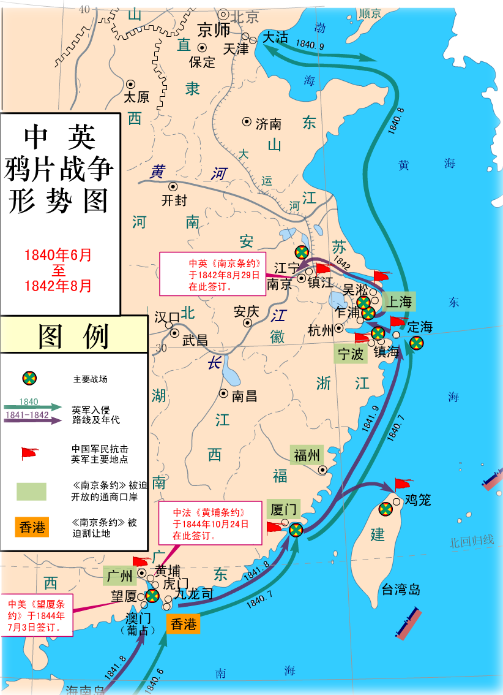
the late qing dynasty
Sea routes connected the Jiangzhe area and Liaoning better.
The British targeted Nanjing as a key city that connected the northern and the southern China.
Taiping Rebellion attacked Yangzhou and occupied the canal system in the region.
The Qing government could not handle the yellow river flooding and the civil war at the same time, hence the switch to seaways.
Yangzhou and other river-based cities became less relevant as economic centers in China.
Notes:
The canal also suffered from illegal privitalization of the waterway, reducing the total water supply. The drought also reduced the overall supply of the water in the canal.

Slide 8
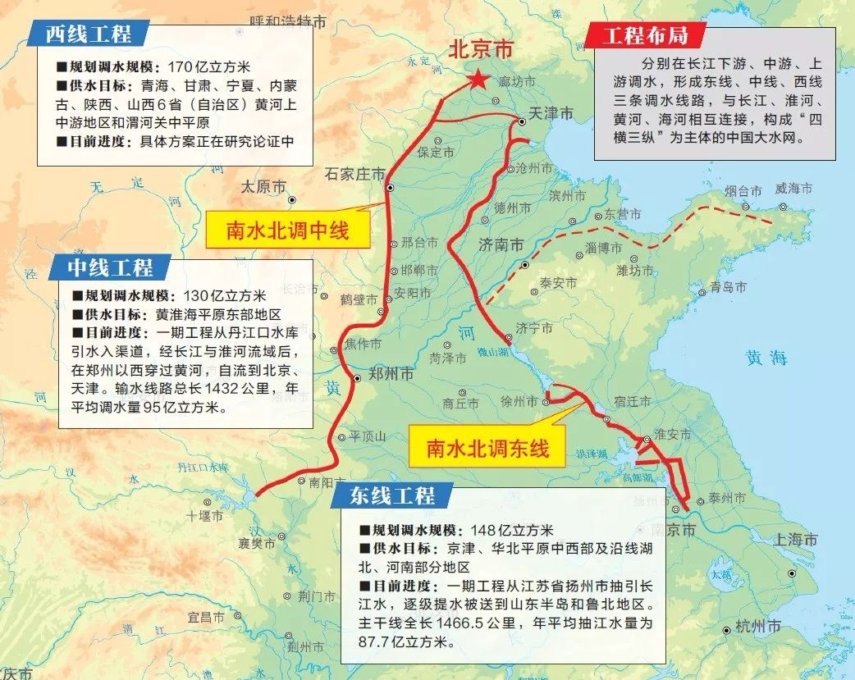
Modern China (1949-)
South–North Water Transfer Project revived the canal.
The main goal of the canal is to transfer drinkable Yangtze River water to the north.
The government focused more on the water quality and sustainability of the canal.
The canal water satisfy the drinkable “GB 5749-2022” standard after processing.

Slide 9
References
http://www.hrc.gov.cn/zlaj/gzjl/134376.jhtml
https://www.chinanews.com.cn/cul/2014/06-23/6308850.shtml
王玥. 咸丰年间京杭大运河河运停滞与扬州衰落[J]. 档案与建设,2021(9):67-69. DOI:10.3969/j.issn.1003-7098.2021.09.021.
王程,曹磊. 京杭大运河的历史演变及文化遗产核心价值[J]. 人民论坛,2019(30):140-141. DOI:10.3969/j.issn.1004-3381.2019.30.052.
闫春伟. 隋炀帝时期大运河对南北经济的影响研究[J]. 兰台世界,2013(21):70-71.
路征远,雷芳. 元代大运河修治原因探析[J]. 安徽农业大学学报（社会科学版）,2013,22(5):127-131.
张公政,王日根. 清代奉天粮食海运考述[J]. 学习与探索,2015(12):162-168. DOI:10.3969/j.issn.1002-462X.2015.12.029.
https://news.cctv.com/2023/11/25/ARTIQpOuAPM20vhYFQnNbZb0231125.shtml

