Slide 1
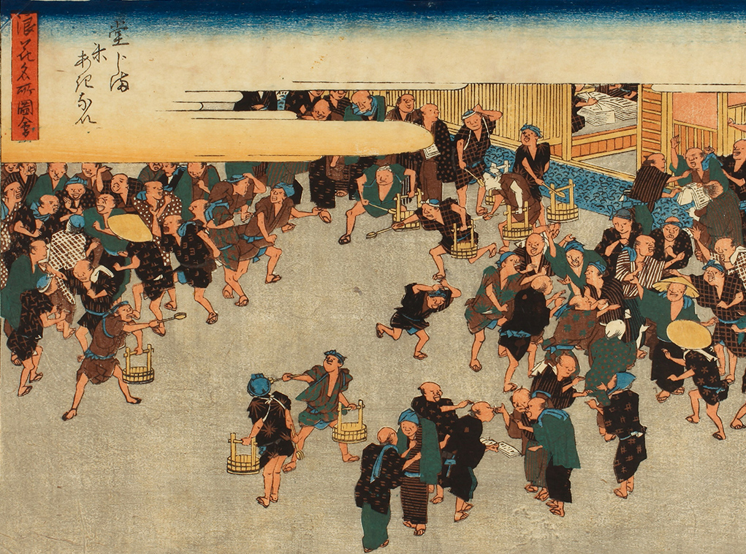
Derivative
Markets
Boston University College of Arts and Sciences
Department of Economics – Cyrus Kwan

Slide 2
Introduction to derivatives
01
Forward agreements
02
TABLE OF CONTENTS
Option contracts
03
Futures market
04
Change in purpose
05
What are derivatives
What were their original purposes
What derivatives will be covered
What are forward contracts
When was it first used
What are option contracts
When was it first used
What are future contracts
When was it first used
Differences between them

Slide 3
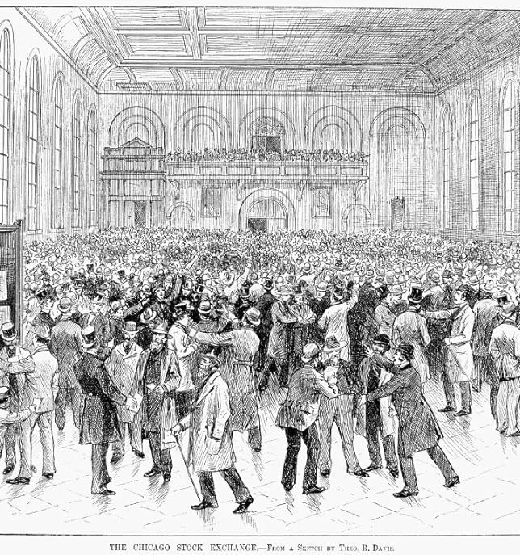
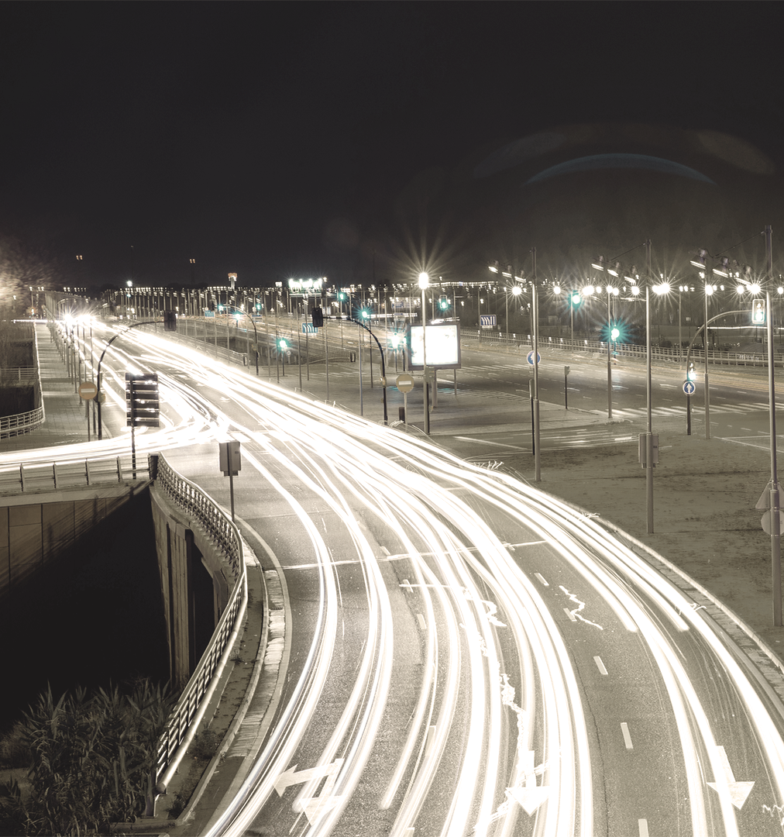
Introduction to Derivatives
01
What are derivatives?
Derivatives are financial contracts that derive their value from the performance of an underlying asset
Fernando, Jason, “Derivatives: Types, Considerations, and Pros and Cons,” Investopedia, https://www.investopedia.com/terms/d/derivative.asp

Slide 4

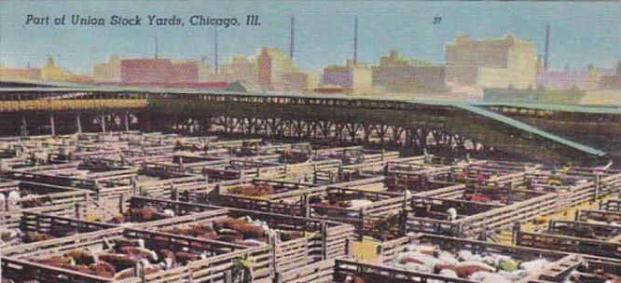
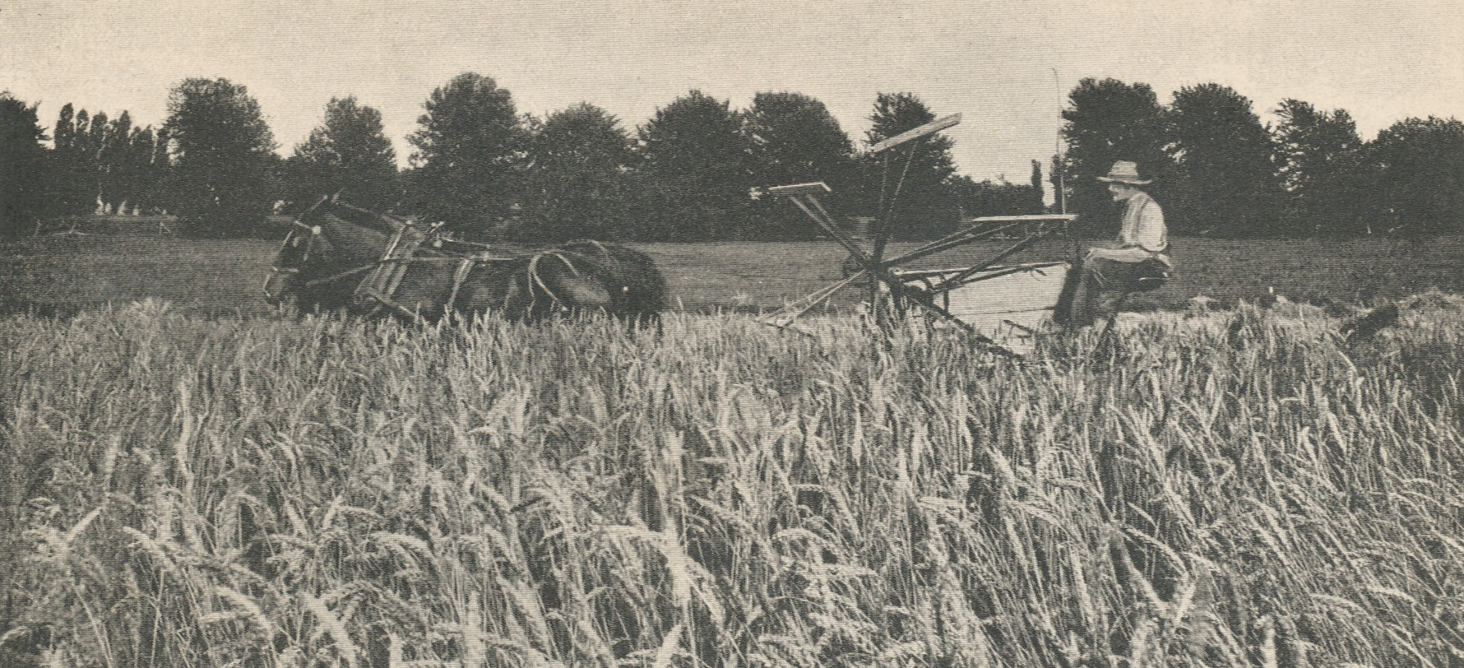
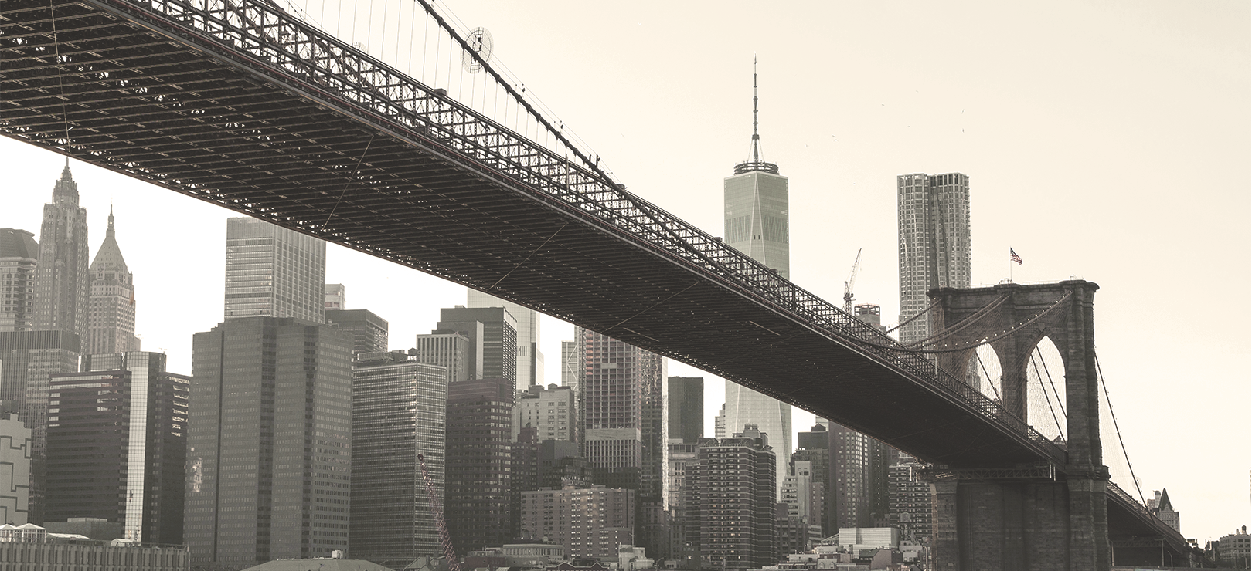
Purpose 1: Facilitate
Original Purposes
Purpose 2: Securing
Facilitate trade to insure and reduce the risk for farmers against potential physical variables such as weather, disaster, or disease in crops that would lead to commodity supply failure
Securing the supply of commodities by allowing producers and consumers to “lock in” a price for a future purchase or sale. Mitigating potential fluctuations and access to price at a predictable cost
Weber, Ernst Juerg, “A Short History of Derivative Security Markets,” University of Western Australia, https://math.nyu.edu/~avellane/Weber_History.pdf

Slide 5
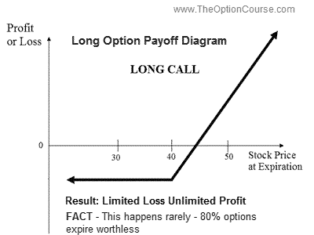
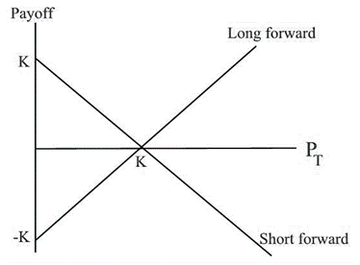
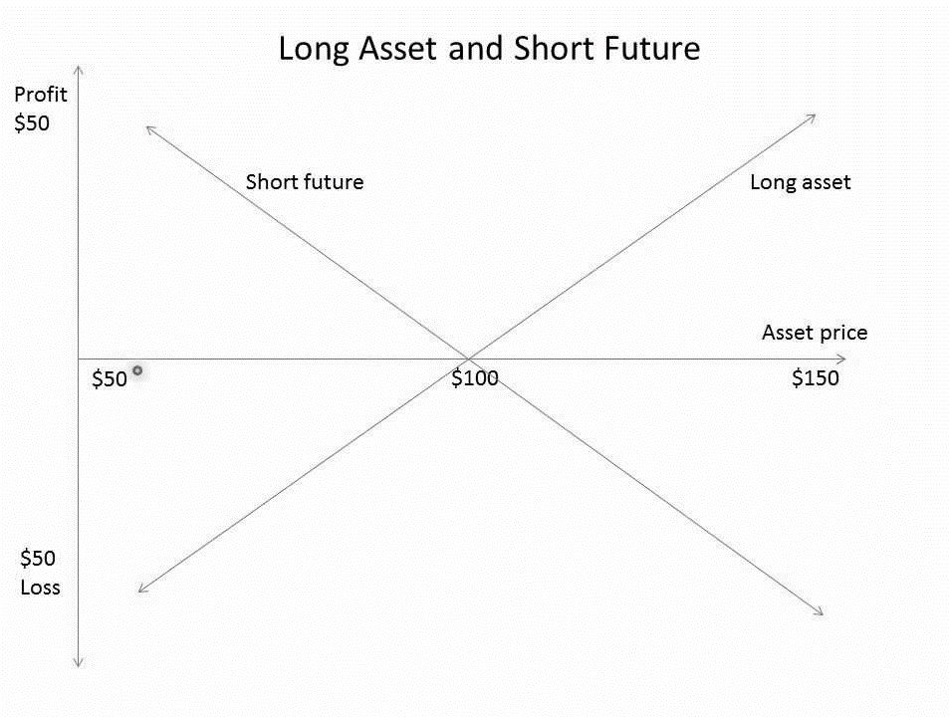
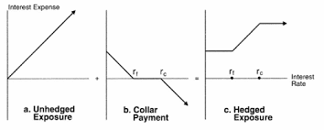
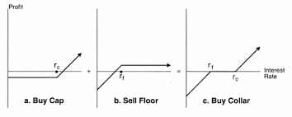
For this Discussion
We will focus on
Forwards and Futures are the same except that one is private, highly customizable and the other one is standardized and exchangeable
Options
The right to buy or sell an asset at a set price within a set time frame. Options are non-binding versions of futures and forwards
Forwards
Agreements to buy or sell an asset at a set price in the future. Forwards are private contracts between two parties
Futures
Agreements to buy or sell an asset at a set price on a future date. Futures are standardized and exchange-traded
Swaps
The exchange of cash flows or liabilities between two parties. Types of swaps includes interest rate swaps, CLS, CDS
The K term refers to the pre-agreed upon delivery price of the underlying commodities. (e.g. I’m a farmer who wants to sell crops at 2 dollars in 6 months. If the market price of crops rise to 3 dollars, I wouldn’t gain from the contract but to sell at 2 dollars to the buyer; however, if the market price drops to 1 dollar, I would still be able to sell at 2 dollars
Fernando, Jason, “Derivatives: Types, Considerations, and Pros and Cons,” Investopedia, https://www.investopedia.com/terms/d/derivative.asp

Slide 6
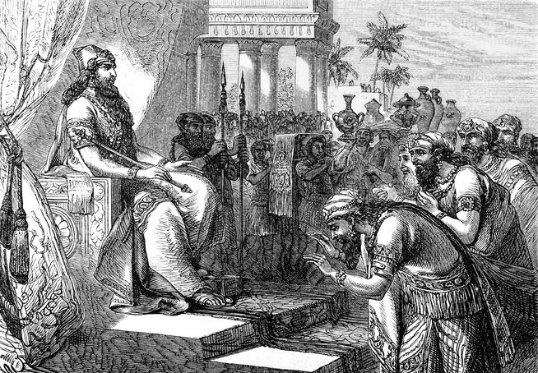
Forwards
Ancient Babylon
02

Slide 7
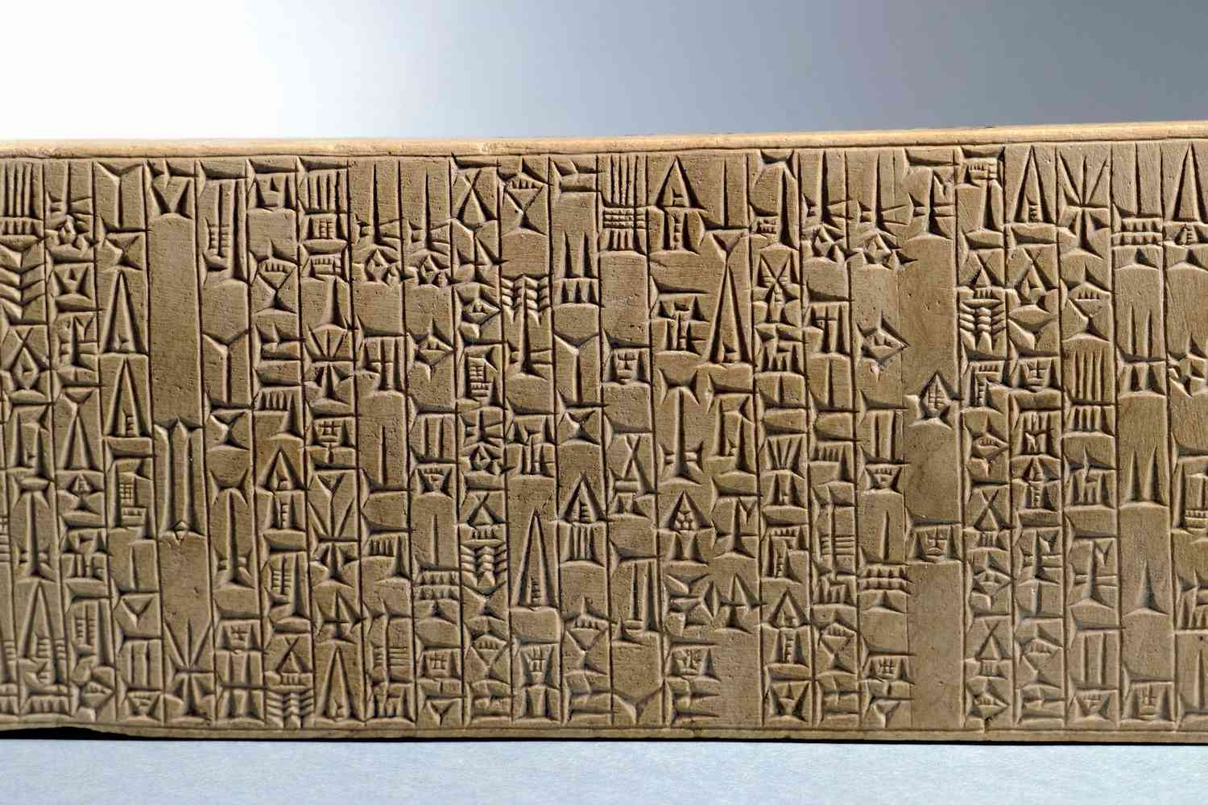
Earliest Form of Derivatives: Forwards
1
Buyer and sellers agree in advance on the number of goods, price, and time for those goods to be delivered
2
Seller starts planting the required numbers of crop for transaction future transaction
Early forms of derivative could be traced back to Code of Hammurabi, king of Babylon (1792 to 1750 BC), which covered most aspects of civil and commercial laws of the time.
With the established contract law on top of encouraging tade and securing the supply of commodities, legal certainty was present for trade engagement. The ultimate purpose was to minimise “your word against mine” maxim in case of disputes.
When the contract was establishing, witnesses must be present and has to be recorded in writing format. After, in no circumstances that contract could be altered. Usually, transaction will be done at city gate and temples (clearing services), where long-distance trade would be supervised by the government.
3
Seller deliver the pre-determined numbers of crop to the buyer. Contract settles
Kummer, Steve and Pauletto, Christian, et al., “The History of Derivatives: A Few Milestones,” Research Gate, Published in 2012, https://www.researchgate.net/publication/349385381

Slide 8
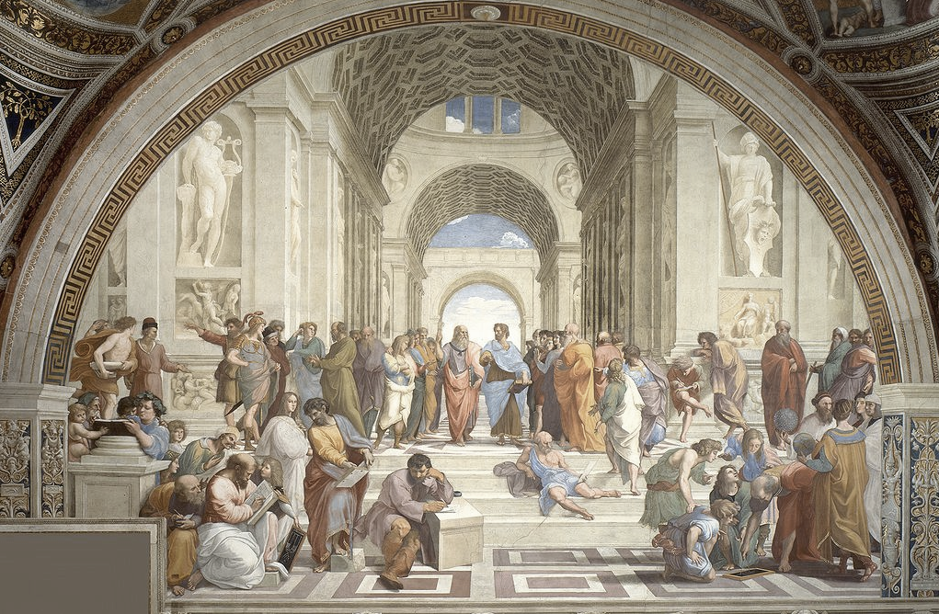
Options
Ancient Greece
03

Slide 9
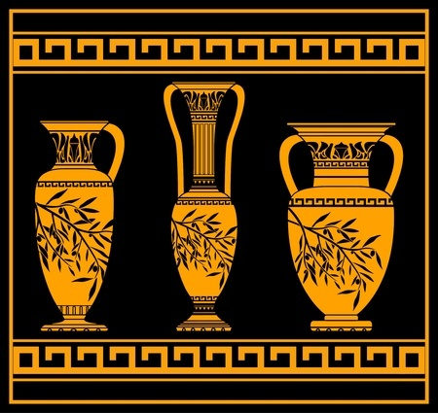
Evolving Obligations:
Options
1
Buyer and sellers agree in advance on the number of goods and the strike price for those goods with payments
2
Buyer holds the contract during the determined contract life or till expiration
Contract laws and derivatives had carried on throughout the time being and evolved into more subforms. Option contracts were believed to be founded in Ancient Greece by Thales of Miletus (625 to 550 BC), who was also a philosopher and a mathematician.
Thales predicted an unusal amount of olive will be harvested a winter before that summer. With such speculation, Thales negotiated with the olive press owners “the right, but not the obligation,” to hire all the olive presses. The contracts were secured by a cash deposit.
Subsequently, the speculation turnt out to be true where Thales was able to hire the presses at the pre-determined prices and lease those presses at a substantial premium.
3
If the price of goods hits the strike price, the buyer has the option to perform transaction. Otherwise, worthless
Kummer, Steve and Pauletto, Christian, et al., “The History of Derivatives: A Few Milestones,” Research Gate, Published in 2012, https://www.researchgate.net/publication/349385381

Slide 10
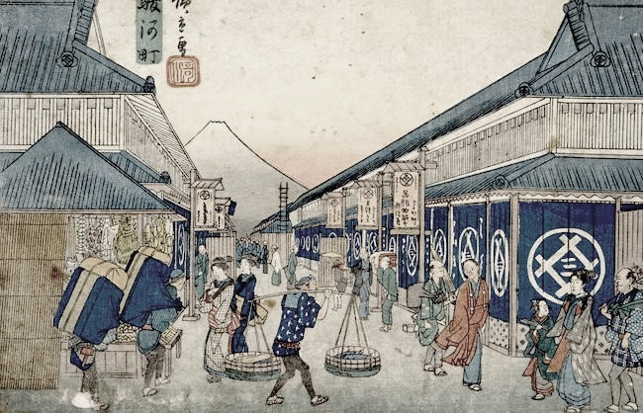
Futures
Edo Japan
04

Slide 11
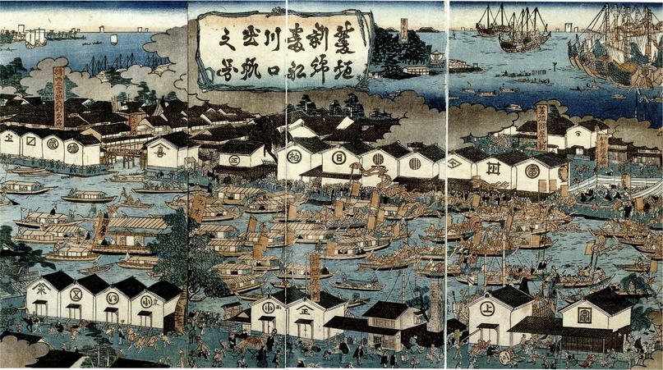
Popularization:
Futures
1
Active buyer and seller establishing contracts with conditions (time, quantity, expiry) within the exchange
2
Market price changes on-time, exchanges will be performed during the life-time of the contract
Dojima Rice Excahnge (17th century) was the first organised market for derivatives trading in Osaka, Japan. Rice played an important role in the Japanese economy, as it is the main agricultural commodity and was the basis of national income.
Samurai, reginal lords, would sometimes sell their crops years in advance to solve their cash-flow problems as their income was highly depended on the value of rice.
There were fixed trading periods, and members of exchange. Contracts traded as futures were standardised, (period, transaction, delivery, quality, and clearing) and on the last day of the trading period all positions had to be cleared by cash or commodity delivery.
3
Holder of contracts till expiry will bare the obligation and settle with either cash or physical delivery of goods
Kummer, Steve and Pauletto, Christian, et al., “The History of Derivatives: A Few Milestones,” Research Gate, Published in 2012, https://www.researchgate.net/publication/349385381

Slide 12
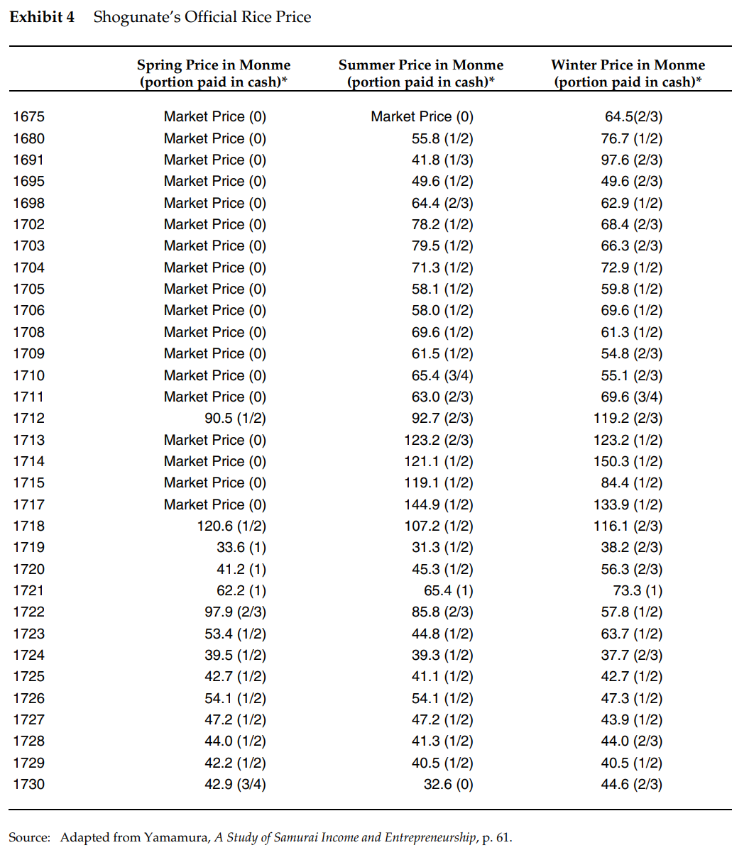
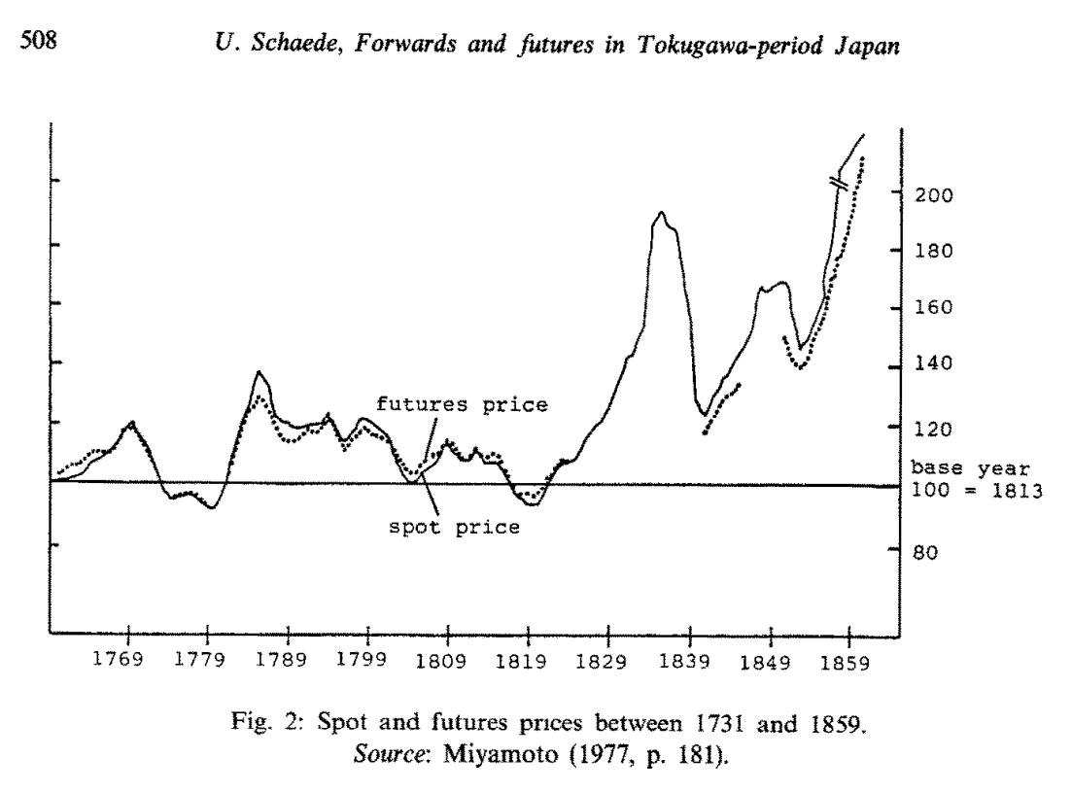
End of Shogunate (1192 to 1867 AD)
Meiji Restoration (1867 onward)
The Shogunate, a hereditary military dictatorship with Emperor remained largely a ceremonial figurehead, governed Japan from 1192 until 1867 where Meiji Restoration happened. The rise in population, stagnant rice production, growing government spending, a reliance on rice as the primary commodity, et cetera had led to the deterioration of Shogunate’s finances (according to the Sumitomo Group)
“The Dojima Rice Market and the Origins of Futures Trading,” Harvard Business School, Published November 2010
Schaede, Ulrike, “Forwards and Futures in Tokugawa-period Japan: A New Perspective on the Dojima Rice Market,” Universitat Marburg, Published March 1989

Slide 13
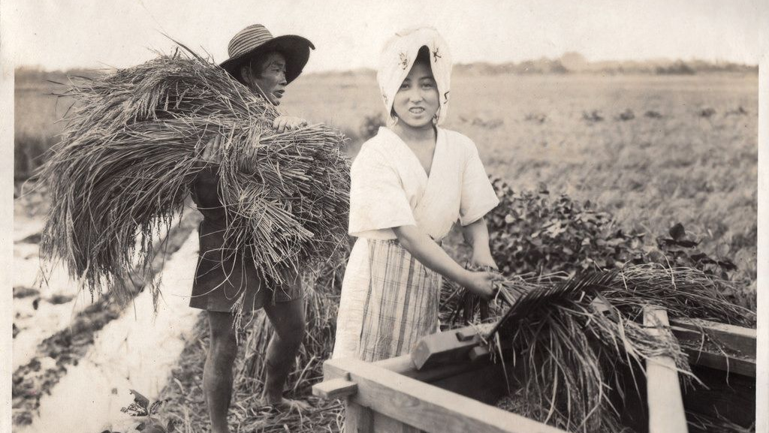
THEN
05
Originally, derivative contracts, particularly in the forms of forward and future contracts, were used widely as an insurance for farmers to protect themselves from potential trade and production risks externally and internally. That is not limited to climate, natural disaster, failures, et cetera.
Kummer, Steve and Pauletto, Christian, et al., “The History of Derivatives: A Few Milestones,” Research Gate, Published in 2012, https://www.researchgate.net/publication/349385381

Slide 14
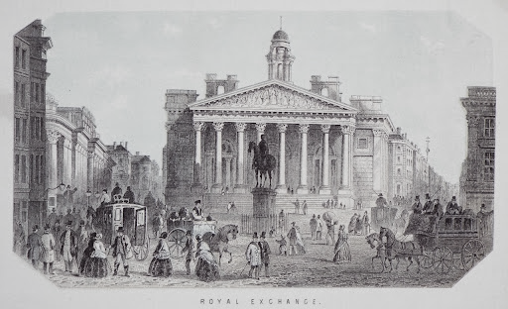
NOW
Derivatives were still widely used to hedge against risks in the fields of interest, exchange, and trade risks insurance. However, it has opened the ground that welcomed speculators to make specific bet to enable them to profit in market volatilities.
Boyd, Charles Austin II, “The Historical Role of the Use of Derivatives for Speculation,” University of South Carolina, Published in 2025, https://scholarcommons.sc.edu/senior_theses/48

Slide 15
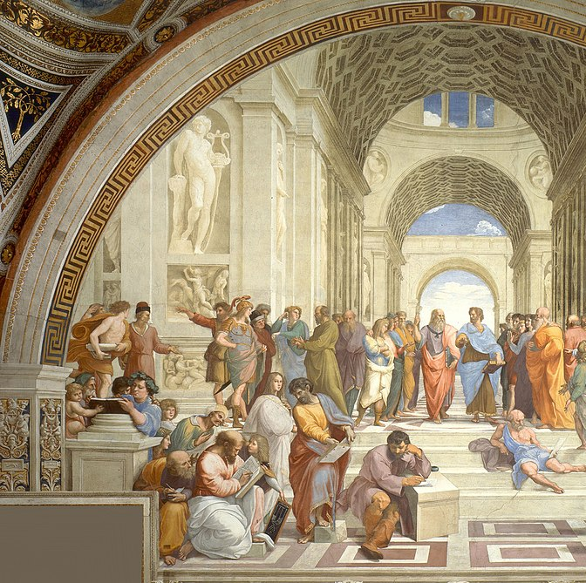
THANKS
Thank you for listening to the presentation
Now we open the ground for Q&A
cyruszqk@bu.edu

