Slide 1
A Comparison between Anglo-Saxon and German Financial Systems
Boston University College of Arts and Sciences – Department of Economics EC565 Economic Institutions in Historical Perspectives
Cyrus Zheng Qian Kwan

Slide 2
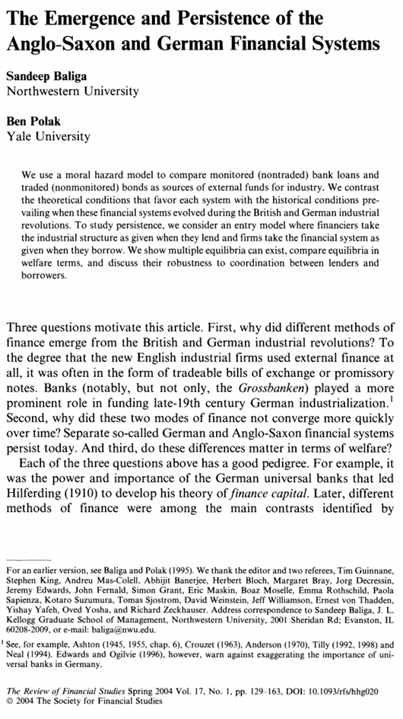
The content of this presentation is based on Baliga’s and Polak’s paper on Anglo-Saxon and German Financial Systems from the perspective of monitored and nonmonitored loans, preferences of loan selections, and their economic implications
“The Emergence and Persistence of the Anglo-Saxon and German Financial Systems” Oxford University Press 2004

Slide 3
  Abstract & Introduction
  Economic Models and Figures
  Derived Propositions
  Conclusions and Discussions
Table of Content

Slide 4
Abstract & Introduction
Anglo-Saxon and German Financial Systems

Slide 5

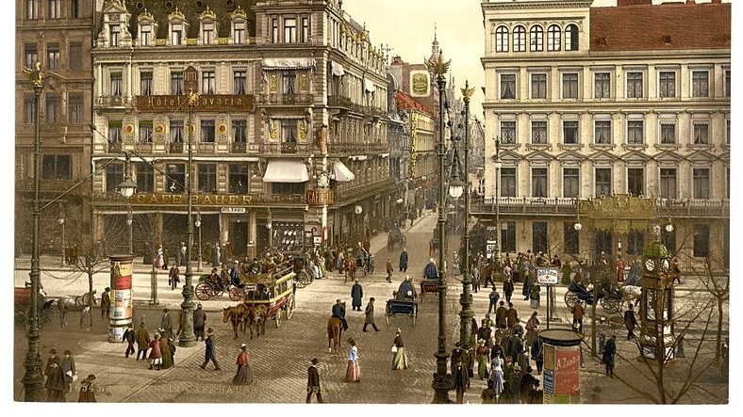
The Abstract
This paper aims to examine why Anglo-Saxon and German financial systems prevailed and persisted since their inception through a moral hazard model to compare monitored and non-monitored loans for industries. This paper presents an extended form of simulation into at what given situation would borrower or lender prefer monitored and non-monitored loans; thus, projecting that multiple equilibria can exist, welfare implications, and their robustness to coordinate.
Glossaries
Welfare implications
The total economic surplus generated by the financial system, including entrepreneur payoff, lender’s profit, and externalities (The broader impacts of economic activity on society)
Zero-profit situation
When the lender’s expected income (from loan repayments) exactly covers their costs, including both variable and fixed costs. The lender earns no surplus or loss
Equilibria
When the zero-profit intersects with entrepreneur’s incentive compatibility condition
Robustness to coordination
The ability of a financial system to maintain efficient outcomes even when participants’ actions are not perfectly aligned or coordinated

Slide 6
Anglo-Saxon Model
German Model
Key Features:
Unmonitored debt and limited bank involvement, market-based finance
Preference for liquidity
Small and short-term based loans
Encouragement of small, independent firms
High dependence on market mechanisms
Important Historical Aspects
Earlier industrialization
More resources and private wealth
Liquid and thick market
Interest rates were usually lower relative to Germany
Key features
Bank monitoring and hands-on governance, universal banking (banks provided all means of financial services)
Limited use of tradeable debt
Focus on long-term relationship
Preference for large, capital-intensive firms
Concentration of financial power
Important Historical Aspects
Late Industrialization
Less Resources and private wealth
Iliquid and thin market
Interest rates were usually 0.5 to 1 percent higher than England
Notes:
The Anglo-Saxon financial mode is characterized by its reliance on tradeable, non-monitored debt and a market-driven approach to financing. It developed in Britain during the Industrial Revolution and remains a defining feature of financial systems in countries like the United States and the United Kingdom.
The German financial system is characterized by a bank-centric, relationship-based model that prioritizes close monitoring of borrowers, long-term financing, and active involvement of banks in firm governance. This system emerged during Germany’s industrialization in the 19th century and is closely associated with the “universal banking” model, where banks serve as both financiers and strategic partners to industrial firms.

Slide 7
Comparison Table for Anglo-Saxon and German Models
Feature | Anglo-Saxon Model | German Model
Loan Type | Non-monitored, Tradeable debt | Monitored, Relationship-based debt
Monitoring | Minimal or none; Relies on market mechanisms | Intensive; Banks monitor firms closely
Cost Structure | Lower fixed costs (no monitoring); Deadweight loss from moral hazard | Higher fixed costs (monitoring); Reduces deadweight loss from MH
Preferred Industries | Small-scale, Entrepreneurial firms | Large-scale, Capital-intensive

Slide 8
Economic Models & Figures
Anglo-Saxon and German Financial Systems

Slide 9
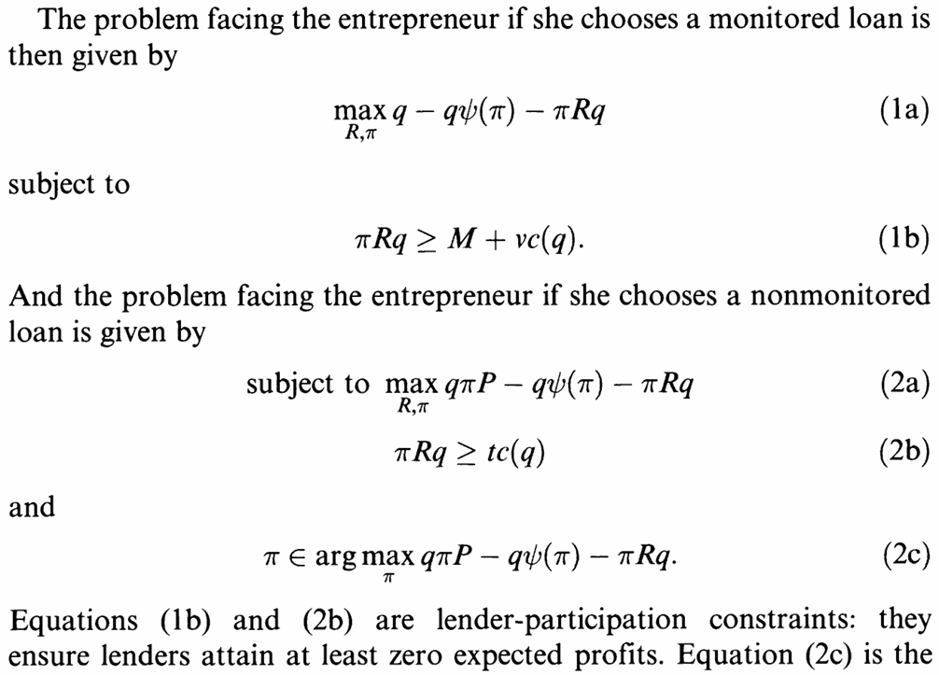
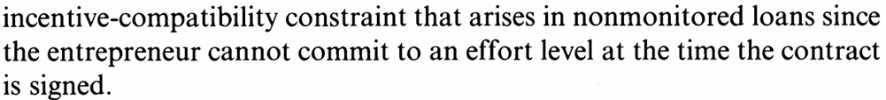
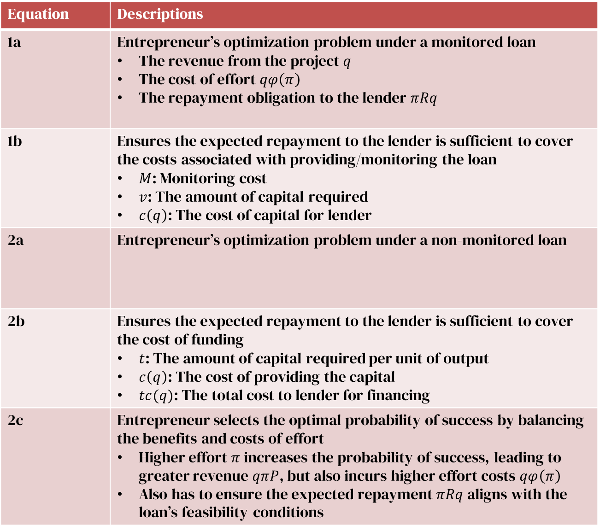
Equation | Descriptions
1a | Entrepreneur’s optimization problem under a monitored loan The revenue from the project $q$ The cost of effort $qφ\left(π\right)$ The repayment obligation to the lender $πRq$
1b | Ensures the expected repayment to the lender is sufficient to cover the costs associated with providing/monitoring the loan $M$: Monitoring cost $v$: The amount of capital required $c\left(q\right)$: The cost of capital for lender
2a | Entrepreneur’s optimization problem under a non-monitored loan
2b | Ensures the expected repayment to the lender is sufficient to cover the cost of funding $t$: The amount of capital required per unit of output $c\left(q\right)$: The cost of providing the capital $tc(q)$: The total cost to lender for financing
2c | Entrepreneur selects the optimal probability of success by balancing the benefits and costs of effort Higher effort $π$ increases the probability of success, leading to greater revenue $qπP$, but also incurs higher effort costs $qφ\left(π\right)$ Also has to ensure the expected repayment $πRq$ aligns with the loan’s feasibility conditions
$v$: Cost per unit of capital for the lender (variable cost component)
$t$: A parameter representing effort incentives and monitoring impact on loan feasibility

Slide 10
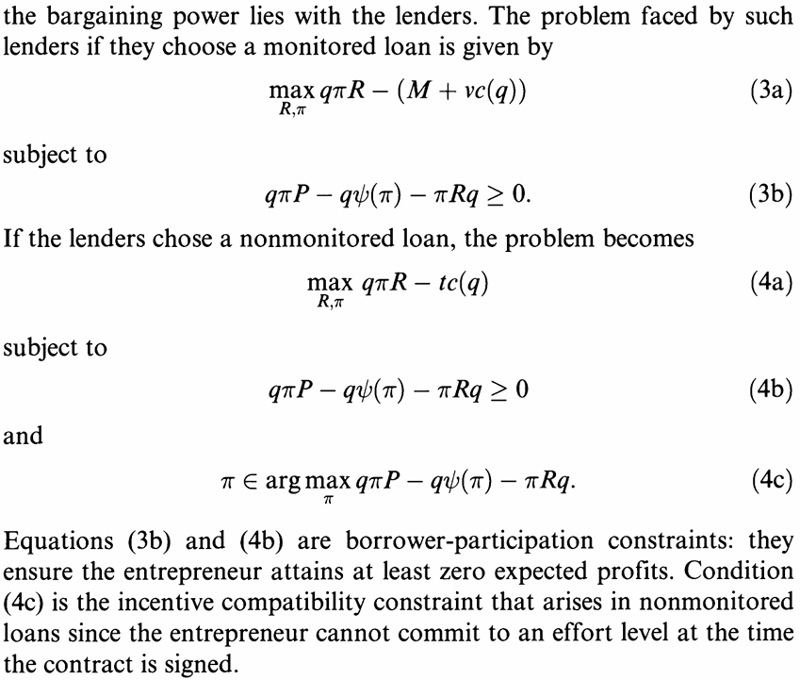
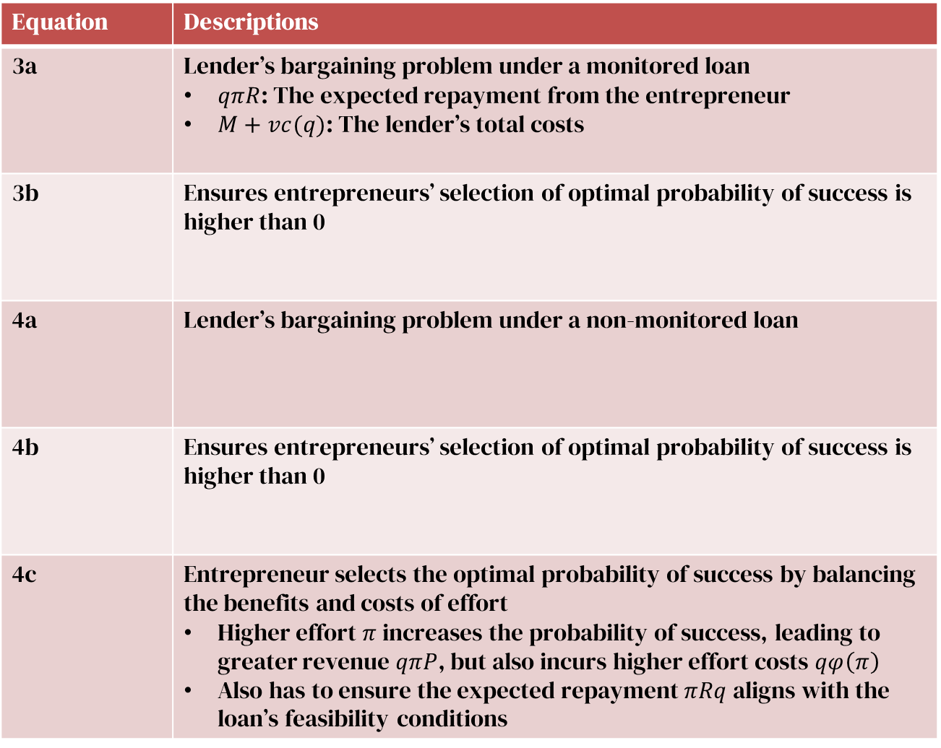
Equation | Descriptions
3a | Lender’s bargaining problem under a monitored loan $qπR$: The expected repayment from the entrepreneur $M+vc(q)$: The lender’s total costs
3b | Ensures entrepreneurs’ selection of optimal probability of success is higher than 0
4a | Lender’s bargaining problem under a non-monitored loan
4b | Ensures entrepreneurs’ selection of optimal probability of success is higher than 0
4c | Entrepreneur selects the optimal probability of success by balancing the benefits and costs of effort Higher effort $π$ increases the probability of success, leading to greater revenue $qπP$, but also incurs higher effort costs $qφ\left(π\right)$ Also has to ensure the expected repayment $πRq$ aligns with the loan’s feasibility conditions

Slide 11
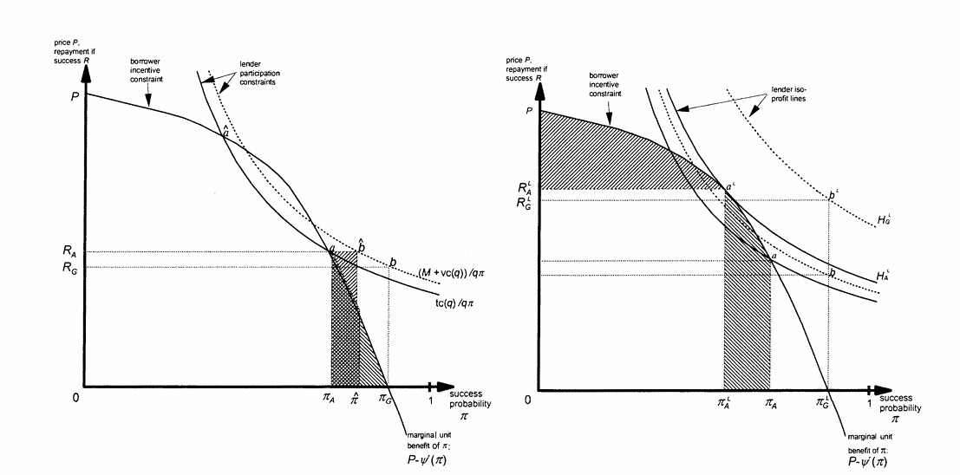
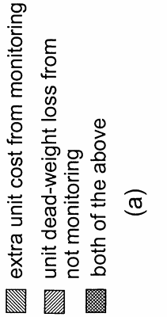
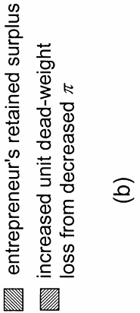
Trade-offs Model in Monitored and Nonmonitored Loan
Model for Borrowers Bargaining Power
Model for Lenders Bargaining power
Dashed Hyperbolas:
Zero-profit condition for monitored loans
Solid Hyperbolas:
Zero-profit condition for non-monitored loans
Dashed Hyperbolas:
Zero-profit condition for monitored loans
Solid Hyperbolas:
Zero-profit condition for non-monitored loans
Output price and repayment terms
Output price and repayment terms
Concave curve: Entrepreneur’s marginal benefit of increasing the probability of success
Concave curve: Entrepreneur’s marginal benefit of increasing the probability of success
Probability of project success
Probability of project success

Slide 12
Trade-offs Model in Monitored and Nonmonitored Loan
Optimal project size q under the German system
Optimal repayment level R set by the lender in equilibrium
Optimal probability of success by entrepreneur
Deadweight Loss or Monitoring Cost
Deadweight Loss or Monitoring Cost

Slide 13
Trade-offs Model in Monitored and Nonmonitored Loan
Trade-Offs Between Loan Types
Monitored loans ensure higher project success probabilities but come with additional monitoring costs
Non-monitored loans avoid monitoring costs but suffer from moral hazard, leading to lower effort and efficiency
Influence of Bargaining Power
When borrowers have bargaining power, Figure 1a, non-monitored loans are more attractive due to reduced costs
When lenders have bargaining power, Figure 1b, they might favor monitored loans to secure higher returns
Conditions for Equilibrium
  The figures visually illustrate the conditions under which an entrepreneur or lender would prefer one type of loan over the other. These conditions depend on:
  The relative size of monitoring costs M
  The deadweight loss due to moral hazard
  Bargaining power distribution
When lenders have bargaining power, successful surplus is captured by the lender, leaving less for the borrower. Lowers borrower’s incentives and efforts

Slide 14
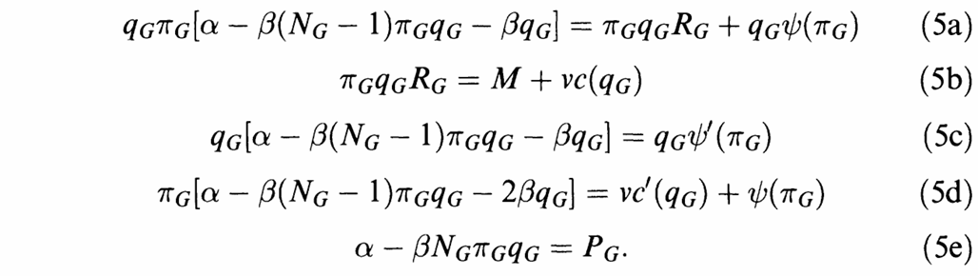
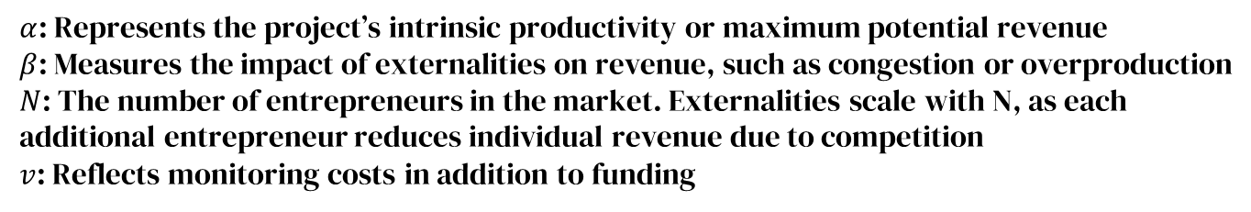
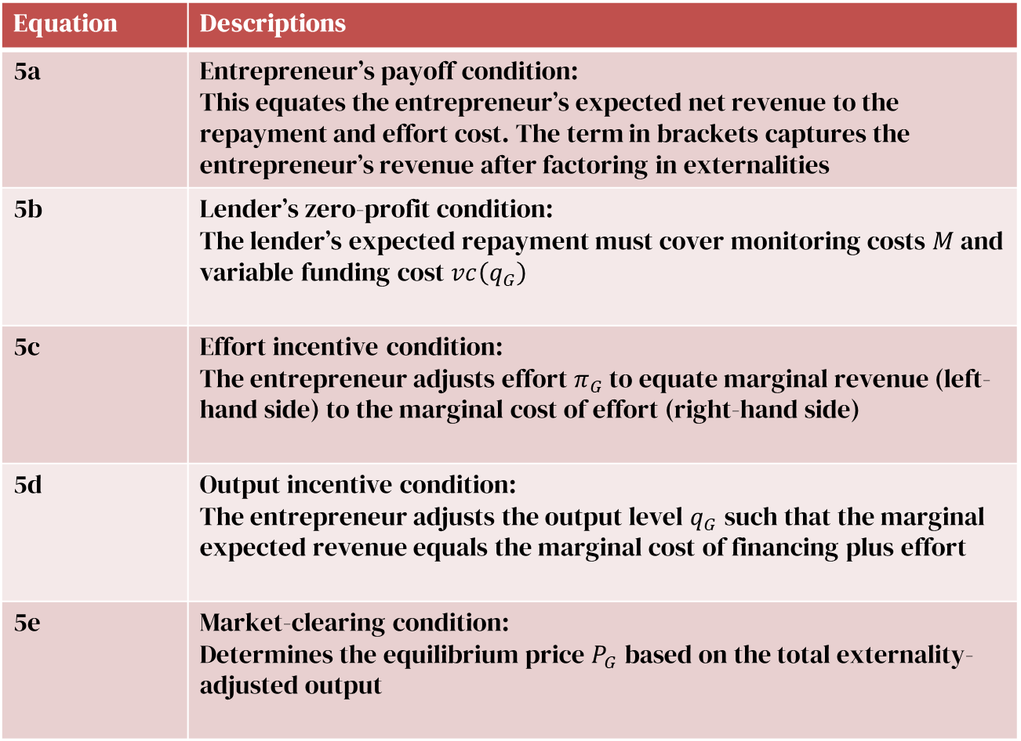
Equation | Descriptions
5a | Entrepreneur’s payoff condition: This equates the entrepreneur’s expected net revenue to the repayment and effort cost. The term in brackets captures the entrepreneur’s revenue after factoring in externalities
5b | Lender’s zero-profit condition: The lender’s expected repayment must cover monitoring costs $M$ and variable funding cost $vc\left(q_{G}\right)$
5c | Effort incentive condition: The entrepreneur adjusts effort $π_{G}$ to equate marginal revenue (left-hand side) to the marginal cost of effort (right-hand side)
5d | Output incentive condition: The entrepreneur adjusts the output level $q_{G}$ such that the marginal expected revenue equals the marginal cost of financing plus effort
5e | Market-clearing condition: Determines the equilibrium price $P_{G}$ based on the total externality-adjusted output
German Equilibrium
$α$: Represents the project’s intrinsic productivity or maximum potential revenue
$β$: Measures the impact of externalities on revenue, such as congestion or overproduction
$N$: The number of entrepreneurs in the market. Externalities scale with N, as each additional entrepreneur reduces individual revenue due to competition
$v$: Reflects monitoring costs in addition to funding
Notes:
What is alpha, beta, N, and Tau (Anglo-Saxon)

Slide 15
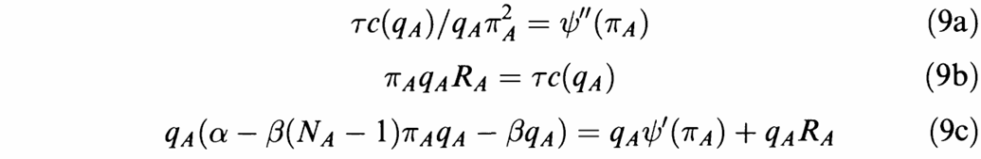
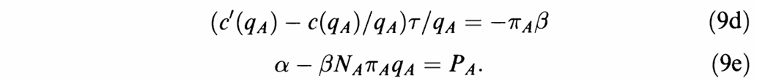
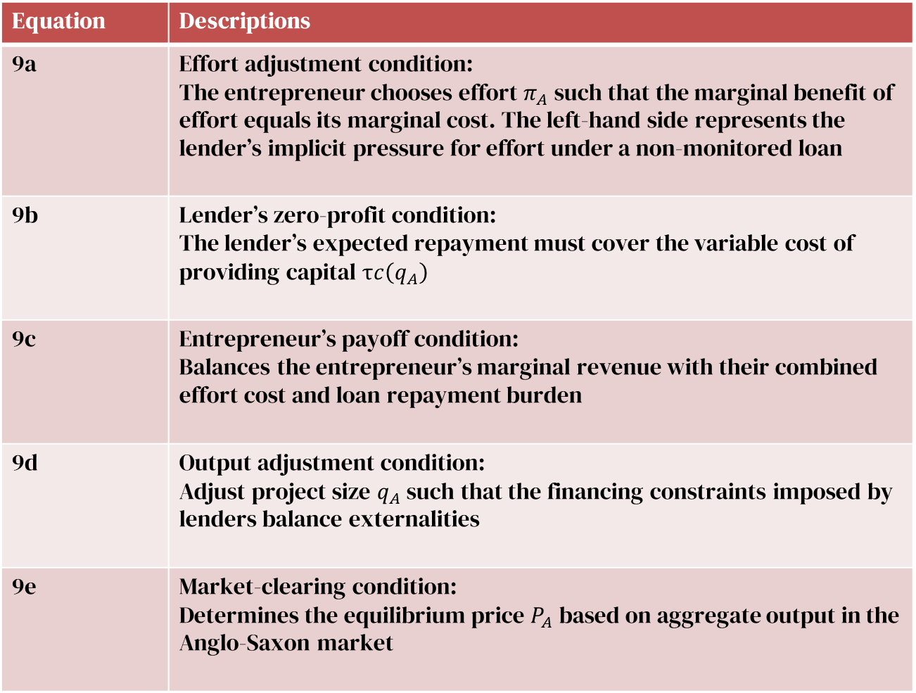
Equation | Descriptions
9a | Effort adjustment condition: The entrepreneur chooses effort $π_{A}$ such that the marginal benefit of effort equals its marginal cost. The left-hand side represents the lender’s implicit pressure for effort under a non-monitored loan
9b | Lender’s zero-profit condition: The lender’s expected repayment must cover the variable cost of providing capital $τc\left(q_{A}\right)$
9c | Entrepreneur’s payoff condition: Balances the entrepreneur’s marginal revenue with their combined effort cost and loan repayment burden
9d | Output adjustment condition: Adjust project size $q_{A}$ such that the financing constraints imposed by lenders balance externalities
9e | Market-clearing condition: Determines the equilibrium price $P_{A}$ based on aggregate output in the Anglo-Saxon market
Anglo-Saxon Equilibrium
$τ$: Excludes monitoring costs, representing the pure cost of funding

Slide 16
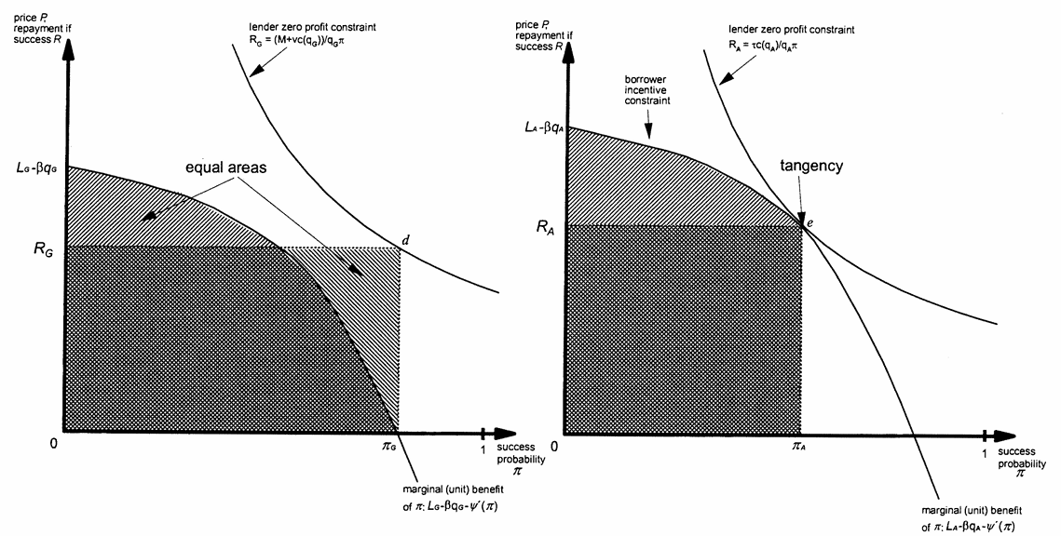
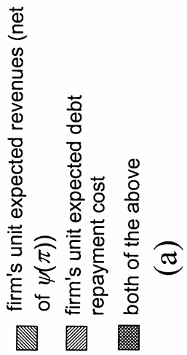
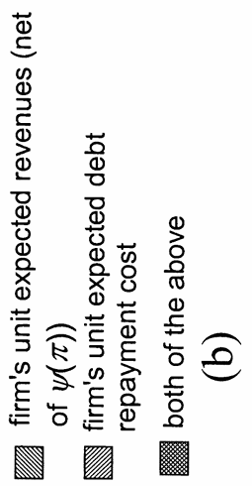
Equilibrium Conditions for German and Anglo-Saxon Models
German Equilibrium
Anglo-Saxon Equilibrium
Hyperbola:
Lender’s zero-profit condition for monitored loans
Hyperbola:
Lender’s zero-profit condition for non-monitored loans
Output price and repayment terms
Output price and repayment terms
Concave Curve:
Entrepreneur’s marginal benefit of increasing the probability of success, net of effort costs
Concave Curve:
Entrepreneur’s marginal benefit of increasing the probability of success
Probability of project success
Probability of project success
Notes:
What does benefit hear mean? What is zero-profit condition?

Slide 17
Equilibrium Conditions for German and Anglo-Saxon Models
Deadweight Loss due to moral hazard
Notes:
Where are the equilibria?

Slide 18
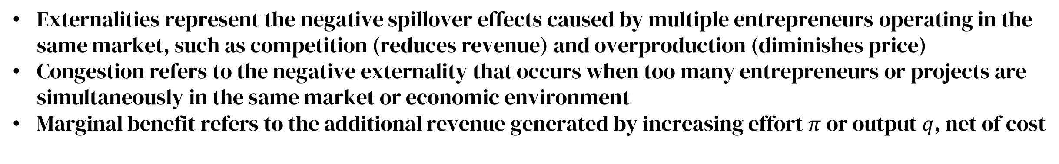
Equilibrium Conditions for German and Anglo-Saxon Models
Trade-Offs Between Loan Types
Monitored loans, Figure 2a, are costlier but reduce inefficiencies from moral hazard, making them ideal for industries requiring significant investment and stability
Non-monitored loans, Figure 2b, avoid monitoring costs but are prone to inefficiencies from moral hazard; thus, favoring smaller, flexible firms
Firm and Market Dynamics
The German system supports large-scale industrialization^
Anglo-Saxon system fosters entrepreneurship and market competition
Equilibrium Stability
  Both systems represent stable equilibria under specific conditions, but transitions between them require significant economic or policy changes
Externalities represent the negative spillover effects caused by multiple entrepreneurs operating in the same market, such as competition (reduces revenue) and overproduction (diminishes price)
Congestion refers to the negative externality that occurs when too many entrepreneurs or projects are simultaneously in the same market or economic environment
Marginal benefit refers to the additional revenue generated by increasing effort $π$ or output $q$, net of cost

Slide 19
Derived Propositions
Anglo-Saxon and German Financial Systems

Slide 20
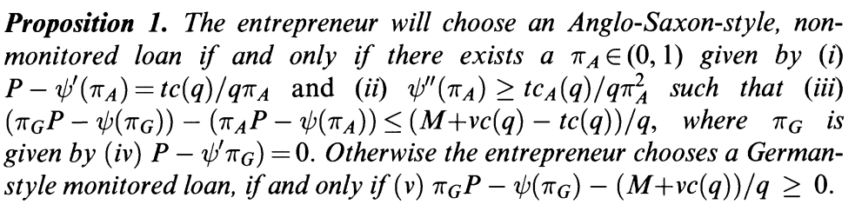

Figure 1a and 1b
Proposition 1
Entrepreneurs choose monitored loans if the benefit of eliminating moral hazard outweighs the additional monitoring costs; otherwise, they choose non-monitored loans.
Proposition 2
Non-monitored loans are preferred when monitoring costs are high, credit is cheap, borrowers have bargaining power, or entrepreneurs possess significant private wealth.
Figure 2a and 2b
Proposition 3
A German equilibrium emerges when monitoring costs are low, moral hazard risks are high, and industries are dominated by large, capital-intensive firms.
Proposition 4
An Anglo-Saxon equilibrium emerges when monitoring costs are high, deadweight loss from moral hazard is low, and secondary markets for debt are liquid and well-developed.
Notes:
Explains what bargaining power mean, monitored and non-monitored loan mean

Slide 21
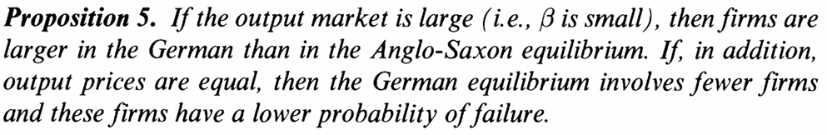
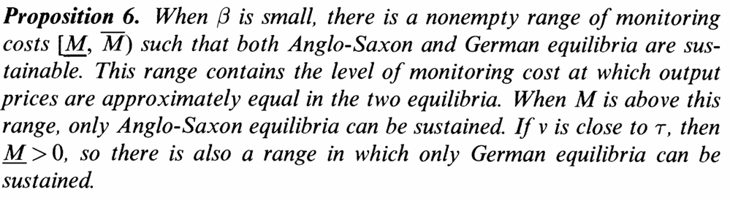
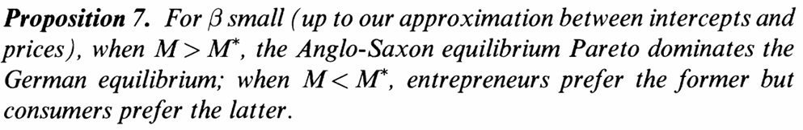
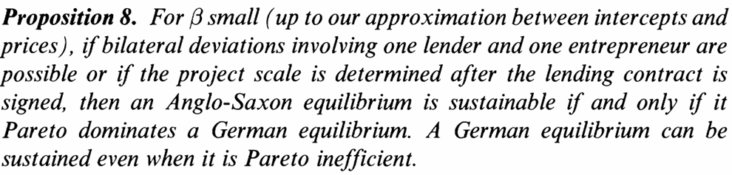
Figure 2a and 2b
Proposition 5
Both German and Anglo-Saxon equilibria can coexist due to self-reinforcing dynamics. Transitioning between them requires overcoming significant structural inertia.
Proposition 6
Neither equilibrium is guaranteed to be welfare-optimal. A German equilibrium may stifle innovation, while an Anglo-Saxon equilibrium may fail to support large-scale industrial projects.
Proposition 7
The German equilibrium is more stable due to entrenched bank-firm relationships, while the Anglo-Saxon equilibrium is more vulnerable to shocks like market disruptions or shifts in industrials structure.
Proposition 8
Policies can help economies transition between equilibria (Case for America) by reducing monitoring costs (favoring German systems) or enhancing market liquidity (favoring Anglo-Saxon systems).

Slide 22
Proposition Comparison for Anglo-Saxon and German Models
Welfare Implications | Anglo-Saxon Model (Prop. 6) | German Model (Prop. 6)
Efficiency | Encourages innovation and flexibility; supports small firms | Supports stability and coordination; favors large firms
Potential Risks | May fail to support large-scale industrial projects (time horizon) | May stifle innovation and entrepreneurship
Welfare-Optimal | Can be inefficient when moral hazard or systemic risk is high | Can be inefficient if monitoring costs outweigh the benefits
Robustness to Shocks | Anglo-Saxon Model (Prop. 7) | German Model (Prop. 7)
Stability | Vulnerable to shocks (e.g., financial crises or disruptions in market liquidity) | Resilient due to entrenched bank-firm relationships
Adaptability | More flexible; can quickly respond to changes | Less adaptable; strong path dependency
Impact of Shocks | Major shocks may destabilize markets and disrupt financing | Shocks are absorbed by strong lender-borrower ties
Policy Implications | Anglo-Saxon Model (Prop. 8) | German Model (Prop. 8)
Policy Focus | Enhance market liquidity, reduce transaction costs | Reduce monitoring costs, support bank-firm coordination
Potential Interventions | Deregulation, development of secondary markets | Subsidies for monitoring, support for large-scale industries
Transition Challenges | Moving to a German system requires building monitoring capacity | Moving to an Anglo-Saxon system requires deep, liquid financial markets

Slide 23
Conclusion and Discussion
Anglo-Saxon and German Financial Systems

Slide 24
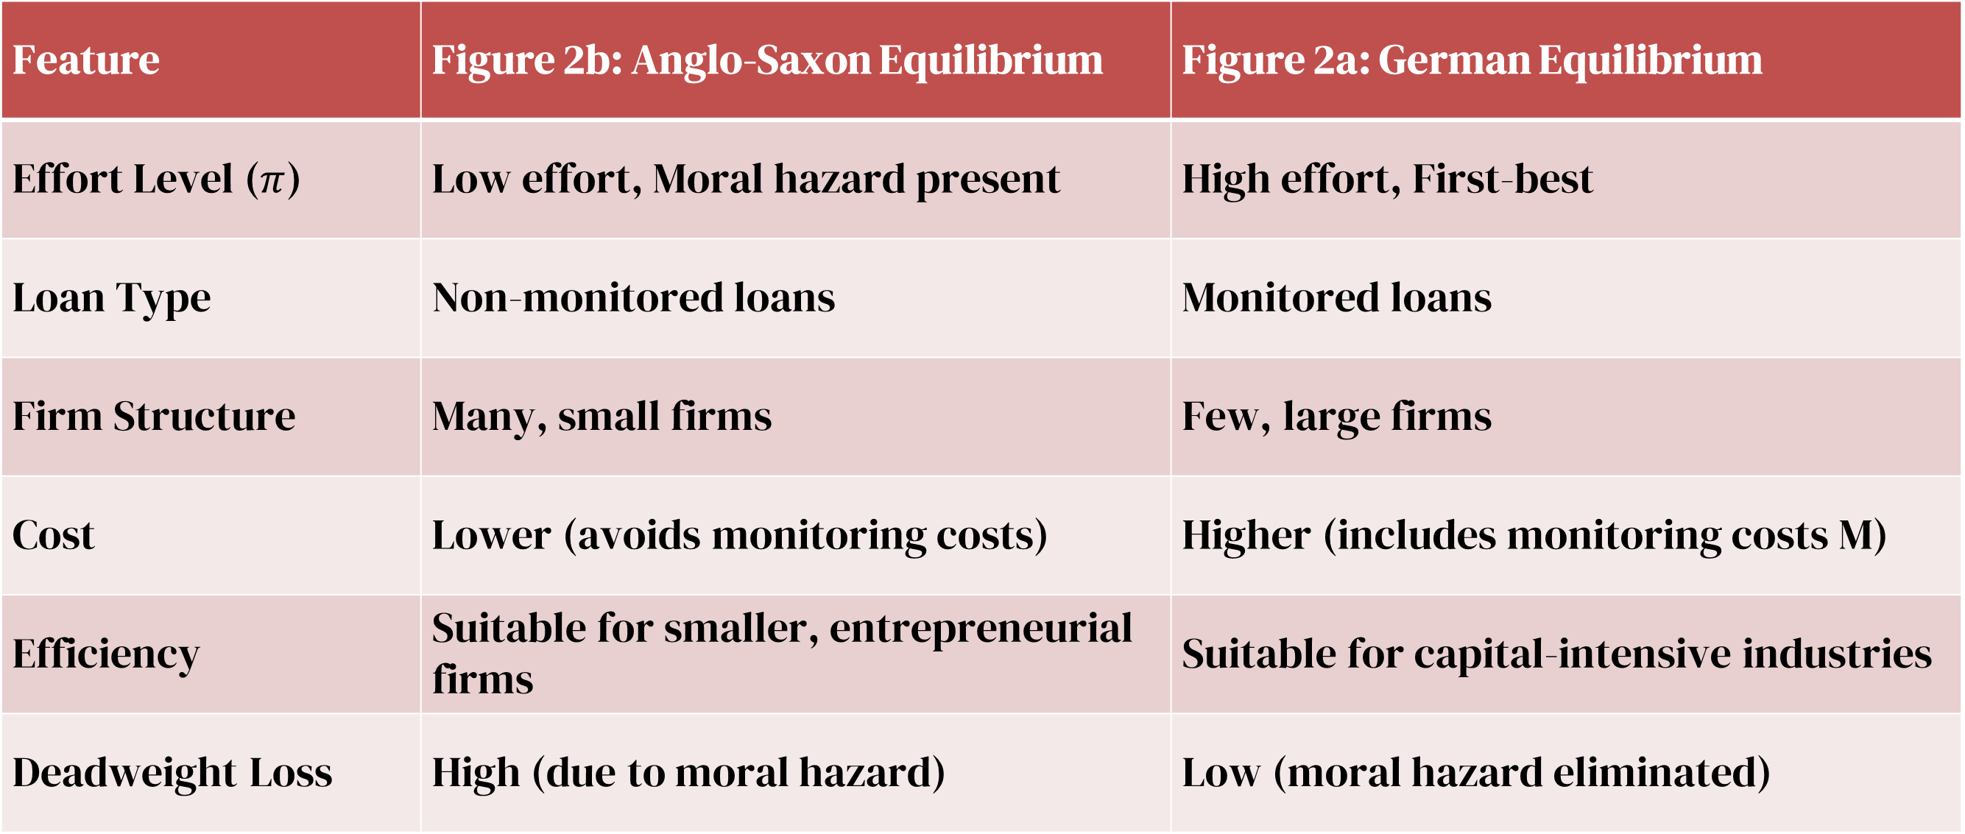
Equilibrium Conditions for German and Anglo-Saxon Models
Feature | Figure 2b: Anglo-Saxon Equilibrium | Figure 2a: German Equilibrium
Effort Level ($π$) | Low effort, Moral hazard present | High effort, First-best
Loan Type | Non-monitored loans | Monitored loans
Firm Structure | Many, small firms | Few, large firms
Cost | Lower (avoids monitoring costs) | Higher (includes monitoring costs M)
Efficiency | Suitable for smaller, entrepreneurial firms | Suitable for capital-intensive industries
Deadweight Loss | High (due to moral hazard) | Low (moral hazard eliminated)

Slide 25
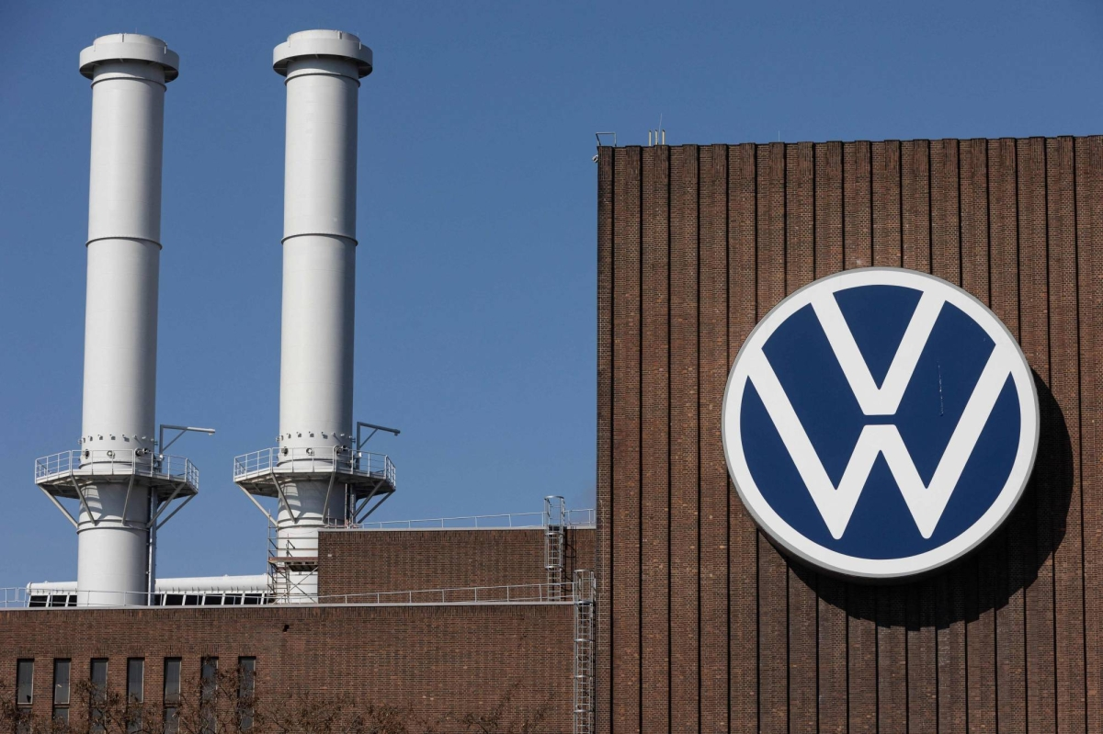
So, Anglo-Saxon or German System
Neither system is universally “better.” Policymakers often design hybrid systems to balance the strengths and trade-offs of both models
Emerging markets may adopt a German-style system to stabilize development
Advanced economies with strong institutions may lean toward Anglo-Saxon principles to foster innovation
A case for America: The US emphasizes the potential challenges and trades-offs policymakers face when choosing or adapting elements of the Anglo-Saxon or German model.
Risk of market failures in the Anglo-Saxon model
Efficiency versus stability in the German model
Balancing innovation with risk
Importance of institutional strength
Avoiding overreach in regulation and market excesses

Slide 26
Thank you for listening
If you have any question, do not hesitate to send a request at
cyruszqk@bu.edu

